Slide 1
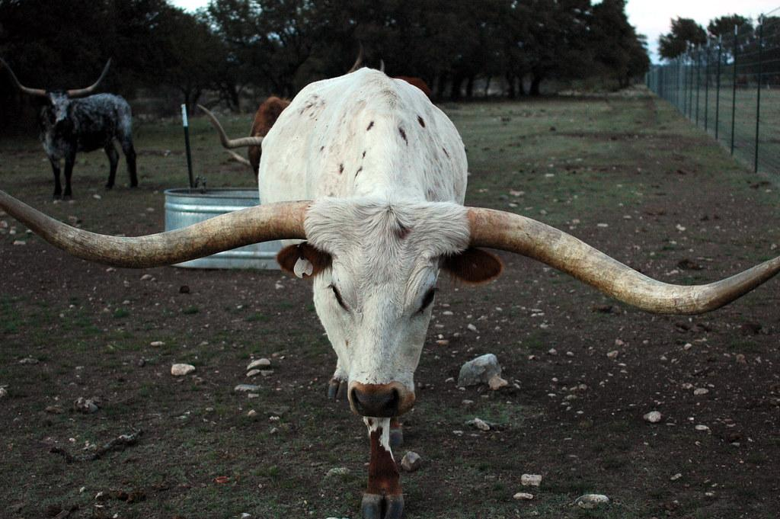
Texas longhorn
Vicente Romero
Notes:
1 Background Color
1 Title (or write the question)
1 Pictures
1 Include Transitions
0 Answering question using complete sentences (multiple sentences if needed to fully explain your answer)
1 Accuracy of information
5
When the title is not a sentence please capitalize every word.

Slide 2
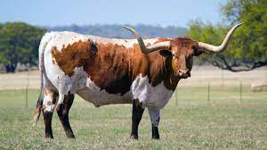
Where the texas longhorn came from.
The Texas longhorn is a hybrid breed resulting from a random mixing of Spanish retinto criollo stock and English cattle that Anglo American frontiersmen brought to Texas from southern and midwestern states in the 1820s and 1830s they behaved like Spanish stock but had an appreciable amount of British.
Notes:
1 Background Color
1 Title (or write the question)
1 Pictures
1 Include Transitions
0 Answering question using complete sentences (multiple sentences if needed to fully explain your answer)
1 Accuracy of information
5
New sentence at 1830s. They behaved .. of British??? Does that make sense.?

Slide 3
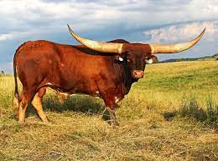
What the texas longhorns ecosystem is.
The Texas Longhorn inhabits grasslands Longhorn cattle have a strong survival instinct and can find food and shelter during times of rough weather.
Notes:
1 Background Color
1 Title (or write the question)
1 Pictures
1 Include Transitions
0 Answering question using complete sentences (multiple sentences if needed to fully explain your answer)
1 Accuracy of information
5
Period after grasslands. Longhorn cattle….

Slide 4
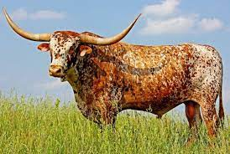
What it is like in texas longhorn ecosystem
Habitat refers to an environment or an ecological area that a specific animal inhabits. For Texas longhorn cattle, habitat stretches far and wide across North America. The breed developed its hardiness on open ranges from the sixteenth century through the cattle drives of the late nineteenth century. In the twentieth century, the breed nearly died out, then rebounded. The Texas longhorn is characterized by hardiness and adaptability to habitat.
Notes:
1 Background Color
1 Title (or write the question)
1 Pictures
1 Include Transitions
0 Answering question using complete sentences (multiple sentences if needed to fully explain your answer)
1 Accuracy of information
5
Title.. In the Texas longhorn ecosystem. …longhorn cattle, their habitat stretches… century and through the cattle drives…. …died out but then rebounded.

Slide 5
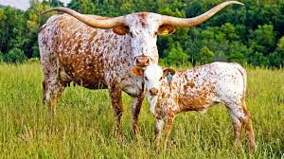
The type of consumer the texas longhorn is.
Texas Longhorn bulls are the bull of choice for first calf heifers The commercial cattleman knows that the lower birth weight of the calves puts less stress on the mother It also gives him a live calf to sell at market the first time out.
Notes:
1 Background Color
1 Title (or write the question)
1 Pictures
1 Include Transitions
0 Answering question using complete sentences (multiple sentences if needed to fully explain your answer)
1 Accuracy of information
5
Title: the Texas longhorn is. Paragraph… first calf heifers. The commercial…….. …mother. This also gives…

Slide 6
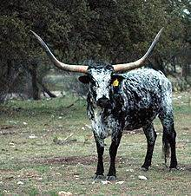
What the texas longhorn bulls eats
Texas Longhorn cattle eat a wider range of grasses, plants, and weeds than do most other cattle
Notes:
1 Background Color
1 Title (or write the question)
1 Pictures
1 Include Transitions
0 Answering question using complete sentences (multiple sentences if needed to fully explain your answer)
1 Accuracy of information
5
Title Texas longhorn… eats.

Slide 7
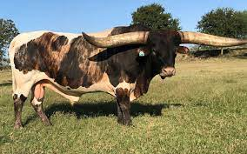
The texas longhorns predators
Feral longhorn cattle benefited from having inherited sweeping twisted curved long horns When potential predators including coyotes wild peccaries known as javelina wolves and bears approached the cattle had a formidable defense mechanism in their horns.
Notes:
1 Background Color
1 Title (or write the question)
1 Pictures
1 Include Transitions
0 Answering question using complete sentences (multiple sentences if needed to fully explain your answer)
1 Accuracy of information
5
Title. Since this is not a sentence but a heading… The Texas Longhorn Predators
Paragraph… period after horns… horns. When….predators including; coyotes, wild peccaries known as javelina wolves, and beers approached the cattle they had a formidable….

Slide 8
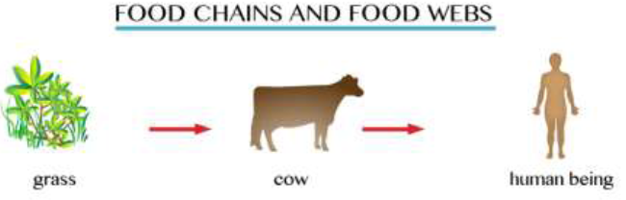
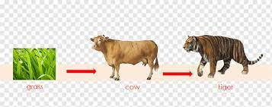
The texas longhorns food chain.
Notes:
1 Background Color
1 Title (or write the question)
1 Pictures
1 Include Transitions
0 Answering question using complete sentences (multiple sentences if needed to fully explain your answer)
1 Accuracy of information
5
Title. This is not a full sentence… try.. The Texas Longhorns Food Chain

Slide 9
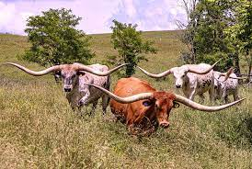
The specific adaptations for texas longhorns
A cow's face has thick hair wide mouth for eating grass wet nose big eyes with long lashes large ears that can turn and horns.
Notes:
0 Background Color
1 Title (or write the question)
1 Pictures
1 Include Transitions
0 Answering question using complete sentences (multiple sentences if needed to fully explain your answer)
1 Accuracy of information
4
Title text size is to small. And capitalize every word. Paragraph. This is hard to read against this background. …that can turn and horns??? What does that mean?

Slide 10
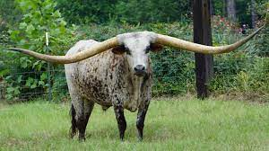
The texas longhorn height and weight
Bulls weigh in around 1,400-2,200 pounds. Steers range between 1,400-2,500 pounds. The average height of Texas Longhorns is between 4 and 5 feet from hoof to shoulder.
Notes:
1 Background Color
1 Title (or write the question)
1 Pictures
1 Include Transitions
0 Answering question using complete sentences (multiple sentences if needed to fully explain your answer)
1 Accuracy of information
5
Title capitalization.

Slide 11
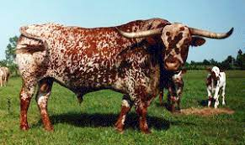
The males and females weight.
Adult average Texas longhorns weigh around 900 to 1,200 pounds for cows and 1,200 to 1,500 pounds for bulls and steers.
Notes:
1 Background Color
1 Title (or write the question)
1 Pictures
1 Include Transitions
0 Answering question using complete sentences (multiple sentences if needed to fully explain your answer)
1 Accuracy of information
5
The paragraph is hard to read against this background.

Slide 12
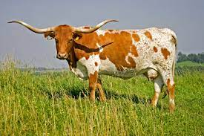
The life span for texas longhorns are
The texas longhorns lifespan 20 to 25 years
Notes:
1 Background Color
1 Title (or write the question)
1 Pictures
1 Include Transitions
0 Answering question using complete sentences (multiple sentences if needed to fully explain your answer)
1 Accuracy of information
5
Title please rephrase into a question…. What is the lifespan of the Texan longhorn? Lifespan is one word. Paragraph……lifespan ranges from 20 to 25 years.

Slide 13
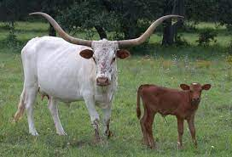
8 facts about texas longhorns.
1. Their population plummeted to near extinction in the 1920s. It took guidance from the United States government to increase their numbers. 2. Both male Longhorn bulls and female heifers have horns. 3. They are not related to the English Longhorn and they don't look anything like them either Sometimes they are mistaken for Watusi cattle though. 4. These breeds of cattle traveled from Spain to the West Indies and then Mexico before arriving in Texas Nebraska and the rest of the usa Yes the Longhorns were originally Mexican longhorn beef instead of Texas longhorn beef. 5. The longhorn didn’t become the texas state large mammal until 1995. 6. They come in all colors and patterns including spotted 7. Longhorn herds traveled long distances because unlike other cattle the animal could forage on brush and survive for days without water on the open range. 8. Known for their hardiness texas longhorn calves stand quicker than other breeds and they are known for their easy calving study live calves are popular in crossbreeding.
Notes:
1 Background Color
1 Title (or write the question)
1 Pictures
1 Include Transitions
0 Answering question using complete sentences (multiple sentences if needed to fully explain your answer)
1 Accuracy of information
5
Title: Texas longhorns. Paragraph… please make this a list using either numbers or bullet points.

Slide 14
Sources
https://animals.mom.com/texas-longhorn-habitat-12344527.html http://www.tlbaa.org/about/texas-longhorn-breed-attributes-and-market-advantages/ https://www.thecattlesite.com/breeds/beef/18/texas-longhorn/#:~:text=Texas%20Longhorn%20cattle%20eat%20a,meat%20less%20fat%20per%20ounce). https://animals.mom.com/texas-longhorn-habitat-12344527.html https://edu.glogster.com/glog/cattle-zoology-project/307vwbiu45o https://blocked.goguardian.com/?ctx=YWZpPTEwOTgwNjEmYXBpPTcyNzgxJm9pPTE5Njk5OTg1NjE5Jm91PWh0dHBzJTNBJTJGJTJGd3d3LnBuZ3dpbmcuY29tJTJGZW https://starcreekranch.com/everything-you-need-know-about-texas-longhorn-horn-length/ https://www.expressnews.com/lifestyle/article/All-you-need-to-know-about-legendary-longhorns-15958154.php#:~:text=Adult%20average%20Texas%20longhorns%20weigh,p https://oakvalewildlife.com.au/explore/our-animals/texas-longhorn#:~:text=The%20lifespan%20of%20the%20Texas%20Longhorn%20is%2020%20%2D%2025%20years. https://www.wideopenpets.com/12-things-didnt-know-texas-longhorns/
Notes:
6

