Slide 1
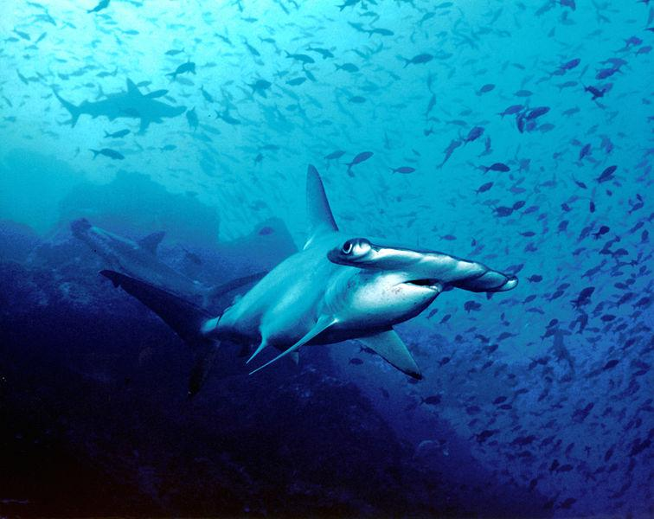
Great Hammerhead Shark
By Vicente A. Garnica
Notes:
1 Background Color
1 Title (or write the question)
1 Pictures
1 Include Transitions
1 Answering question using complete sentences (multiple sentences if needed to fully explain your answer)
1 Accuracy of information
6

Slide 2
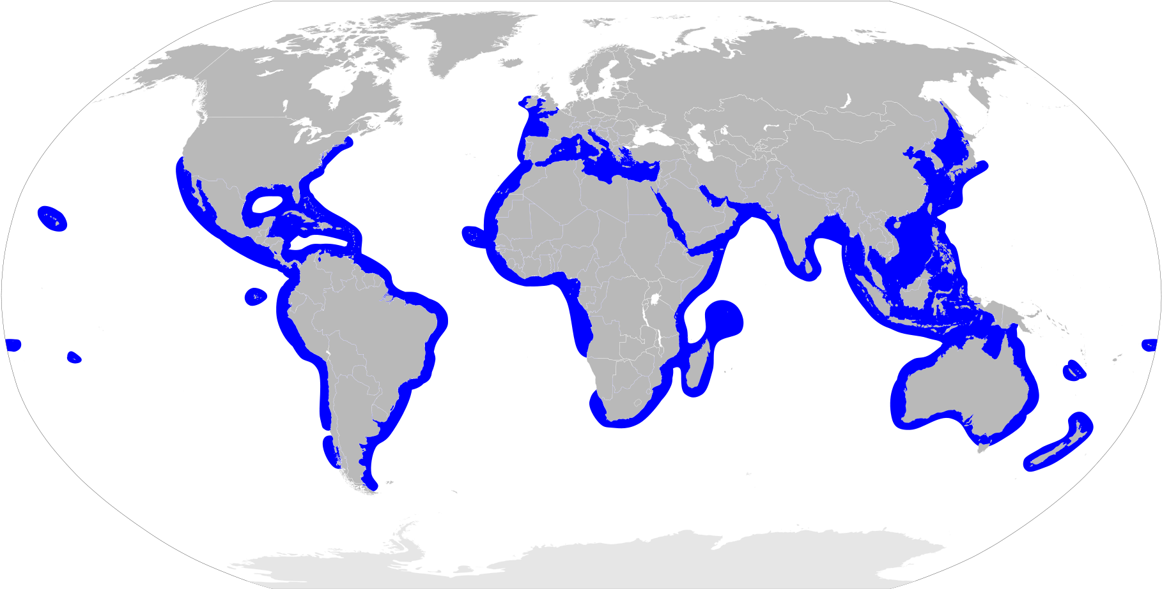
Where Does it Come From?
They are found worldwide in coastal , warm waters such as florida and mexico.
Us
Notes:
1 Background Color
1 Title (or write the question)
1 Pictures
1 Include Transitions
0 Answering question using complete sentences (multiple sentences if needed to fully explain your answer)
1 Accuracy of information
5
Capitalization.. Florida, and Mexico.

Slide 3
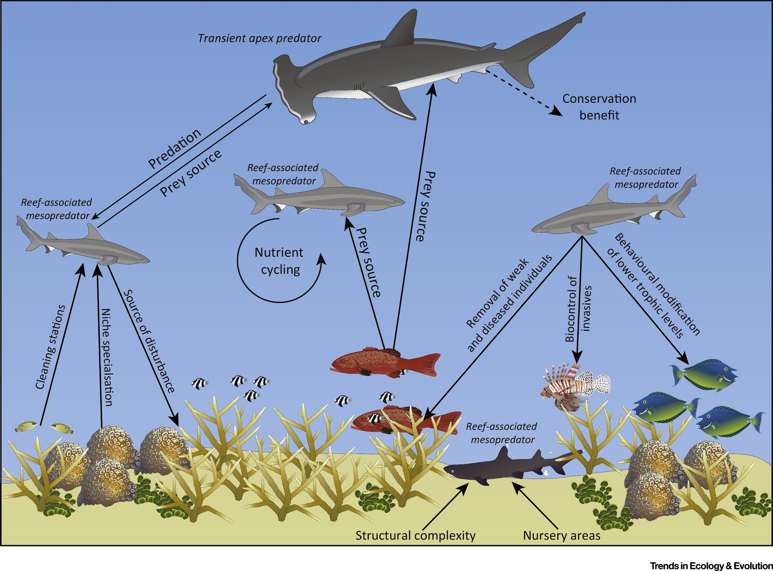
Their Ecosystem
Notes:
1 Background Color
1 Title (or write the question)
1 Pictures
1 Include Transitions
1 Answering question using complete sentences (multiple sentences if needed to fully explain your answer)
1 Accuracy of information
6

Slide 4
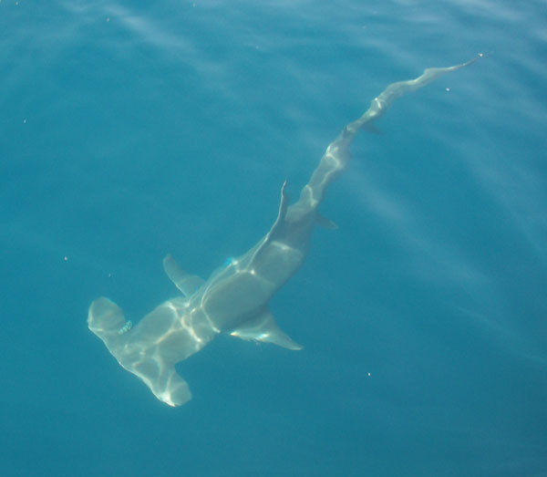
What is their ecosystem like?
The ecosystem for the Great Hammerhead shark is in the warm tropical warm coastal waters that are around 68 degrees fahrenheit.
Notes:
1 Background Color
1 Title (or write the question)
1 Pictures
1 Include Transitions
0 Answering question using complete sentences (multiple sentences if needed to fully explain your answer)
1 Accuracy of information
5
….warm tropical and warm coastal waters with temperatures around 68…..

Slide 5
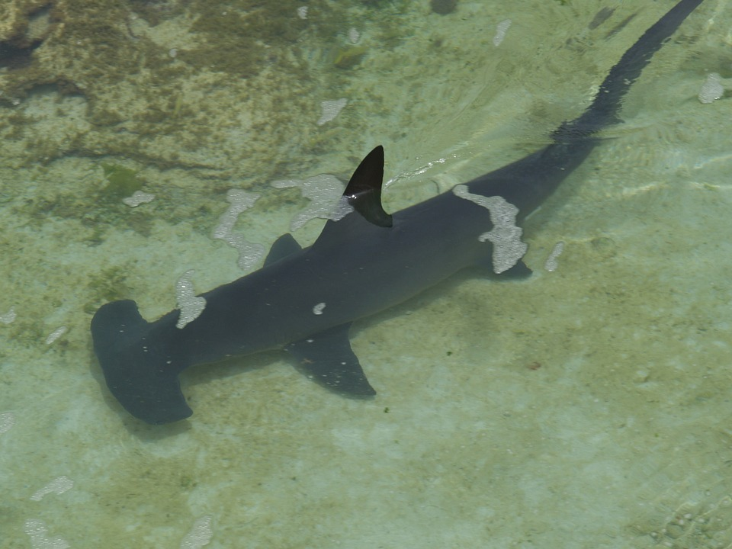
What type of consumer is it?
The Great Hammerhead shark is a carnivore which means it is a predator. When they hunt they go close to the see floor and they search for any food hiding under the sand. How they do this is that they have sensors under their their hammer like head to easily search for food hiding from irs stomach.
Notes:
1 Background Color
1 Title (or write the question)
1 Pictures
1 Include Transitions
0 Answering question using complete sentences (multiple sentences if needed to fully explain your answer)
1 Accuracy of information
5
….close to the sea floor where they search….

Slide 6
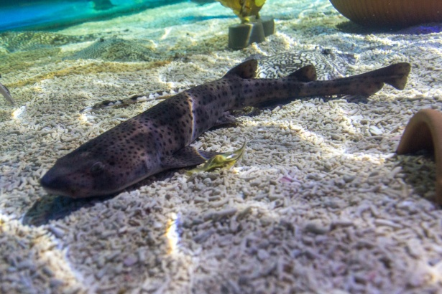
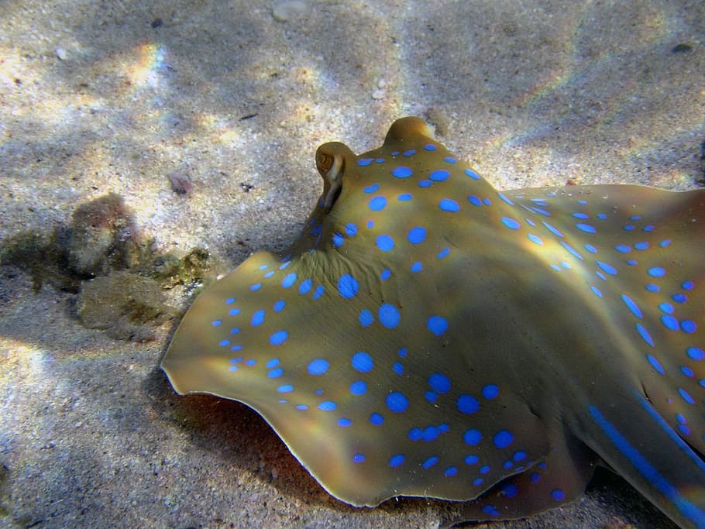
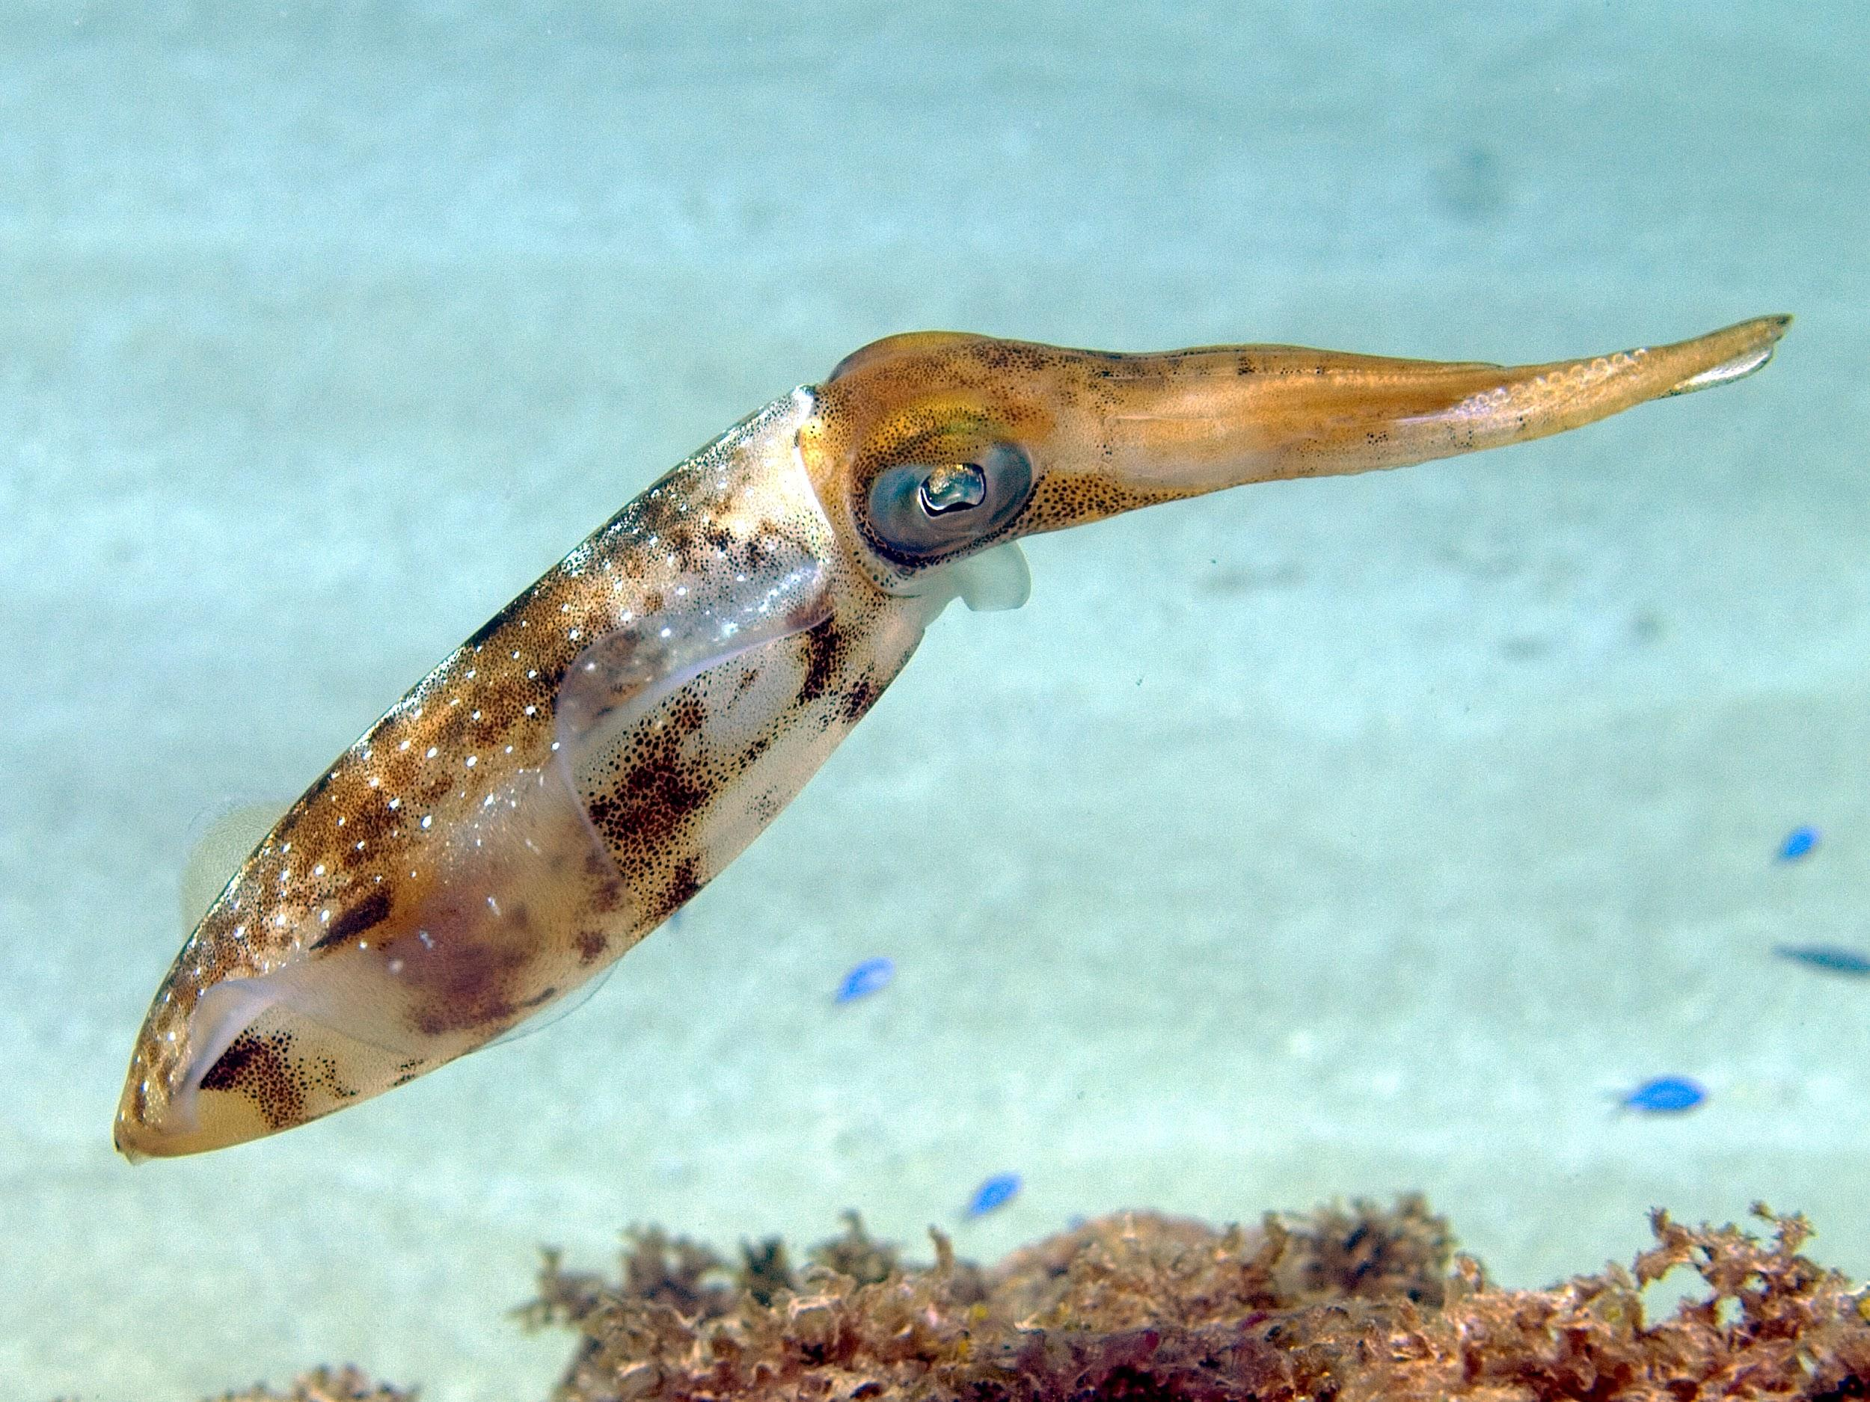
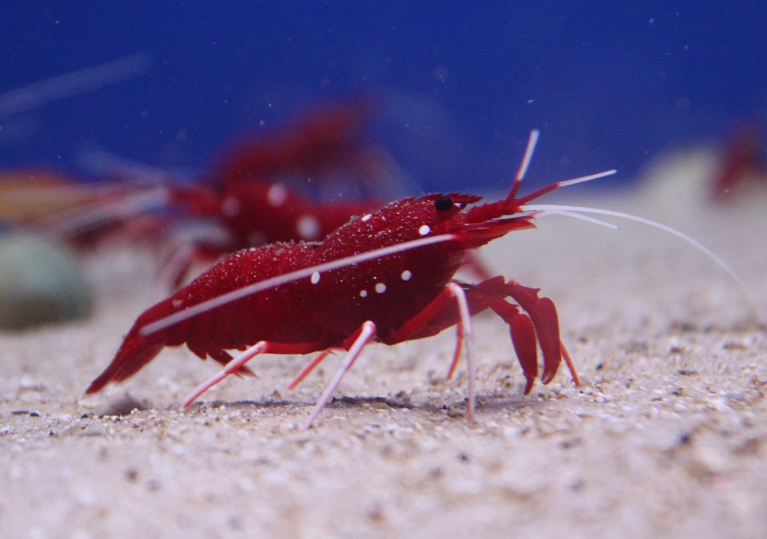
What type of prey does it feast on?
The Great hammerheads primary food source is found at the ocean floor, there they prey on stingrays, cephalopods, crustaceans, and smaller sharks.
Notes:
1 Background Color
1 Title (or write the question)
1 Pictures
1 Include Transitions
0 Answering question using complete sentences (multiple sentences if needed to fully explain your answer)
1 Accuracy of information
5
…floor where they prey…

Slide 7
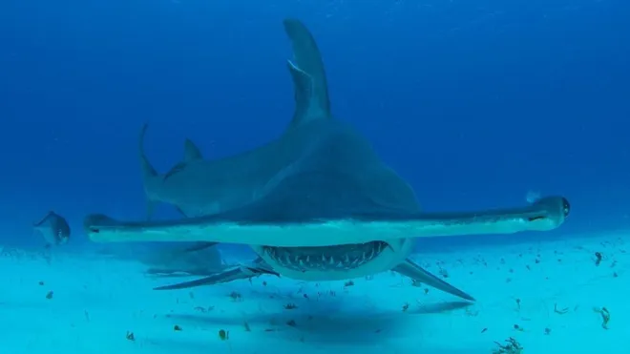
Do they have predators
The Great Hammerheads do not have and predators. They only have 3 predators because of their size and strength. The only time they are predators from other animals is when they are young and little when they are that small they fear all bigger sharks who are willing to eat the youngsters. Another predator they rarely encounter is killer whales because they hunt in packs and sharks travel alone they are able to prey on these creatures. (Unless you count humans) If so humans are the reason for the beautiful beasts nearly being extinct. They are often caught for their “Valuable” fins after that they simply are tossed back into the ocean where they die.
Notes:
1 Background Color
1 Title (or write the question)
1 Pictures
1 Include Transitions
0 Answering question using complete sentences (multiple sentences if needed to fully explain your answer)
1 Accuracy of information
5
Please put a question mark after the title.
They have only 3…. The only time they have predators from other….little. When they are that small…

Slide 8
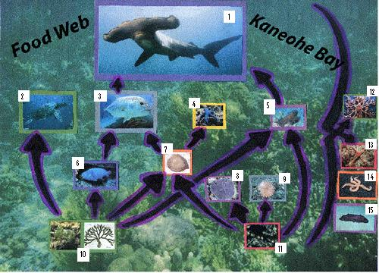
What is it’s food chain
The Great Hammerhead shark is on top of the food chain meaning it is the most dominant species on the coral reef as seen on the picture to the right. The 2 only things that are a threat to these creatures are humans and other more dominate sharks.
Notes:
1 Background Color
1 Title (or write the question)
1 Pictures
1 Include Transitions
0 Answering question using complete sentences (multiple sentences if needed to fully explain your answer)
1 Accuracy of information
5
Please put a question mark after the title.
…as seen in the picture…. The only 2 things…

Slide 9
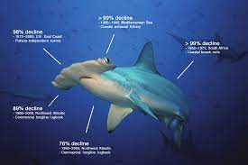
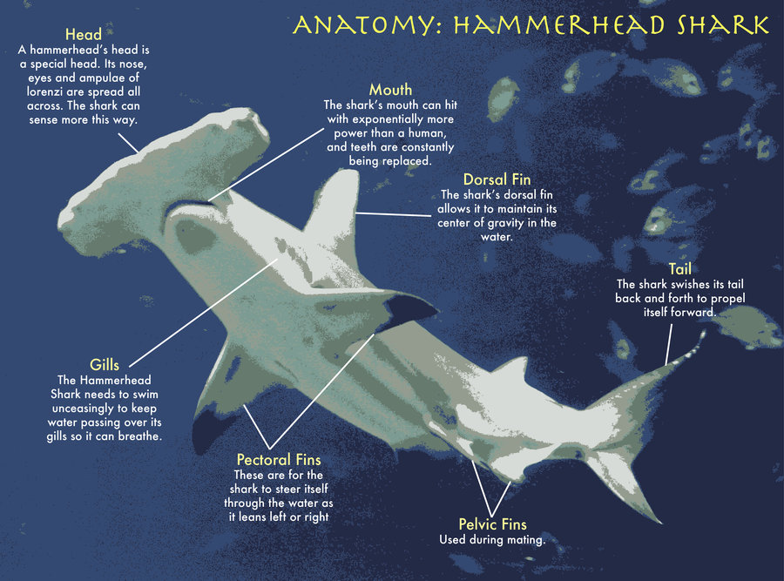
What adaptations do they have to survive
The Hammerheads have like many other sharks have serrated teeth in order to better grab on prey. Another adaptation is the ability to use their hammer like head, their head to detect prey with the electrical receptors to detect hiding prey in the sand. They also have sleek torpedo bodies in order to cut through the water with great speed. A very important adaption is that they have cartilage in replace of bones this is very important so they can make quick sharp turns to catch prey and such. The final but most important adaptation is it fins, like all creatures of the sea they all have fins except a few. Their fins give them the ability to control where they are swimming without spiraling out of control, another skill it adds is to swim at higher speed than humans can run. Lastly, the great hammer is able to swim at 25 mph and even at such speed capable of twisting and turning when needed .
Notes:
1 Background Color
1 Title (or write the question)
0 Pictures
1 Include Transitions
0 Answering question using complete sentences (multiple sentences if needed to fully explain your answer)
1 Accuracy of information
4
Please put a question mark after the title. This slide has no picture.
The Hammerheads, like many other sharks, serrated teeth….
..electical receptors in their hammer like head to detect prey hiding in the sand.
…torpedo shaped bodies…
There is an extra space between that and they.. …bones. This is….important in allowing them to make….
…are its fins…. Like all creatures of the sea with fins they have the ability to contro where they….Lastly, the hammerhead is able to swim at high speeds….

Slide 10
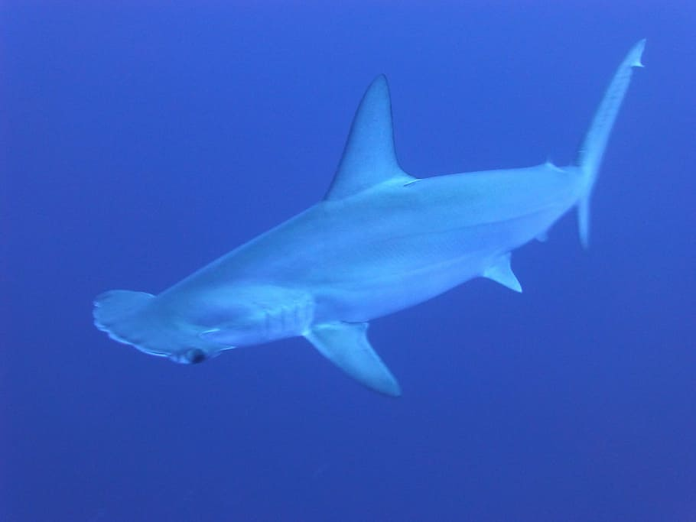
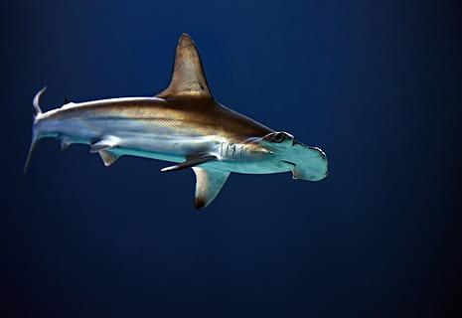
About Their Appearances
The Great Hammerheads are the largest of all of the hammerheads and these rulers of the sea can reach an average of 14 feet in length and also weighing around 500 pounds. Males are always a bit smaller than female. The easiest way to tell them apart is a clasper which only a male has. Another difference is their heads it is slight but still different a female tend to have a rounder hammer shaped head. The final difference is that males also have bigger fins than the female this is so it is easier to mate.
Notes:
1 Background Color
1 Title (or write the question)
1 Pictures
1 Include Transitions
0 Answering question using complete sentences (multiple sentences if needed to fully explain your answer)
1 Accuracy of information
5
When not using a complete sentence for the title capitalize every word or use all caps.
Maybe …kings of the sea…
You have merged two slides here,,, their appearance, and the differences between male and female… theses titiles should be separate.

Slide 11
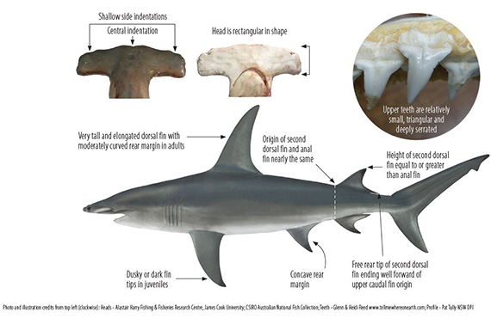
The Difference Between Male And Female
Males are always a bit smaller than female. The easiest way to tell them apart is a clasper which only a male has. Another difference is their heads it is slight but still different a female tend to have a rounder hammer shaped head. The final difference is that males also have bigger fins than the female this is so it is easier to mate.

Slide 12
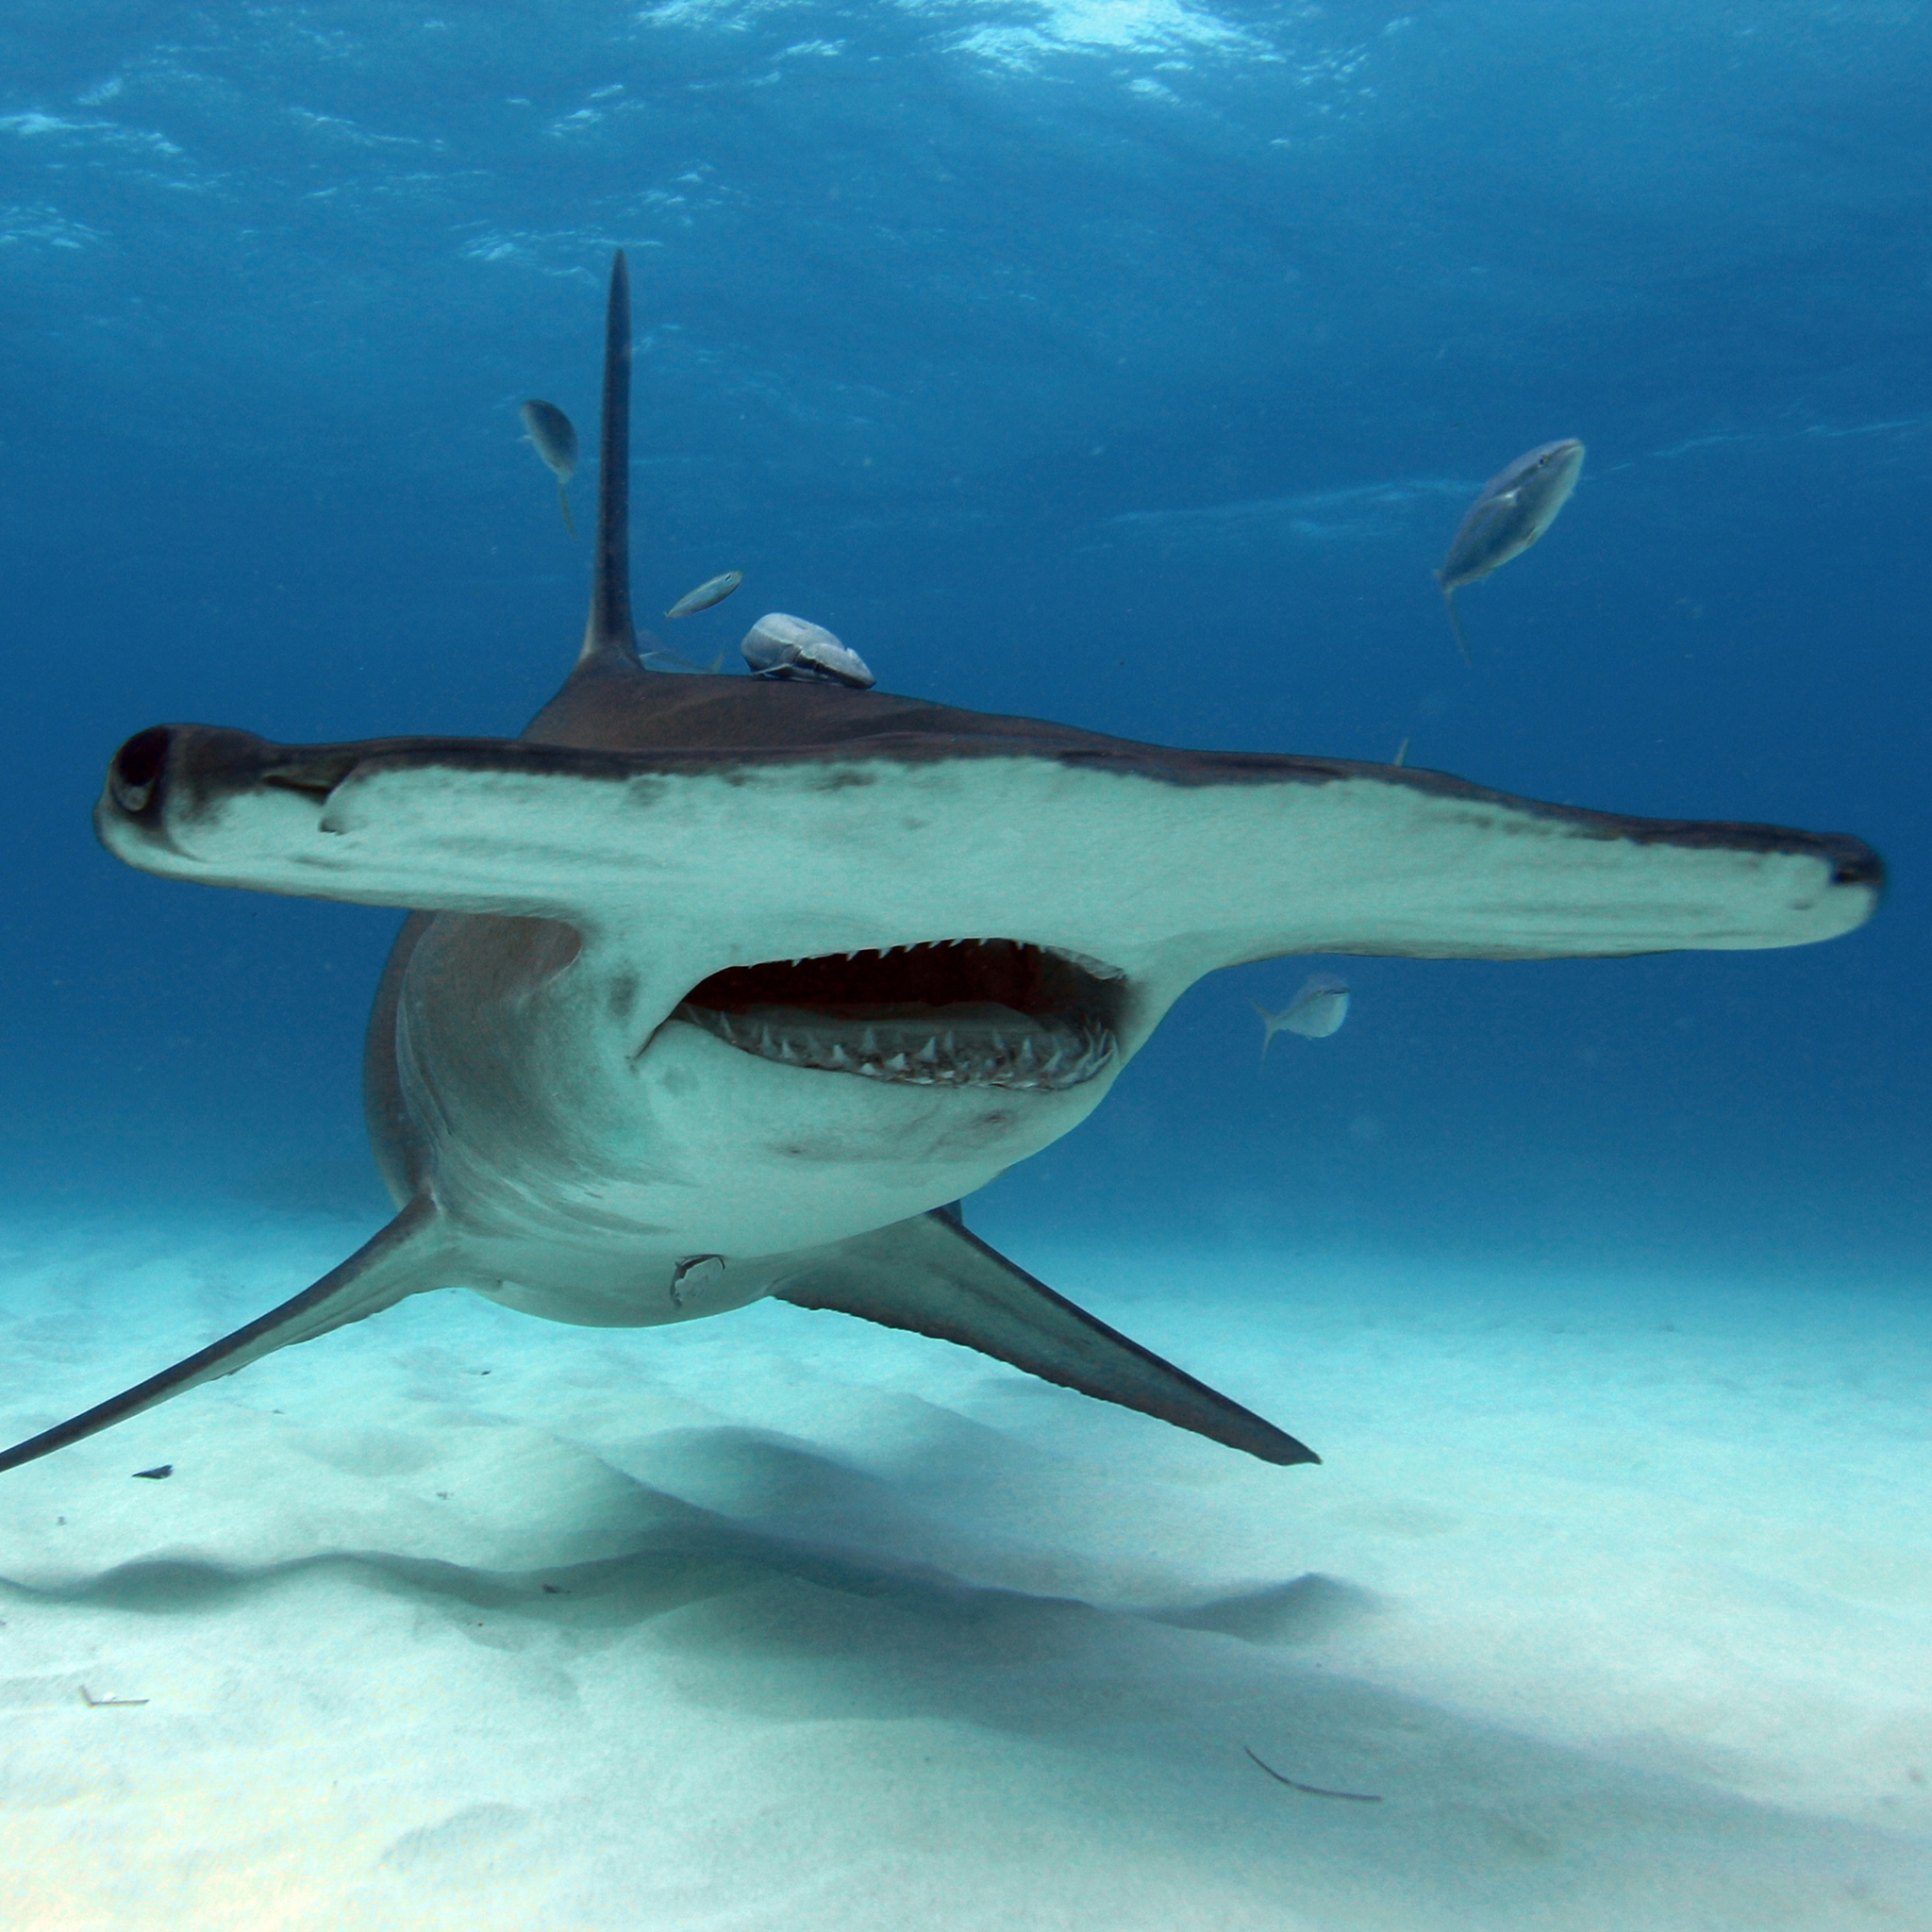
How Long is Their Lifespan
The life span of the Great Hammerheads, if not hunted or badly injured they can live up to 45 years. Though that is not always possible and because of that the average lifespan can be up to 20-30 years as a consequence of humankind.
Notes:
1 Background Color
1 Title (or write the question)
1 Pictures
1 Include Transitions
0 Answering question using complete sentences (multiple sentences if needed to fully explain your answer)
1 Accuracy of information
5
Please put a question mark after the title.
Hammerheads, if not hunted of badly injured, is up to 45 years.
However, today the typical lifespan is 20-30 as a consequence of living with man.

Slide 13
10 fun facts (Part 1)
1. Great Hammerhead sharks are fully grown by the age of ten.
2. The longest great hammerhead shark ever recorded was 20 feet (6.1 m) long, and the heaviest great hammerhead shark ever recorded was 991 pounds (450 kg).
3. Great hammerhead sharks are believed to be cannibalistic, eating their own species if need be.
4. Great hammerhead sharks have been found at depths of 984 feet (300 m) but typically stay in coastal waters up to 262 feet (80 m) deep.
5. Great hammerhead sharks have been found with stingray and catfish barbs sticking out of their mouths, suggesting that they are immune to stingray and catfish venom.
Notes:
1 Background Color
1 Title (or write the question)
1 Pictures
1 Include Transitions
0 Answering question using complete sentences (multiple sentences if needed to fully explain your answer)
1 Accuracy of information
5
Please delete the 2 at the end of #4, and teh 1 at the end of #5.

Slide 14
10 fun facts (Part 2)
6. The Great Hammerhead has 360 degree vision because of where it’s eye are placed, bu they do have a blind spot in the from of their hammer and to cover their blind spot there move their head sideways so they can see better but also doing this helps them swim more efficiently .
7. They have 17 tooth rows on either side of their upper jaw with 2-3 teeth at the midline of the jaw. They have around 16-17 teeth on either side of the lower jaw and 1-3 at the midline of the lower jaw.
8. Larger Hammerheads like to use their hammer like heads to pin down prey to keep them from slipping away.
9. Hammerheads are extremely shy, and do not attack humans unless provoked or if they mistake one for an injured seal.
10. A group of hammerheads has many names such as a gam, herd, frenzy, school or shiver.
Notes:
Not scored added slide…
#6, 7, 8 all need a periods.

Slide 15
Sources
Oceana.org (Main source)
Sciencing.com
kidadl.com
Sharktrust.org
sportdiver.com
Notes:
6
You are missing a slide please separate the one suggested earlier to be complete.

