Slide 1
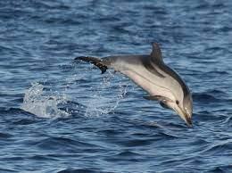
The Striped Dolphin
By Yasleen Perez
Notes:
1 Background Color
1 Title (or write the question)
1 Pictures
1 Include Transitions
1 Answering question using complete sentences (multiple sentences if needed to fully explain your answer)
1 Accuracy of information
6

Slide 2
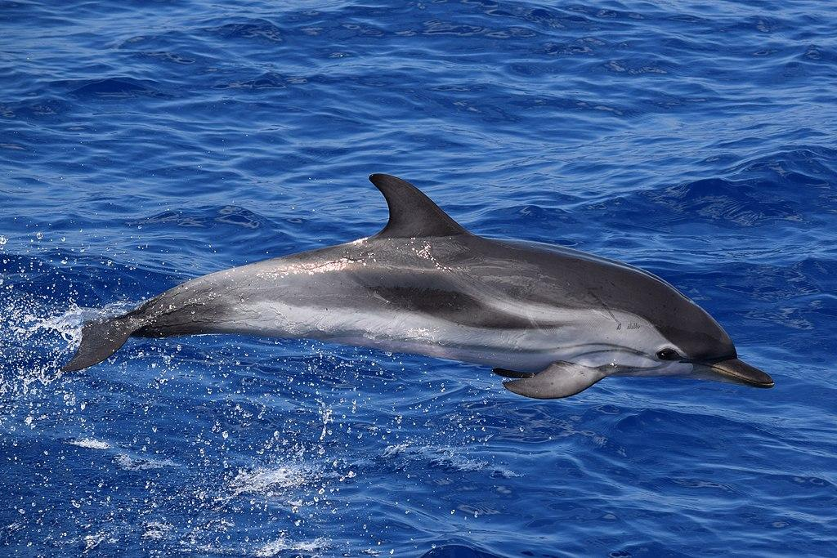
Where does the Striped Dolphin come from?
Striped Dolphins are found world wide, but their range includes waters off of Greenland, Northern Europe, (United Kingdom, Denmark), the Mediterranean Sea, Japan, Argentina, South Africa, Western Australia, and New Zealand.
Notes:
1 Background Color
1 Title (or write the question)
1 Pictures
1 Include Transitions
0 Answering question using complete sentences (multiple sentences if needed to fully explain your answer)
1 Accuracy of information
5
Delete the space before Striped.
…Northern Europe….

Slide 3
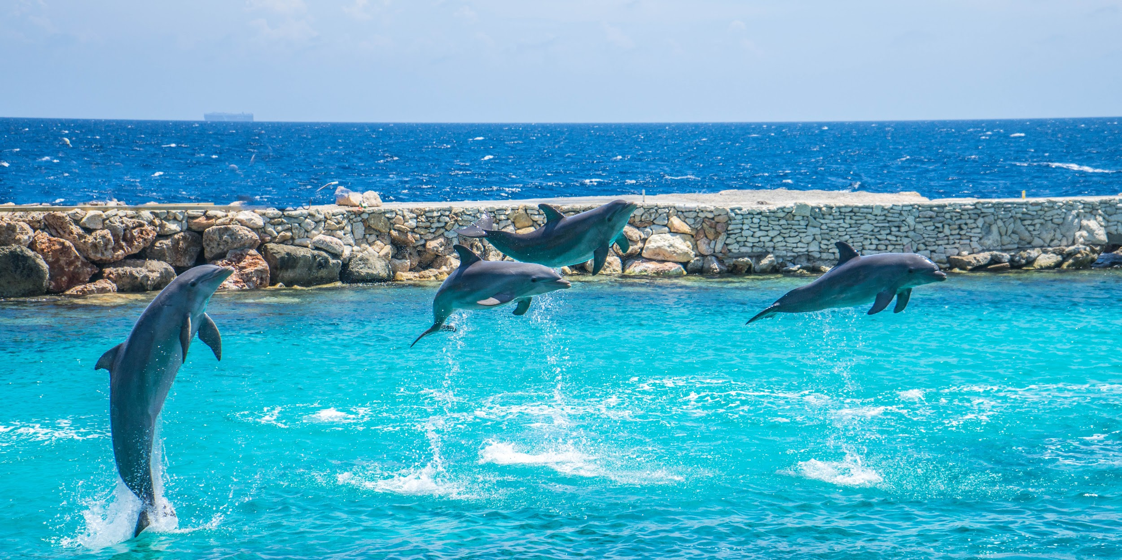
What type of ecosystem do Striped Dolphins live in?
Striped Dolphins prefer to live in deep tropical to warm temperate oceanic waters and are attracted to upwelling areas, where deep, cold, nutrient-rich water rises toward the surface.
Notes:
1 Background Color
1 Title (or write the question)
1 Pictures
1 Include Transitions
1 Answering question using complete sentences (multiple sentences if needed to fully explain your answer)
1 Accuracy of information
6

Slide 4

What is it like in Striped Dolphins ecosystem?
Striped Dolphins prefer to be in tropical to warm temperatures of water that are oceanic and deep. The temperatures of water that Striped Dolphins are usually in is either 52 to 84 degrees Fahrenheit.
Notes:
1 Background Color
1 Title (or write the question)
1 Pictures
1 Include Transitions
0 Answering question using complete sentences (multiple sentences if needed to fully explain your answer)
1 Accuracy of information
5
Fahrenheit or F.

Slide 5
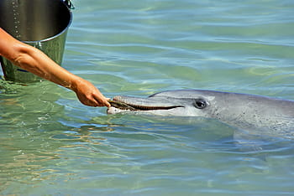
What type of consumer is a Striped Dolphin?
Striped Dolphins are carnivores since they only eat meat.
Notes:
1 Background Color
1 Title (or write the question)
1 Pictures
1 Include Transitions
1 Answering question using complete sentences (multiple sentences if needed to fully explain your answer)
1 Accuracy of information
6

Slide 6
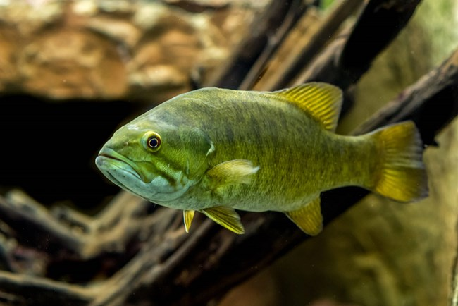
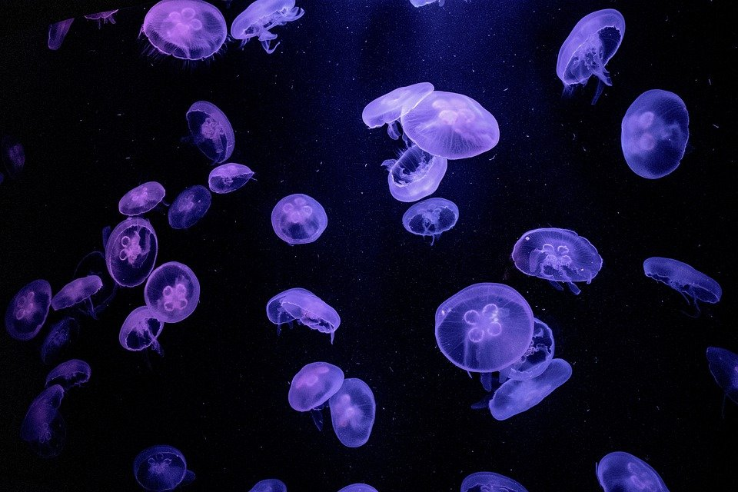
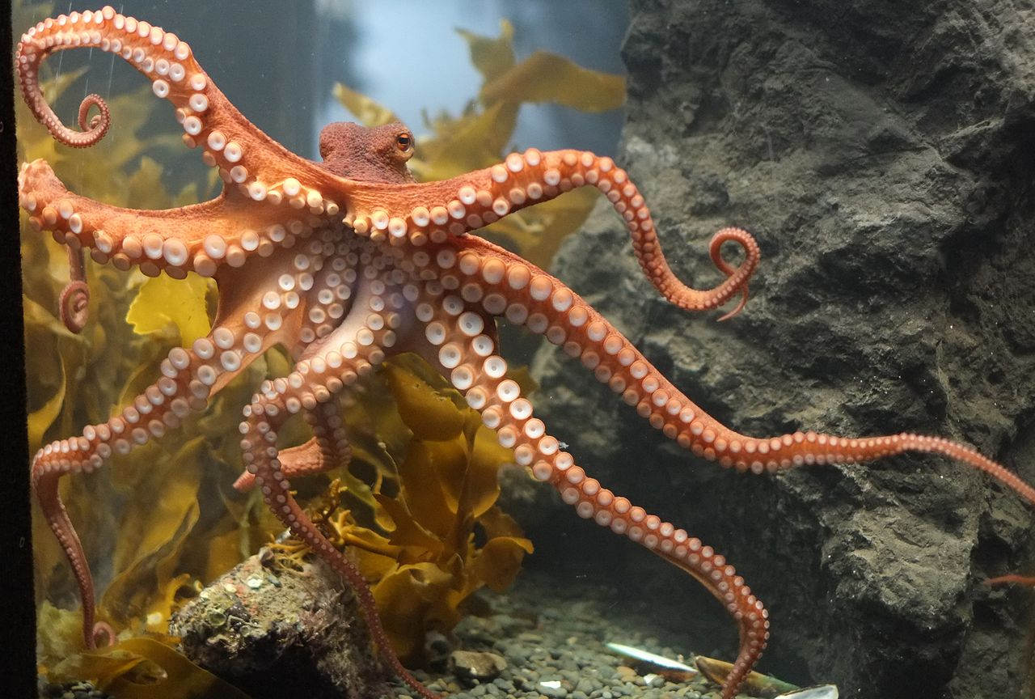
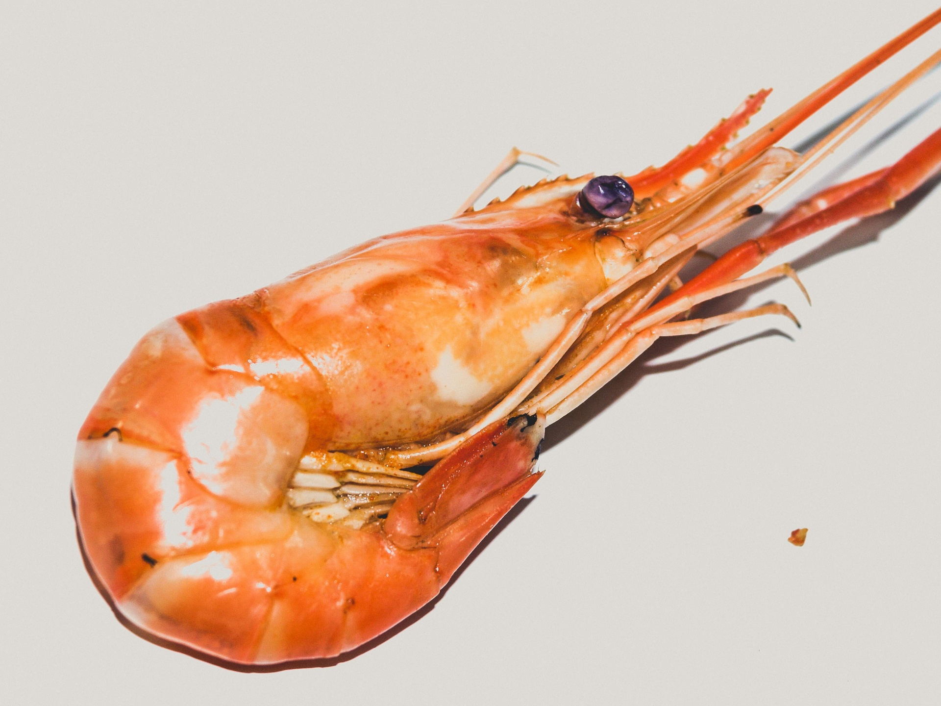
What specific foods do Striped Dolphins eat?
Striped Dolphins eat a variety of fish, squid, shrimps, jellyfish, and octopuses.
Notes:
1 Background Color
1 Title (or write the question)
1 Pictures
1 Include Transitions
1 Answering question using complete sentences (multiple sentences if needed to fully explain your answer)
1 Accuracy of information
6

Slide 7
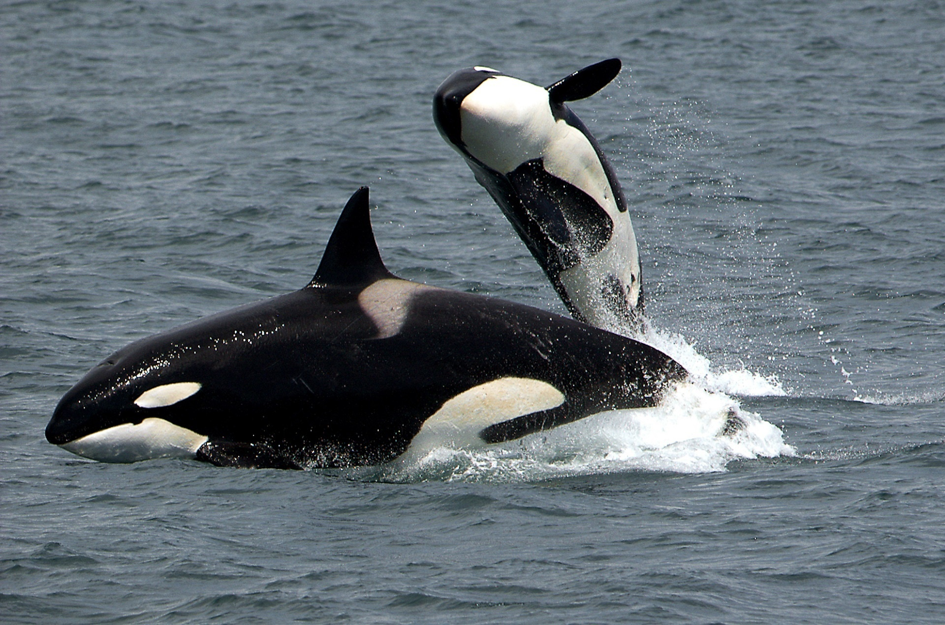
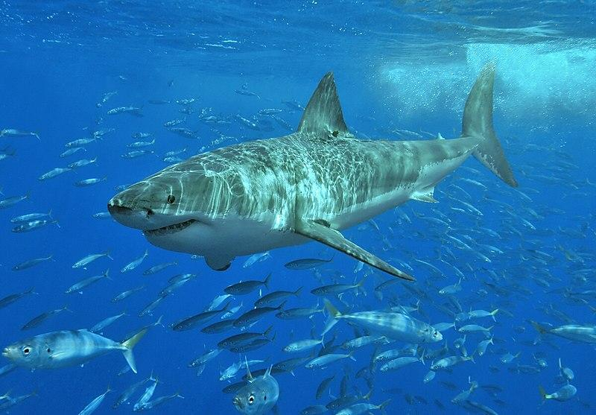
Do Striped Dolphins have any predators?
The animals that are known to prey on Striped Dolphins are Killer whales and sharks.
Notes:
1 Background Color
1 Title (or write the question)
1 Pictures
1 Include Transitions
1 Answering question using complete sentences (multiple sentences if needed to fully explain your answer)
1 Accuracy of information
6

Slide 8
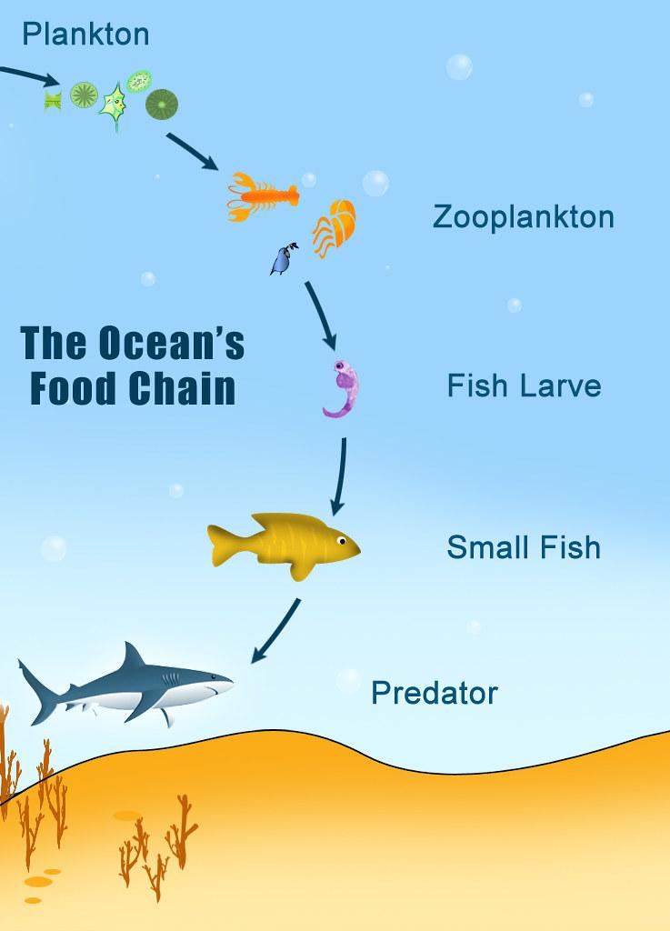
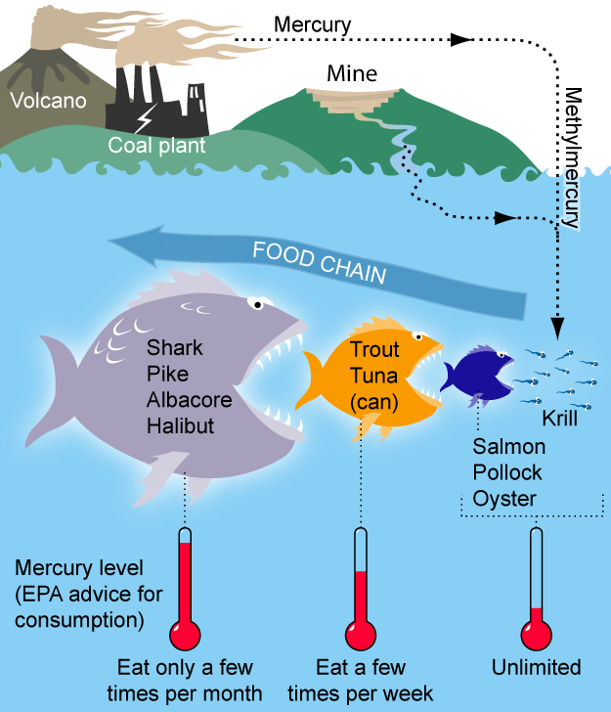
What is a typical food chain for Striped Dolphins?
Dolphins are part of an ocean food chain.
Notes:
1 Background Color
1 Title (or write the question)
1 Pictures
1 Include Transitions
1 Answering question using complete sentences (multiple sentences if needed to fully explain your answer)
1 Accuracy of information
6

Slide 9
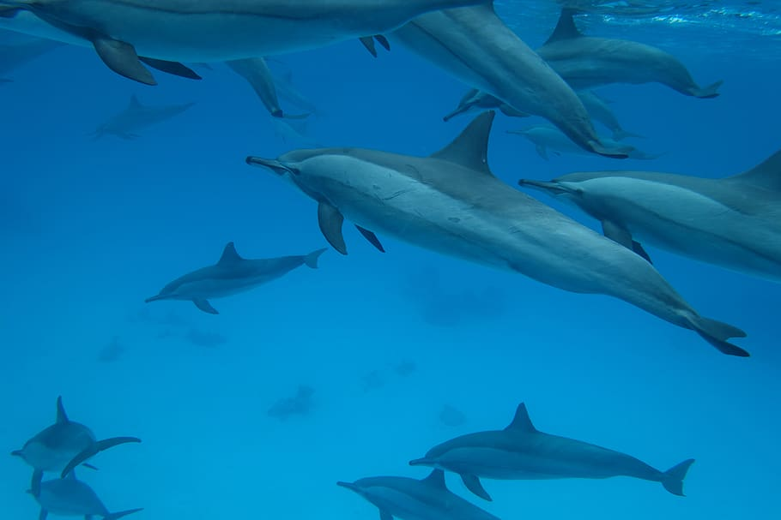
Do Striped Dolphins have any specific adaptations to help them survive?
Here are some of their adaptations that help them survive in the water.
They have a long, sleek, streamlined body that is designed for fast movement in the water.
They have a blowhole located at the top of their body which allows them to come up to the surface, easily take in air, and continue swimming.
When dolphins are asleep, half of their brains remain awake.
Dolphins have an ability that’s called echolocation, that helps them hear everything from a far distance easily.
When dolphins swim in large pods they are able to scare off sharks.
Overall Striped dolphins use their intelligence, incredible speed, communication, echolocation, and traveling in pods to help them survive.
Notes:
1 Background Color
1 Title (or write the question)
0 Pictures
1 Include Transitions
1 Answering question using complete sentences (multiple sentences if needed to fully explain your answer)
1 Accuracy of information
5
No picture… #4 have is duplicated, Overall, Striped dolphins use…

Slide 10
What do Striped Dolphins look like, how much do they weigh, and how tall are they?
Male striped dolphins can reach lengths of 9 feet tall and about 350 pounds. Females can reach up to 8 feet tall and 330 pounds.
Striped dolphins are relatively small, streamlined and colourful. The most recognizable feature on them is their stripes, as the name says. A dark grey stripe runs from the beak, above the eye, across the flank and then down to the underside of the body. A second stripe runs below the eye to the pectoral flipper.
Notes:
1 Background Color
1 Title (or write the question)
1 Pictures
1 Include Transitions
1 Answering question using complete sentences (multiple sentences if needed to fully explain your answer)
1 Accuracy of information
6

Slide 11
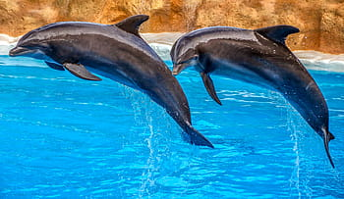
Do males and females of striped dolphins weigh the same and are the same size?
Male striped dolphins are actually bigger than female striped dolphins.
Notes:
1 Background Color
1 Title (or write the question)
1 Pictures
1 Include Transitions
1 Answering question using complete sentences (multiple sentences if needed to fully explain your answer)
1 Accuracy of information
6

Slide 12
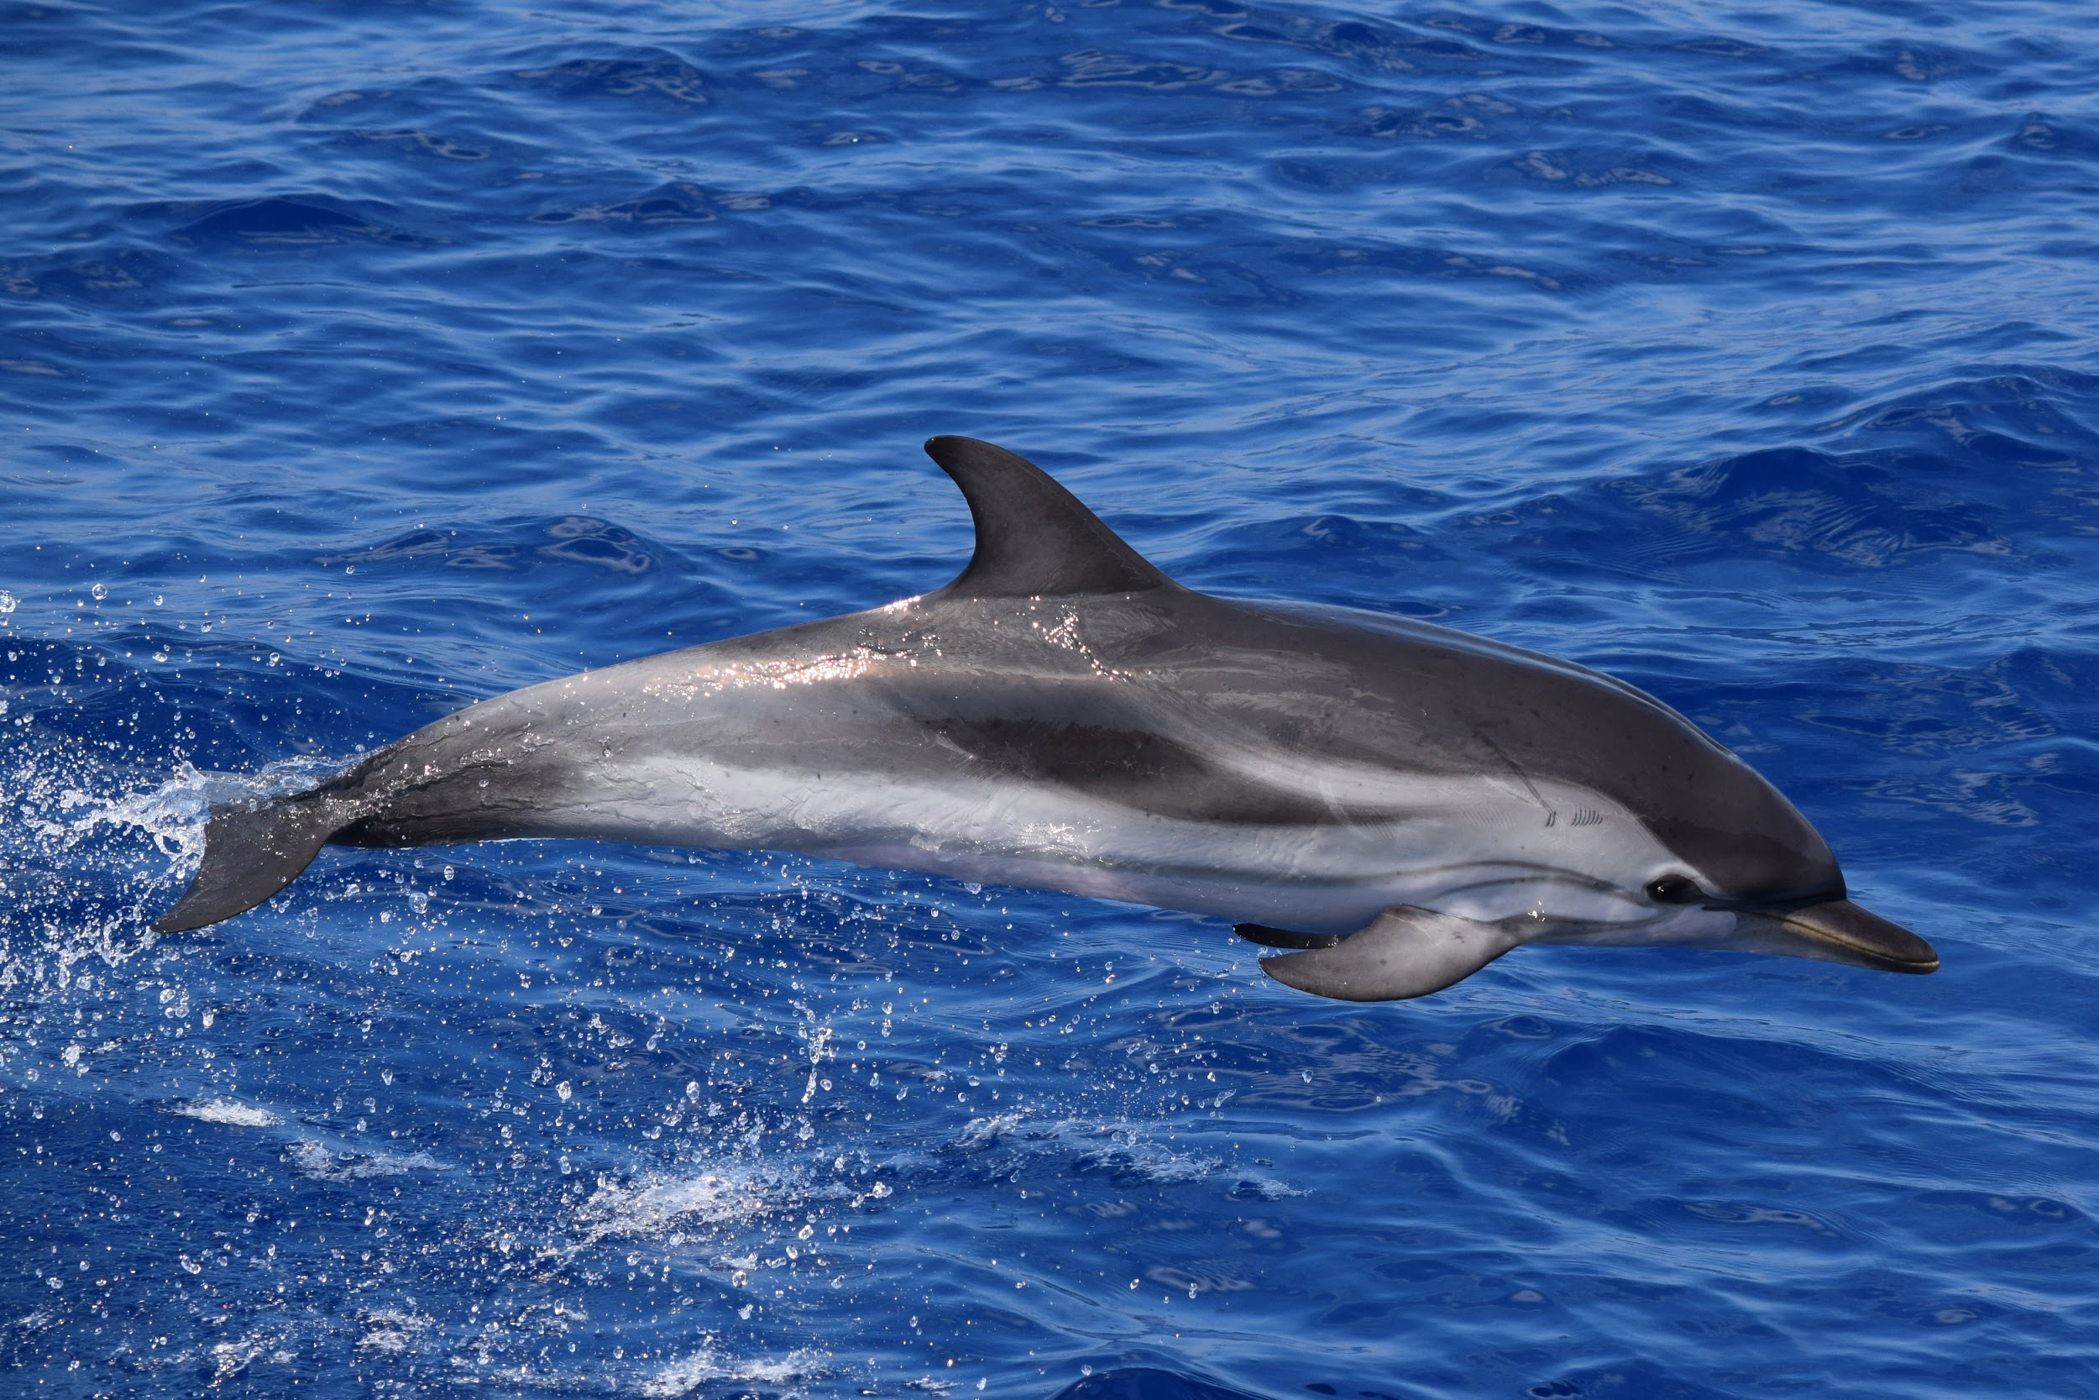
What is the lifespan of striped dolphins?
Striped dolphins live up to 55-60 years.
Notes:
1 Background Color
1 Title (or write the question)
1 Pictures
1 Include Transitions
0 Answering question using complete sentences (multiple sentences if needed to fully explain your answer)
1 Accuracy of information
5
…live 55-60 years..

Slide 13
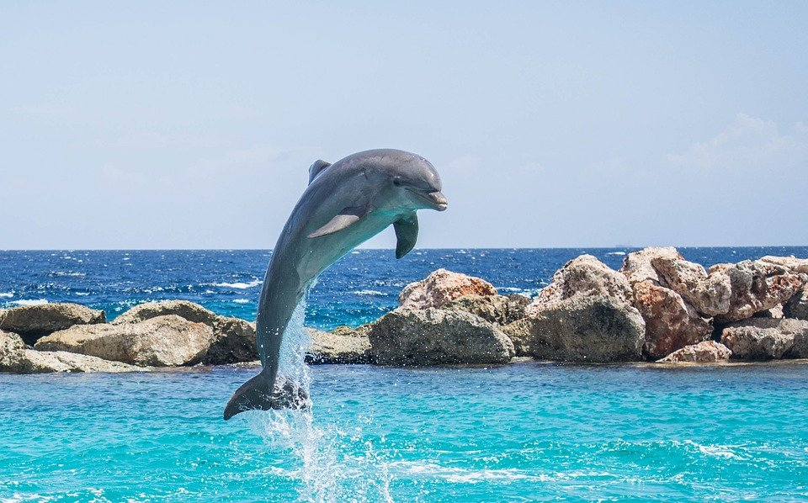
These are facts about striped dolphins
Striped Dolphins are super fast, they can travel up to 20 miles per hour.
Striped Dolphins can jump up to 15 feet in the air.
Notes:
1 Background Color
1 Title (or write the question)
1 Pictures
1 Include Transitions
1 Answering question using complete sentences (multiple sentences if needed to fully explain your answer)
1 Accuracy of information
6

Slide 14
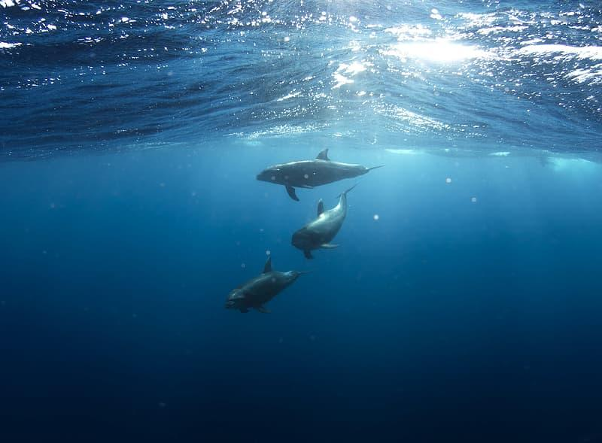
Here are some more facts about Striped Dolphins.
Striped Dolphins can go 1,000 meters under water.
Striped Dolphins have 2 stomachs, 1 is for receiving and storing food, the second one is responsible for digesting and breaking down the food.
Notes:
Not scored extra slide

Slide 15
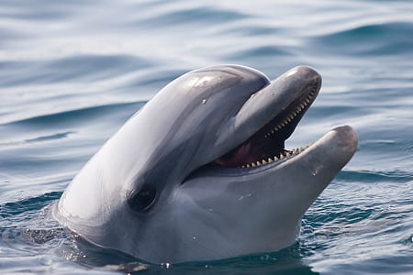
More facts about Striped Dolphins continued.
There are more than 2 million striped dolphins in the world as of right now.
To keep warm in cold water Striped Dolphins body is covered and surrounded by a thick layer or fat, also called blubber. It is just under the skin to keep it warm.
Notes:
Not scored extra slide

Slide 16
Here are the last few facts about Striped Dolphins
A dolphin's cone-shaped teeth interlock to catch fish. Their teeth are not used to chew, they actually swallow their food whole.
Just like dogs, cats, and other mammals, striped dolphins communicate by using sound, touch, smell, vision, and taste.
Each dolphin can make a unique signature whistle that can help other dolphins recognize each other, it can also help aware other dolphins that some other dolphins are near.
Notes:
Not scored extra slide

Slide 17
My resources where I got all of my information from
https://kidadl.com/animal-facts/striped-dolphin-facts
https://teacher.scholastic.com/dolphin/about4.htm
https://us.whales.org/whales-dolphins/what-do-dolphins-eat/
https://carolinamarinegroup.com/some-interesting-facts-about-dolphins-part-1
https://seaworld.org/animals/all-about/bottlenose-dolphin/diet/
https://www.blue-world.org/conservation/species/cetaceans/striped-dolphin/
https://www.dolphins-for-kids.com/how-do-dolphins-hunt
Notes:
1 Background Color
1 Title (or write the question)
1 Pictures
1 Include Transitions
1 Answering question using complete sentences (multiple sentences if needed to fully explain your answer)
1 Accuracy of information
6

Slide 18
I hope you enjoyed my presentation about Striped Dolphins!
By Yasleen Perez

