Slide 1
Creature Project
Ring necked Pheasant
Zachary shoquist

Slide 2
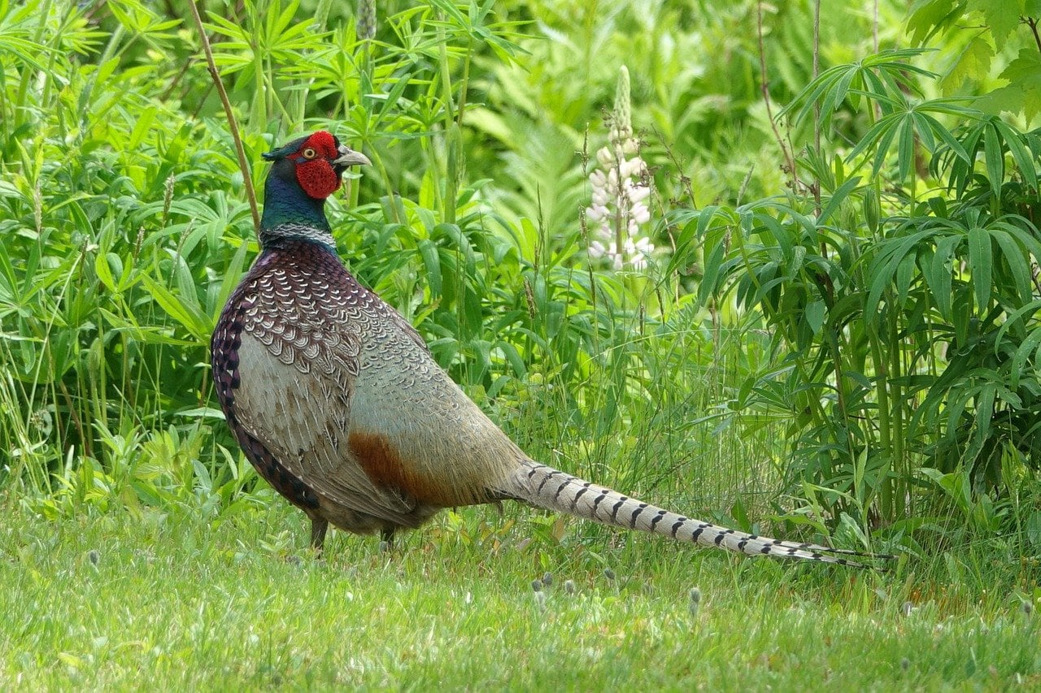
History of where my creature came from.
Common pheasants, also known as ring-necked pheasants, are native to China and East Asia, but they have been successfully introduced in other parts of the world, including North America. The birds are found in woodland, farmland, scrub, and wetlands. In its natural habitat the common pheasant lives in grassland near water with small copses of trees.Common pheasants occupy grassland and farmland habitats. They prefer relatively open cover, such as grass and stubble fields and are found in habitats with grass, ditches, hedges, marshes, and tree stands or bushes for cover.Generally speaking, pheasants do best in mild weather conditions. Mild weather is especially appreciated during the nesting period, as the amount of rainfall . The ring-necked pheasant is one of Minnesota's most popular upland game birds. ... Fox, coyote, owls and hawks are the primary predators. Ring-necked Pheasants are omnivores with diet varying by season. In winter, they eat mostly seeds, grains, roots, and berries, while in the summer they take advantage of insects, fresh green shoots, spiders, earthworms, and snails.

Slide 3
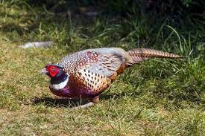
Ringneck pheasant

