Slide 1
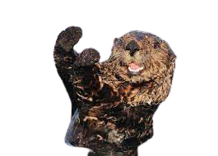
Sea Otters
By Brittany Mumulmea
Notes:
1 Background Color
1 Title (or write the question)
1 Pictures
1 Include Transitions
1 Answering question using complete sentences (multiple sentences if needed to fully explain your answer)
1 Accuracy of information

Slide 2
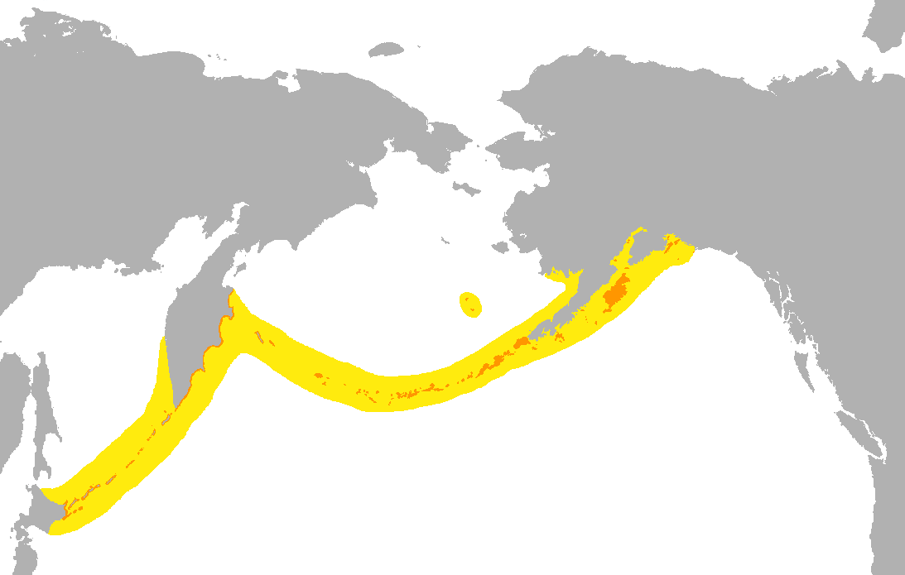
Where do sea otters come from?
Historically, sea otters were present in coastal marine habitats from northern California to Baja California in Mexico. Northern Hokkaido and russia. Sea otters were first discovered in the early 1900
Notes:
1 Background Color
1 Title (or write the question)
1 Pictures
1 Include Transitions
0 Answering question using complete sentences (multiple sentences if needed to fully explain your answer)
1 Accuracy of information
Sea Otters should be in caps when referring to them directly.

Slide 3
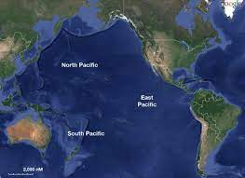
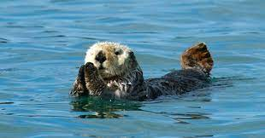
What ecosystem do they live in?
Sea otters live in coastal marine habitats. Sea otters are a marine animal which means they live in water.
Notes:
1 Background Color
1 Title (or write the question)
1 Pictures
1 Include Transitions
1 Answering question using complete sentences (multiple sentences if needed to fully explain your answer)
1 Accuracy of information

Slide 4
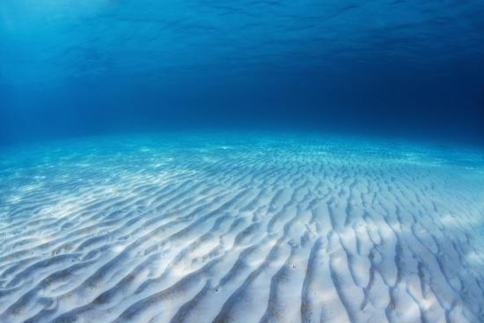
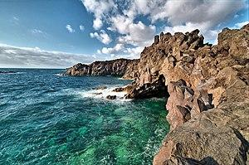
What is it like in their ecosystem?
Sea otters live in coastal marine habitats which include rocky shores and sandy sea bottoms. They can also be found in coastal wetlands. The weather is cold and very humid.
Notes:
1 Background Color
1 Title (or write the question)
1 Pictures
1 Include Transitions
1 Answering question using complete sentences (multiple sentences if needed to fully explain your answer)
1 Accuracy of information

Slide 5
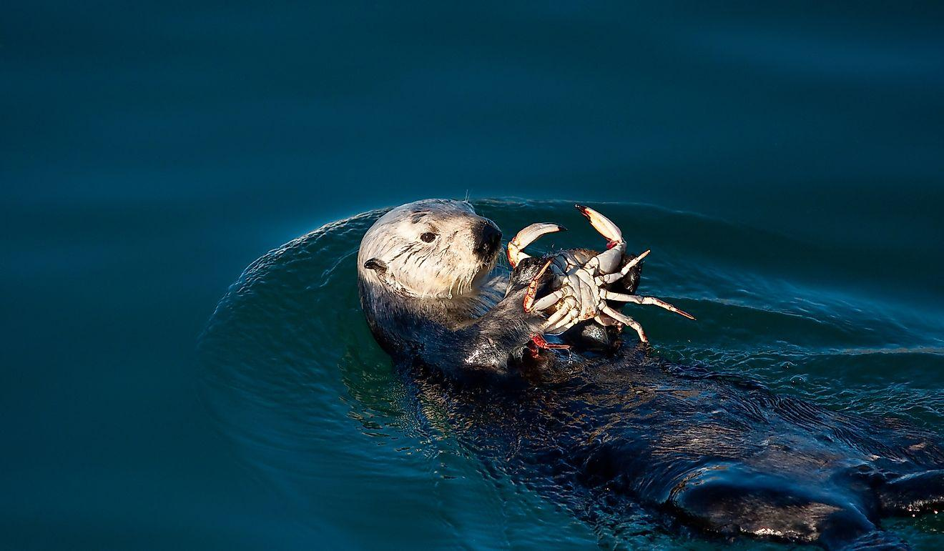
What kind of consumer is a sea otter?
A sea otter is a secondary consumer. Sea otters mostly feed on fish, crab, mussels and ect. But sea otters do not make their own food.
Notes:
1 Background Color
1 Title (or write the question)
1 Pictures
1 Include Transitions
1 Answering question using complete sentences (multiple sentences if needed to fully explain your answer)
1 Accuracy of information

Slide 6
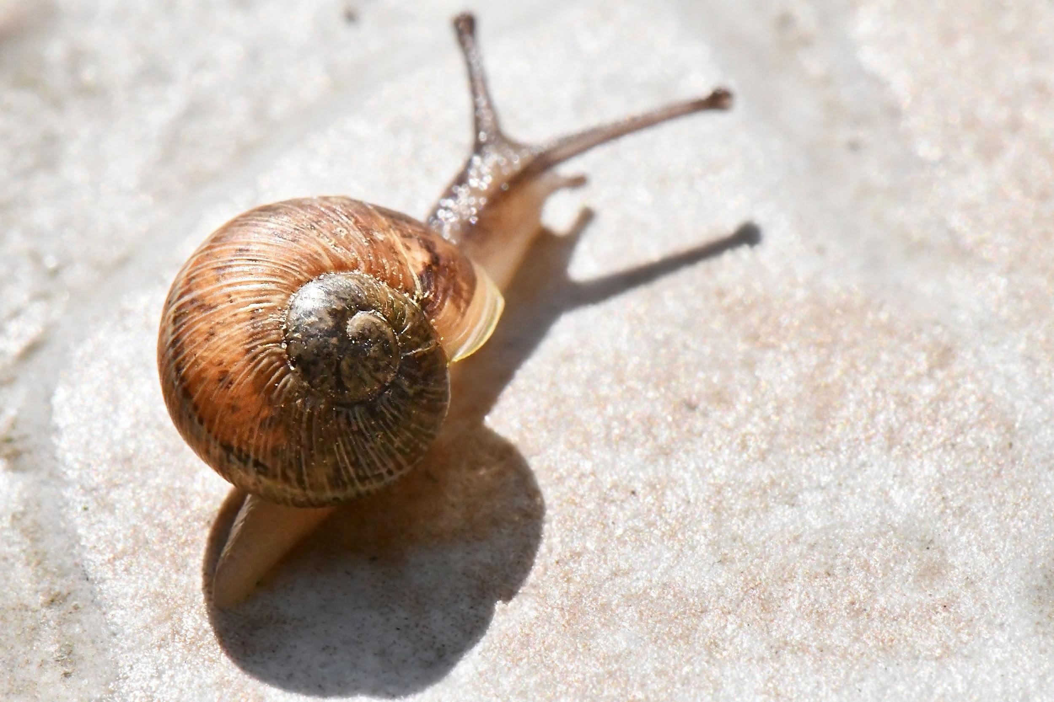
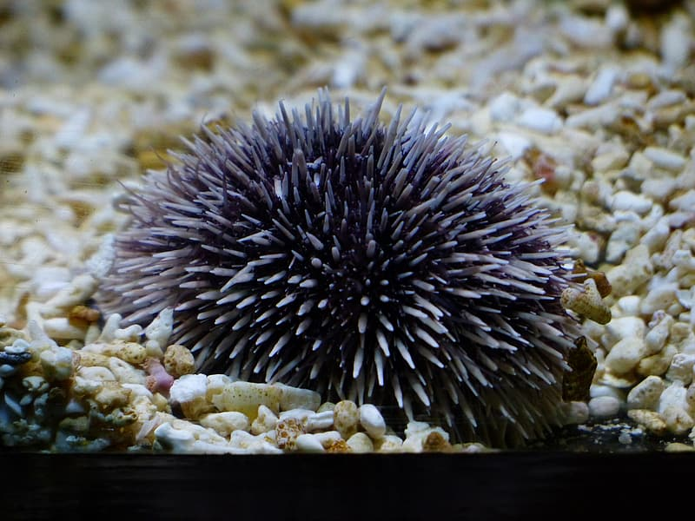
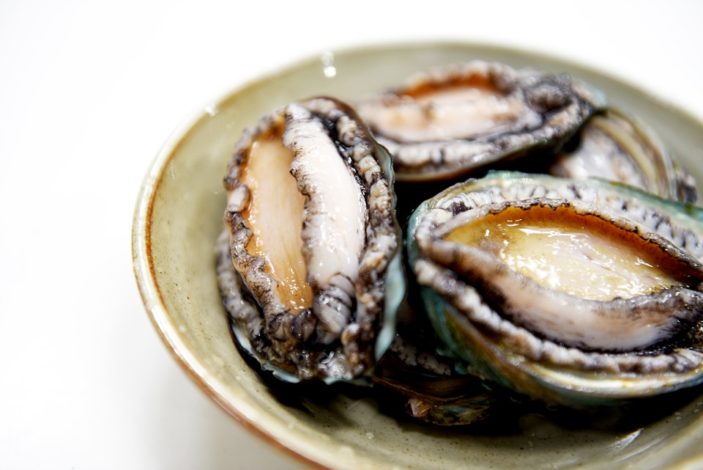
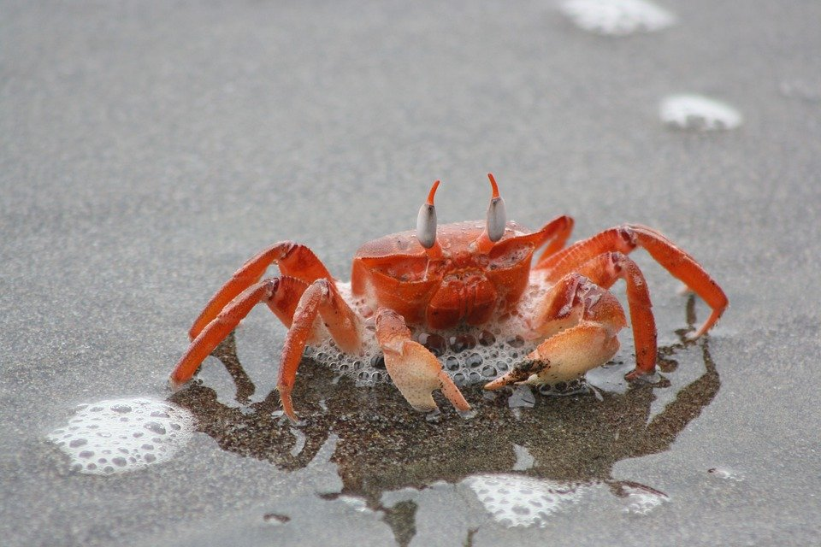
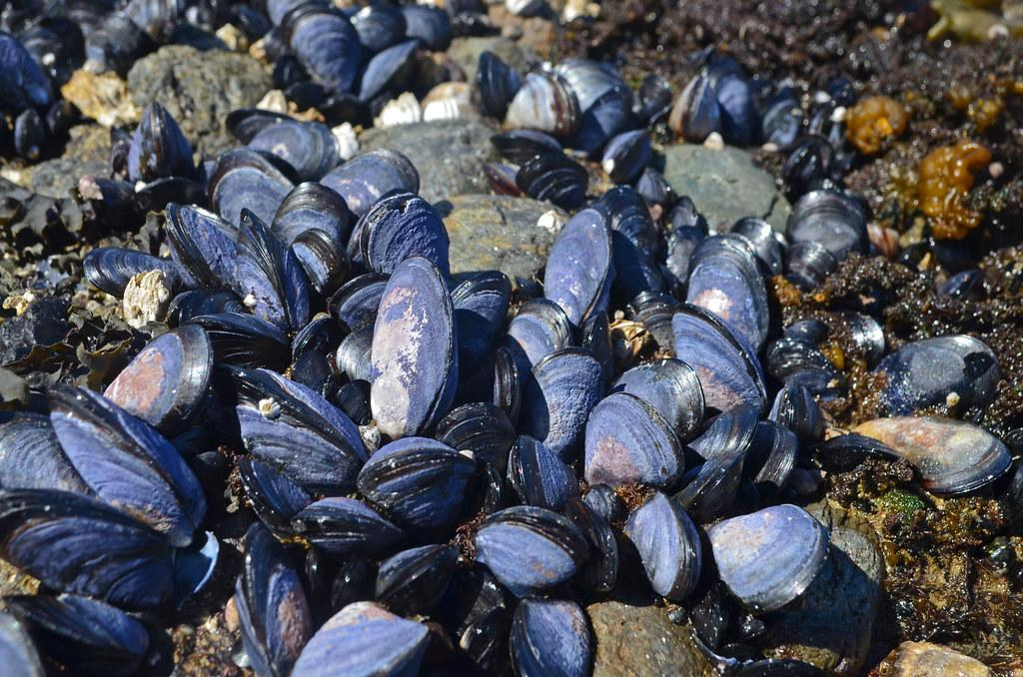
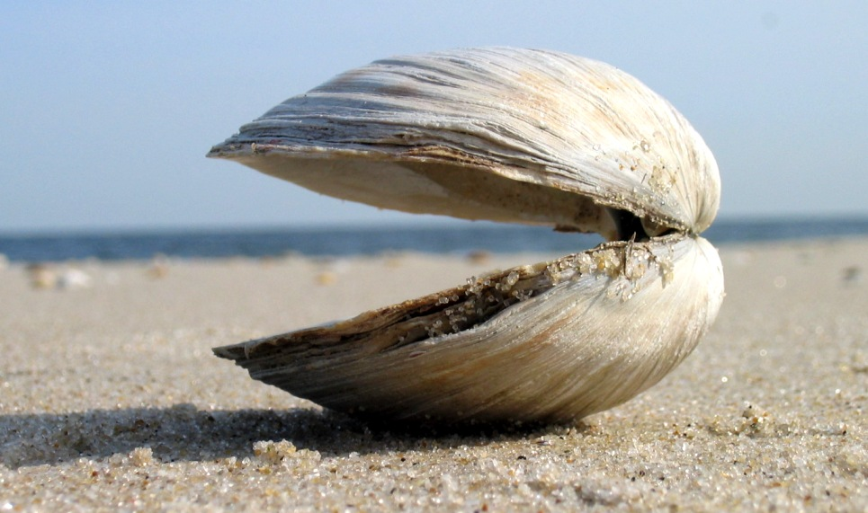
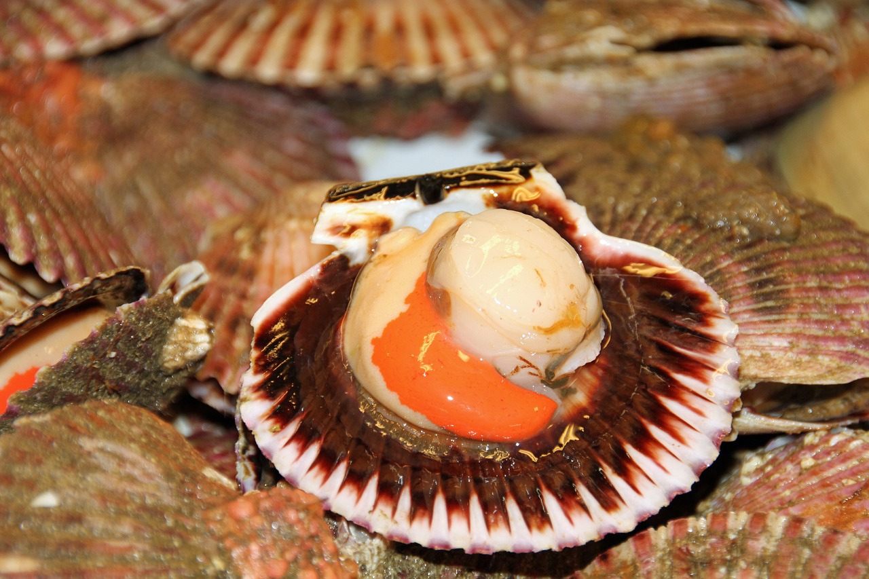
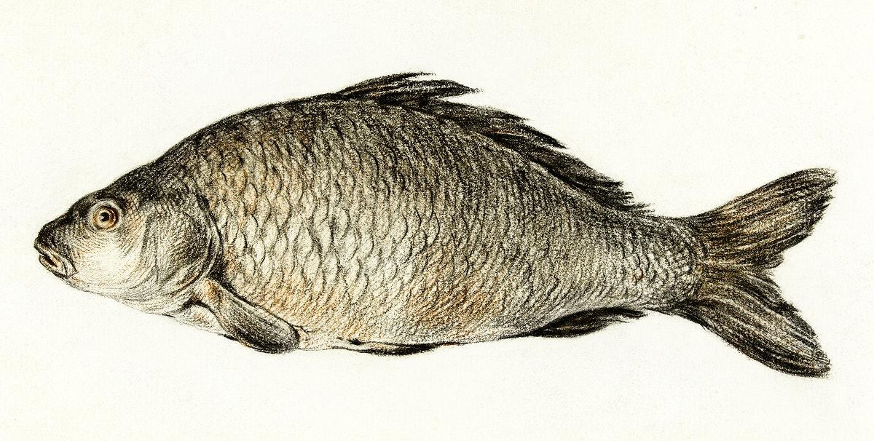
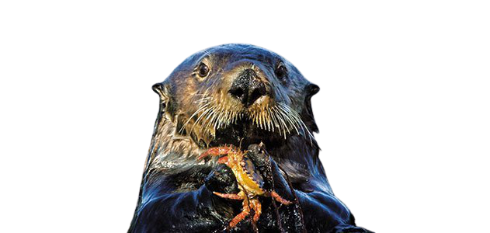
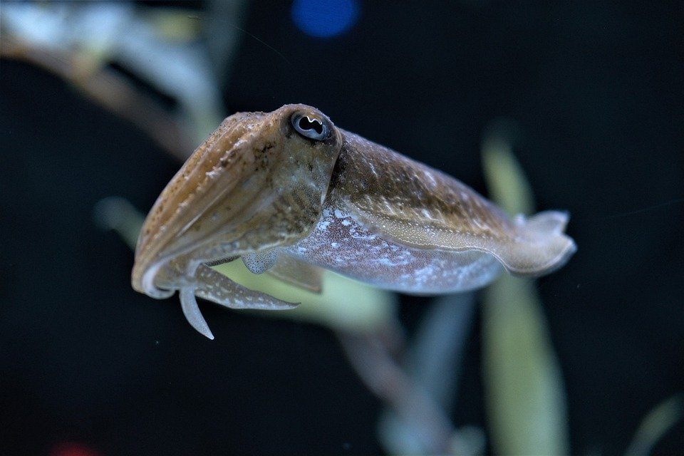
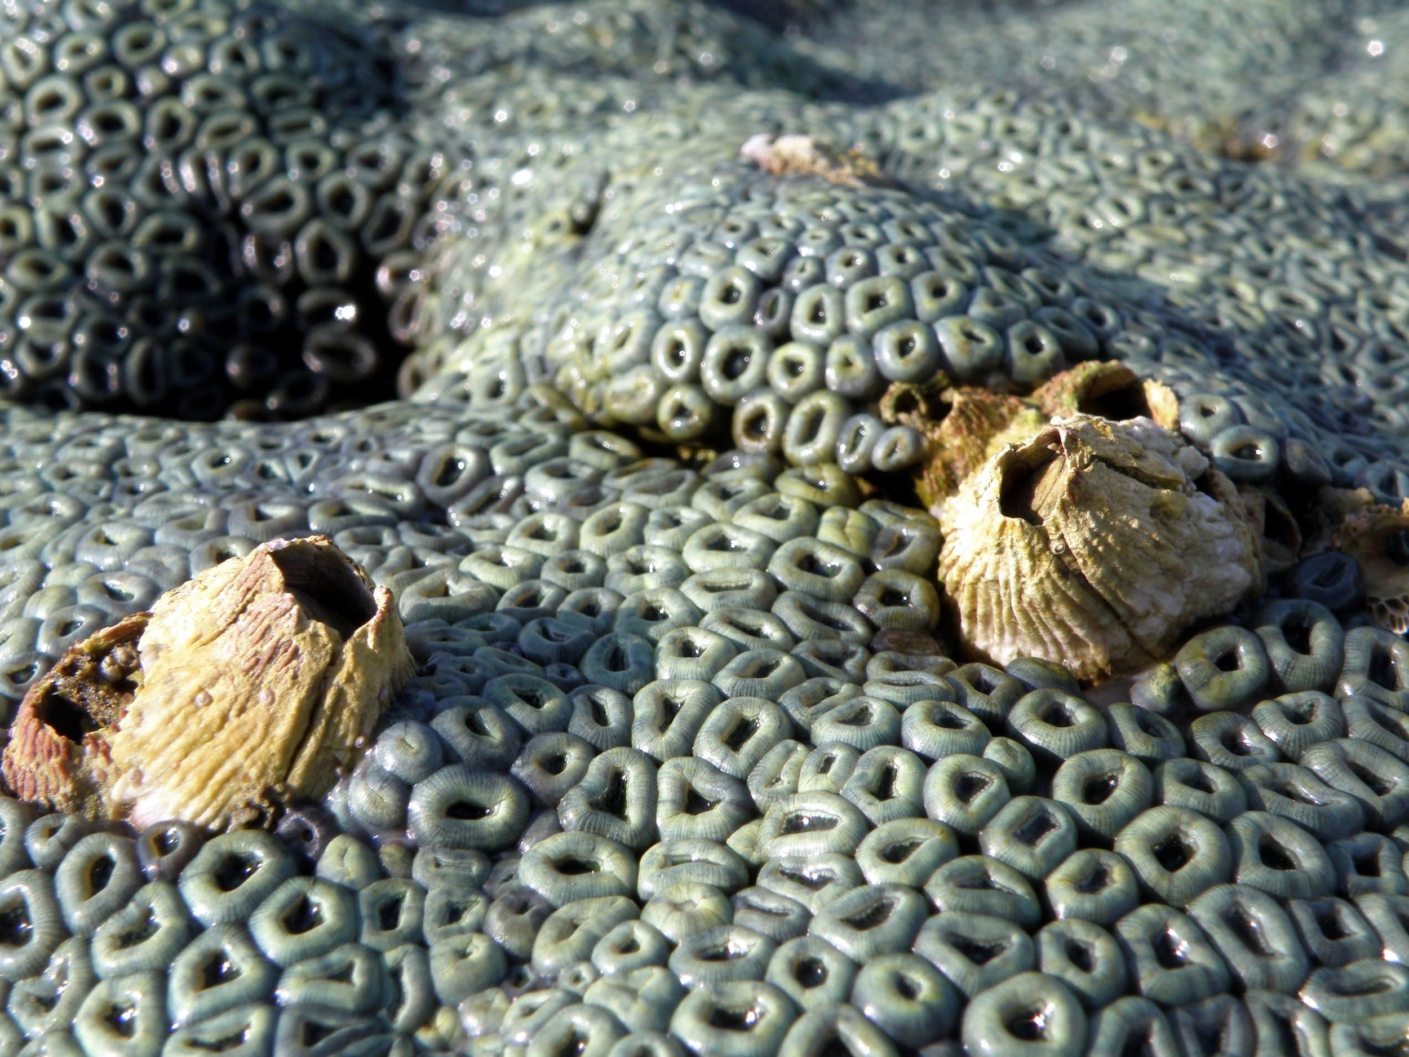
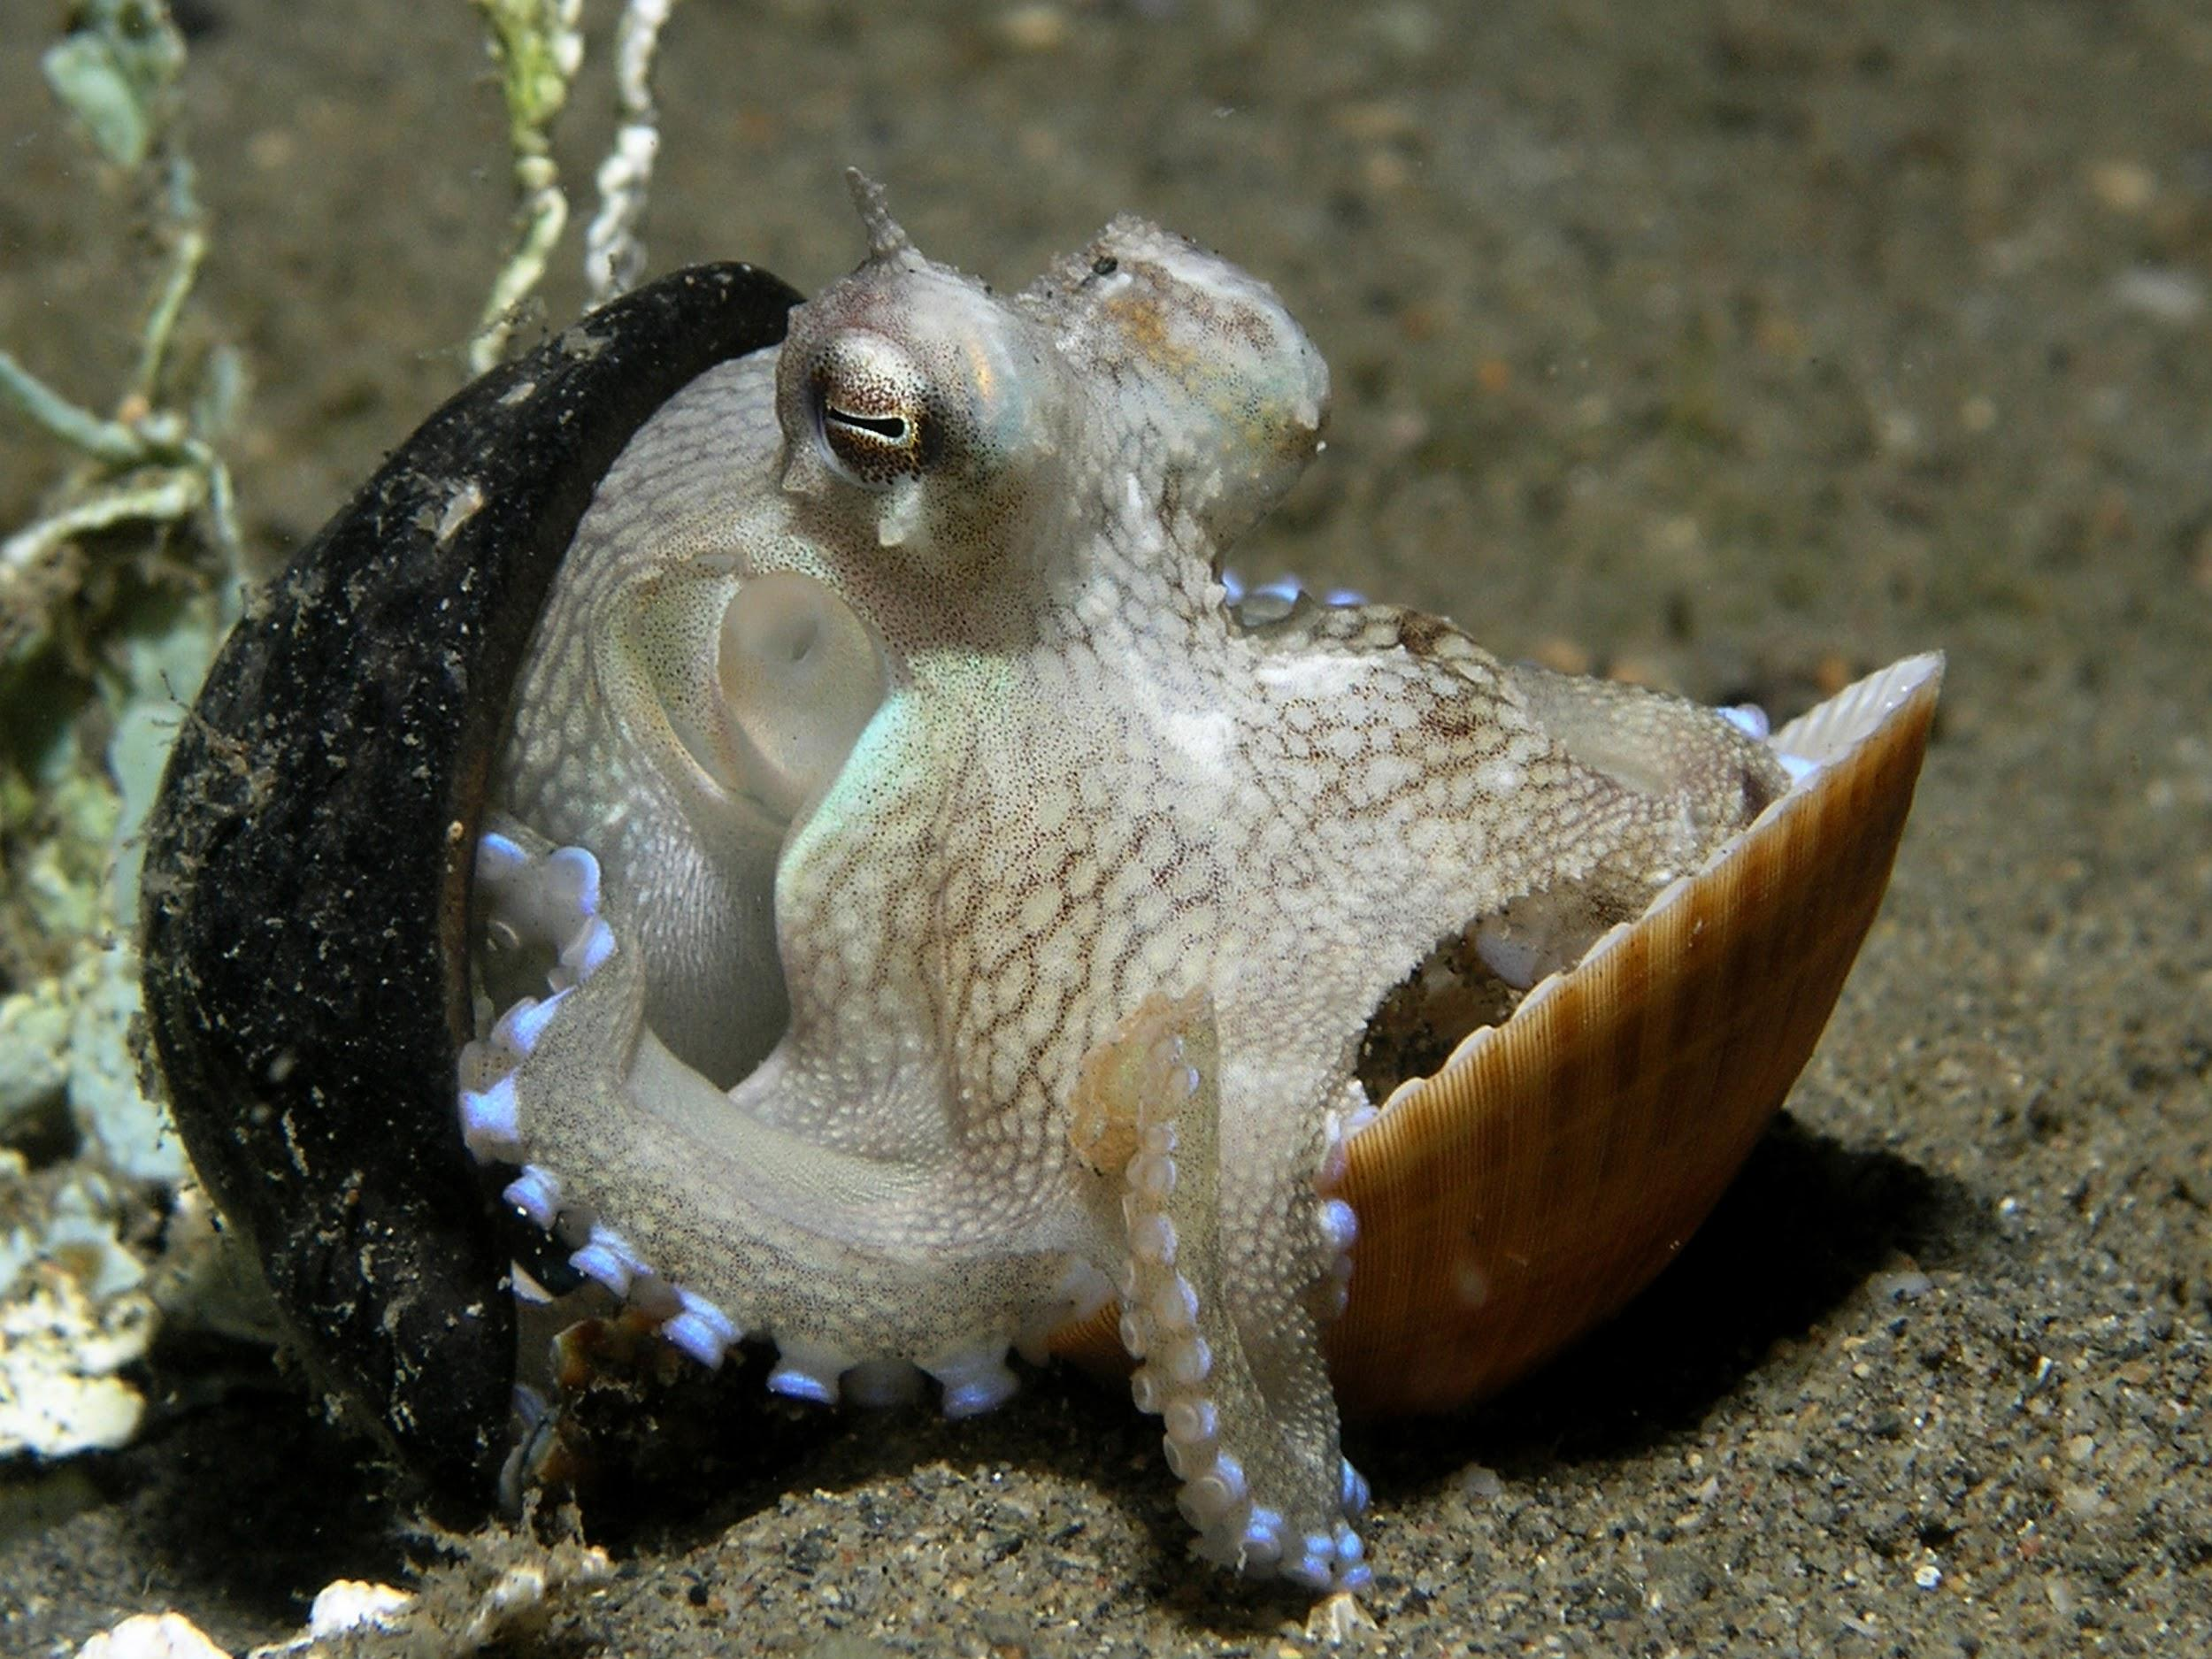
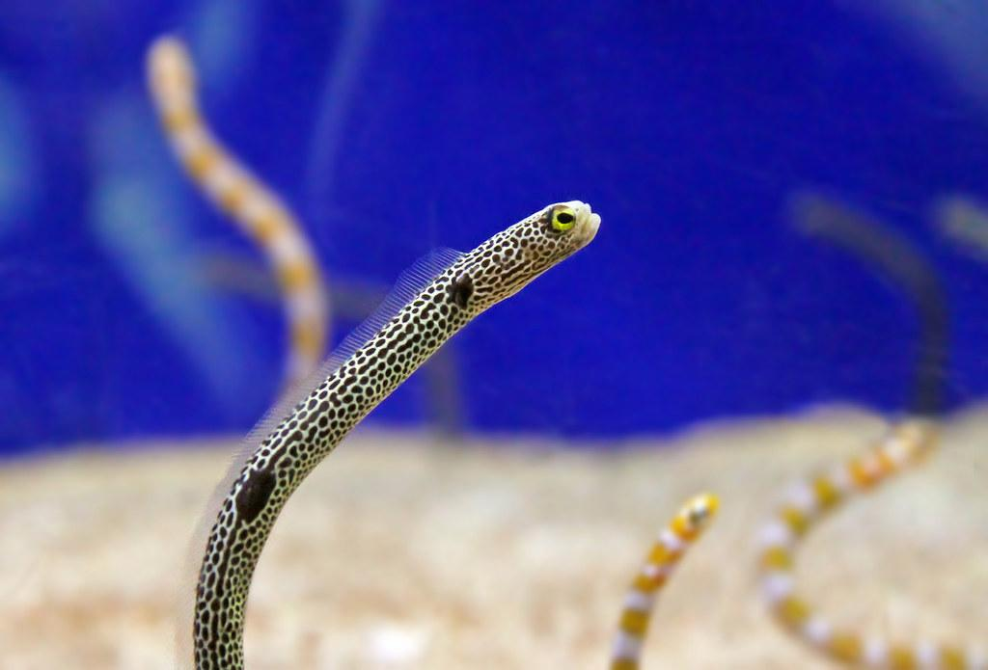
What food do they eat?
sea otter consumes many types of prey including sea urchins, snails, clams, abalone, mussels, crabs, scallops, fish, barnacles, octopus, worms, and squid. which it captures with its clawed paws, not its jaws.
Notes:
1 Background Color
1 Title (or write the question)
1 Pictures
1 Include Transitions
0 Answering question using complete sentences (multiple sentences if needed to fully explain your answer) Capitalizations
1 Accuracy of information

Slide 7
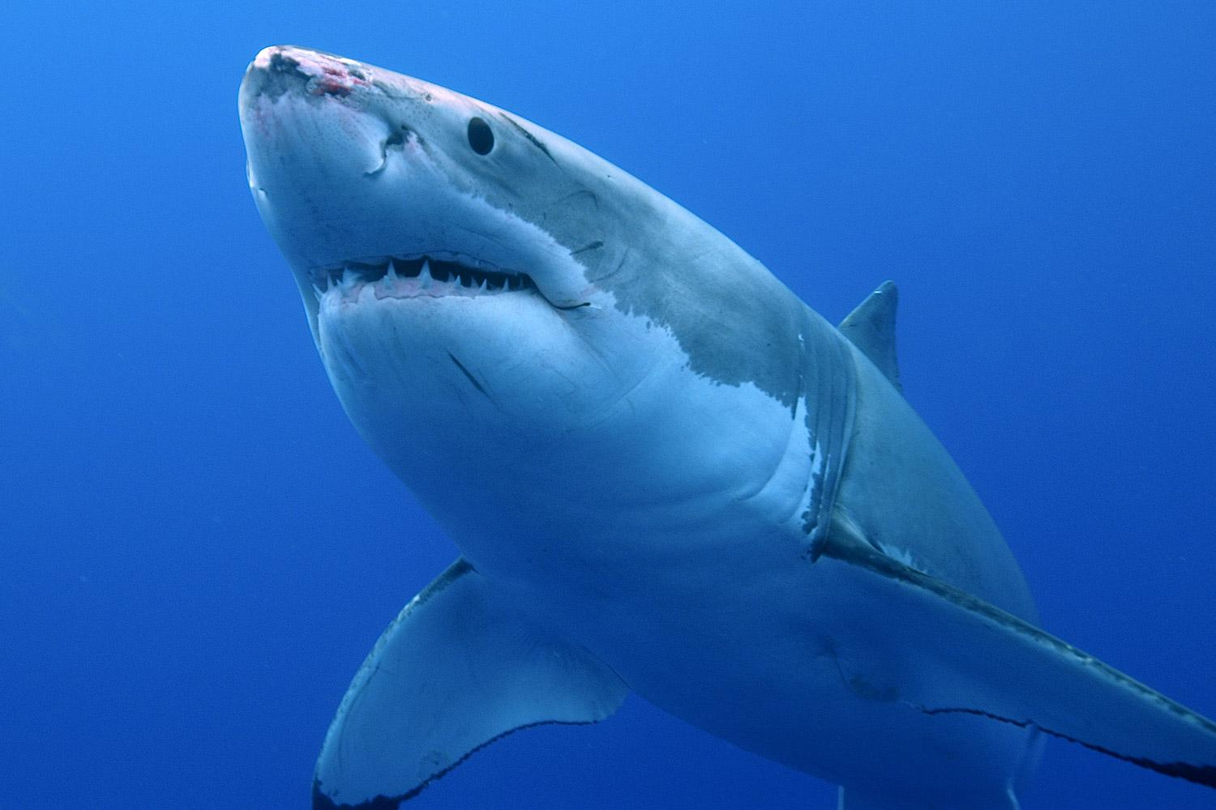
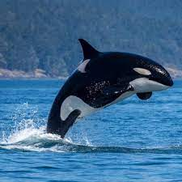
Sea otters predators
One of the primary predators of sea otters are great white sharks. Another big predator is orcas. Orcas have been eating more and more sea otters.
Notes:
1 Background Color
1 Title (or write the question)
1 Pictures
1 Include Transitions
1 Answering question using complete sentences (multiple sentences if needed to fully explain your answer)
1 Accuracy of information

Slide 8
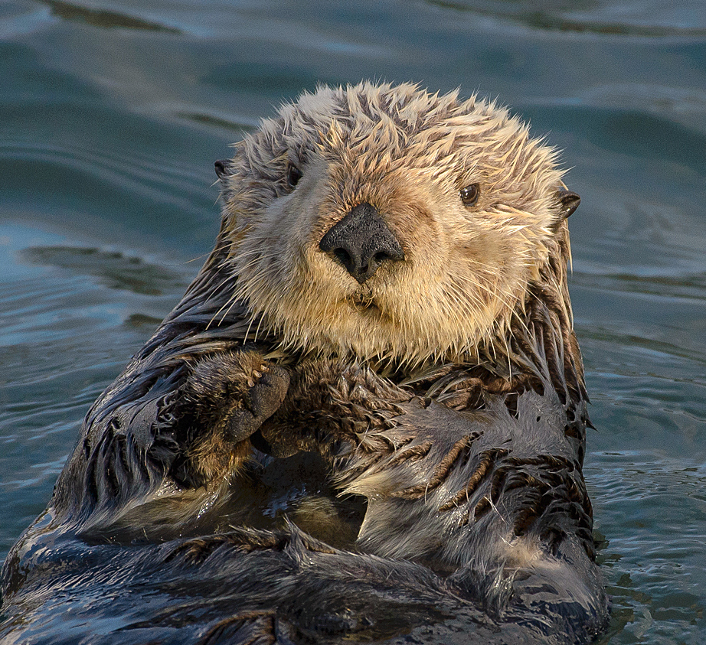

Food chain
Orca
eats
great white shark
Eats
sea otters
eat
crab
eats
mussels
Notes:
1 Background Color
1 Title (or write the question)
1 Pictures
1 Include Transitions
1 Answering question using complete sentences (multiple sentences if needed to fully explain your answer)
1 Accuracy of information

Slide 9
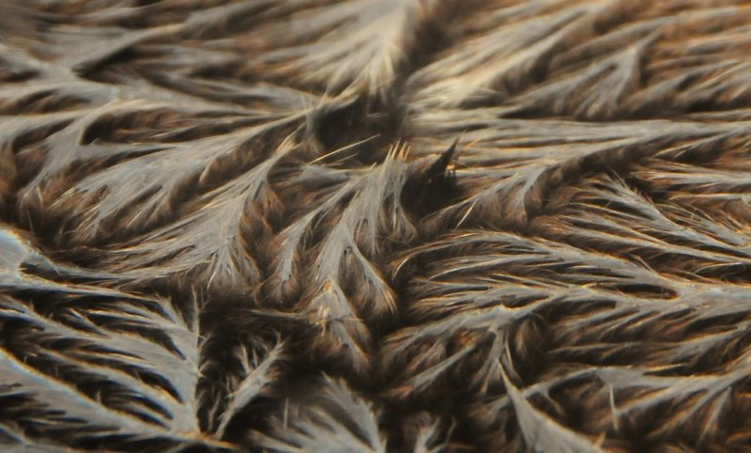
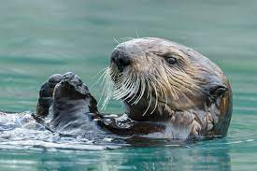
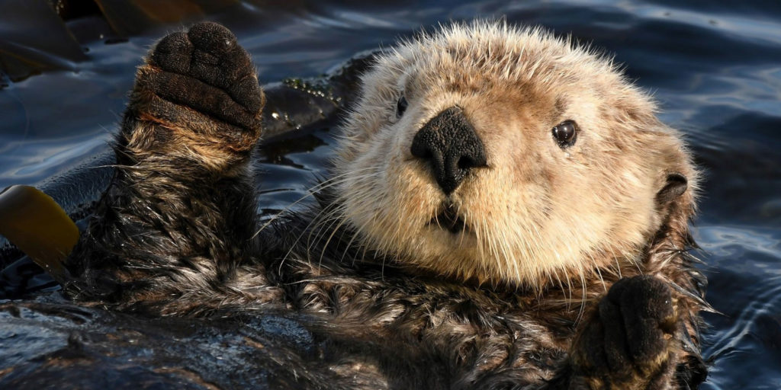
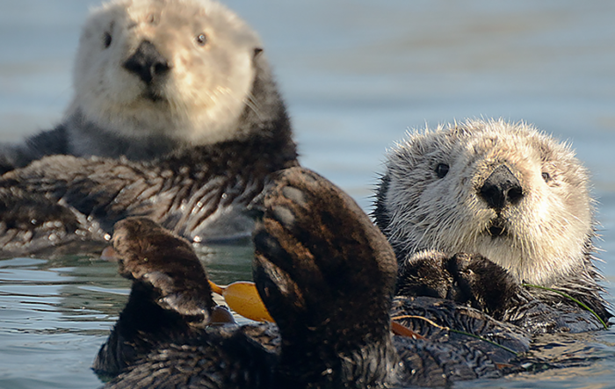
How do they survive?
Thick fur
Sea otters have a very thick fur to keep warmth when they are in the sea. They also have long whisker witch help them detect vibrations in murky waters. Sea otters also have sensitive forepaws, with retractable claws, help them to groom, locate and capture prey underwater, and use tools.
Long whiskers
Sensitive forepaw
Retractable claws
Notes:
1 Background Color
1 Title (or write the question)
1 Pictures
1 Include Transitions
1 Answering question using complete sentences (multiple sentences if needed to fully explain your answer)
1 Accuracy of information

Slide 10

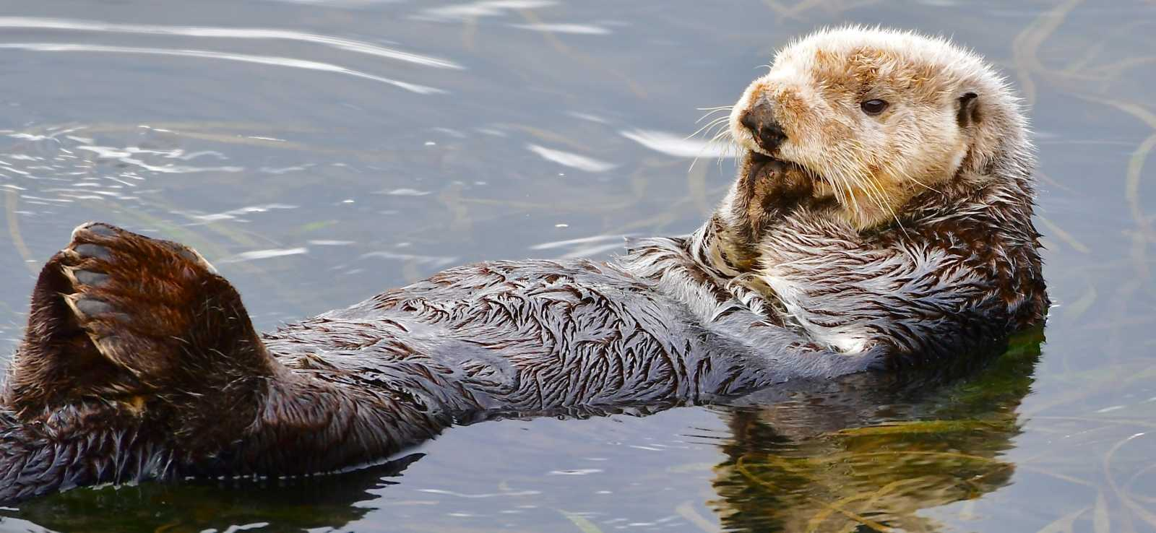
How do they look like?
A sea otter is a medium sized mammal. It has a oval head and the face of a baby bear. The average weight of a sea otter is 49-99 lb for an adult. Or it can also be an average of 31-73 lb for an adult.
Notes:
1 Background Color
1 Title (or write the question)
1 Pictures
1 Include Transitions
1 Answering question using complete sentences (multiple sentences if needed to fully explain your answer)
1 Accuracy of information

Slide 11
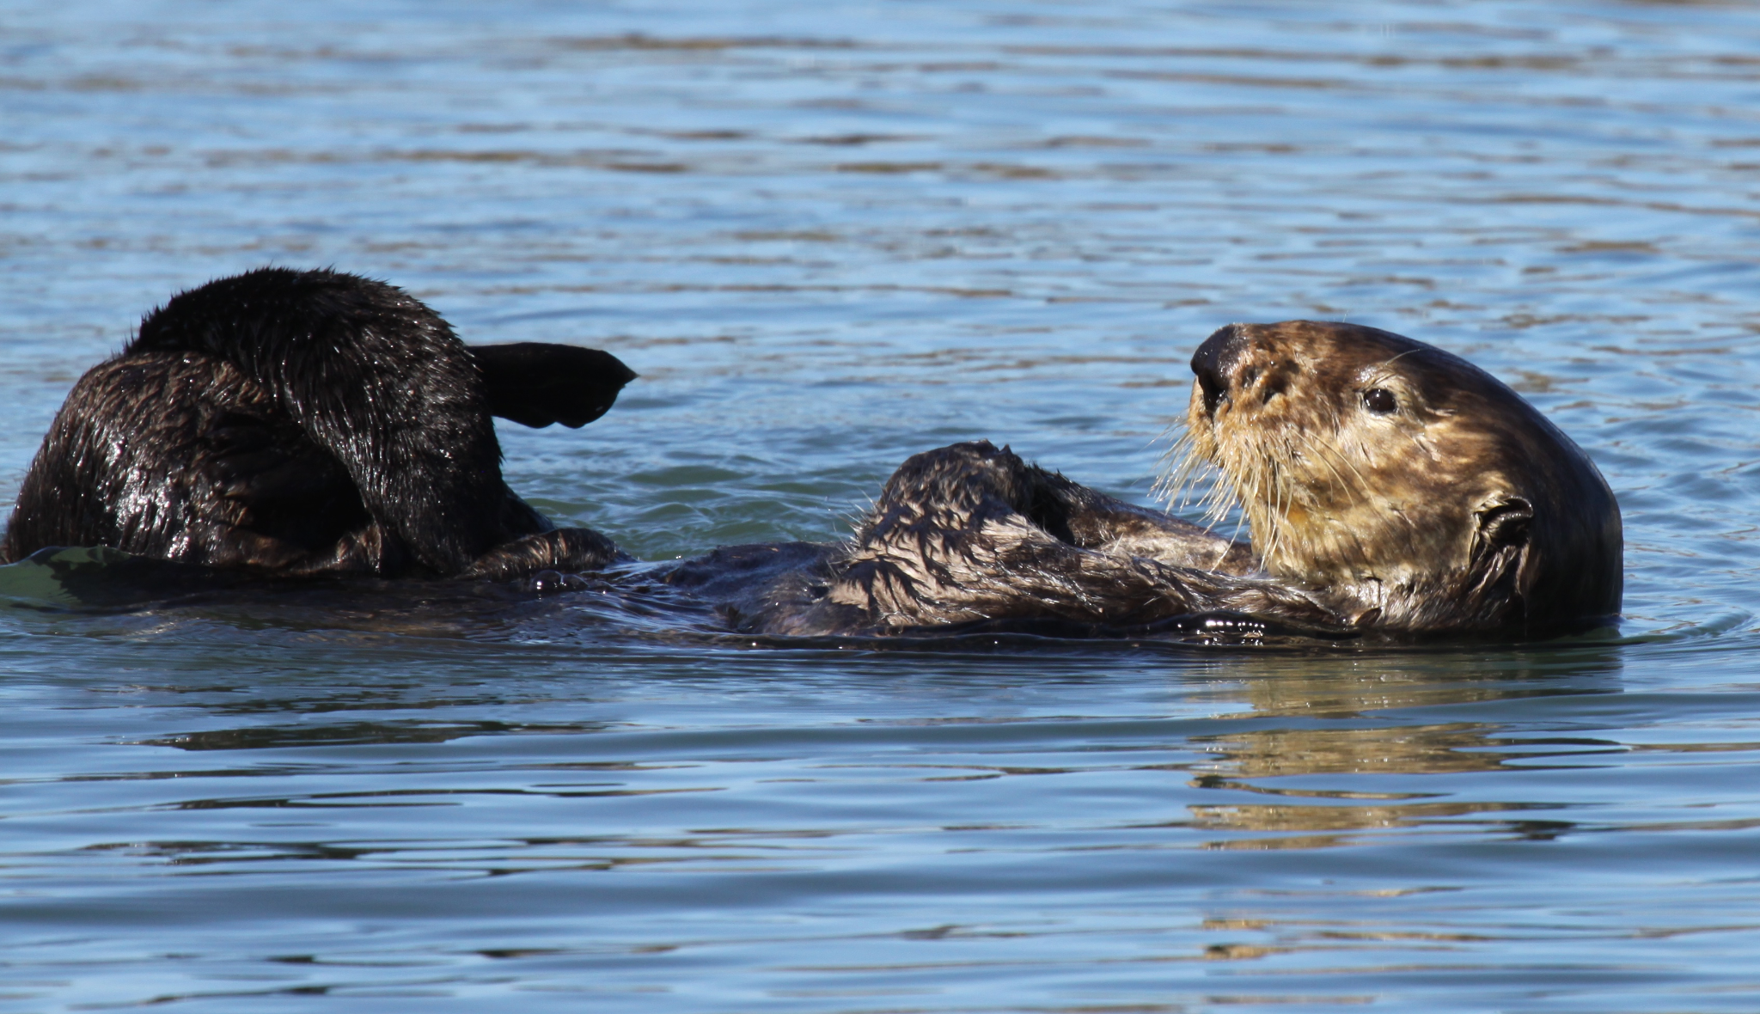
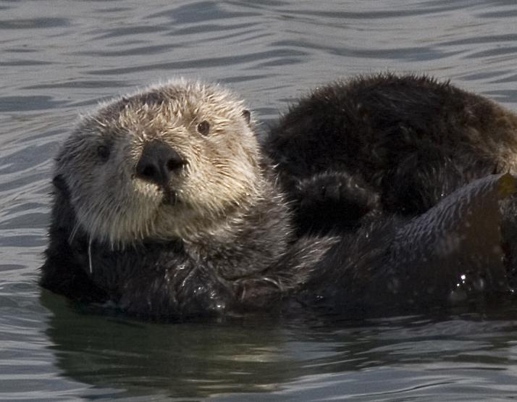
Are males bigger than females?
The average weight of a male is 65 pounds. Female sea otters weight about 50 pounds. The height of a male is 4 feet and 10 inches, and a female can grow up to 4 feet and 5 inches.
Male
Female
Notes:
1 Background Color
1 Title (or write the question)
1 Pictures
1 Include Transitions
1 Answering question using complete sentences (multiple sentences if needed to fully explain your answer)
1 Accuracy of information

Slide 12
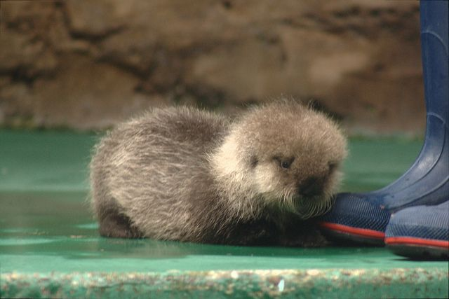
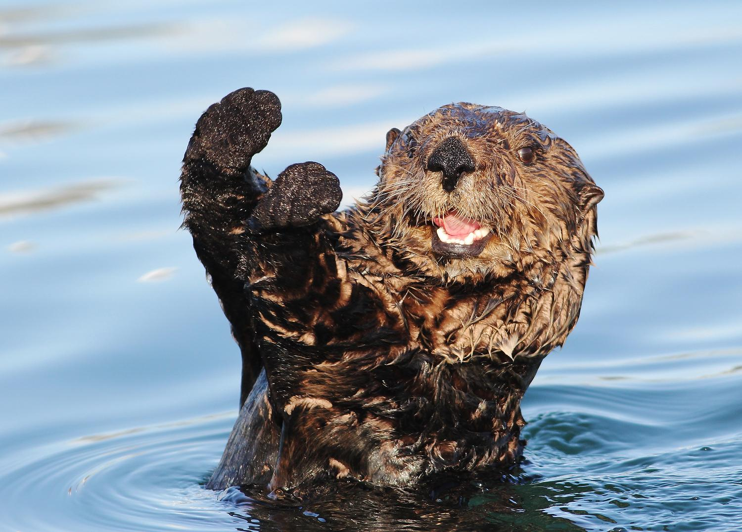
How long do they live?
The lifespan of a sea otter in the wild is 15-20 years. It can also go with 10-15 years in the wild. In captivity sea otters tend to live up to 20-28 years.
Notes:
1 Background Color
1 Title (or write the question)
1 Pictures
1 Include Transitions
1 Answering question using complete sentences (multiple sentences if needed to fully explain your answer)
1 Accuracy of information

Slide 13
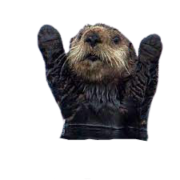
Facts
Currently the southern sea otter population is estimated at just above 3,000 animals
Sea otters spend approximately 9-12 hours foraging each day
Average dive depth for sea otters is about 20 feet, deepest dive recorded is 264
Average dive duration for california sea otters is 60 seconds, longest dive recorded was just under 8 minutes
A group of sea otters resting together is called a raft
There is no pupping season. Pups are born all year long
On average an adult california sea otter consumes 4,000 calories a day
Sea otters are equally active both night and day
Notes:
1 Background Color
1 Title (or write the question)
1 Pictures
1 Include Transitions
0 Answering question using complete sentences (multiple sentences if needed to fully explain your answer) Sentences missing periods.
1 Accuracy of information

Slide 14
Resources
https://defenders.org/wildlife/sea-otter#:~:text=Sea%20otters%20live%20in%20shallow,the%20southern%20sea%20otter%20(E.
https://www.seaotters.com/sea-otter-natural-history/#:~:text=Sea%20otters%20are%20found%20in,of%20food%20and%20kelp%20canopy.
https://www.seaotters.com/sea-otter-facts/#:~:text=Sea%20otter%20fur%20is%20the,weigh%20up%20to%2070%20lbs.
https://defenders.org/sites/default/files/publications/sea_otter_faqs.pdf
https://www.google.com/?safe=active&ssui=on
Notes:
1 Background Color
1 Title (or write the question)
1 Pictures
1 Include Transitions
1 Answering question using complete sentences (multiple sentences if needed to fully explain your answer)
1 Accuracy of information

