Slide 1


Slide 2
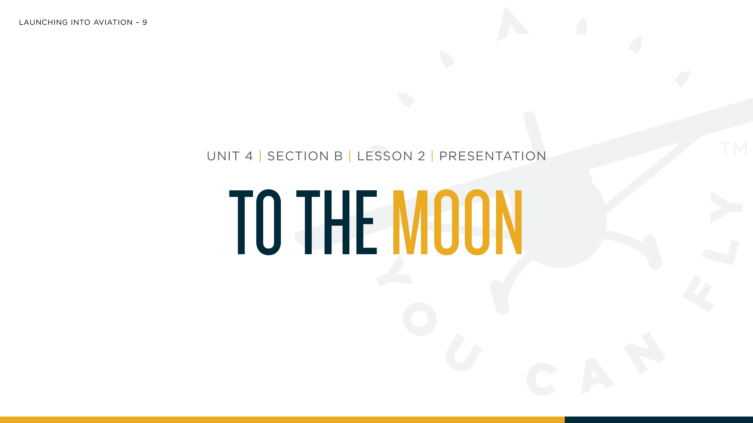

Slide 3
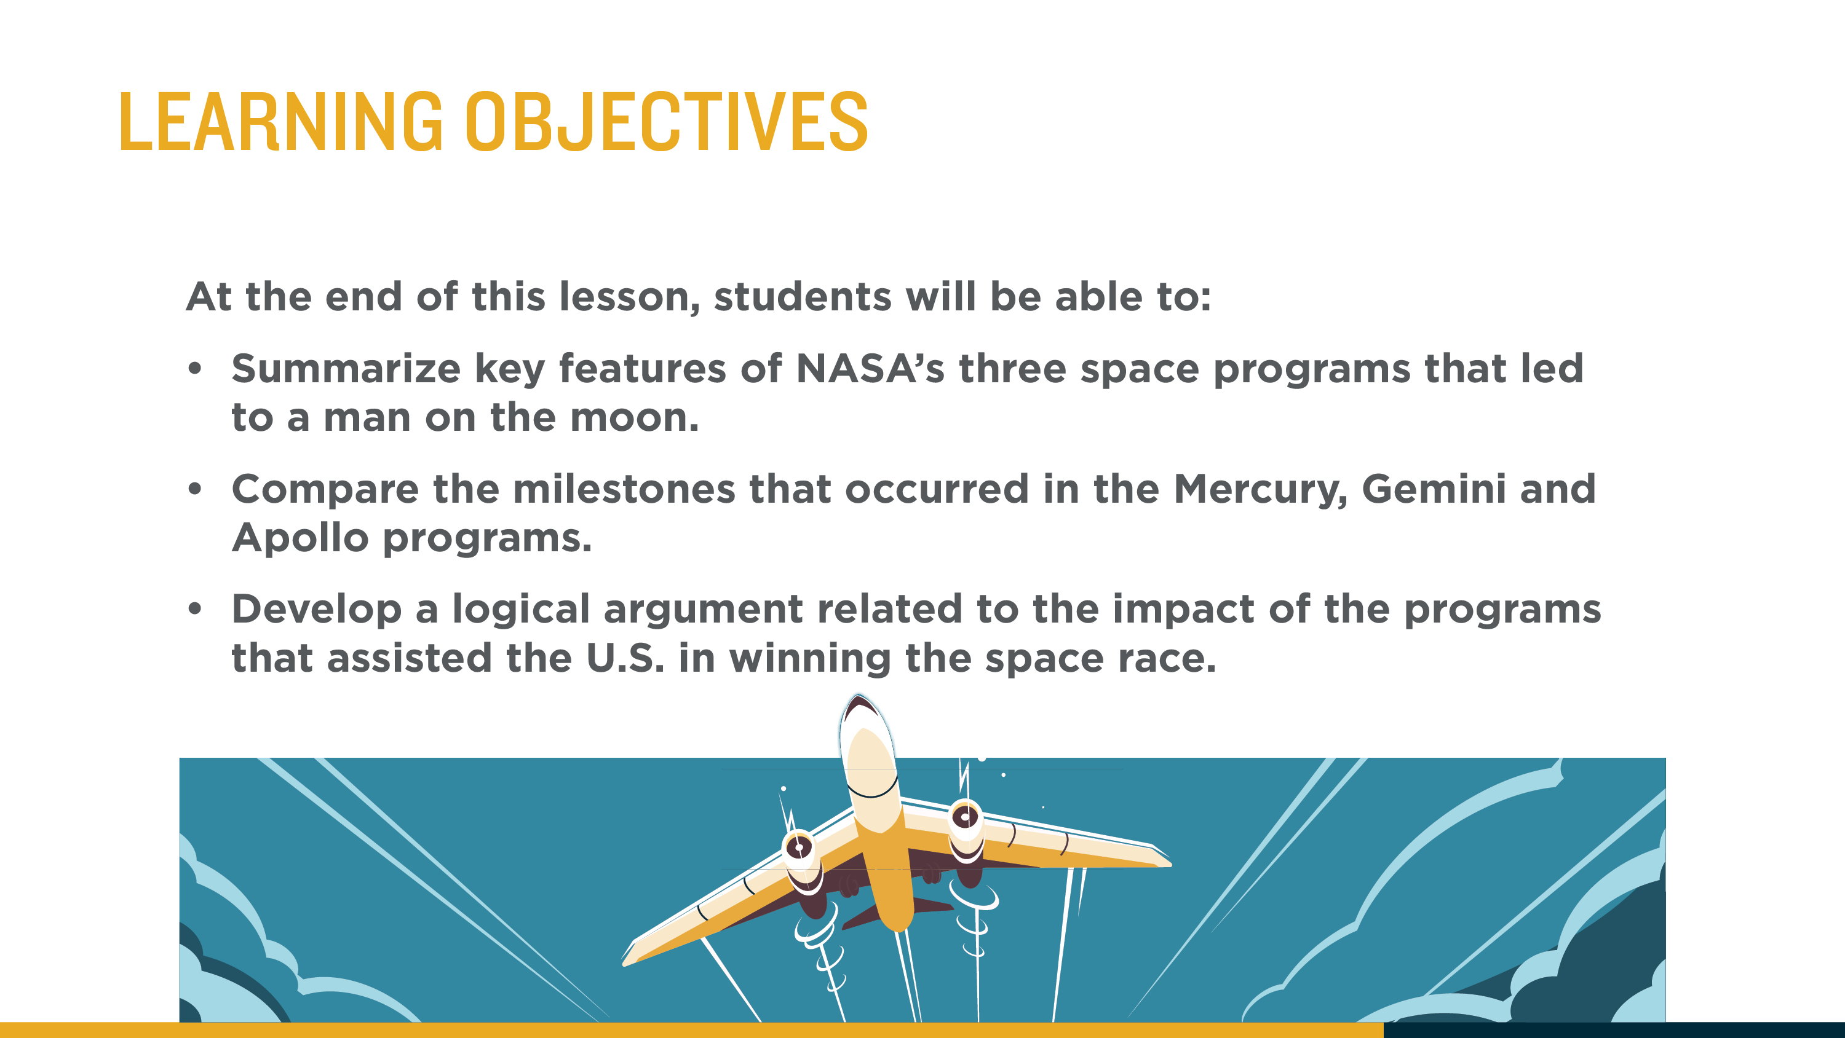

Slide 4
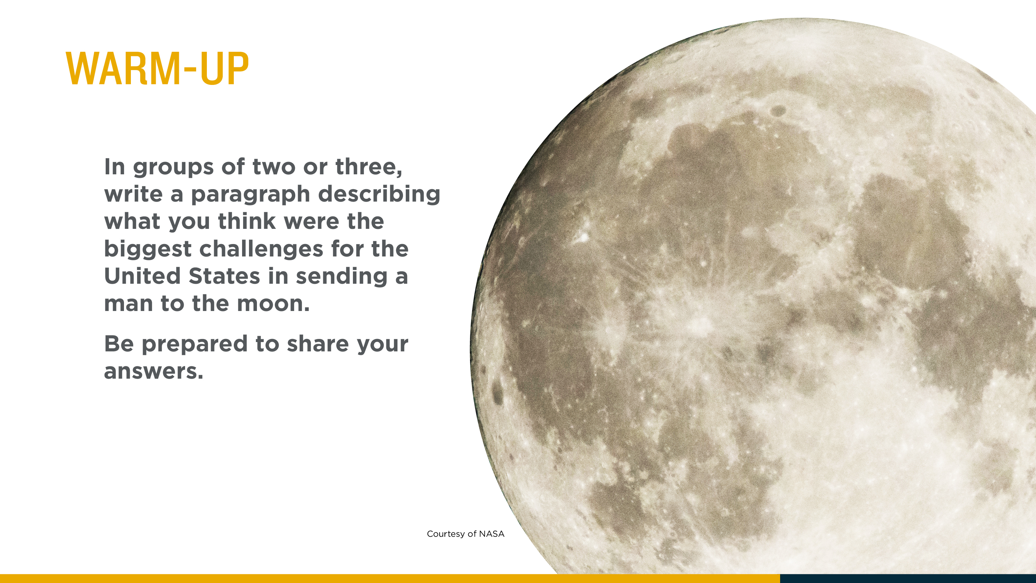
Notes:
Place students into small groups for the warm-up. In small groups, have them write a paragraph describing what they think were the biggest challenges for the United States in sending a man to the moon.
Possible student answers:
Not knowing the effects of space on the human body, creating a recoverable spacecraft, creating a rocket powerful enough rocket to get to space and return, determining how to travel between the orbits and dock spacecraft together.

Slide 5
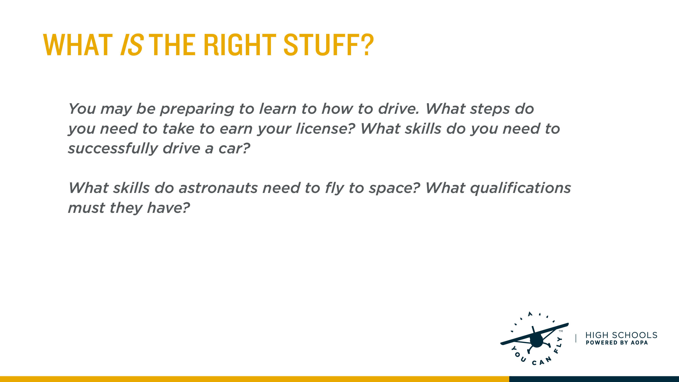
Notes:
During a Think-Pair-Share exercise, ask students to consider what they must do to earn their driver’s licenses and what skills they must possess to drive. Have them write down their answers. Ask students to also hypothesize (research if time allows) what qualifications astronauts must have to go to space. Students should share their answers with a partner, and then the teacher will lead a class discussion.
Many of you may be preparing to learn how to drive. Identify some of the steps you have to take to earn your driver’s license. What skills do you need?
Sample answers may include passing the driving test, written test, proof of citizenship or residency, certain number of hours of classroom instruction, a certain number of hours behind the wheel, some hours at night, vision test, parent permission. Skills will require ability to park, drive at a faster speed, understanding of rules, knowledge of the car’s controls, etc.
When the first Americans became astronauts, they were preparing to fly something unknown to them, unlike learning how to drive a car. What skills do you think they would need? So much was unknown that some training was a little unconventional
These men were skilled military test pilots, very confident and competitive, as well as physically fit to handle the stresses put on the body when going into the unknown of space. They spent a lot of time in a classroom, studying, and training. Astronauts have to have good vision, able to handle an emergency situation, etc.
For further explanation on the topic, you may show an additional video: “Classic NASA Film- Mercury Training”
http://video.link/w/C8Ld (Length 2:47).

Slide 6
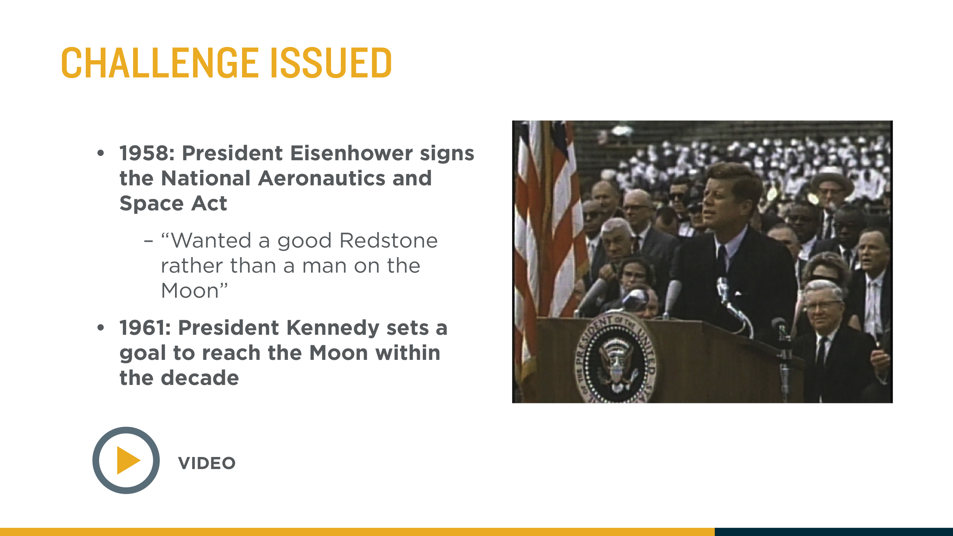
Notes:
President Eisenhower stated that he “would rather have a good Redstone than be able to get to the Moon, for we didn't have any enemies on the Moon.” President Eisenhower was implying that he would rather focus spending funds on protecting the United States here on Earth rather than focus efforts on going to the moon.
The Redstone rocket was America’s first large surface-to-surface missile and Eisenhower was worried about the impending threat of nuclear weapons by the Russians, as well as just ending the Korean War in 1953.
However, in 1961, John F. Kennedy made an announcement that the United States would send a man to the Moon before the end of the decade. This generated a lot of excitement and energy about space exploration.
Show students a video of JFK's speech at Rice University on September 12th, 1962 setting the goal of the space race during the 1960's

Slide 7
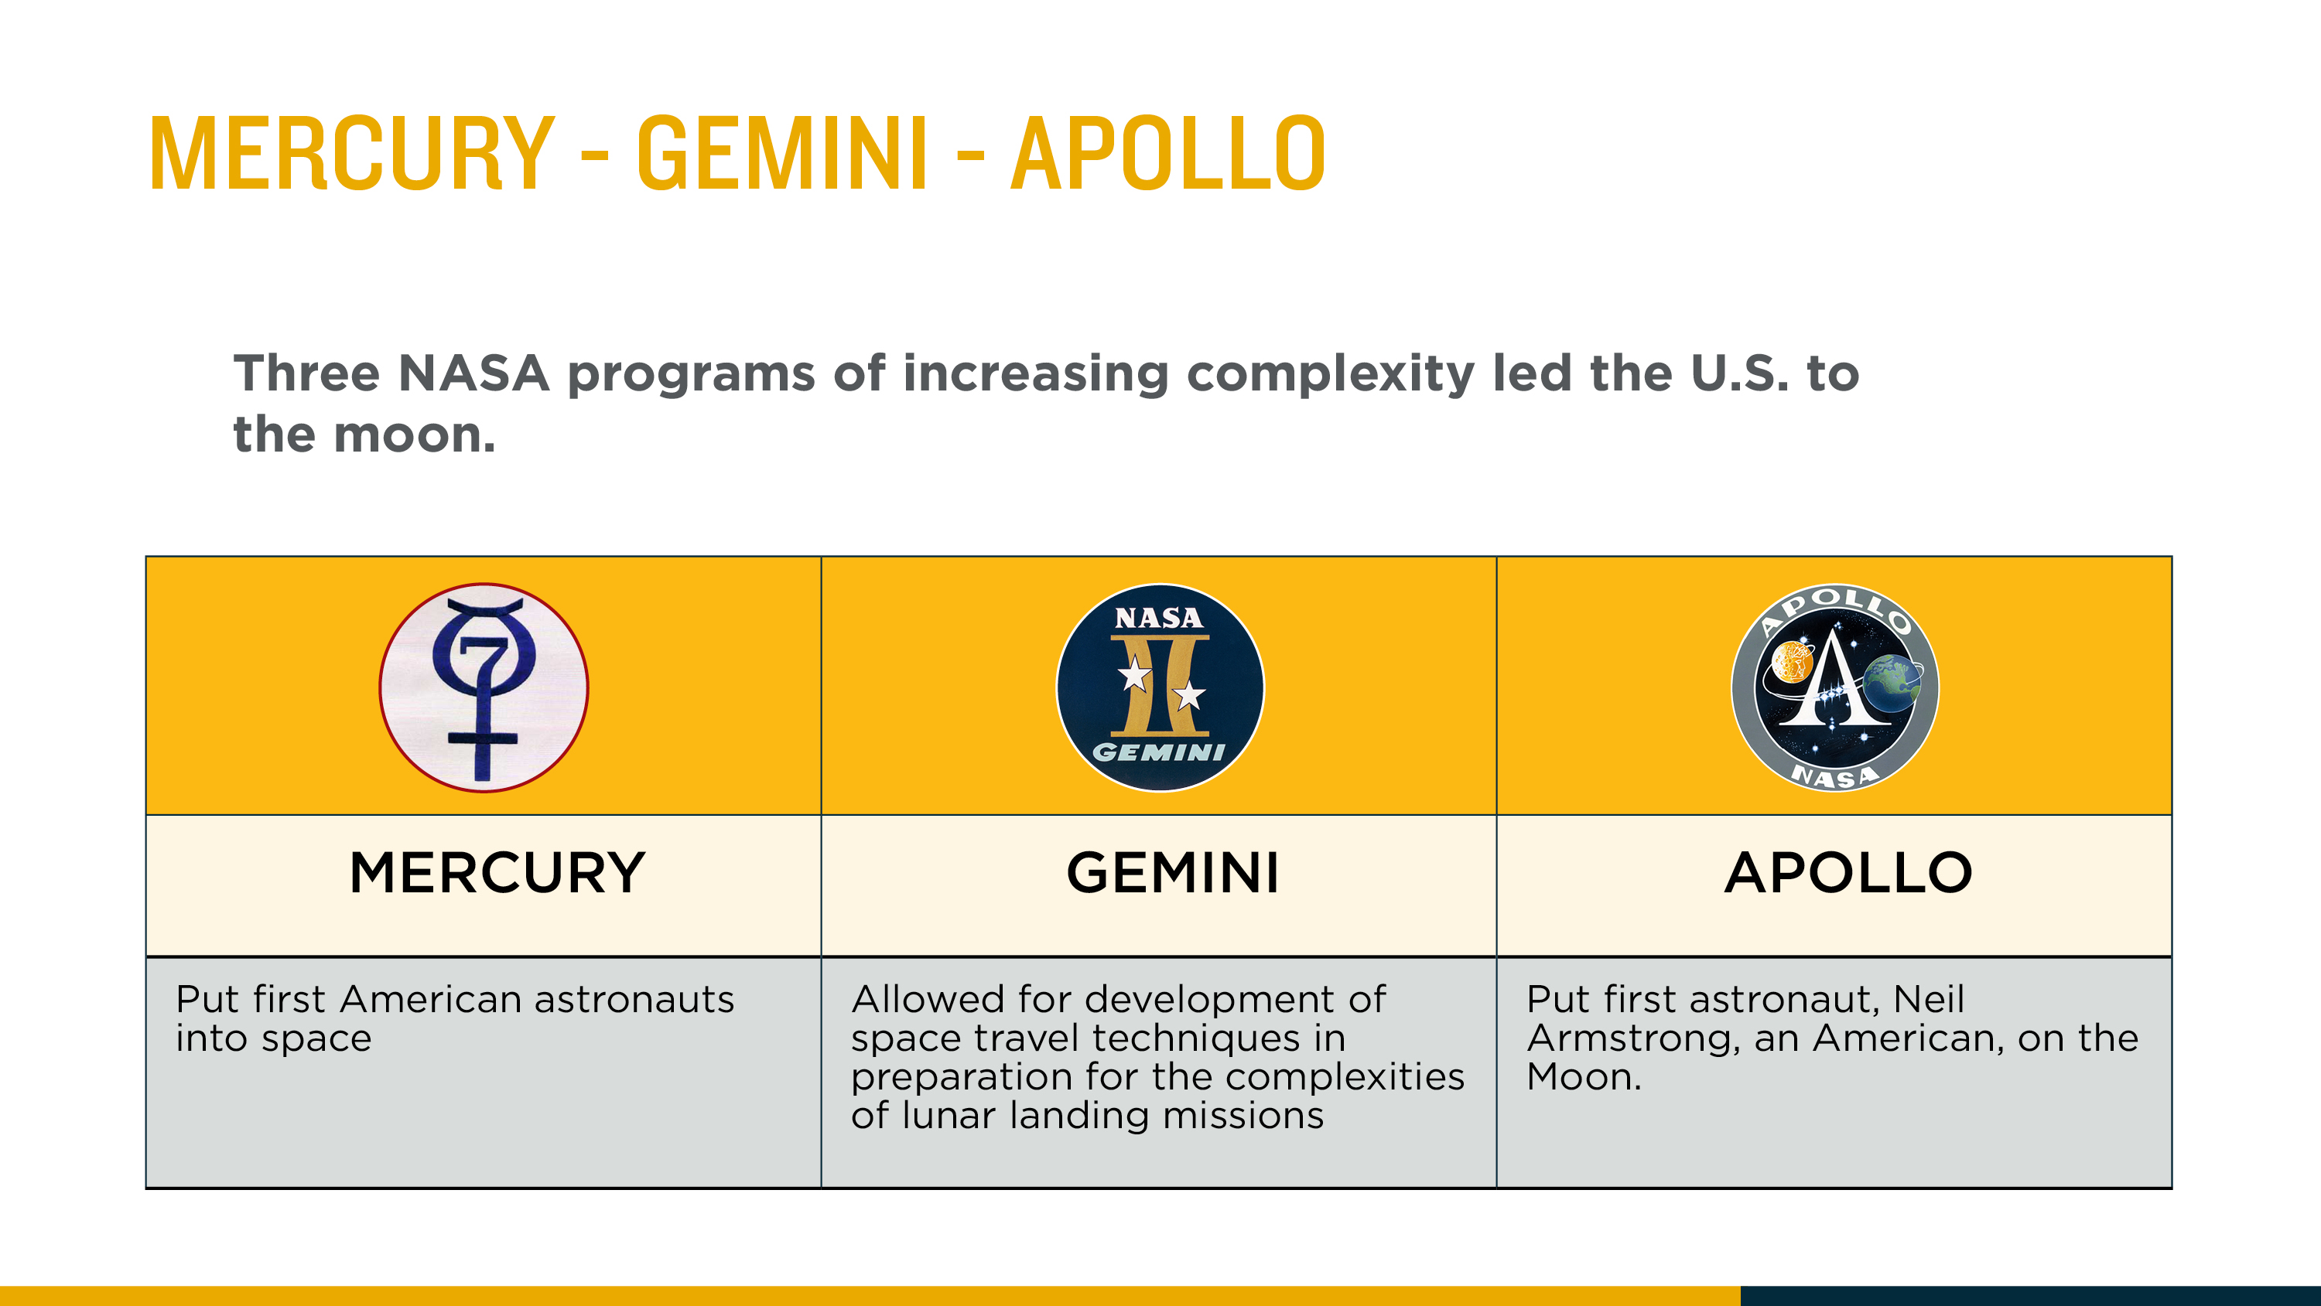
Notes:
Explain to students that three major NASA programs culminated in U.S. winning the space race.
Project Mercury was the first human spaceflight program and put the first U.S. astronaut into orbit. Project Gemini allowed the U.S. to prepare for the techniques that would eventually allow astronauts to land and walk on the moon. These included performing missions outside the spacecraft, space rendezvous and docking and extended duration missions in orbit. Project Apollo landed the first humans on the moon.

Slide 8
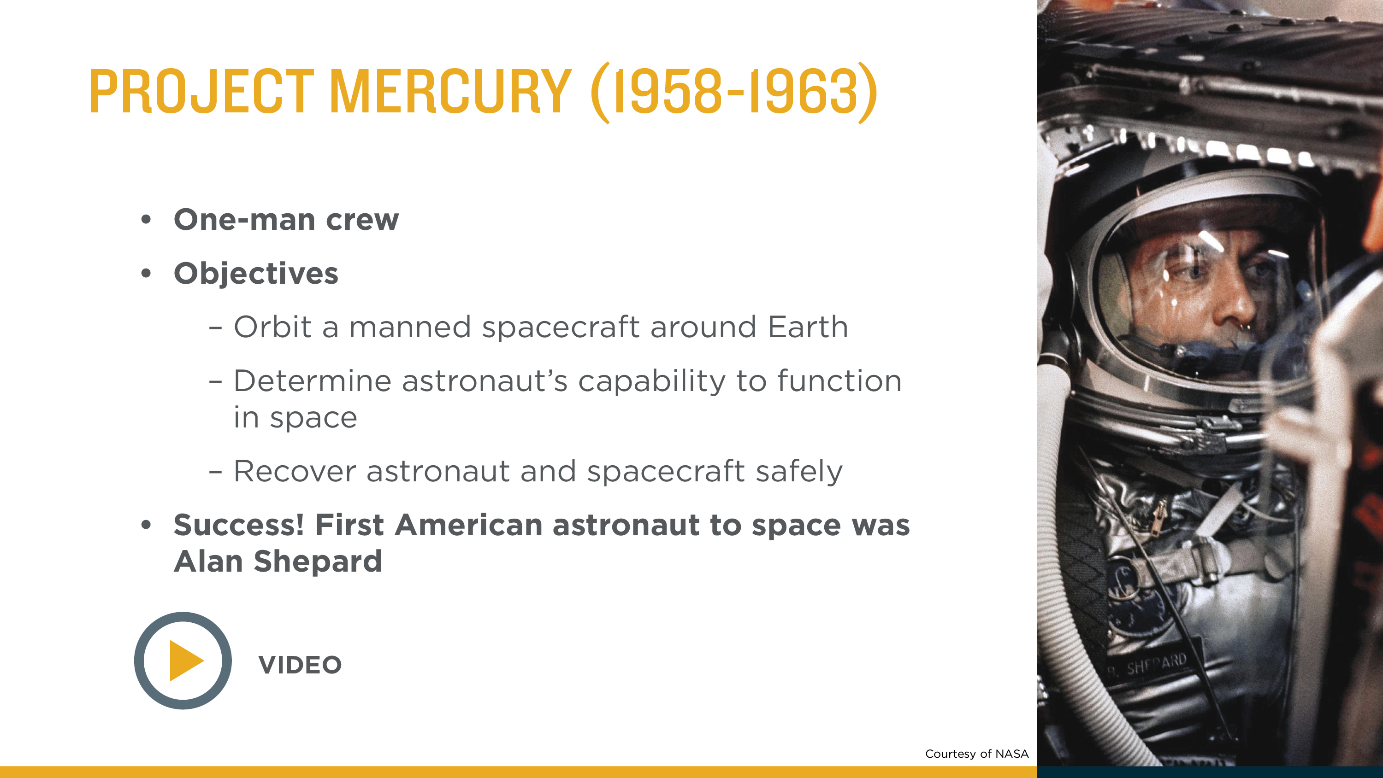
Notes:
The Mercury Project lasted almost five years, the first flight occurring on May 5, 1961 and the last flight occurring on May 15-16, 1963.
Astronauts made a total of six spaceflights during Project Mercury. Two of those flights reached space and came right back down (called suborbital flights.) The other four flights went into orbit and circled Earth.
Alan Shepard made the first Mercury flight. That flight made him the first American in space. The 15-minute flight went into space and came back down.The Project Mercury spacecraft was a capsule, with 100 cubic feet of habitable space, just enough for one astronaut crew. The controls and switches inside the small capsule rivel what one would find inside a modern-day, medium-sized aircraft possessing a combination of switches, fuses, and levers totaling 120 controls. The spacecraft was equipped with environmental control systems, parachute systems, communications equipment, as well as the heat shield that protected the spacecraft upon reentry. One thing that the spacecraft did not have onboard were computers for calculations, relying solely on ground control to transmit the needed calculations.
Show a video of Alan Shepard’s launch into space on Mercury 7.

Slide 9
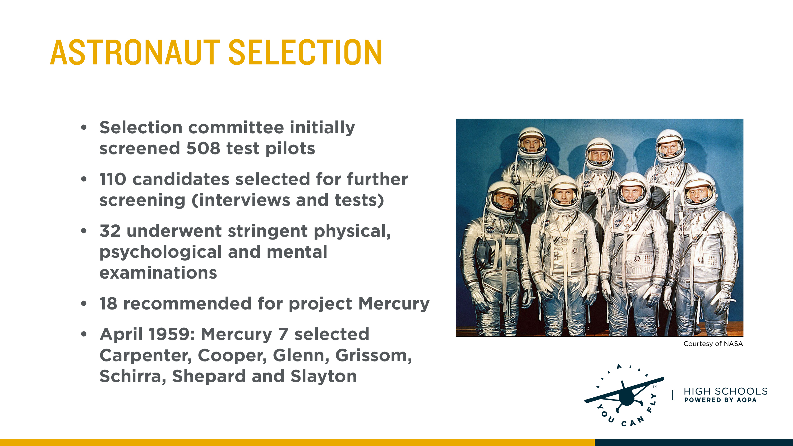
Notes:
The first American astronauts were military test pilots. They went through physical, psychological and mental examinations. On April 9, 1959, NASA announced the Mercury 7 program astronauts to the public at a press conference in Washington, DC.

Slide 10
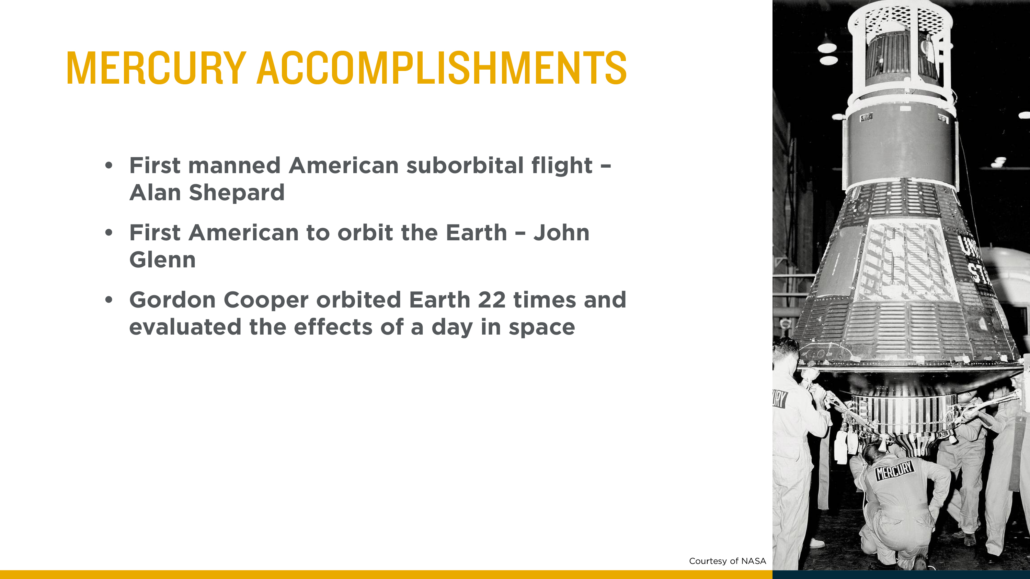
Notes:
The first Mercury spaceflight was a 15 min, 28 sec suborbital flight that put Americans in space and the last flight by Gordon Cooper lasted more than 34 hours to determine what effects one day in space might have on the human body.

Slide 11
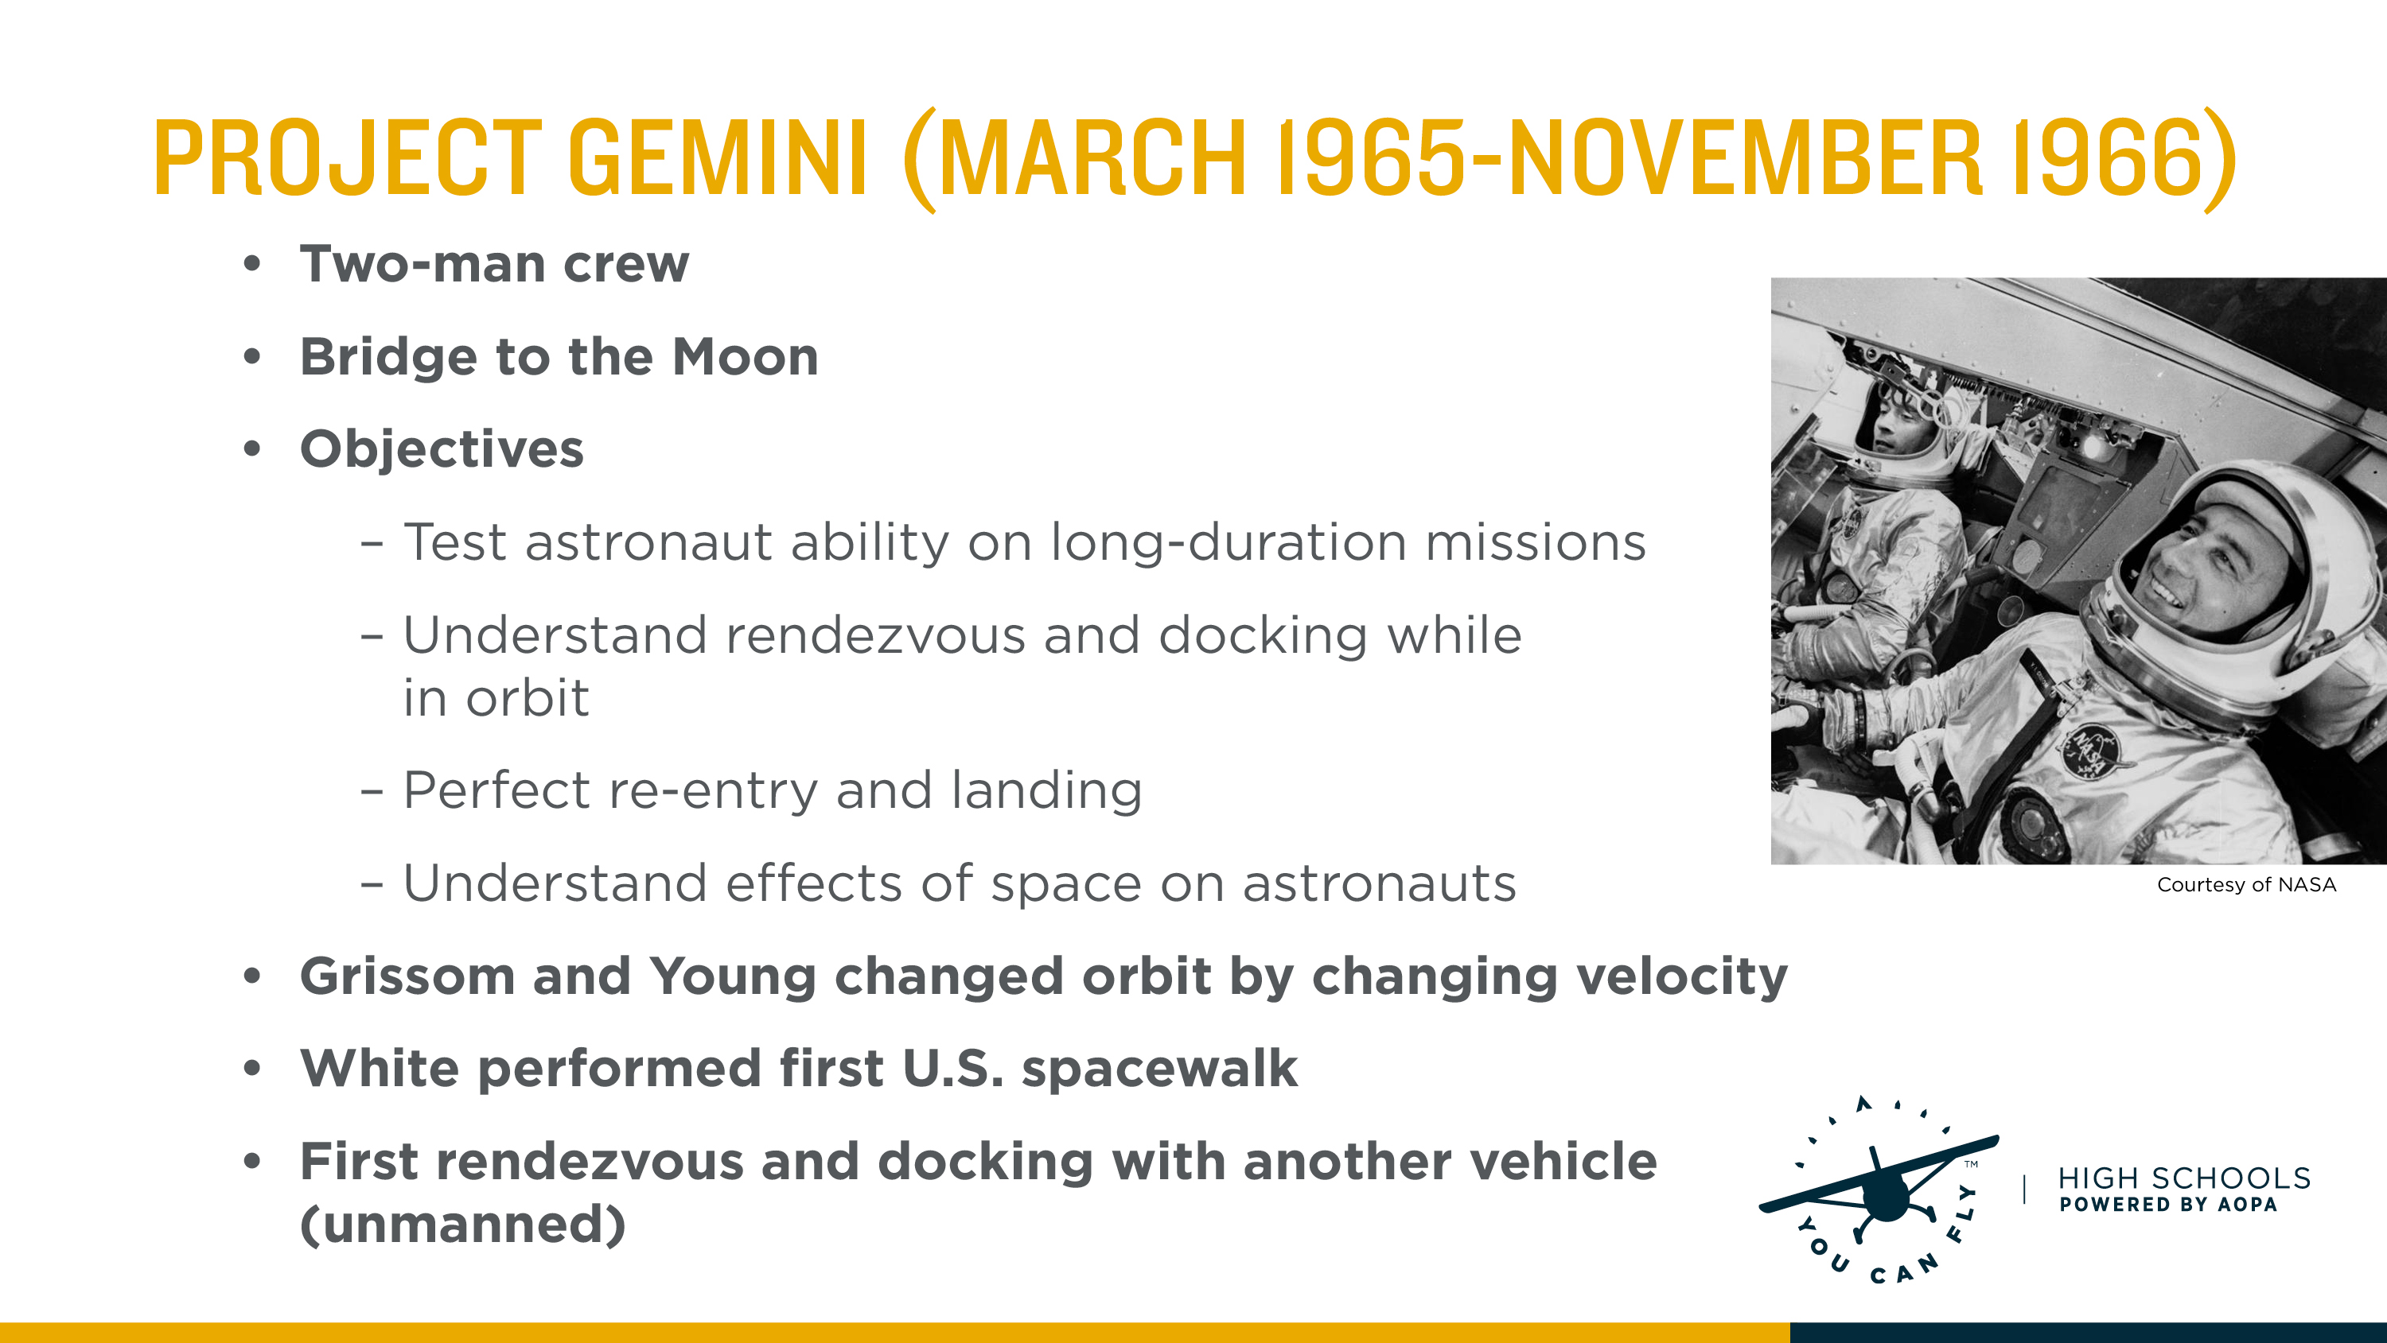
Notes:
The Gemini program helped get astronauts ready for Apollo moon landings. The Gemini capsules were larger than Mercury capsules and could hold two astronauts instead of one. Unlike Mercury capsules, the Gemini capsules could vary which orbit they were flying in by adjusting their speed.
Gemini was used to prepare for trips to the moon by testing the effects of long-duration spaceflights on the human body. The program also completed the first successful spacewalks (extra-vehicular activity) and docked with other spacecraft.
Astronaut Ed White became the first American astronaut to venture outside of a spacecraft on Gemini 4. The first American spacecraft, Gemini 8, docked on March 16, 1966, with an unmanned spacecraft.
The Gemini module differed in that many of the components that were integrated into the Mercury capsule were, for the Gemini program, were contained in the adapter module. The Gemini module also contained computers, contrary to the Mercury module.

Slide 12
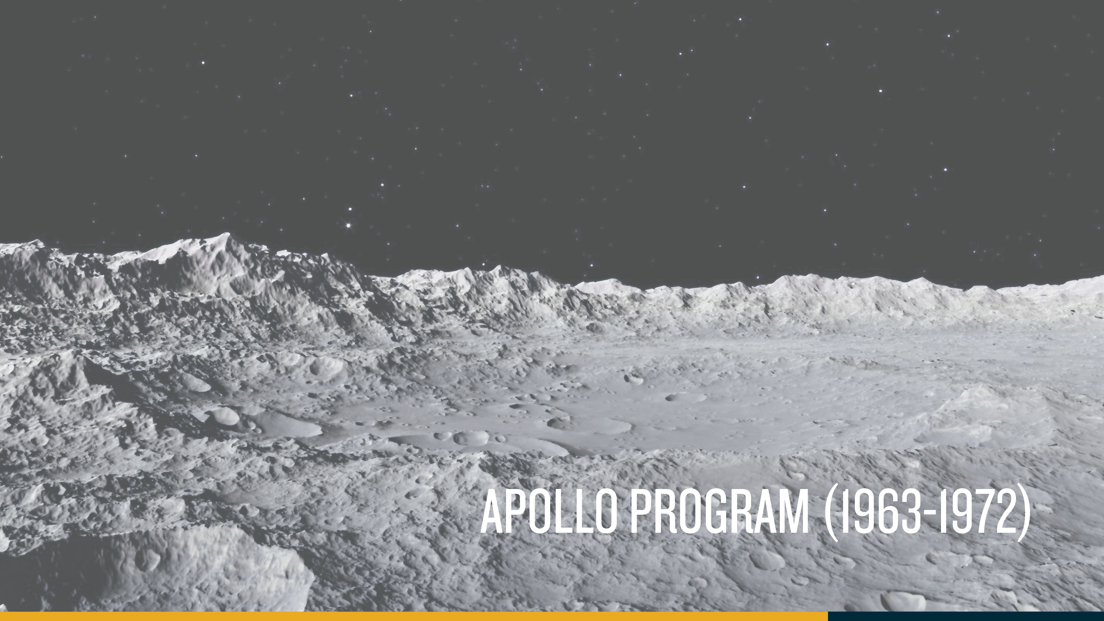

Slide 13
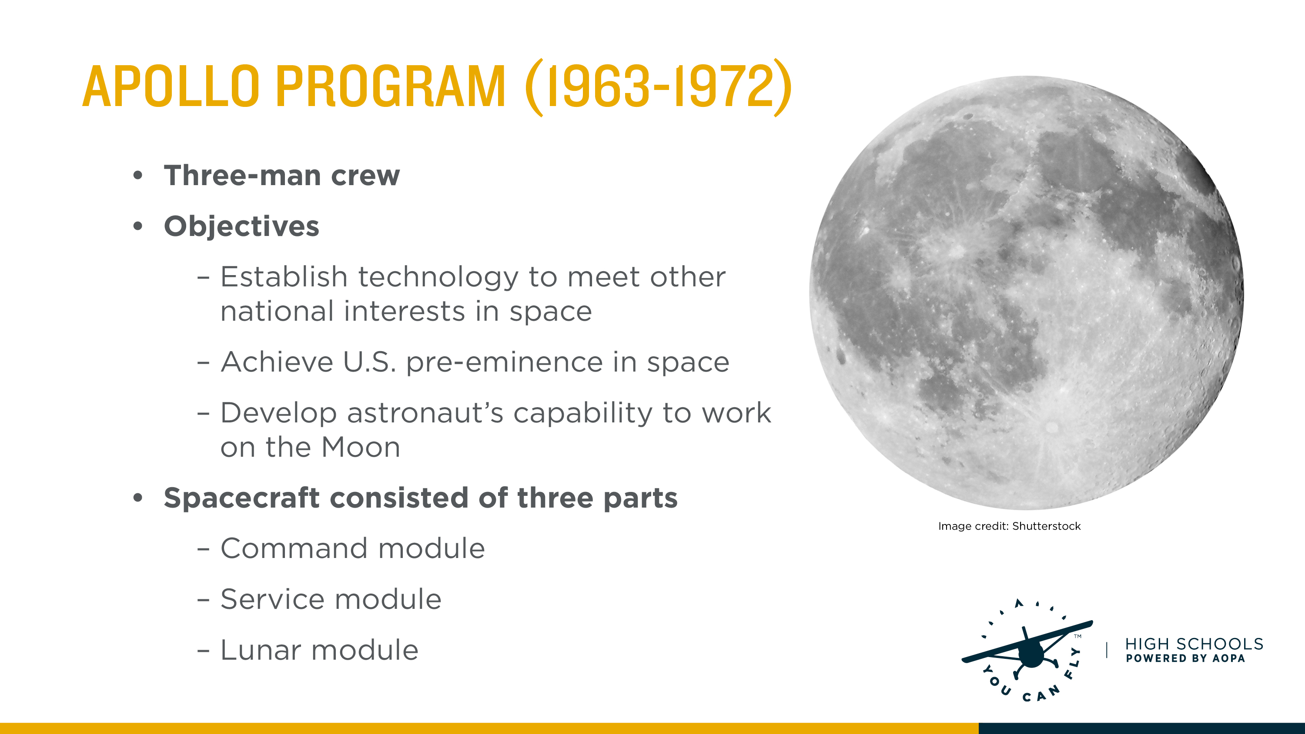
Notes:
Now that NASA was one step closer to the moon by its accomplishments in Mercury and Gemini, it was ready for the next step.
Apollo was a three-part spacecraft-command module (crew quarters and flight control), service module (propulsion), and the lunar module (take crew to the lunar surface and return them).
The spacecraft used for the Apollo program was of a modular design, to accommodate the mission of landing on the moon. The command/service module was a two part system, the command module with similar shape and design to previous capsules, was this time large enough to carry three astronauts into space, and return them back home safely. The support module was was cylindrical and housed the extended life support systems, communications equipments, as well as an orbital instrument package, the support module also included a engine.
The second half to the modular system was the Lunar module, designed specifically to land astronauts on the moon, and then launch them off once again. The system, never needing to fly within earth’s atmosphere was designed with little aerodynamic consideration in regards to shape as well as construction materials.

Slide 14
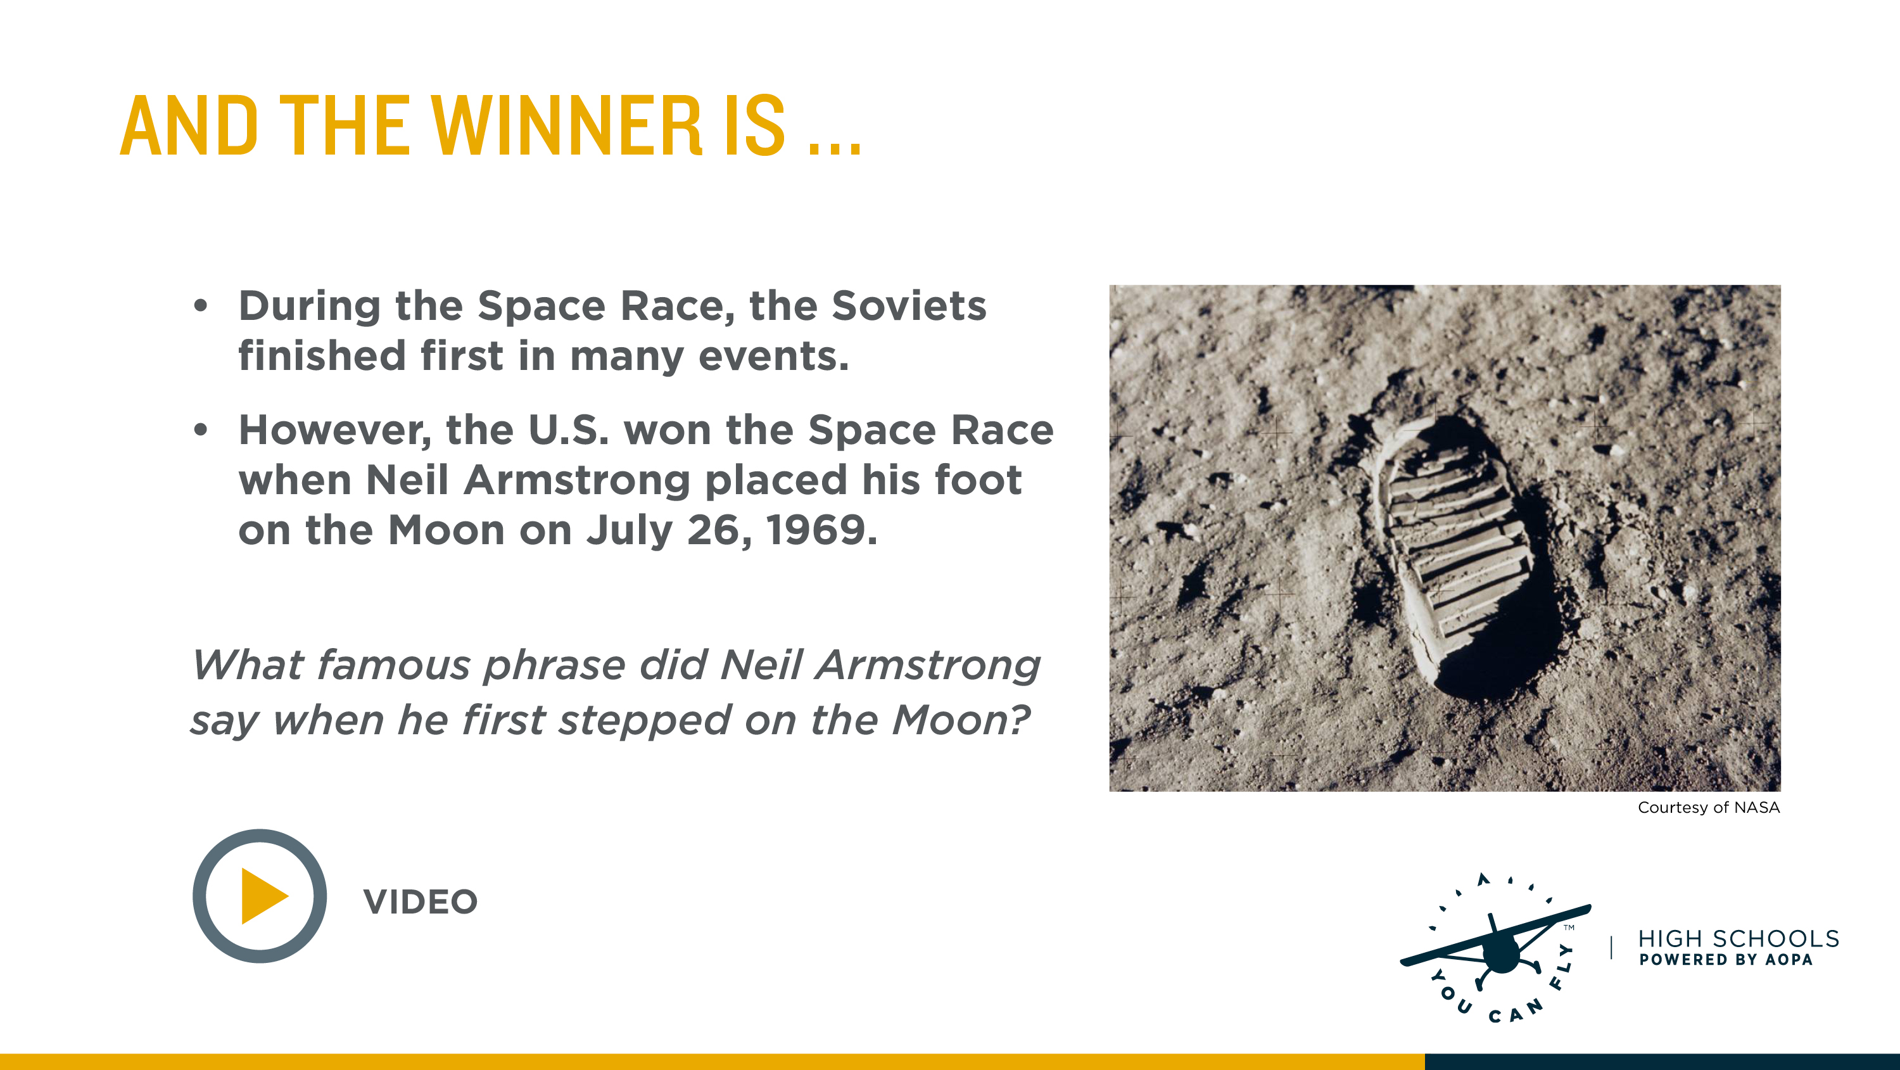
Notes:
In thinking about the space race, the Russians were first in many areas-first man in space (first to orbit the Earth, first woman in space, first man to complete a spacewalk, etc.) However, the United States claimed to have won the space race by being the first to put a man on the moon.
Ask students if they know what famous phrase Neil Armstrong said when he first stepped on the moon. A video replays the phrase.
“Watch Neil Armstrong's first steps on the moon” (Length 00:26)
https://video.link/w/kGiKb

Slide 15
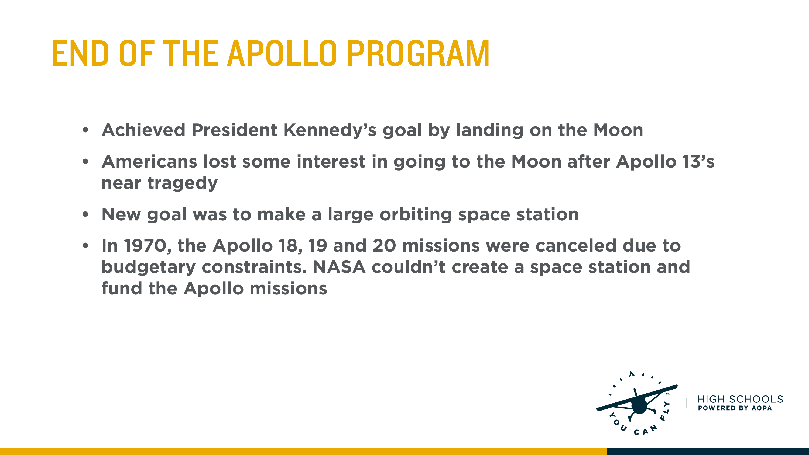
Notes:
After Neil Armstrong walked on the moon and the Apollo 13 near-tragedy, Americans lost interest in going to the moon. The United States settled for a more conservative space program, using leftover rockets. The tensions between the Soviet Union and the United States had reduced.

Slide 16
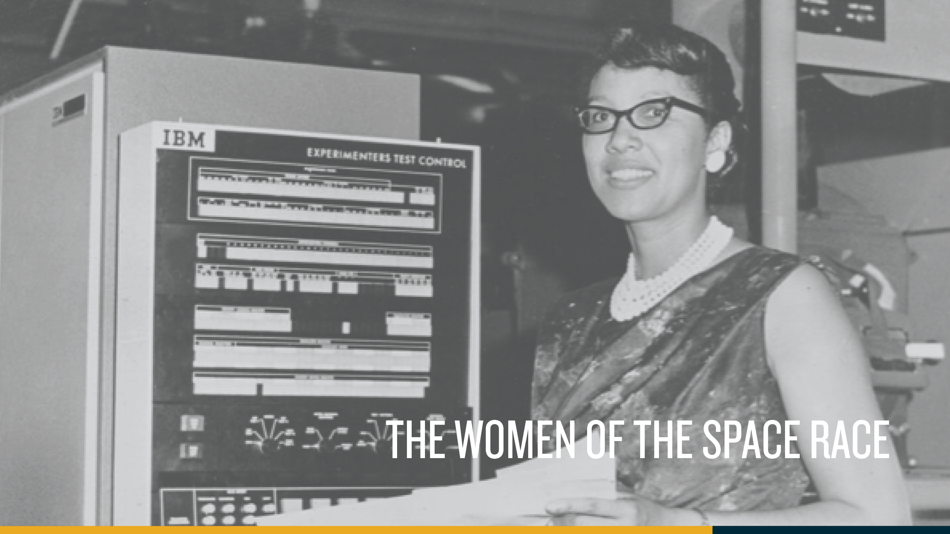
Notes:
Explain to students that space exploration involves many people who have different yet important tasks. All of them are needed to support each mission.

Slide 17
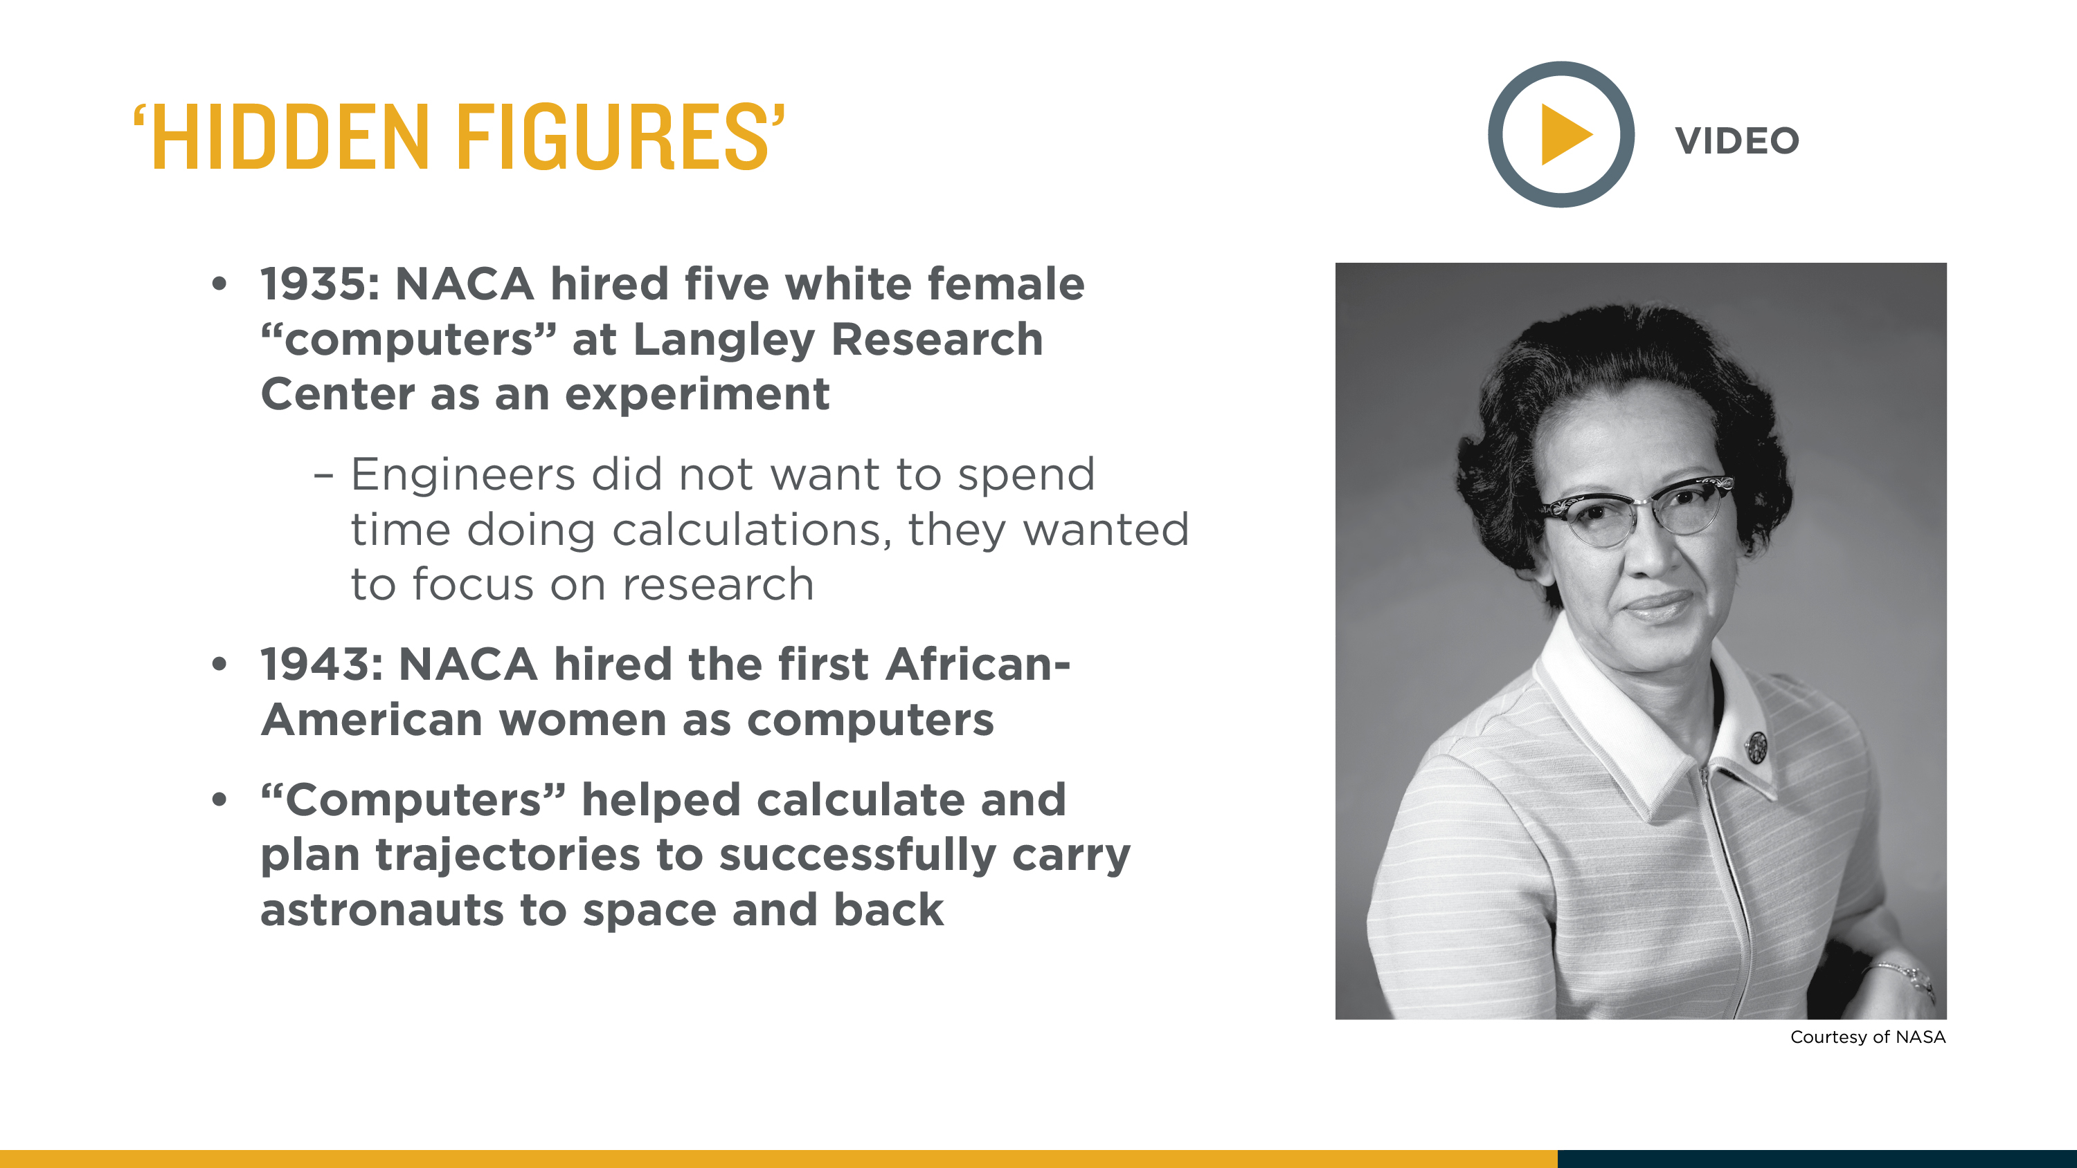
Notes:
Explain that at the beginning of the Space Race, NACA (the precursor to NASA) engineers didn’t have calculators or computers to do math problems. Their research was slowed because they spent so much time doing calculations. In 1935, NACA hired five white women to serve as “computers” to complete calculations quickly. In the 1940s, NACA bought its first computer and it took up a huge room. These computers were slow and unreliable. NACA found the women to be more accurate, efficient, and didn’t complain. They paid them less – cheap labor for a better job done.
In 1943, NACA hired the first African American women “computers.” These women all had college degrees in mathematics and flourished although they faced racism and sexism.
Show the video about Katherine Johnson, who was highlighted in the full-length feature film Hidden Figures.

Slide 18
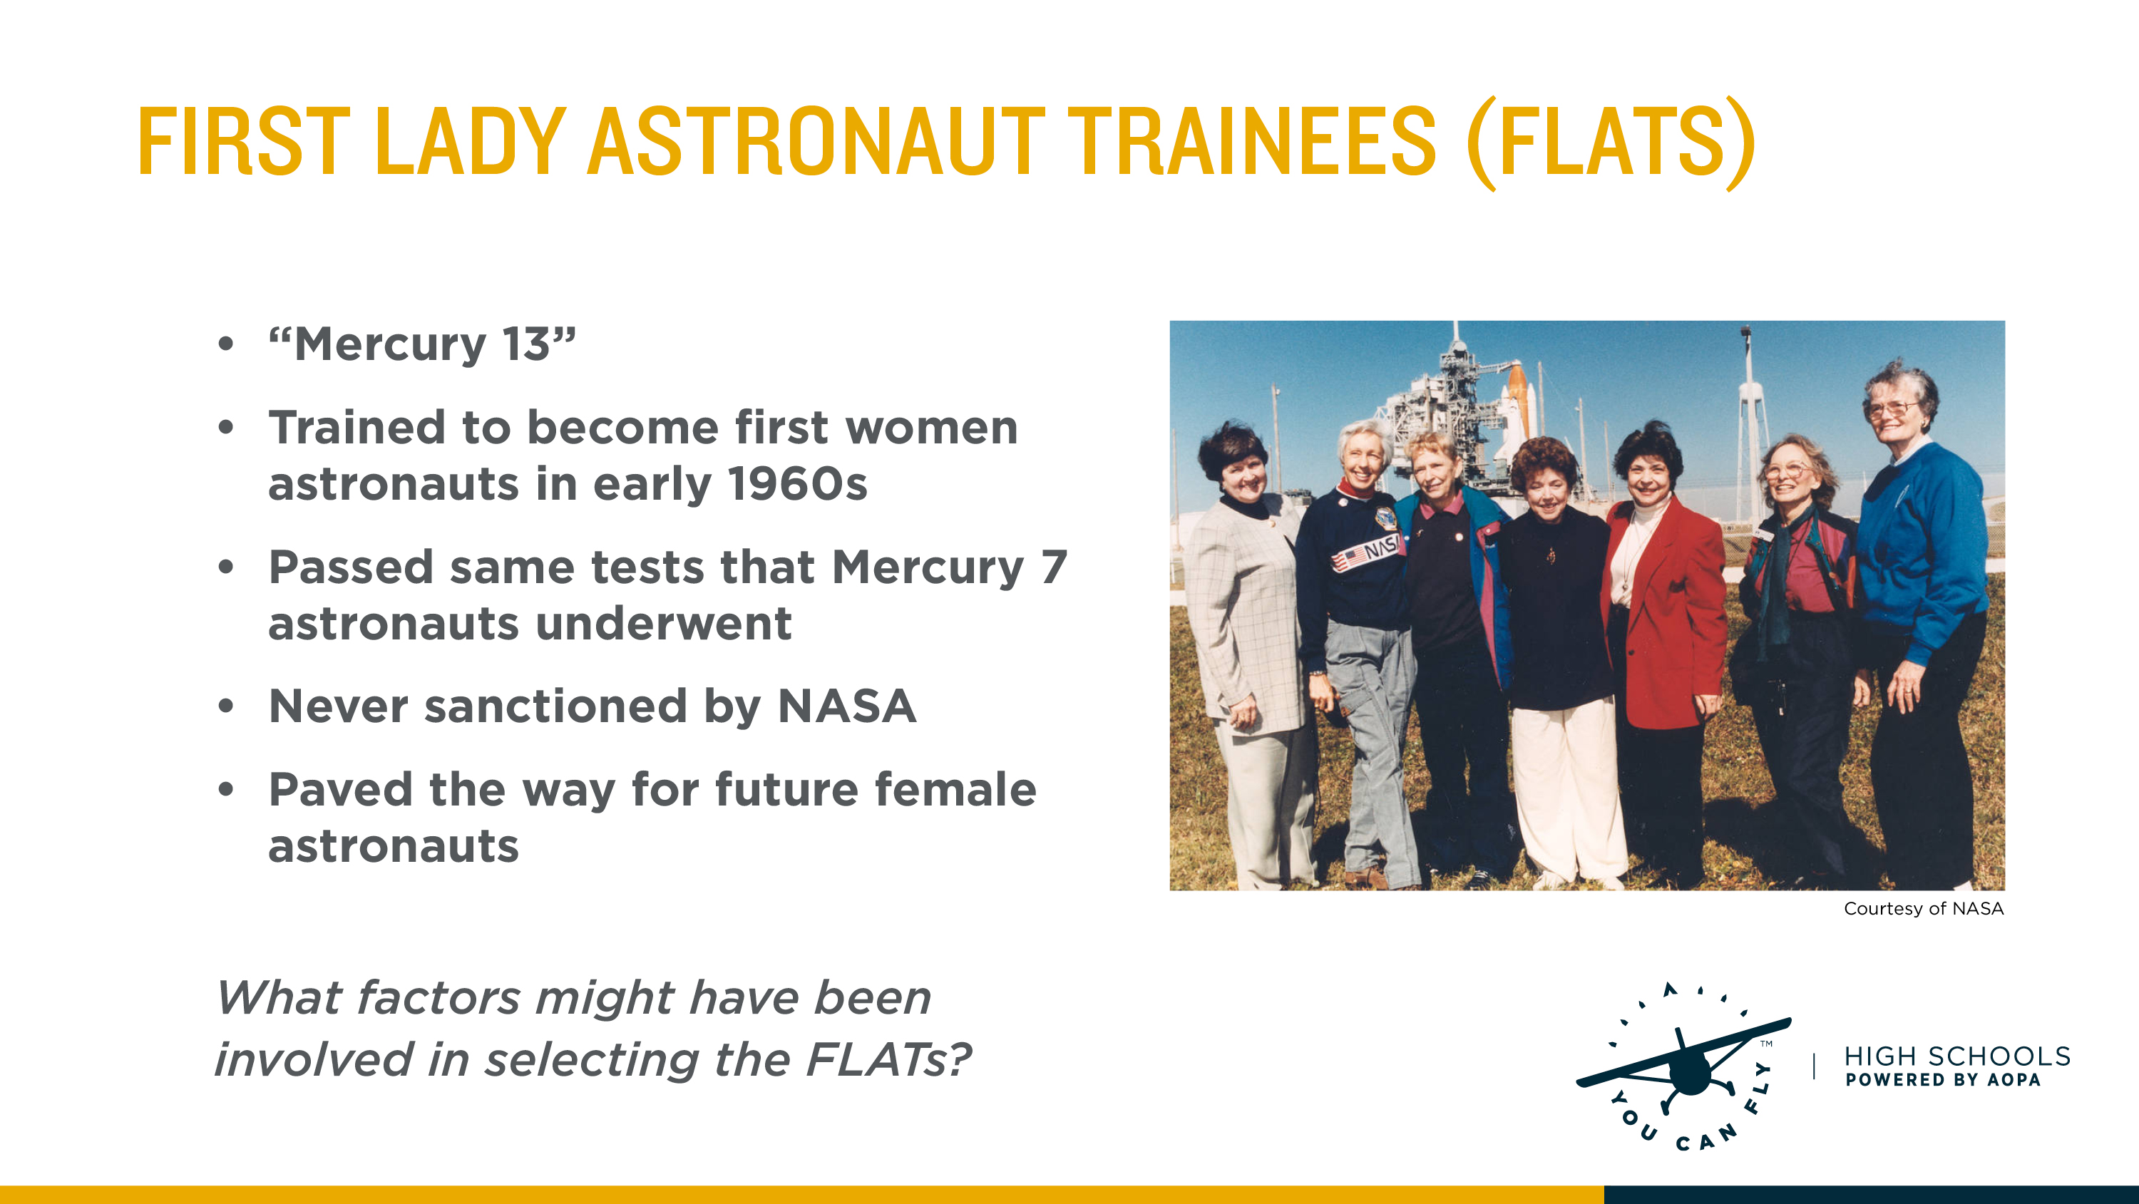
Notes:
Dr. William Lovelace, a researcher who was a contractor for NASA, helped develop the tests for the Mercury 7 astronauts and wondered how women would do if taking the same tests. He asked Jerrie Cobb, an experienced pilot, to participate and she passed all three phases of testing. This encouraged Dr. Lovelace to test more women, and eventually, 13 more women passed the same tests. They never flew in space, although one of the women, Wally Funk, is planning to take a flight to space via Virgin Galactic. These women were referred to as the First Lady Astronaut Trainees (FLATs). Another name for these women was the Mercury 13.
Ask students what factors might have been involved in selecting the FLAT candidates. Although the women were pilots and had thousands of flight hours, (they were recruited through the 99’s, an all female pilot association started by Amelia Earhart), women were not allowed to fly in the military in the 1960’s so were not “qualified” to be astronauts according to NASA’s eligibility requirements at the time.

Slide 19
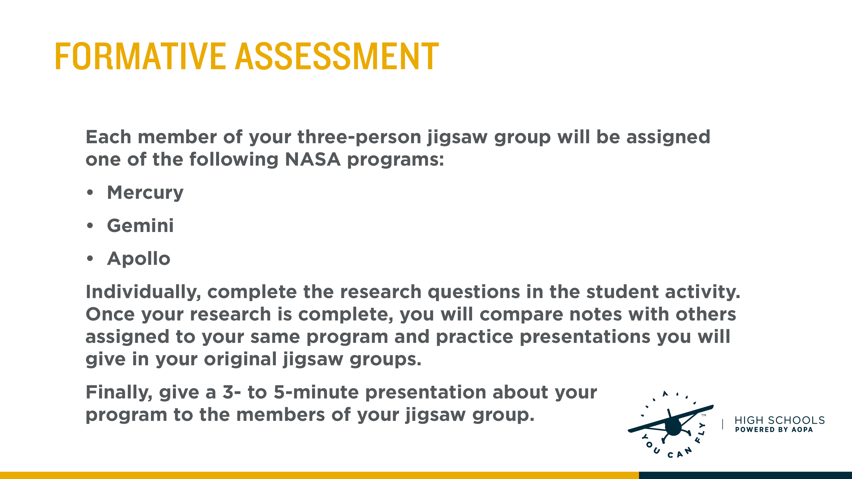
Notes:
During the second session of the lesson, divide students into groups of three for a jigsaw exercise. Provide students with To The Moon Student Activity. Next, assign each student within the jigsaw groups one of the three NASA programs: Mercury, Gemini or Apollo. On an individual basis, have the students do research and complete the provided activity sheet for their assigned NASA prgoram.
Once the students finish their activity sheets, have all the students assigned to the same NASA program get together to compare notes, resolve differences in their answers, and practice the presentations they will give when they reassemble into the original jigsaw groups.
To complete the jigsaw exercise, students will gather in their original jigsaw groups and make a 3- to 5-minute presentation on their assigned program. Each student should take notes during their classmates’ presentations. Inform students they will use these notes to create a class timeline during the next session.

Slide 20
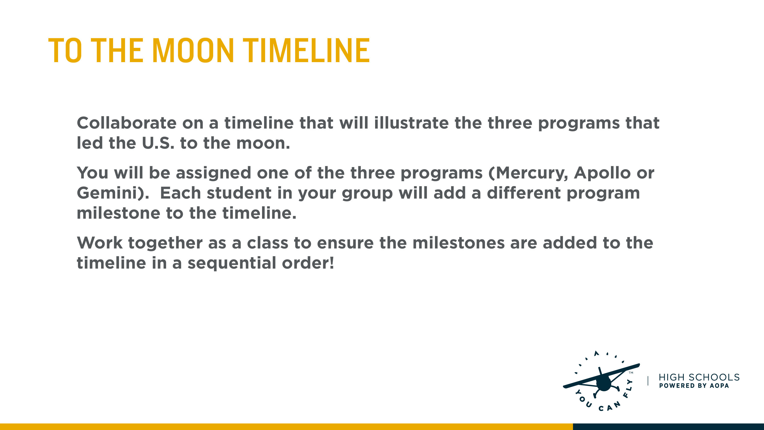
Notes:
During the first session of the third lesson, have students collaborate on a class timeline that will illustrate the three programs that led to the U.S. being the first on the moon. The timeline can be drawn on newspaper roll, poster board or on a whiteboard.
Divide students into three groups and assign each group one of the programs: Mercury, Gemini or Apollo.
Each student will add a different program milestone to the timeline. Ensure that students add the milestones in a sequential order.

Slide 21
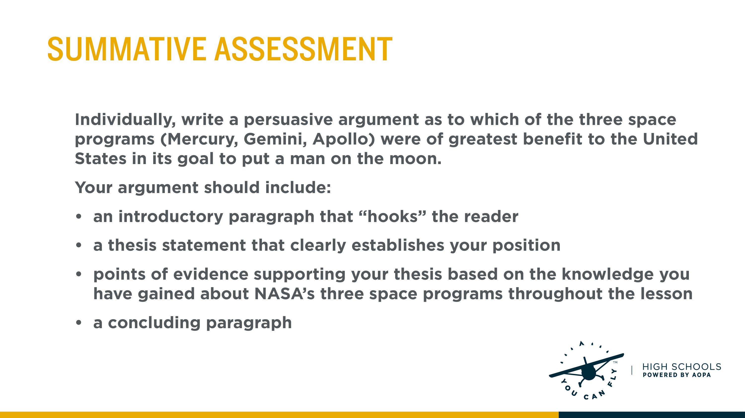
Notes:
Individually, students will write a persuasive argument as to which of the three space programs were of greatest benefit to the United States in its goal to put a man on the moon. Their argument should include an introductory paragraph that “hooks” the reader, it should make a thesis statement that clearly establishes the writer’s position, the body should include points of evidence supporting their thesis based off the knowledge they have gained about NASA’s three space programs throughout the lesson, and an a concluding paragraph.

