Slide 1
Apollo
By: Phoenix and Noah

Slide 2
Important Dates During the Apollo Missions
October 11, 1968
First manned Apollo flight mission launched
July 20, 1969
Apollo 11 lands on the Moon
April 17, 1970
Apollo 13 lands safely on Earth after a malfunction

Slide 3
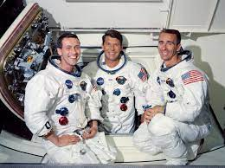
Apollo 7, First Manned Flight to Space
Apollo 7 was the first manned flight to space, the aircraft orbiting the Earth. The main reason for this was to demonstrate the Command and Service Module, crew, the launch vehicle, mission support facilities, and to demonstrate the CSM rendezvous capability. There were also medical experiments planned along with photographic experiments.
The crew had bad head colds because of the zero-gravity environment.
The Crew

Slide 4
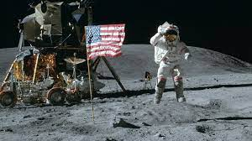
Apollo 11, Moon Landing
Apollo 11 was the first landing on the Moon, causing America to win the space race. It was also when the first man walked on the Moon. The point of the lunar landing was to win the space race, and to collect samples of the Moon’s surface and perform experiments
The Lunar Module

Slide 5
Apollo 13, The Successful Failure

