Slide 1
Project Mercury
Created by Cassidy Reyes

Slide 2

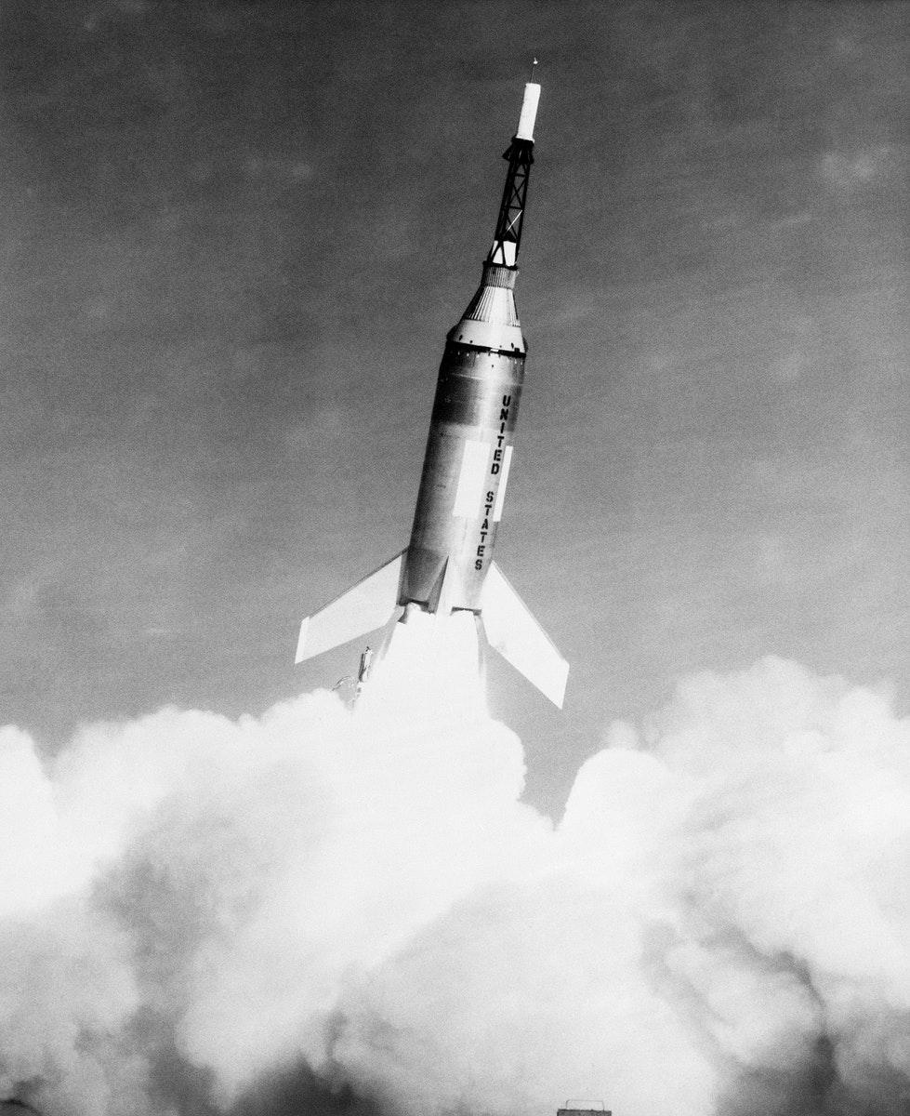
Major accomplishments, milestones, and missions
Project Mercury has made many accomplishments while on their missions. One of those accomplishments is that they learned how to put astronauts in orbit around earth. ANother accomplishment they made was that they learned how people could live and work in space. Last but not least, they had also accomplished how to recover both man and spacecraft safely. They completed every single goal they had at the beginning of Project Mercury.

Slide 3
Spacecraft and rockets used during the program and their key features?
The spacecraft and rockets used during Project Mercury all proved to be very useful and not one of them failed their purpose. There were 2 types of rockets that are used in Project Mercury. The Atlas rocket had four manned flights orbiting the earth. A Redstone rocket was used for the first two flights. In total, there was 6 flights that took place. These rockets were supposed to be designed for missiles for the united states military. There was one spacecraft used as well. It was a small capsule that could only hold one astronaut. This is where the astronaut would stay during the flight.

Slide 4
Obstacles.
Obstacles appear everywhere on earth, even in space. Sadly, Project Mercury’s obstacles were very briefly discussed. They had run into some technological difficulties in the first flight with the chimpanzee, Ham, inside(Thankfully Ham didn’t die on the way down). Another issue they ran into was when Gus Grissom’s Liberty Bell 7 had their door unexpectedly blow open. They never found the cause of the door problem. These were the very few obstacles that were shown to the public.

Slide 5
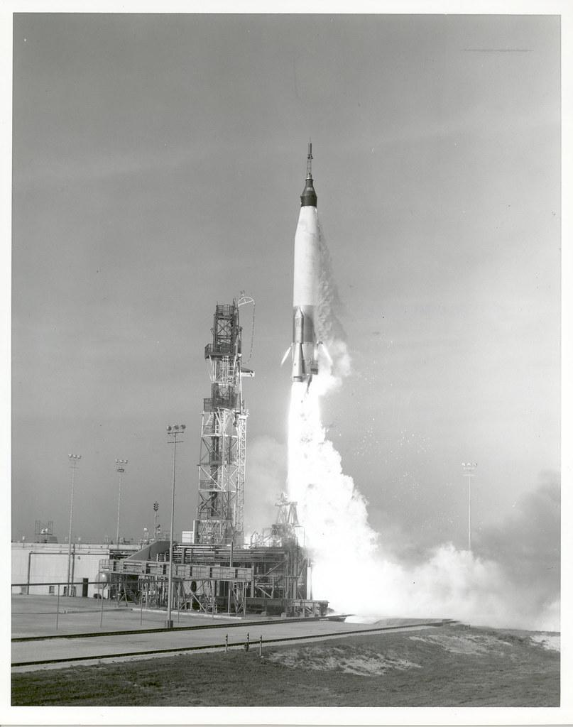
How did this program contribute to landing on the moon?
Just like any other program NASA had, Project Mercury significantly contributes to landing on the moon. This program had helped NASA find and fix problems during the test flights. It had also helped NASA learn how to make the rockets safer for when they send someone to the moon.

Slide 6
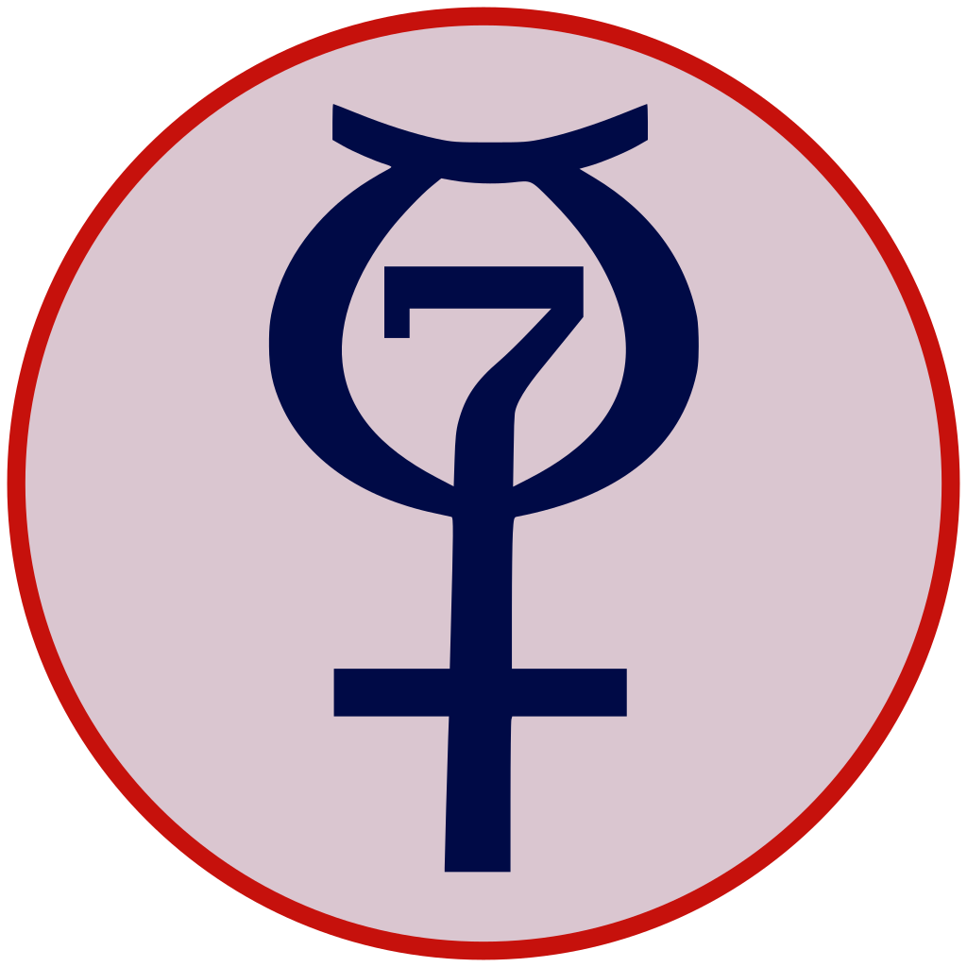
Interesting facts
-20 Mercury spacecraft were built, but only 6 were used for manned flights.
-The first mercury “astronaut” was a monkey.
-The astronauts actually insisted a lot on the idea of having a window in the rocket for them.
-Gus Grissom almost drowned after re-entering the program and getting on the second flight.
-Project mercury had took its name from a roman god who was known for his speed.

Slide 7
References
-https://www.nasa.gov/mission_pages/mercury/missions/goals.html
-https://www.nasa.gov/audience/forstudents/5-8/features/nasa-knows/what-was-project-mercury-58.html
-https://www.space.com/24638-project-mercury.html
-https://www.spaceanswers.com/space-exploration/five-amazing-facts-about-project-mercury/
-https://www.surfnetkids.com/go/1841/10-exciting-facts-about-project-mercury-2/

