Slide 1
Gemini Program
Destiny Johnston
Lillyauna Bartley
Emma Sanchez

Slide 2
The Gemini Program is…
This program was used for the techniques the Apollo moon landing had required to succeed. The Gemini missions answered many questions from NASA, for example, what could happen if humans stayed in space for many days. The questions they answered were also required for moon landings. Originally it had been used for testing astronauts to have the ability to adapt and survive in space for at least 2 weeks.
In conclusion, the main goals were: To prepare Apollo for the moon landing, To perfect re-entry and landing methods, to further understand long-term space flights, and to test astronauts’ survival abilities in space.

Slide 3
Missions, Accomplishments, and Milestones
The Gemini program was meant to do missions, they used Gemini to prepare for the Apollo landing. One accomplishment was being able to orbit for more than a week (Gemini 5). Gemini 2 flew highest out of all the Gemini missions. There were many adjustments made to fix problems from previous missions. The Gemini missions had proved NASA’s theories. For example, connection to spacecraft in space or the possibilities of astronauts staying in space for many days. The solved general and requirements to go to the moon.

Slide 4
Problems That Occurred
The Gemini missions had required learning to spacewalk. At one point, they lost radar lock-on at 74 miles. “The mission conducted the first docking of two spacecrafts in orbit, but suffered the first critical in-space system failure of a U.S. spacecraft, which threatened the lives of astronauts and required an immediate abort of the mission”.

Slide 5
The moon
The Gemini program developed the space travel techniques used to land Astronauts on the moon(Apollo).

Slide 6
Key features of rockets and spacecraft used
There was a capsule that was on a Titan II Rocket during flight. Originally, the Titan II was a missile. But was changed to meet the requirements for carrying humans. In all, there were about 19 launches. Each carried two astronauts. They were carried to Earth’s orbit.

Slide 7
Facts
The Gemini program got its name from how it had a two-man capsule instead of a one-man. The name was influenced by the Gemini twins.
Project Gemini was NASA's second human spaceflight program.
Project Gemini proved that astronauts could survive up to two weeks in space

Slide 8
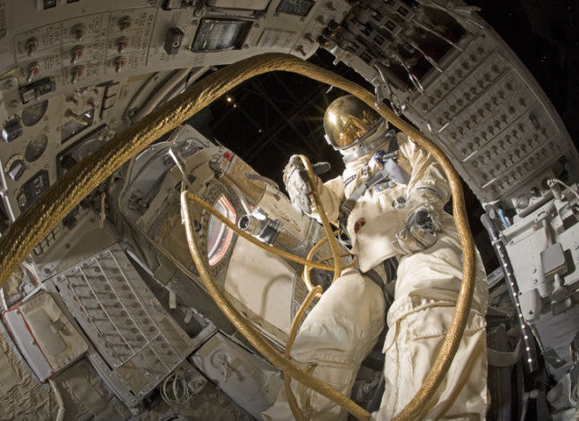
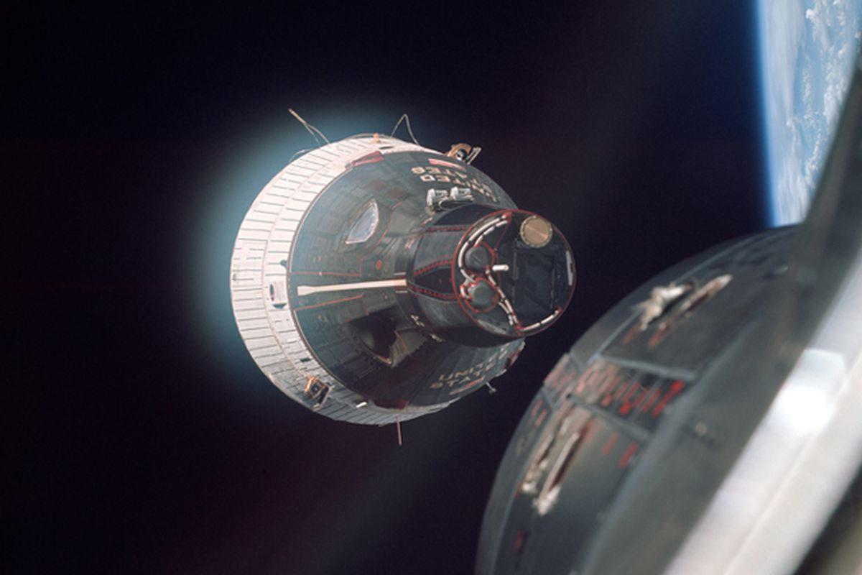
Pictures of the Gemini Missions

