Slide 1
NASA’s Apollo
By: Ethan Harris

Slide 2
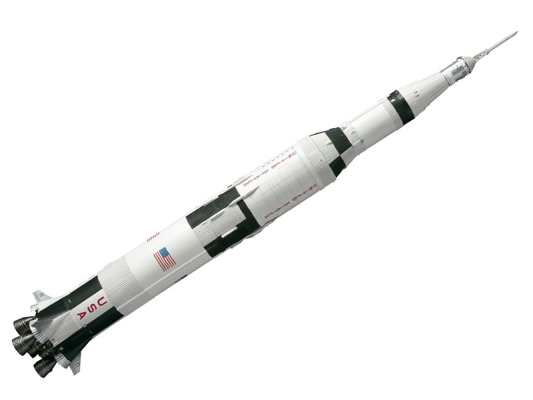
Major Programs, Accomplishments, and Milestones
Apollo’s main and extremely important mission, was to safely bring people or other objects or animals to the moon and back to earth. A big accomplishment was of course, finishing the mission of bringing people to the moon and back, making one of the most well known and biggest moments in history. Three big Apollo milestones were, landing on the moon of course (done by Apollo ship 11), orbit the entire moon while still making it back to earth with photos (Apollo 8) and winning the space race against Russia (once again by Apollo 11)

Slide 3
Spacecrafts used during the program Obstacles faced during the program
Apollo has made and used many spaceships all being named Apollo 1-17 and almost all of them were different in someway, some would fly to the moon, orbiting the moon or earth, or making a permanent space station in space that is used as a resting spot that is still there today.
Lunar dust was the biggest issue for almost all missions from Apollo and just for NASA itself. It hurts spacesuits by covering the visors, clogging mechanisms inside the suit, and erode layers off of the suit.

Slide 4
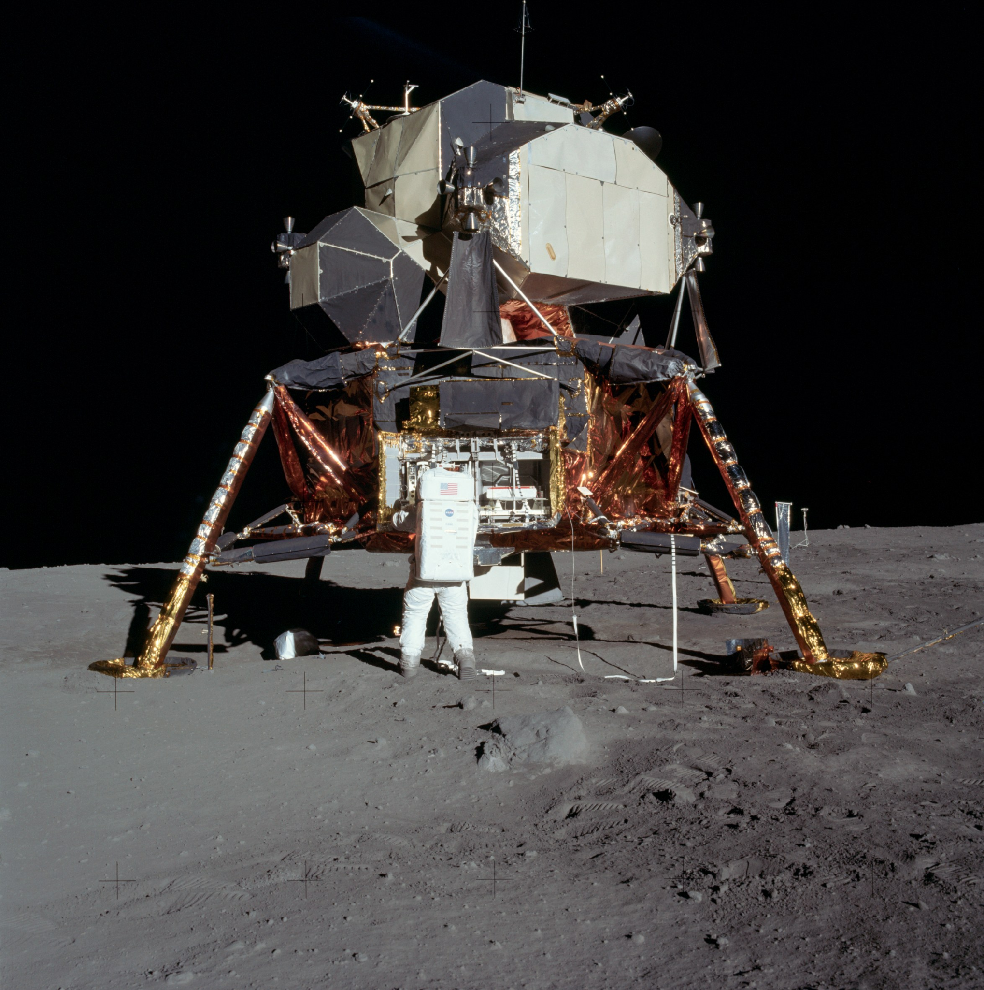
In what ways did the program help land on the moon
Apollo made the Apollo 11 ship that was the ship that held Neil Armstrong and others to the moon and back to earth completely safe, marking a place in history.

Slide 5
Interesting Fact about Apollo
i
The Apollo project is currently over. The project made 12 ships that all served amazing purposes and made one of the most well known quotes, stories, and made a giant mark in history.

