Slide 1
Mercury
Lillie Bartley

Slide 2
Accomplishments, milestones, and Major program missions.
Mercury was the first space program to put a man in space. They used Freedom 7 which is a Mercury Spacecraft(slide 3-4) for this project. The first person who was put into space was Alan Shepard. Mercury was created in 1958 and lasted until 1963. In 1959 they sent 7 astronauts into space. From this program NASA learned how to put spacecraft into Earth’s orbit, how to operate spacecraft in orbit, as well as how people lived and worked in space.

Slide 3
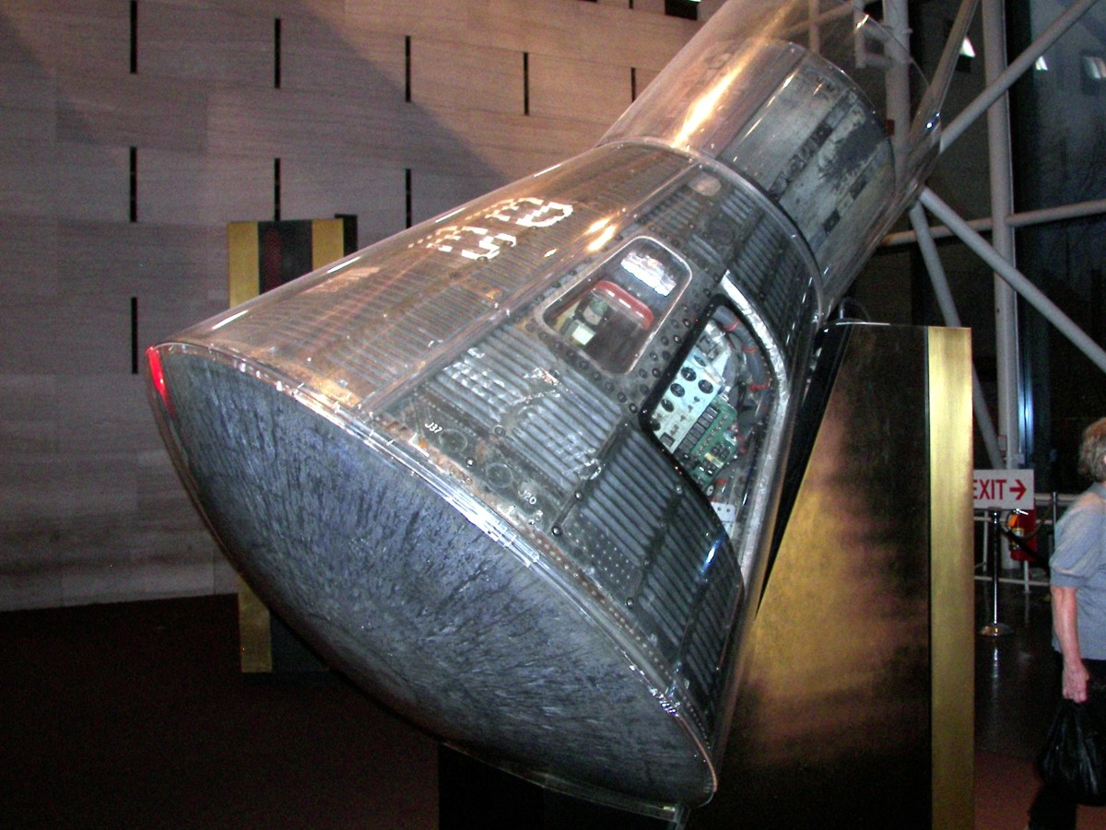
Mercury spacecraft.

Slide 4
Mercury spacecraft.
The Mercury spacecraft was a small cone shaped capsule that had been built to hold one person. The astronaut had enough room to sit down during the flight. It was built to be 2 meters long and 1.9 meters in diameter. It was also built to withstand 3000 degrees of heat, for when coming back into Earth's atmosphere. The names of the 7 spacecraft that were sent up are, Freedom 7, Liberty bell 7, Friendship 7, Aurora 7, Sigma 7, Faith 7.

Slide 5
Obstacles faced
They first had to find out how to get to space, these first experiments didn’t end well. The first time they tried with an Atlas rocket, the spacecraft exploded. This helped them learn what not to do next time. The first actual flight only ended with the craft going 4 inches into the air. They send up 3 monkeys first before sending humans. They did this to make sure that humans would be able to survive in outer space.

Slide 6
Fun facts.
Mercury was named after a Roman god.
Two of the rockets used were originally designed as US Military Missiles
(Stated in page 2 “In 1959 they sent 7 astronauts into space”…) they had another astronaut who was also supposed to be sent into space on a Mercury mission, but was unable to due to health issues, however he did participate in another project; Apollo-Soyuz in 1975.

Slide 7
Resources.
(Info)-https://www.nasa.gov/audience/forstudents/5-8/features/nasa-knows/what-was-project-mercury-58.html
-https://www.nasa.gov/mission_pages/mercury/missions/spacecraft.html
(Pictures)-https://historicspacecraft.com/mercury.html

