Slide 1
Group Informative Assignment: Apollo 1
Serena Elizabeth Lacorbiere - HarleeQuinn Head - Mari-Ana

Slide 2
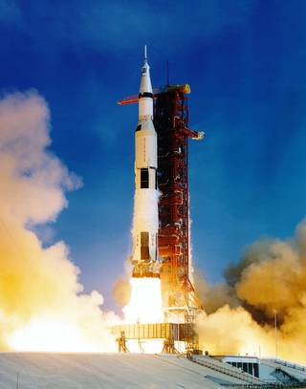
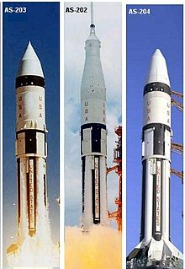
Spacecraft And Rockets Used During The Program And Their Key Features
NASA used As-204 spaceship. The spaceship was used to test launch operations. It was also used for ground tracking, control facilities, and the performance of the Apollo-Saturn launch assembly. It would have lasted up to two weeks! That´s depending on how the spacecraft performed.

Slide 3
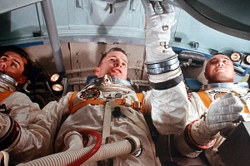
Obstacles faced during the program
Their were a couple of obstacles faced during the program.
NASA had to rework some of the Apollo command modules witch postpones crewed launches until cleared by officials for flight.
The reason for all this is because a fire broke out in the capsule. Many people died, and others injured.

Slide 4
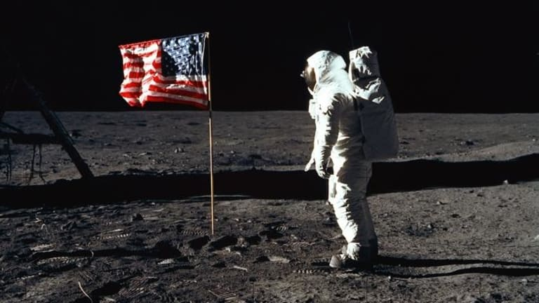
Ways In Which This Program Contributed To Landing On The Moon
Apollo 1 contributed to landing on the moon by the research they obtained and technically sacrificing their lives for NASA.

Slide 5
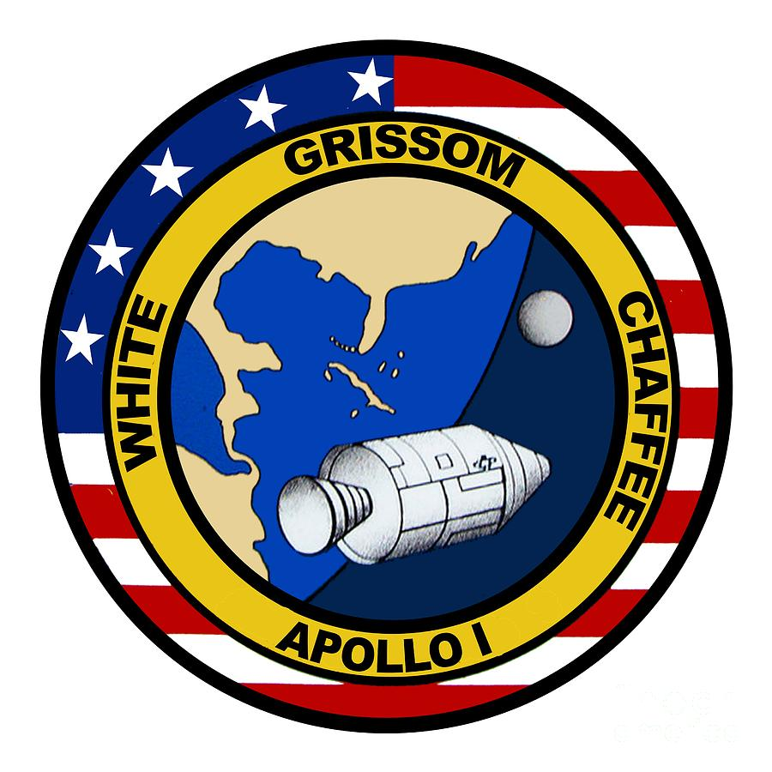
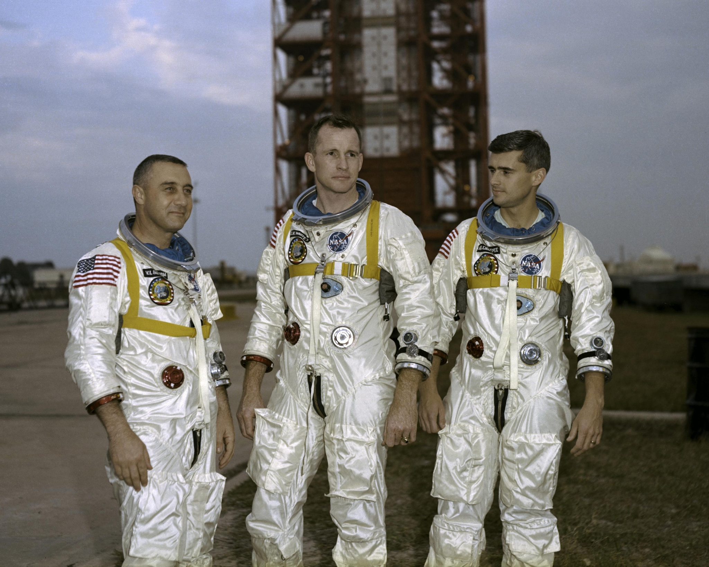
Other Interesting Facts About The Program
Apollo 1 was the first manned mission of the united states!
On the Low Earth Orbit test of the Apollo command/service module never actually made it to its target launch date of February 21, 1967.
A cabin fire burned out during a rehearsal test on January test on January 27 at Cape Kentucky Air Force Base Station Launch Complex killing 34 along with the three crew members

Slide 6
