Slide 1
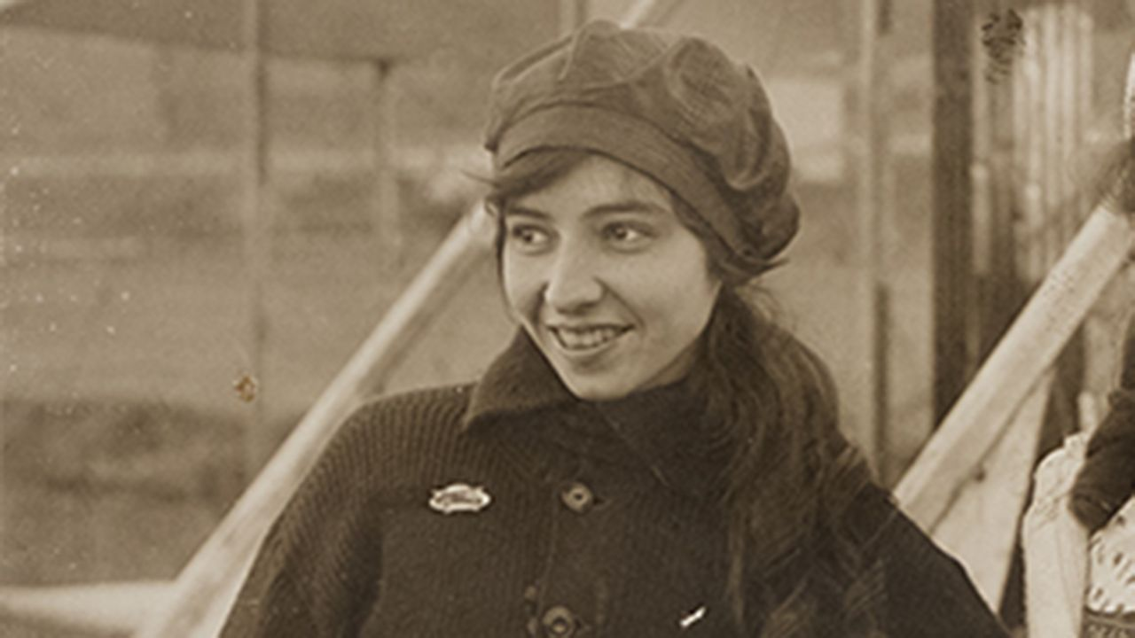
Katherine Stinson
By:
Serena Elizabeth Lacorbiere, HarleeQuinn Head, Destiny Johnston
Noah Covington, and August Laughlin

Slide 2
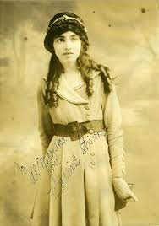
Who Is Katherine Stinson?
Katherine Stinson is an American woman who became famous for her outrageous acts in aviation. She has many accomplishes and has faced many obstacles. She even fell ill with tuberculosis but overcame her sickness which was pretty rare back then.

Slide 3
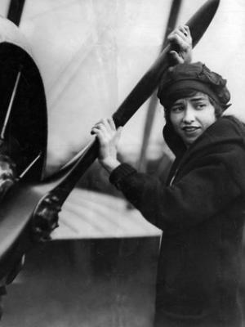
When Was Katherine Born?
Katherine was born on February 14, 1891 in Fort Payne, Alabama. Katherine died July 8th, 1977 in Santa Fe, New Mexico. Katherine’s resting place is in Santa Fe National Cemetery.

Slide 4
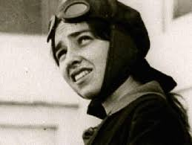
What Are Some Of Katherine Accomplishments
Katherine was the first woman to perform a loop while flying midair. Katherine's family also owned a flight school and manufactured airplanes.
Katherine was the first woman to fly in Asia, performing her show in China. She set a record of 610 miles when she flew from San Diego to San Francisco in 1917.

Slide 5
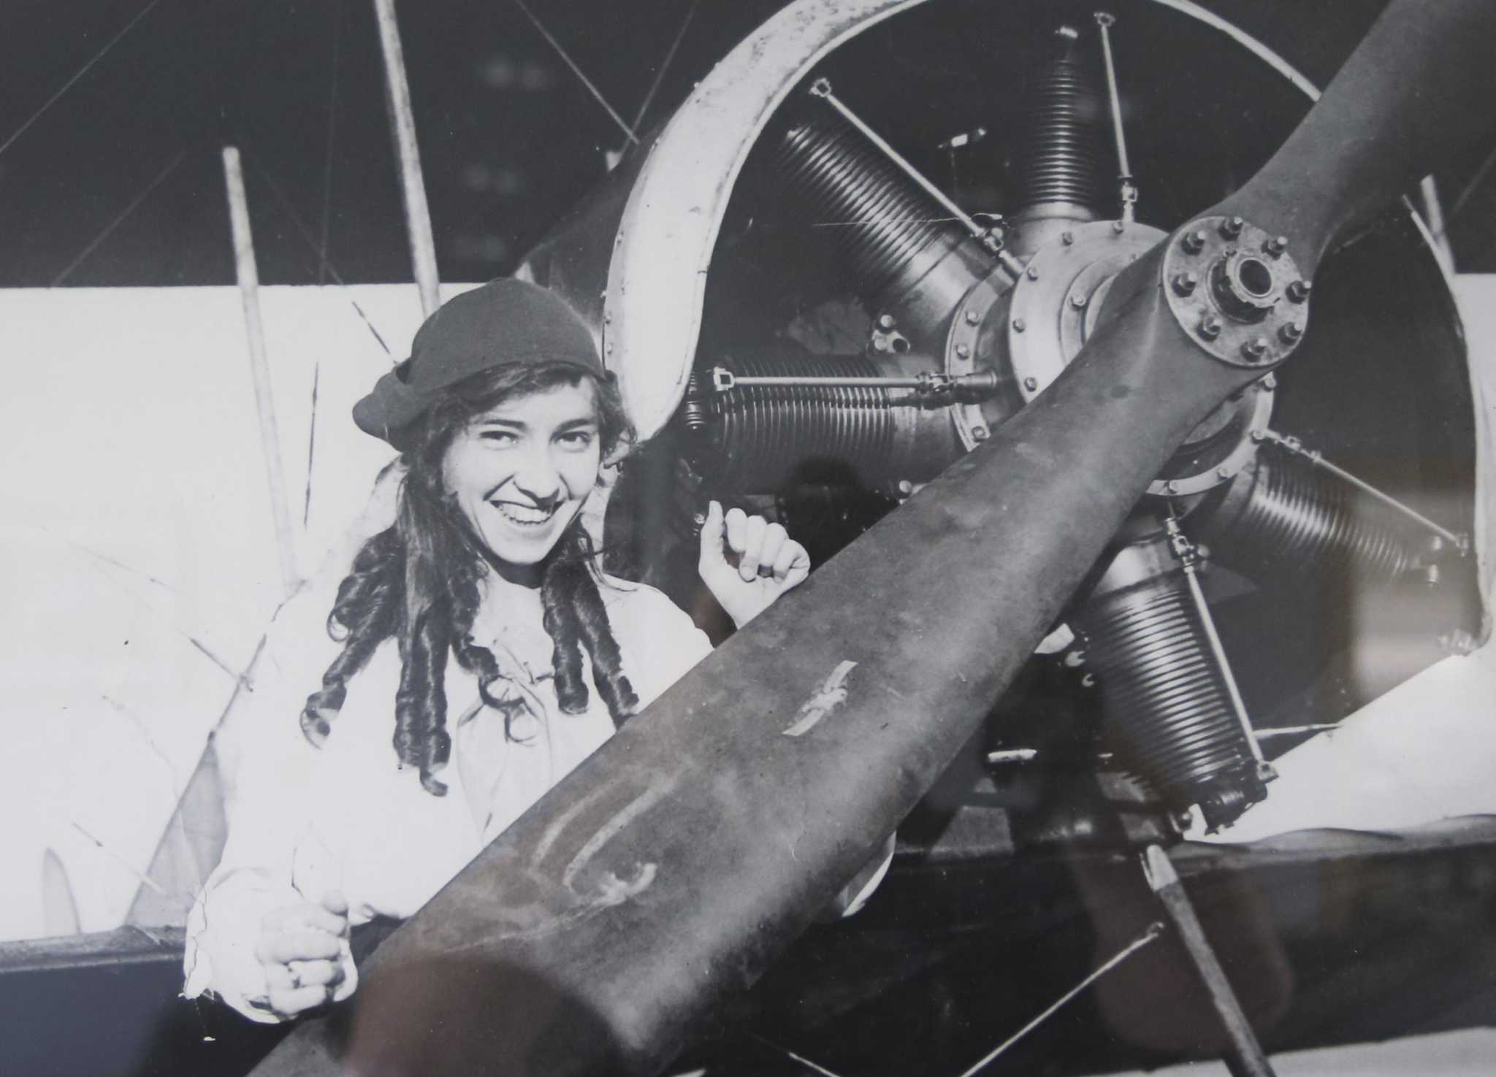
What Are Some Challenges Katherine Had to Overcome?
Katherine was forced to stop flying because she fell ill with tuberculosis. She eventually overcame her sickness, which was pretty rare back then.
She volunteered to fly for World War I twice, but was rejected both times. Instead, she volunteered and was accepted to do ambulance driving for the Red Cross.

Slide 6
What Are Some Interesting Facts About Katherine
Katherine Stinson bought a Wright bi-winged plane
Katherine Stinson was the first female commissioned airmail pilot.
Katherine as a young girl originally wanted to study music in Europe.
The plane that Katherine did a loop in, she built herself.

Slide 7
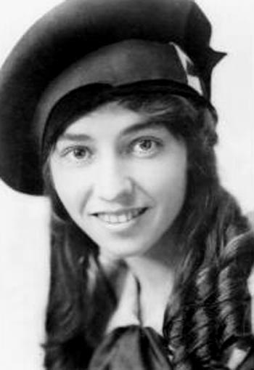
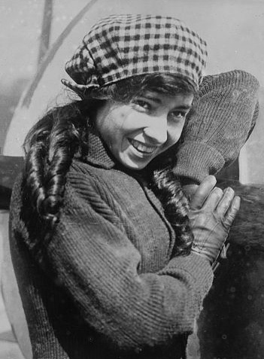
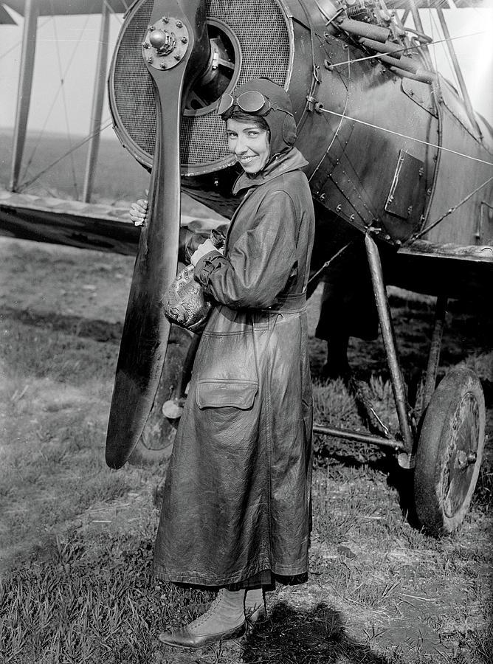
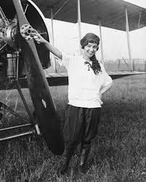
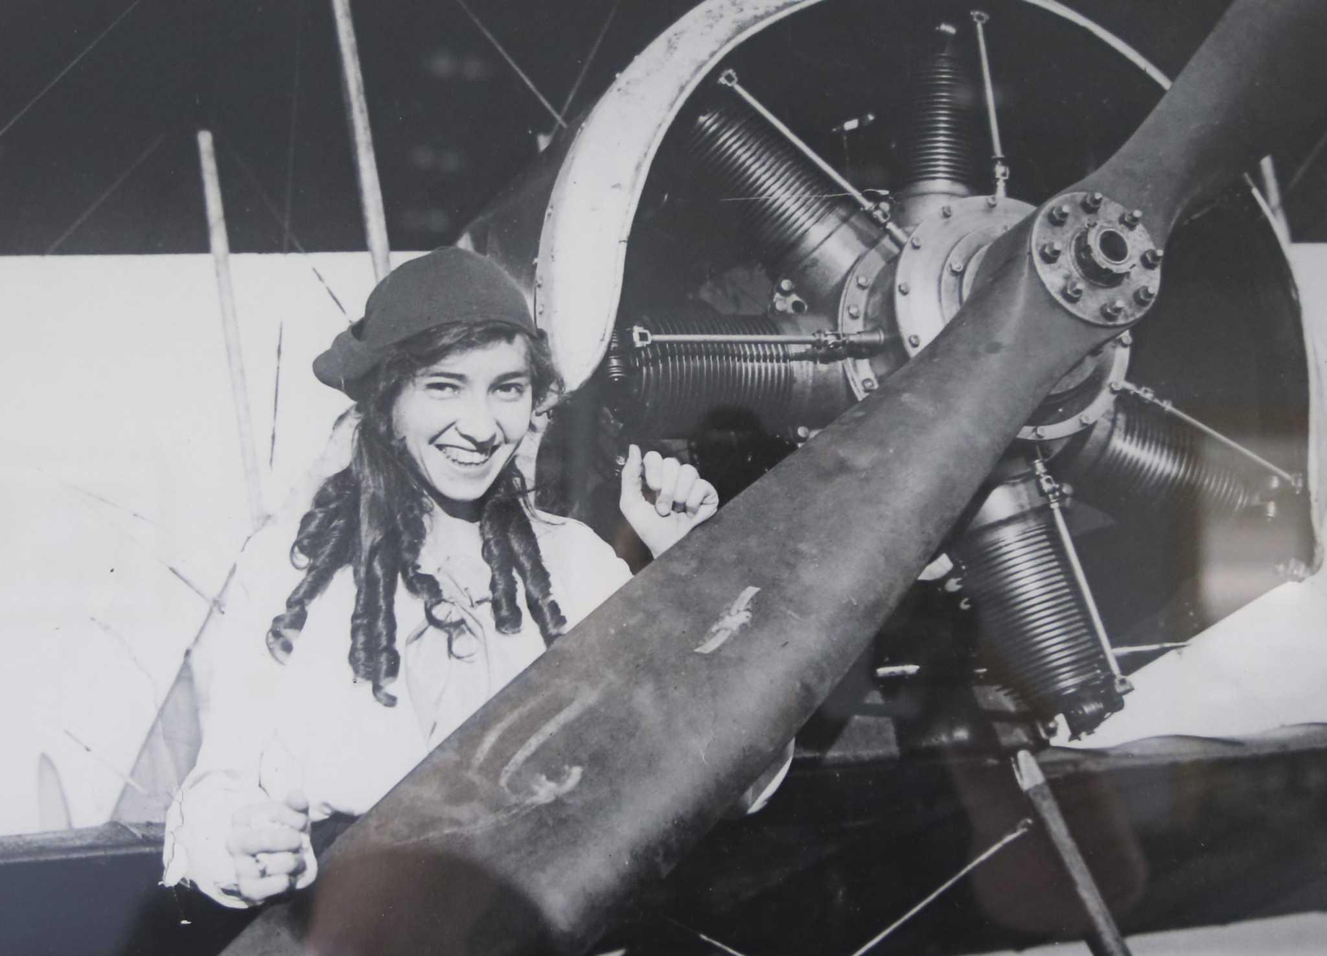
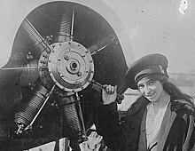
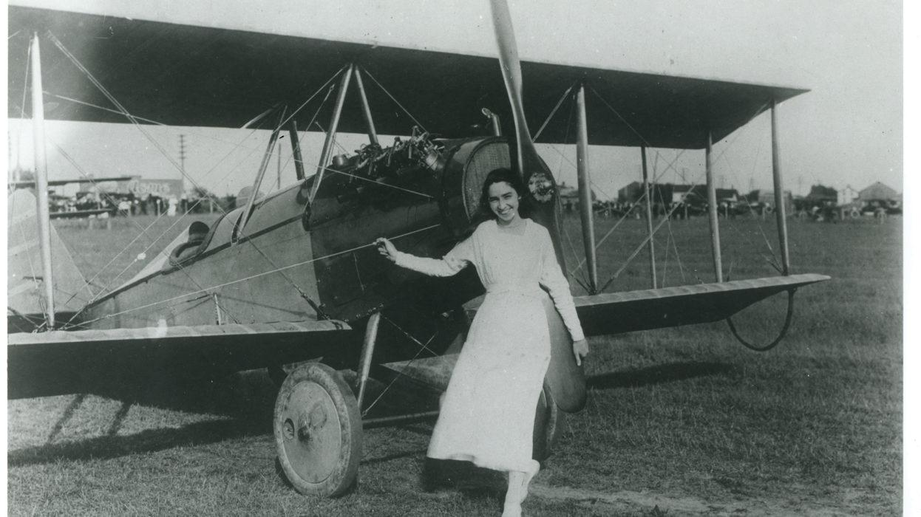
Photos Of This Beautiful Woman

Slide 8
Summary
Katherine Stinson was a beautiful, devoted, driven, and tough woman who accomplished what others did not think was possible. She treated her obstacles as stepping stones on her way to success. She learned from all her step backs. Katherine stayed positive through tough times. She was the first woman in the whole world to perform a loop in a plane! She was the first ever women to fly airmail. She was the youngest female to get her licence. Katherine Stinson is an amazing role model for young women in aviation.

Slide 9
Resources
https://www.infoplease.com/biographies/society-culture/katherine-stinson

