Slide 1
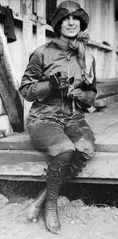
Harriet Quimby
Made by:
Phoenix Marques, Rileigh Keller, Ethan Harris,
and Cassidy Reyes
Notes:
Made by us all

Slide 2
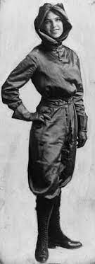
Who is she?
Her name is Harriet Quimby and she was born in 1875 in Michigan. She was a journalist, a film screenwriter, and she was an american pioneering aviator. Harriet died at the early age of 37 in 1912 in Massachusetts.
Rileigh
Notes:
Made by Rileigh

Slide 3
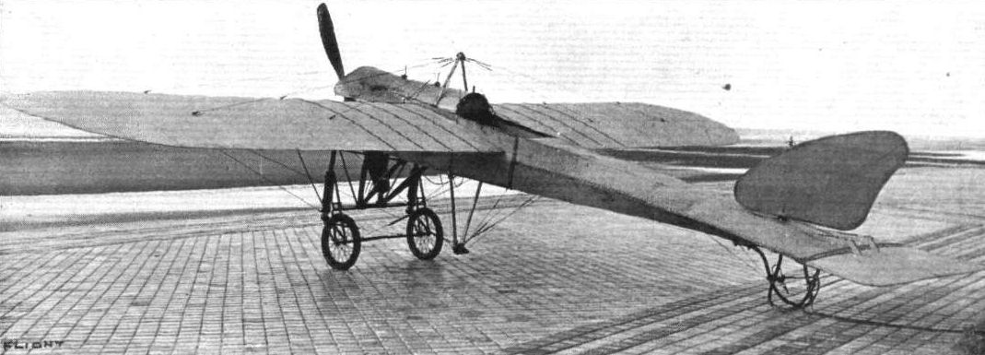
Accomplishments in Aviation
She has made some big accomplishments during her career in aviation. For example, Harriet Quimby was the first woman in the U.S. to get her pilot’s license. She was also the first woman to fly solo over the English Channel.
The plane shown here is a French Bleriot Monoplane which is what Harriet Quimby learned to fly in.
Phoenix
Notes:
Made by Phoenix

Slide 4
Obstacles
There were some obstacles she had to face during and before her career. For starters, back when she was alive any “respectable” woman were supposed to devote themselves to domestic concerns only and keep their names out of the newspaper. There was also a lack of profiting job positions that were available to middle-class women which reinforced their dependance on men. Once reporters found out about her flying lessons, she was given a lot of “criticism” on her attempts to fly. The Aero Club of America didnt let her take the exam she needed to be a pilot because she was a woman. Thankfully, one day, they finally allowed her to do so.
Ethan
Notes:
Made by Ethan

Slide 5
Interesting facts
I love Mr. Bow
She was a successful journalist.
Learned how to fly with some famous aviators.
Her face was the advertising face for a specialized soda.
She became interested in aviation at an airshow.
Wrote seven screenplays.
`
Cassidy
Notes:
Made by Cassidy

Slide 6
References
https://www.cradleofaviation.org/history/history/women-in-aviation/harriet_quimby.html
https://gazette665.com/2018/09/07/10-things-to-know-about-harriet-quimby/
https://www.encyclopedia.com/women/encyclopedias-almanacs-transcripts-and-maps/quimby-harriet-1875-1912#:~:text=Harriet%20Quimby%2C%20however%2C%20embodied%20the,she%20was%20a%20conspicuous%20celebrity
All
Notes:
Made by us all

