Slide 1

Amelia Earhart
Lillyauna, Mari-Ana, Skyler, Niko

Slide 2
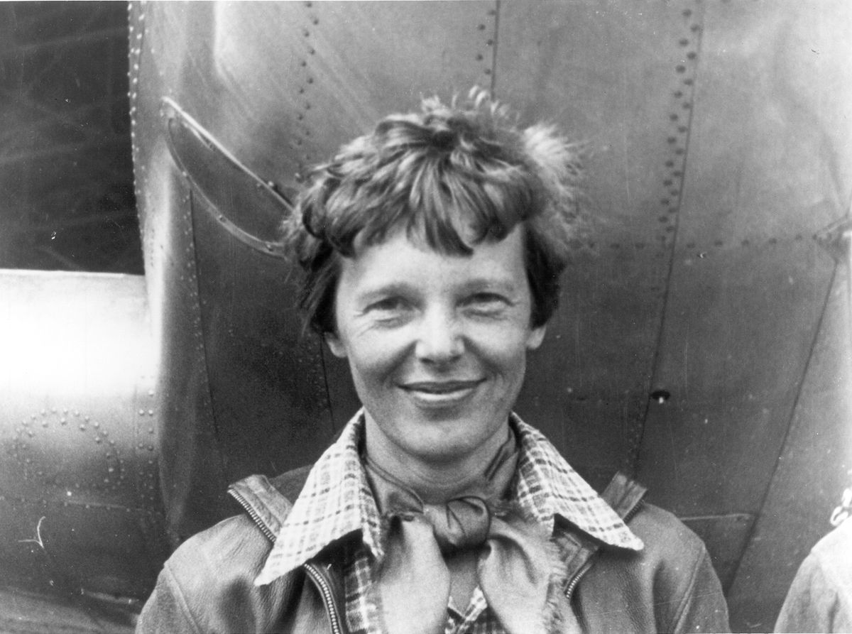
Birth and technical death
Lillyauna Bartley
Amelia Earhart was born on July 24, 1897. She was deemed dead on January 5, 1939.

Slide 3
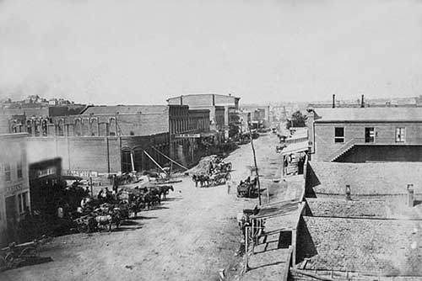
Where she was born and raised
Niko Antongiorgi
Amelia Earhart was born in 1897 in Atchison, Kansas she was raised in Kansas, Iowa, Minnesota, and Illinois. They moved around a lot because of the death of their grandparents. They stayed inside their grandparents house for a bit but it was hard because they struggled financially to keep it. Because they couldn’t get a stable job. Amelia was raised inside that house and moving was the last thing she would think about because its her family’s house.

Slide 4


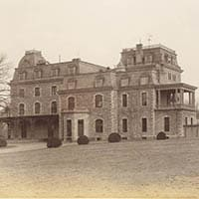


Where she went to school
Niko Antongiorgi
Amelia Earhart attended school at multiple schools in her life because her parents were always moving due to them not getting to keep up with rent. She attended at Central High school and Hyde Park Academy High school. This is were Amelia finished high school in Chicago in 1916. After her mother received her inheritance she was able to attend the Ogontz School in Rydal, Pennsylvania. But she left school to work at a Canadian military high school where she met aviators and was interested in flying. For college she went to Penn State Abington, and Columbia University.

Slide 5

What did Amelia Accomplish?
Lillyauna Bartley
First woman to fly across the Atlantic Ocean as both a passenger and solo.
On October 22, 1922 Amelia broke the women's altitude record when she rose to 14,000 feet.
Amelia was a founding member and president of Ninety-Nines, An international Organization of Women Pilots (Today Ninety-Nines has thousands of members from 44 different countries)
After flying across the Atlantic, Congress awarded Amelia the Distinguished Flying Cross which is a military decoration awarded for “heroism or extraordinary achievement while participating in an aerial flight.” She was the first woman to receive the honor.

Slide 6

Some Obstacles
Lillyauna Bartley
There were many obstacles Amelia faced, first off she was a woman. Back then women were to clean cook and care for their husbands and children. Amelia defied the standards and helped to shape a different path for a lot of women. There is no doubt that Amelia was told she couldn't do something, yet she continued to break many records.

Slide 7
Interesting facts
Mari-Ana Vargas
Amelia Earhart was the second and first woman to fly solo nonstop across the Atlantic
Amelia’s childhood nickname was Meelie ( she was a very adventurous child and often had her little sister grace follow her while she climbed tree, hunted rats, did what every child did collect insects).
She did build her own roller coaster with her uncles help.

