Slide 1
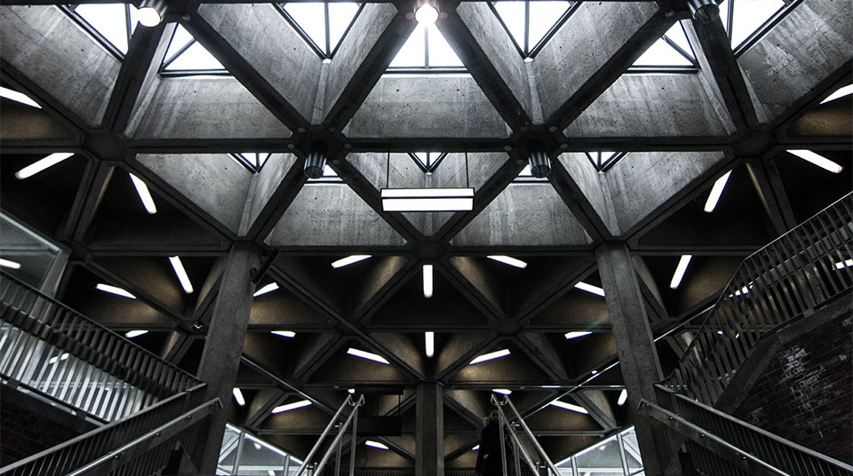


Business plan of jmm llc
2
+
2
+
Brandman University

Slide 2


Executive Summary
2
+
2
+
Jeffery Morse Ministries

Slide 3


2
+
Executive Summary
JMM is an internationally based nonprofit startup with the goal of providing humanitarian aid throughout the world, deliver the Gospel of Jesus Christ, plant churches, train leaders, and equip people to carry on the ministry of Christ in a similar fashion. JMM is both a product and service-based company. The product is free of charge and is the Gospel of Jesus Christ. Services range from providing food and the necessities of life, especially after a major crisis, and establish churches and educational facilities around the world. JMM is a volunteer-based organization, as such, employees and volunteers constantly rotate, however, all who align themselves with JMM have one objective – to love people.

Slide 4
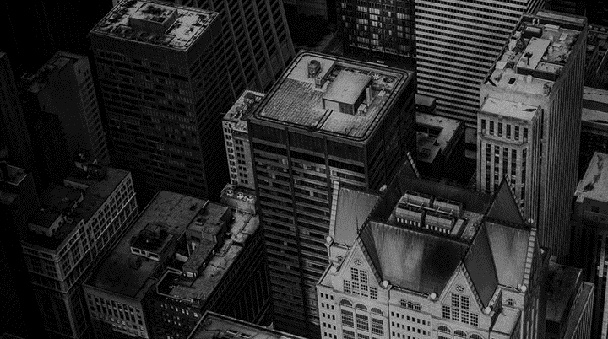
Mission
2
+
2
+
2
+
Jeffery Morse Ministries

Slide 5
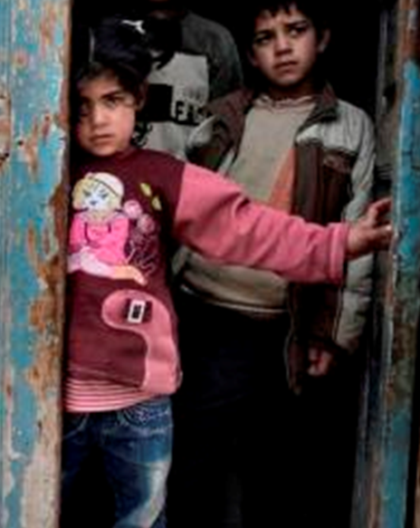
2
+
Mission Statement
We are connecting the Salvation Gospel to the world to bring hope to the hopeless, food to the hungry, shelter to the homeless, and to bring all of this by preaching the truth of the Gospel of Jesus Christ through evangelism, missions, music, worship, education, and media, the establishing of Churches and the training and ordination of Apostles, Prophets, Pastors, Evangelists, Teachers, Missionaries, Worship Leaders, Minstrels, and any other office that is beneficiary to the work of the gospel of Jesus Christ. We will take advantage of every legal opportunity, and every legal resource to accomplish this end.

Slide 6
Vision Statement
2
+
2
+
2
+
Jeffery Morse Ministries

Slide 7
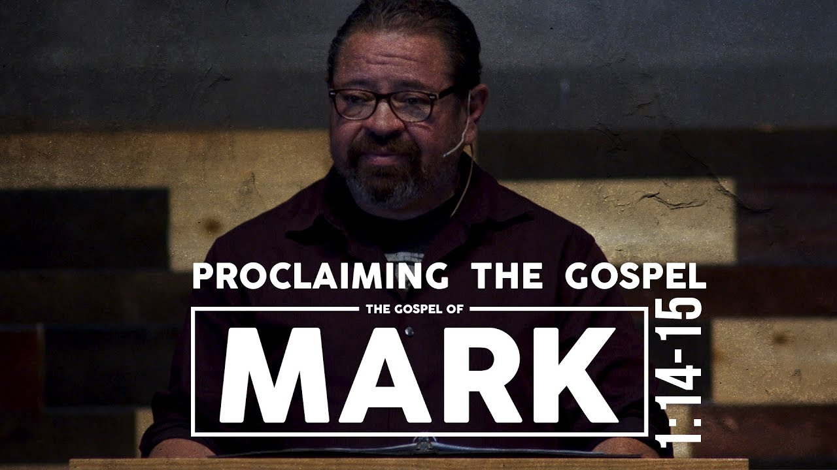
2
+
Vision Statement
Centering on proclaiming the Gospel of Jesus Christ, to people in every country of the world, while fulfilling the call to feed, clothe, house, and minister to all we can while demonstrating excellence, honesty, faithfulness, and the love of Christ.

Slide 8
Company Description
2
+
2
+
Jeffery Morse Ministries

Slide 9


2
+
Company Description
The Distinctive Core Competencies of JMM LLC lay in its vision statement, “while demonstrating excellence, honesty, faithfulness, and the love of Christ.” While JMM does not hold the monopoly on honesty, today so many humanitarian and religious organizations seem to be for profit. JMM is focused on the items listed in its mission statement. This company is not here to make someone wealthy, but rather to enrich the lives of those in need. By opting for the LLC in its startup phase, instead of a Corporate structure, JMM uses money for its intended purposes rather than for salaries, however, JMM will be converting to a corporate structure when appropriate.

Slide 10
Industry Analysis and Trends
2
+
2
+
2
+
Humanitarian Need

Slide 11
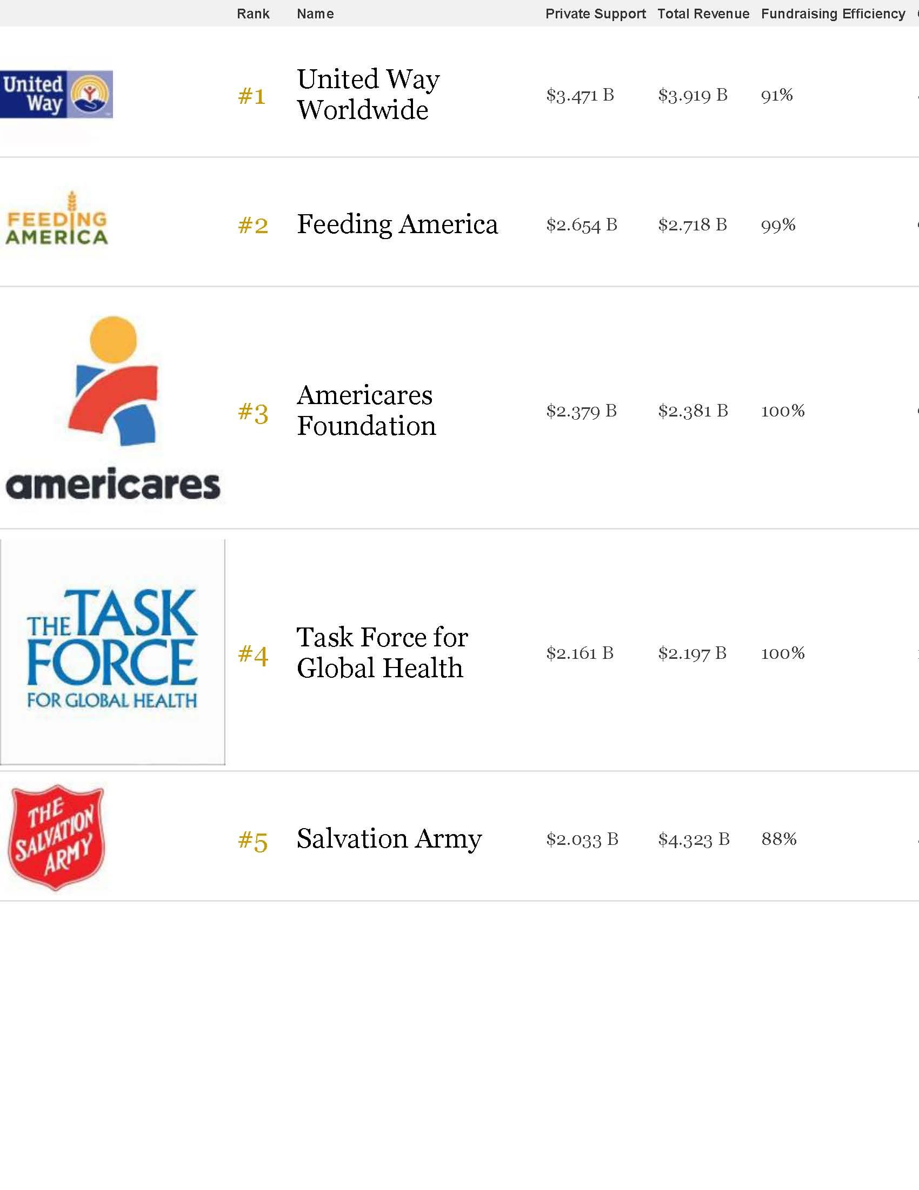
11

Slide 12
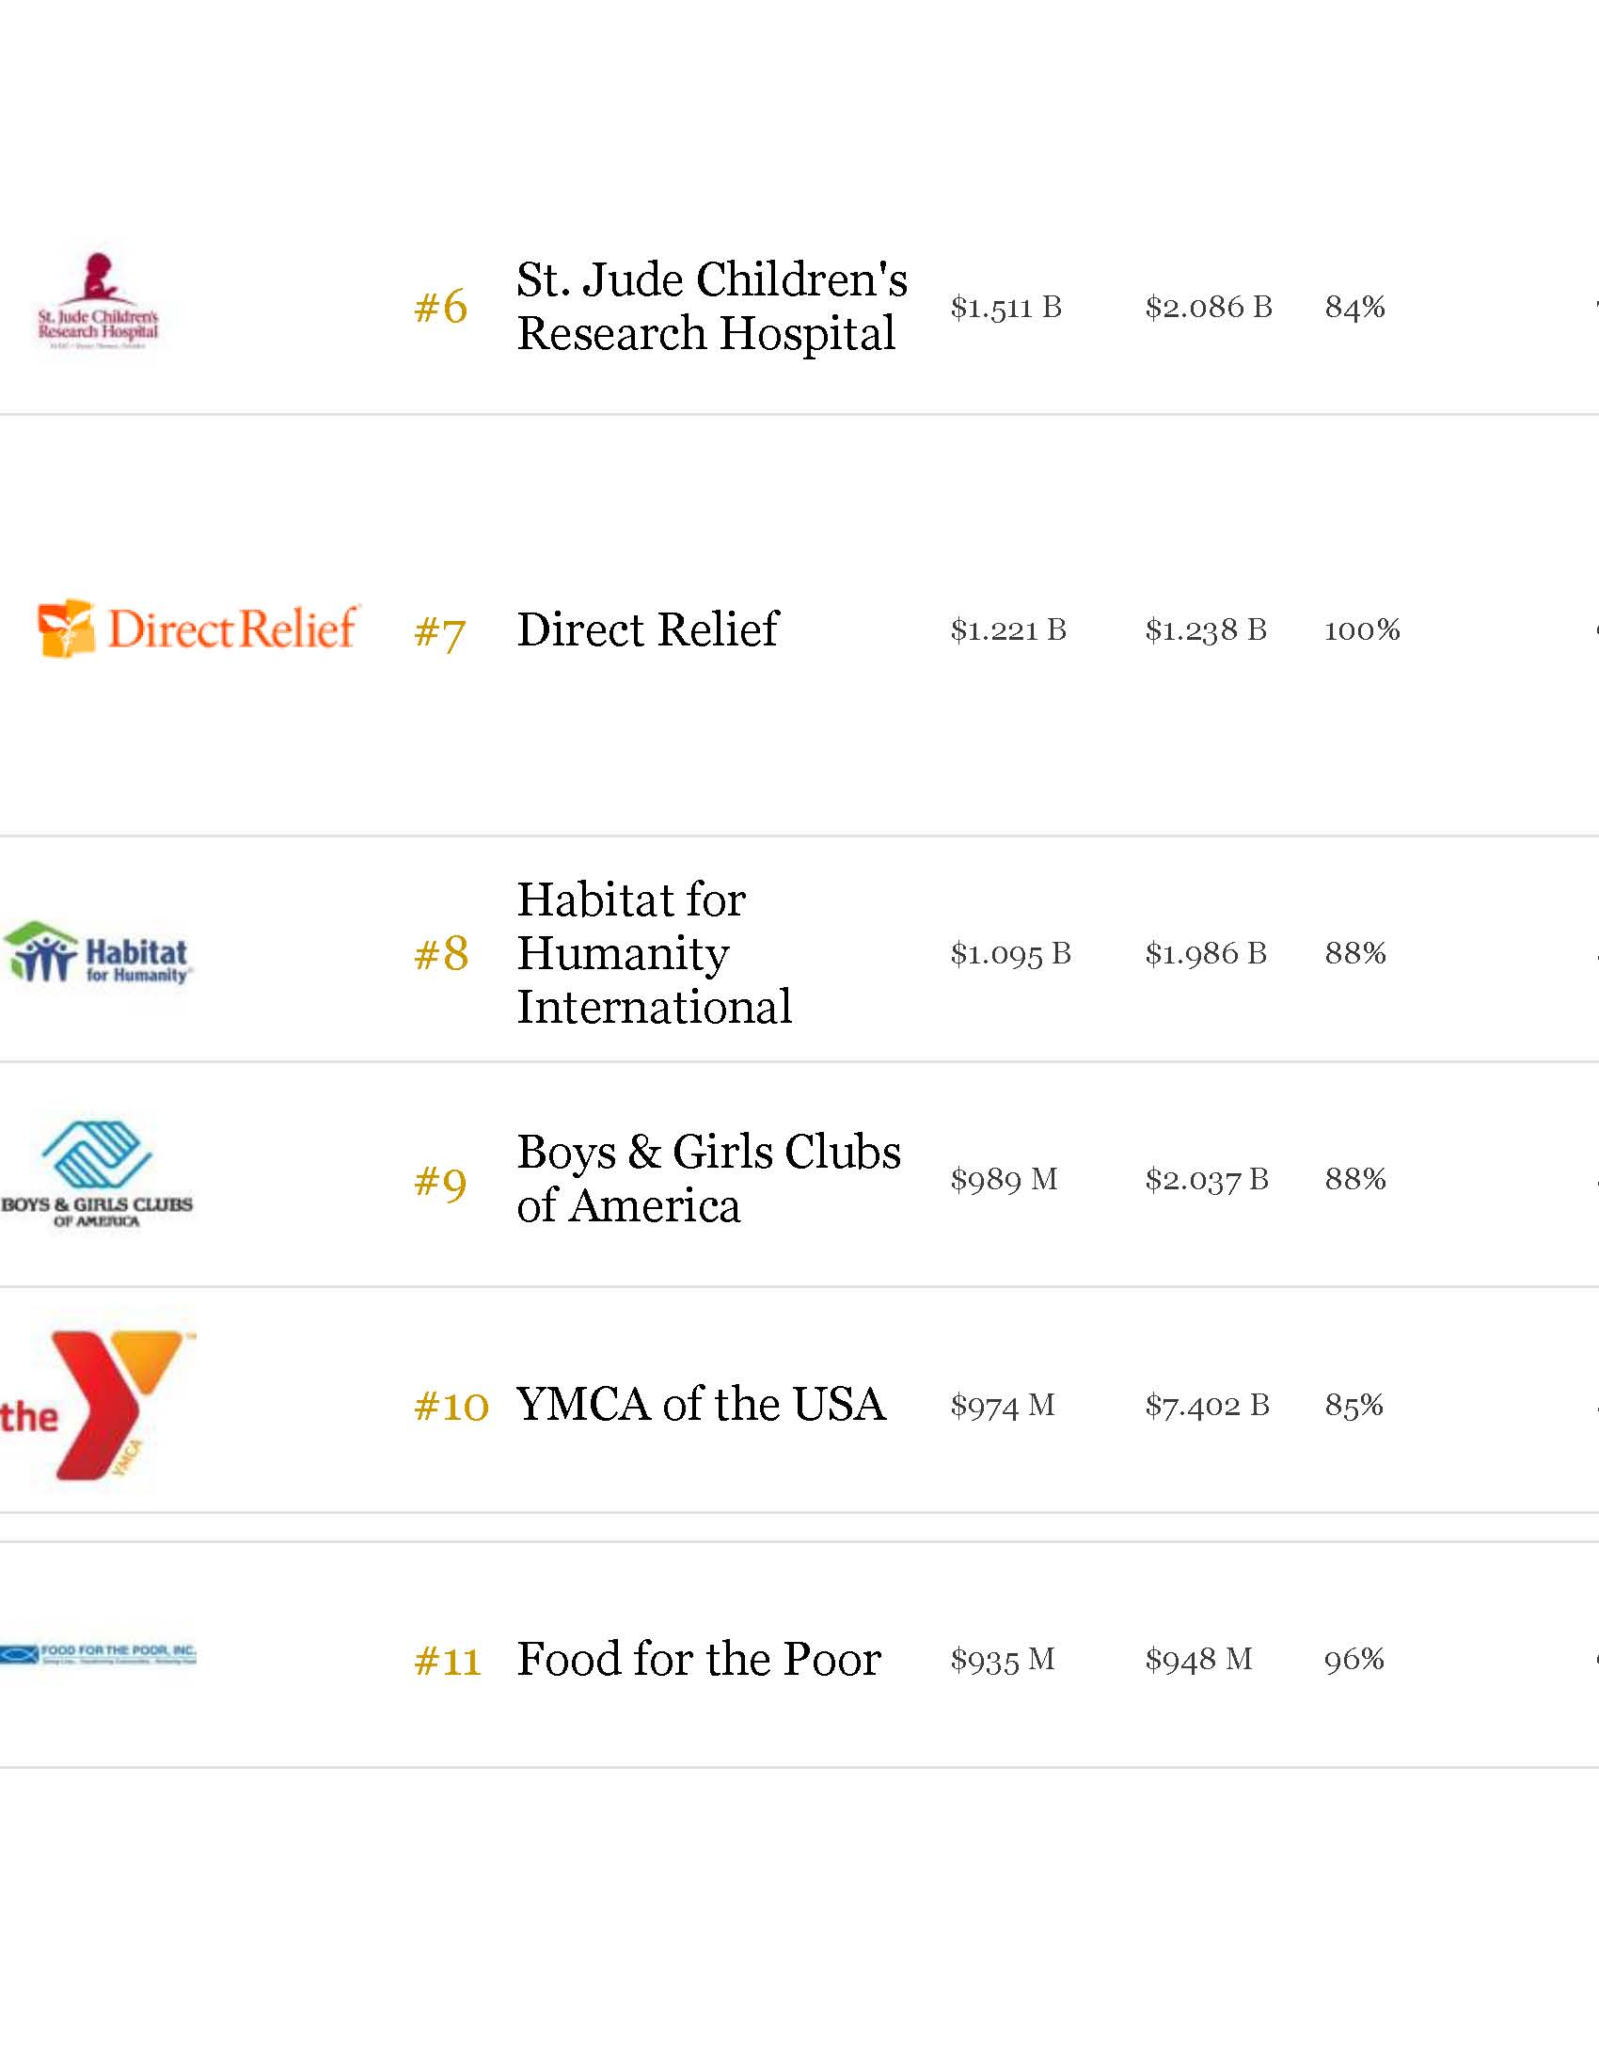
12

Slide 13

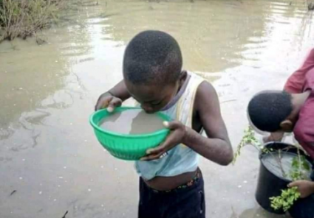

Clean water for better health
We are partnering with organizations like World Vision to bring help children and families in need.
Disease-infested water kills millions every year needlessly. Access to clean water will limit child deaths and bring renewed vitality to communities.
Place Church Logo Here
13

Slide 14
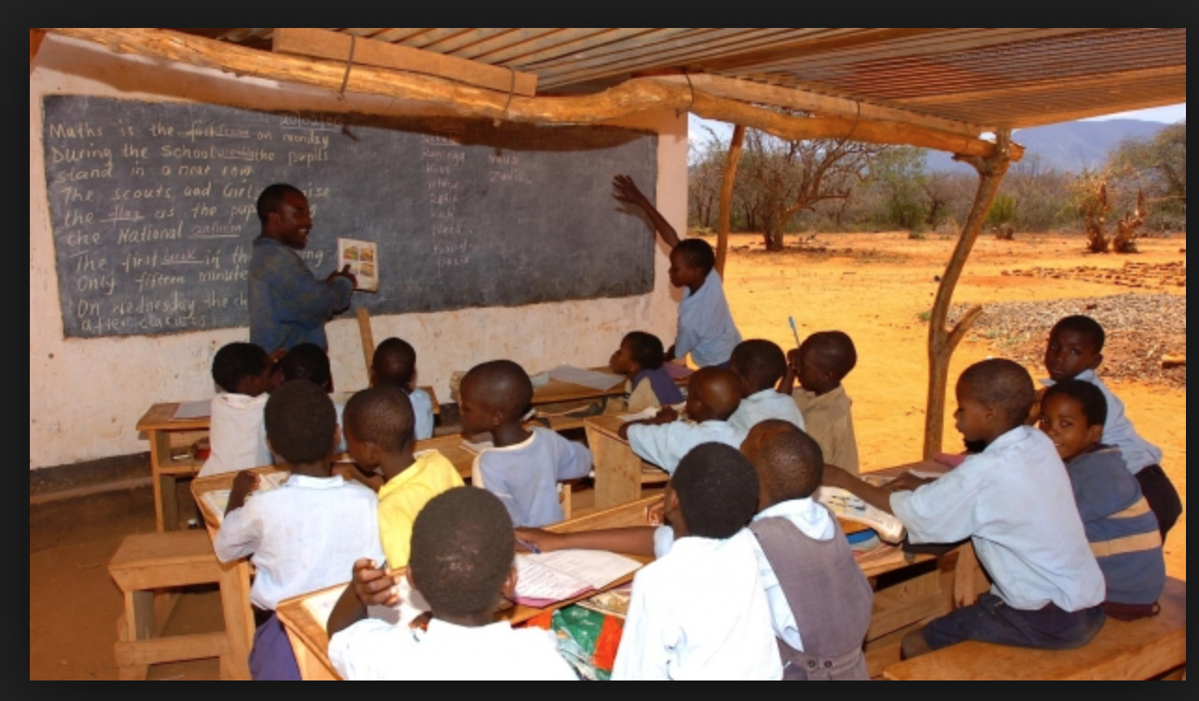

Help for our Neighbors
We are partnering with organizations like Samaritans Purse to bring help children and families in need.
Resources such as clothing, school supplies, art supplies and basic education to provide hope and tools to rebuild lives. Poverty and disaster in the U.S. and abroad is met with provisions that will strengthen families and provide children with hope and self-esteem.
Place Church Logo Here
14

Slide 15
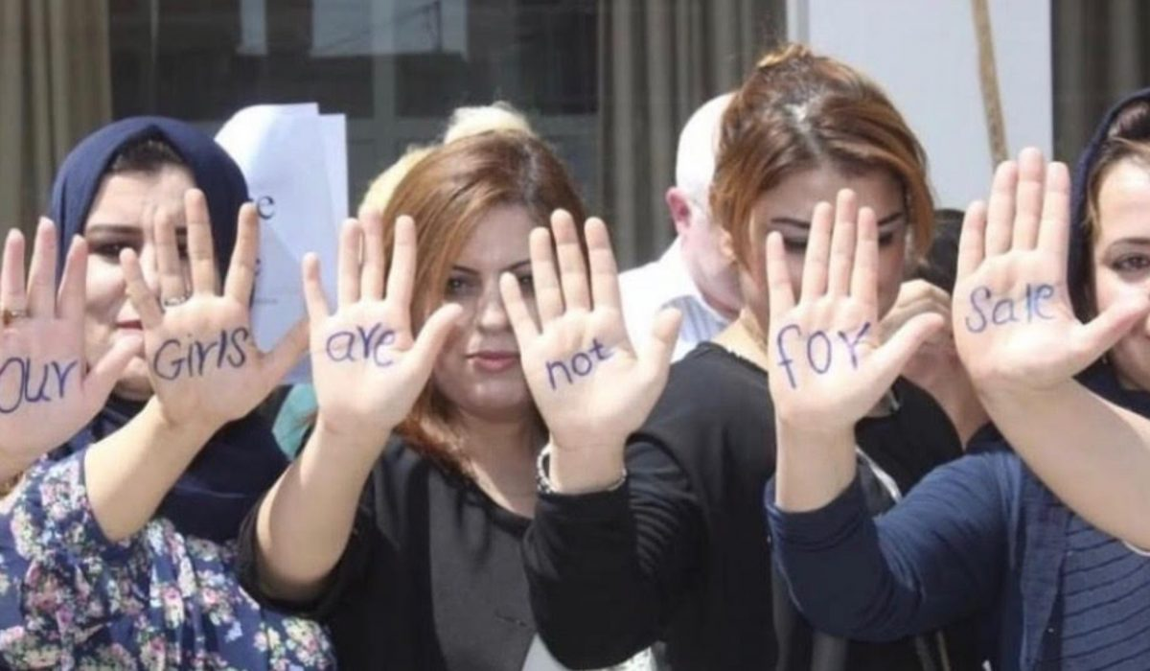
Support for Impoverished
Girls and Women
We are partnering with organizations like Ford to help fight for human rights in all forms. One example is Ford’s “Girls Not Brides” campaign.
.
In many parts of the world, girls and women are not respected. JMM fights to stop human trafficking, provides gifts to support girls’ in education and health. JMM also works to provide vocational training that can help overcome unhealthy cultural beliefs and offer them hope-filled futures.
Place Church Logo Here
15

Slide 16
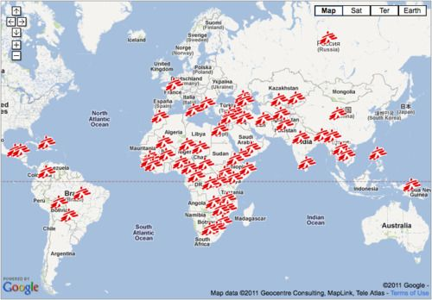
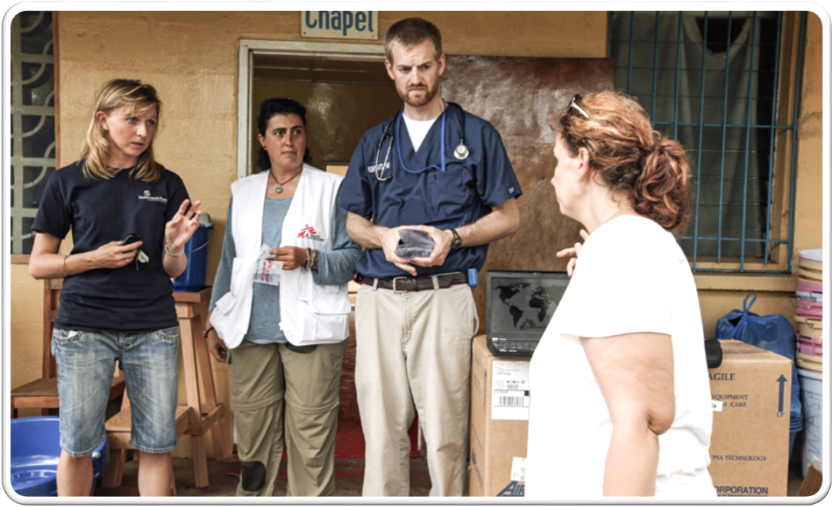
Better medical care
for improved health
We are partnering with organizations like Doctors Without Boarders to bring medical help to children and families in need.
Vitality and premature death in millions of children and adults around the world from illnesses that are preventable and treatable. JMM with DWB fights to provide the gift of basic health care and medicines that literally will saves and transforms lives!
Place Church Logo Here
16

Slide 17
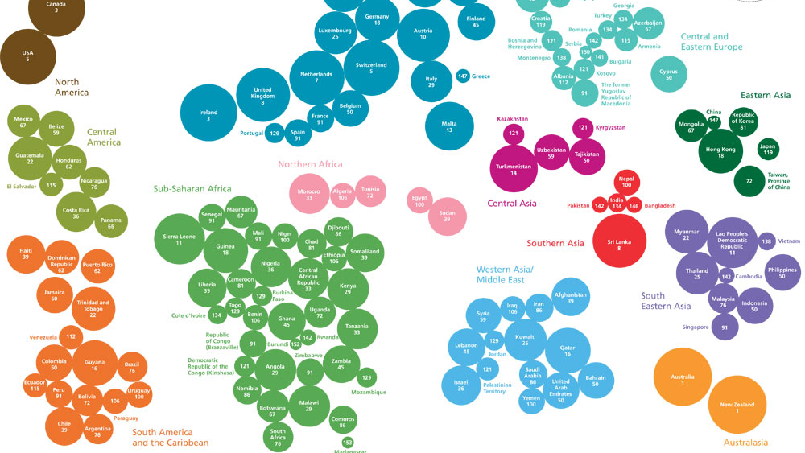
17

Slide 18
Industry Analysis and Trends
2
+
2
+
2
+
Humanitarian Aid

Slide 19
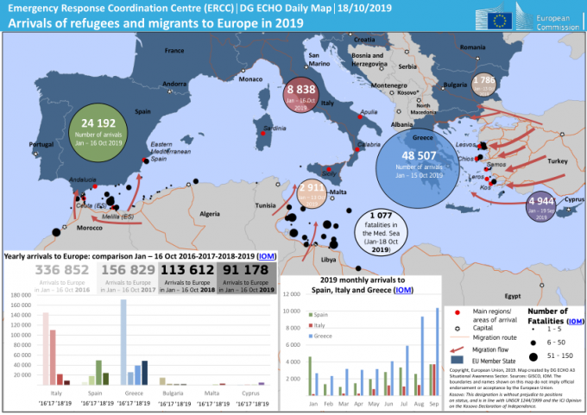
JMM
World in Crisis
2
+
According to Collacott (2018), an estimated 201 million people in 134 countries were subject to crisis and needed some form humanitarian aid. Though the Middle East continues to reduce aid funding from private donors – individuals, non-profits (NP), trusts, and foundations is increased. Individual charitable contributions remain the single largest source of private donations, though those from trusts and foundations are growing (Collacott, 2018). The need is still high, and the resource to meet that need is increasing. JMM can create a platform centered on excellence, technology, and Christ to take the resource of those who give and meet humanitarian needs quickly and efficiently. By introducing next generation Web Based technology that simply links three things together. Current NGO’s that respond in action, a current up-to-date crisis monitoring system, and a database of individuals, foundations, and governments willing to supply the need to those in crisis.

Slide 20
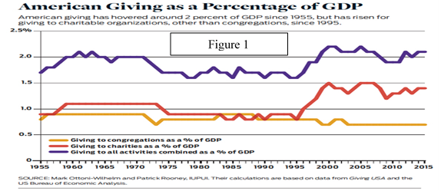
JMM
World in Economics
2
+
JMM is located in the US. Bea.gov reports that the GDP reported in the first quarter of 2019 is up by $3.1trillion (BEA, 2019). This is the highest it has been in many years. In addition, people are making more money and spending more money as US residence enjoy a more significant amount of disposable income (BEA, 2019a). If that is not enough, msnbc.com reported that in 2018 the unemployment rate in the US fell to 3.9% and has been in steady decline since its peak at 10% in 2009 (Benson, 2018). Finally, the reflection of this economic standing is shown in the amount Americans give to charities. In 2018, Americans gave $410.02 billion to charity blasting through $400 billion in charitable giving for the first time in history (Giving, 2018). This is good news for JMM whose primary source of revenue is charitable giving.

Slide 21
JMM
World in Philanthropy
2
+
According to a report performed by Stanford University giving to charities has substantially increased from year 2000 to 2019 almost matching the GDP curve (Lilly, 2019). Both of these facts show the market to be very healthy. Charitable giving is way up, as is philanthropic giving by faith-based organizations (Giving. 2015; Rooney, Ottoni-Wilhelm, Wang, & Han, 2019).
.

Slide 22

JMM
Continuing Trends
2
+
This trend will continue if people have disposable income. Since the evolution of the industry has now become an official career choice, the need is ever increasing, and crisis is always looming there is no other option but for these trends to continue. If one also reviews the sustainability movement in business, the tendency to heal environments, and solve global warming, alongside humanitarian crisis firms such as JMM have the potential to increase and meet the need. As the world becomes more enlightened one can only expect that in five- or ten-years philanthropic giving will double. In addition, as global warming challenges become more apparent, the earth can expect an increase in natural disasters. Not only does this bring the need for humanitarian aid but also counseling, spiritual guidance, and education.

Slide 23
The Humanitarian Situation in & Response
2
+
23

Slide 24
Strategic Positioning
2
+
2
+
2
+
Positioned to Give

Slide 25
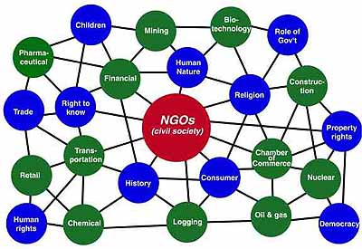
JMM
Strategic Positioning
2
+
Currently, JMM is positioning itself for success. The current economic standing of the US is the first thing that show today is the time to do something. Secondly, the internet and technology boom has impacted the world at large (Beer, 1980). Today every country is accessible through media. This makes things like logistics much more relaxed and cheaper. Also, since crisis is so readily seen on social media the outcry to do something by the world’s population has increased. Organizations such as the UN have sites that report on crisis globally like new.un.org. Such sites are adding to the outcry for humanitarian aid. On the gospel front, the mass migration from Iran continues according to worldpoliticsreview.com (Editors, 2018

Slide 26
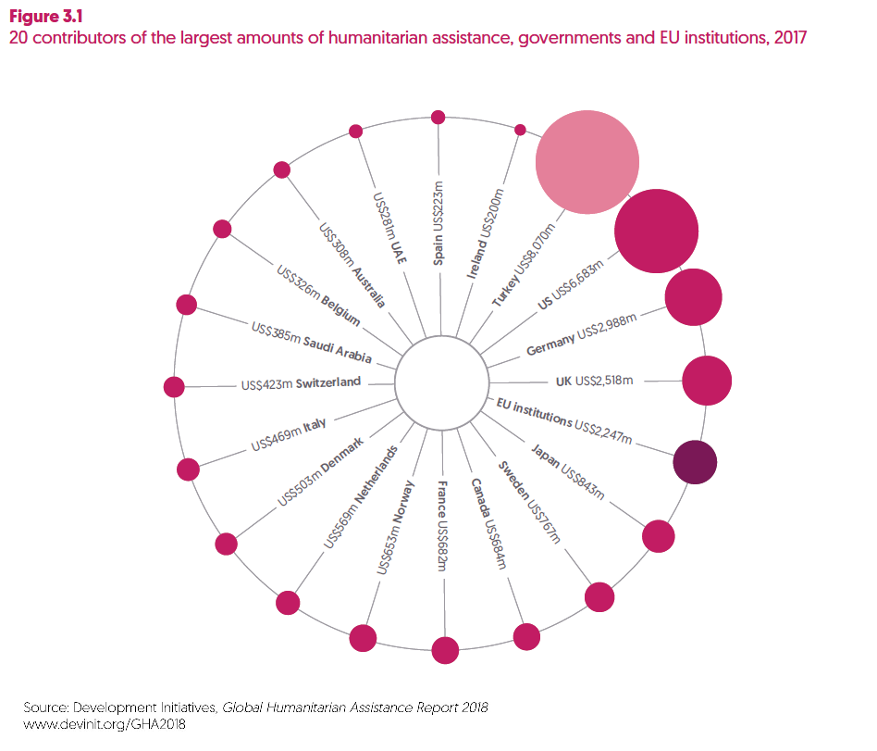
JMM
Prominent Philanthropy
When it comes to competitors, there are many. One, Action Against Hunger, exists to save the lives of malnourished children while providing access to safe water (Action, 2019). Items they have to overcome are logistics, monetary resources, agricultural resources, and technological resources. CARE​ dedicates itself to ending poverty, bringing social justice, and saving lives (Care, 2019). The CARE program’s biggest hurdle is monetary resources. Many people in the US recognize the name CARE from the grant program; they reduce electricity costs to low-income households. Doctors Without Borders (DWB) is comprised of doctors and health professionals aiding those in distress, victims of disasters, or victims of armed conflict (Doctors, 2019). Today DWB’s biggest hurdles include staffing and logistics.
2
+

Slide 27
JMM
Prominent Philanthropy
While those called to medicine usually are up for such things as DWB, many times, just getting the medical ship to port can be the factor that prevents medical care from happening. World Vision (WV) is a global Christian relief program working with children, families, and communities to overcome poverty (World, 2019). WV’s most substantial obstacles might include monetary resources, logistics, as well as, overcoming obstacles put in place by regimes caring more for power than people.
The most prominent players in the game according to owler.com are Five Loaves, Oxfam America, Fair Tourist, Food for the Hungry, Compassion, Goods for Good, Samaritans Purse, Chemonics International, World Vision, and UNICEF (Owler, 2019). Confusingly, owler.com reports $76.7 million at year end while SP lists $458 million at year-end 2018 this is quite a discrepancy (SP, 2019). Also, it is odd to see that SP is listed last in CEO rating; in any case, it is the goal of JMM to match or exceed the CEO rating of UNICEF--82/100.
2
+

Slide 28
Strategic Analysis & Intent
2
+
2
+
2
+
Jeffery Morse Ministries

Slide 29
JMM
SWOT
Opportunities– The amount of aid needed is growing exponentially. Today opportunities exists in obtaining higher education in humanitarian efforts. There is an opportunity in media. JMM has media channels available as the CEO does lives stream from the church he is on staff. Also, media opportunities exist due to the nature of social media. Opportunities exists with to partner with those already in the field.
Threats– JMM’s biggest threat is not obtaining the needed resources to fulfill its call. Secondly, if JMM is unable to retain its non-profit status for any reason. Lastly, a threat exists in its image. JMM must be diligent to protect its image as in this field one bad report could mean the end of ministry.
Strengths – The call of God. The outcry to do something by governments and peoples. US economics, and the upswing in giving. JMM is based out of California a liberal government. JMM has a new base of operations at low cost. JMM has existing web presents, and a lot of work already performed. JMM’s CEO just receive a BBAL degree.
Weakness– JMM is relatively unknown. JMM has not yet completed an international response. JMM has a lack in resource. JMM has a lack in volunteers. JMM is still an upstart.
2
+

Slide 30
JMM
AAA
Adaptation. JMM may create global value by changing one or more elements to meet local requirements instead of global ones. Since an opportunity may exist to take over the properties in which JMM is currently based, it may be possible first to focus locally and then branch out globally. JMM may create agriculturally based relationships that may later prove to provide revenue or supplies for local crisis and need. In recent years the city of Paradise burned almost completely. There is still a need to manage this crisis locally. The problem may be that if focus is changed from global to local, JMM may never achieve its global vision.
Aggregation. Aggregation could play a part in the future. Aggregation is mainly about creating economies of scale. Since JMM is still in a start-up this is not currently a viable alternative. However, as JMM grows and supplies food, clothing, shelter, and care, aggregation will take a center role.
Arbitrage. Arbitrage at its core, is defined in one saying–buy low sell high. Alternatively, arbitrage could take on another meaning. If JMM can search out what it is that current global ministries are struggling with and fill the need they have this could easily springboard JMM into the global market. The downfall of this is it could create only one area of ministry that JMM functions in, but that ministry would be a global one.
In considering SWOT and AAA, it is recommended to do an unbalanced hybrid strategy. Mainly focusing on arbitrage but adapting for local ministries also. This would help JMM to establish its name locally and globally at the same time. Problems with setting a timetable with this method may exist as who and when the opportunity to provide ministry and retaining adequate resources to do so may be highly randomized.
2
+

Slide 31

JMM
Strategic Intent
S.M.A.R.T. goals for JMM
Goals are fundamental. The next primary goal for JMM is its non-profit standing. This can be broken down into the following smaller goals. 1. CEO acquires B.A. from Brandman University by November. 20, 2019. 2. All paperwork that needs to be sent with the application reviewed No later than Dec. 1, 2019. 3. Financial costs for the application acquired no later than December 20, 2019. 4. Mail the application by Jan 1, 2020. By the time the application is sent JMM should also have be informed whether they will be taking over the properties outside of Yuba City. If they do, then local efforts for ministry will begin, if not then attempts will be made to align with a global ministry like World Vision. With a bachelor’s degree in business opportunities should begin to be presented. Finally, if all that fails the CEO can acquire a teaching credential and begin teaching. Oversees teaching may be an option to springboard JMM into the global market through education.
2
+
1. Establishing JMM both locally and globally.
2. Improve inter-agency response by completing and distributing JMM’s version of the Crisis App.
3. A practical and inclusive humanitarian partnership system (regional and global).
31

Slide 32
Product Service
2
+
2
+
2
+
Jeffery Morse Ministries

Slide 33

JMM
Product
Defining the Product The product that JMM offers changes according to who is asking. For some big business, it is merely a tax right off. For the person called to make a change it is an opportunity to do just that. One person may feel the best way they can have a positive effect is to volunteer. Another person may not have time to volunteer but may choose to donate making it possible for others to go in their place. For the founder of JMM the product is Love – but not for sale. Jesus offers a new life, deliverance from bondage, healings, a friend who will walk through trials and tribulations, but most of all freedom to choose.
More than any other thing in this world the gospel of Jesus Christ has brought healing, hope, and security. For a comprehensive testimony of the power of God to do healing work please visit YouTube and search “God Healed Me”.
2
+
33

Slide 34
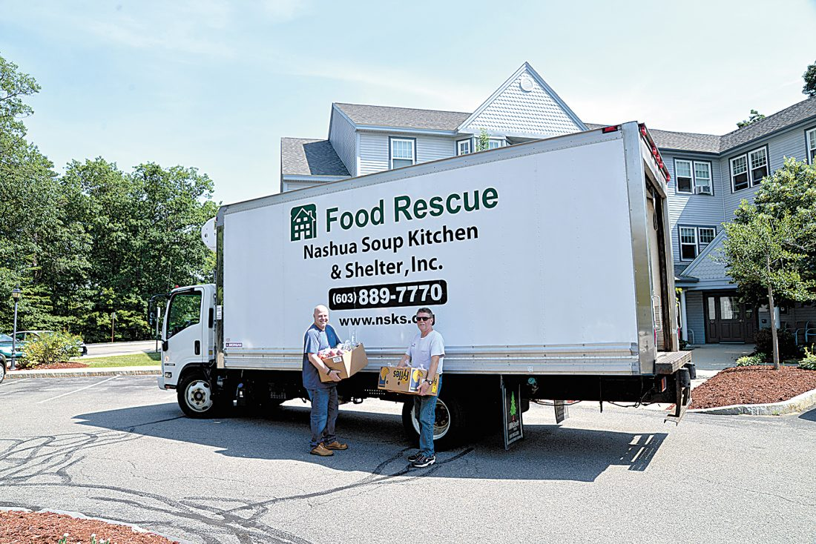
JMM
Services
The emissaries of Christ at JMM offer food, shelter, or whatever they can give to meet a need when they are equipped to do so and sometimes when they are not. For some maybe JMM offers the opportunity of positive impact for them to invest. Others may feel JMM is an opportunity to right wrongs or atone for some past wrong; still others are driven by an inward need just to do good. JMM serves people. Areas of service include training, education, food, shelter, and clothing. While the only real call is from Jesus, he tells us if we have done it for any of these than we have done it for him.
2
+
34

Slide 35
worthwhile
2
+
2
+
2
+
Love God & Love People

Slide 36
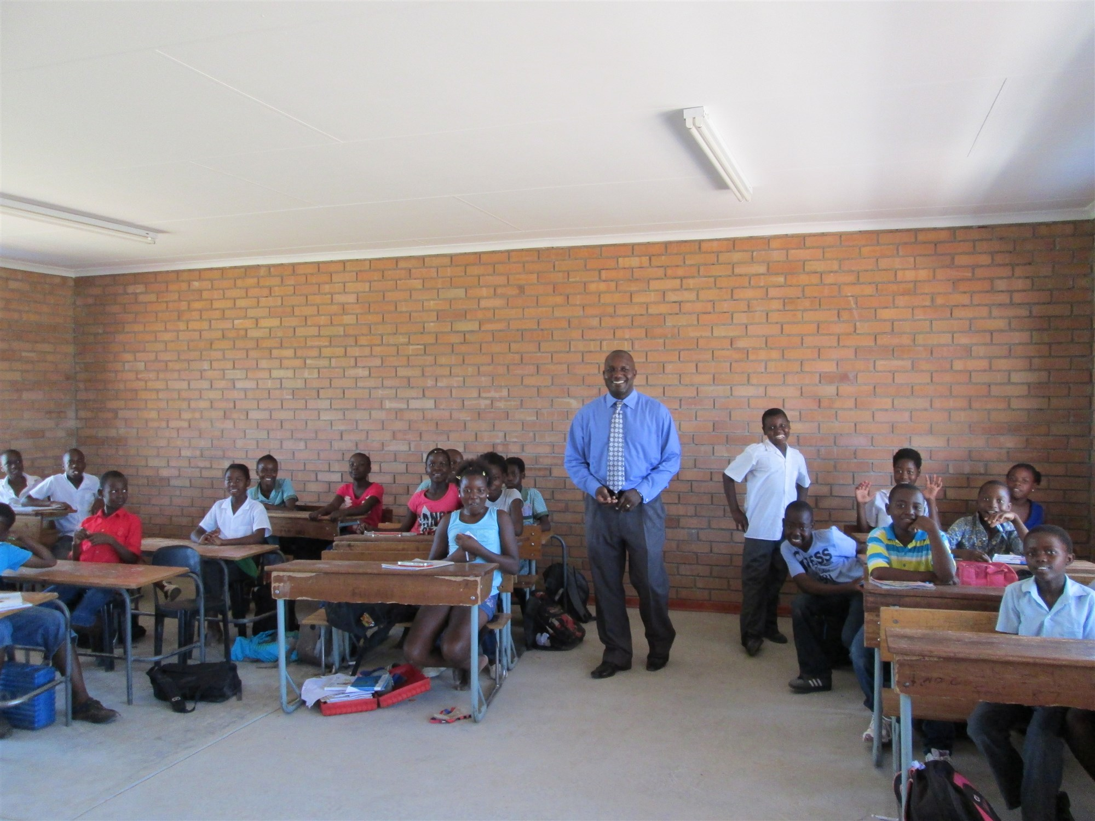
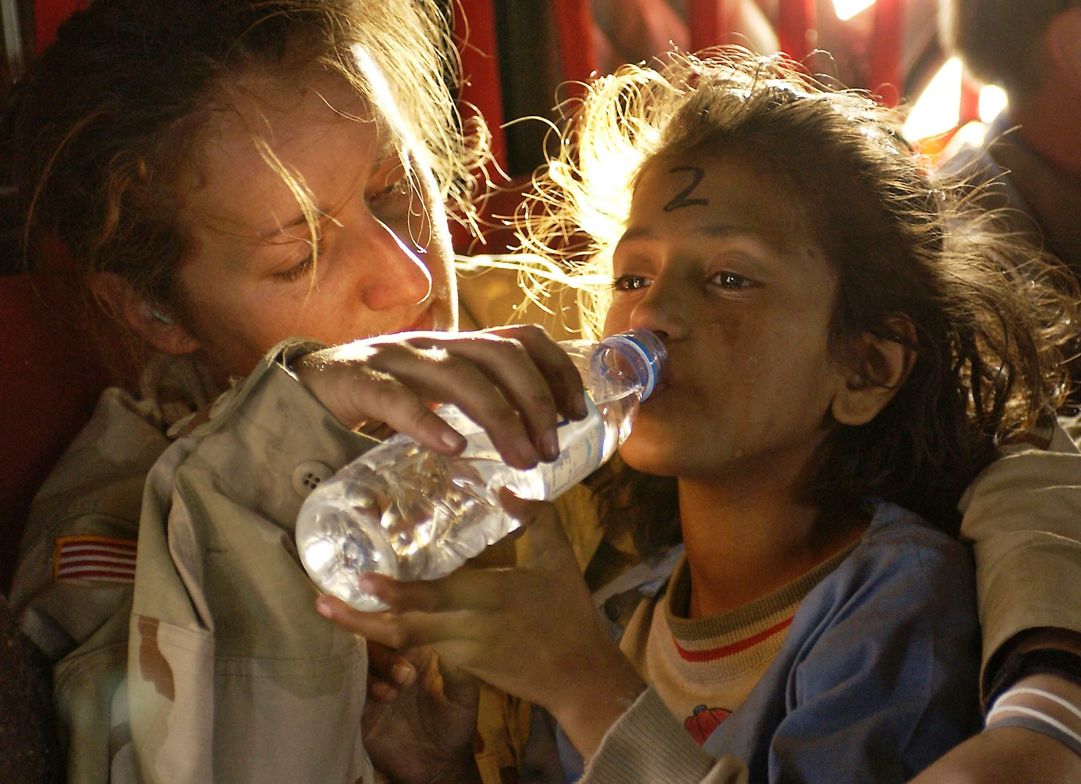
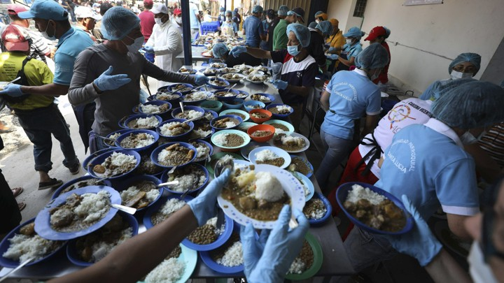
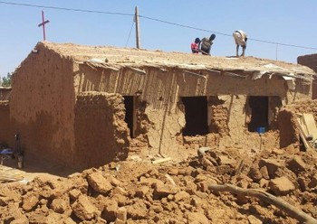
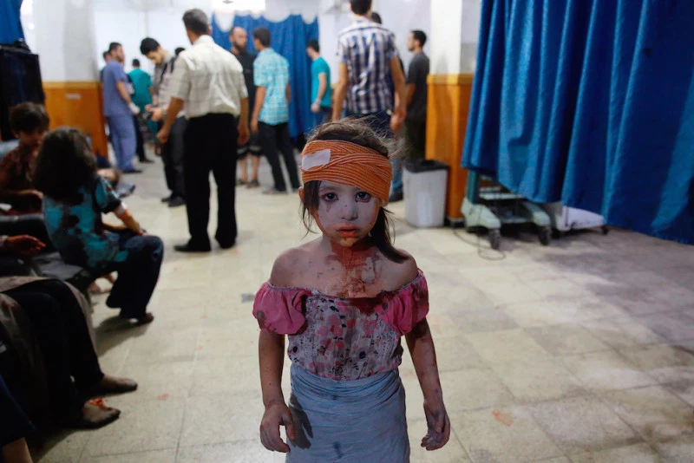
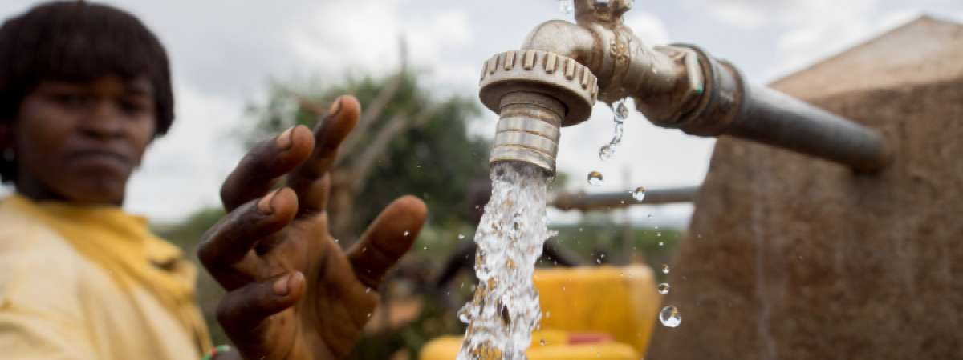
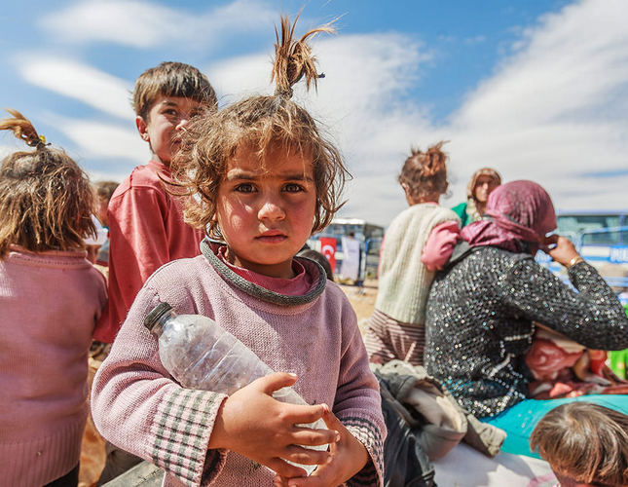
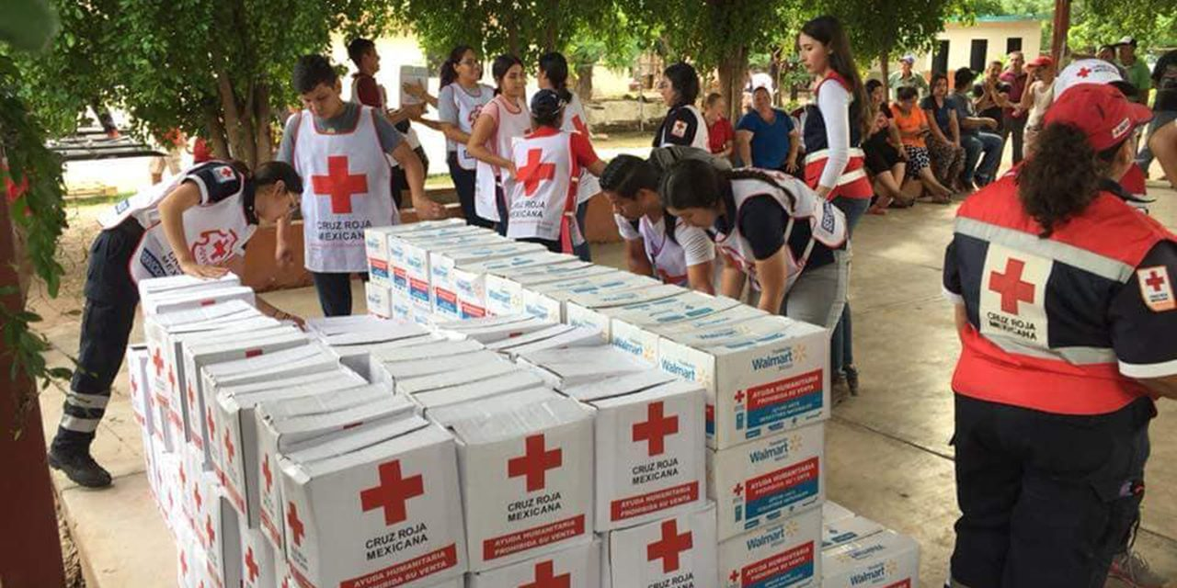
JMM
A Worthwhile Endeavor
Today most who seek riches find that they are unfulfilling. Real riches cannot be measured in dollars. Jesus' legacy is that He does good, heals all he can heal, and always tells the truth. He is the truth, life, and the way. Amazingly, He taught this over two thousand years ago, and today it mostly is still not learned. One pastor when asked if celebrating Christmas was of God, his response was, “have you ever seen a child’s face light up as they run to open presents on Christmas morning?” Pure joy cannot be bought, but money can buy presents. At the end of the day one may look in the mirror. At that moment do they hate who they see or love who they see? JMM will bring meaning to the lives of those who administer ministry to those in crisis. Those in crisis are comforted by ministering angels. Those that supply revenue takes part in making this all happen. What is the price tag for a life? The service of JMM is to supply the Gospel of Jesus Christ, spiritual guidance, establish educational centers, emergency aid, food, clothes, medical, or housing in the short term and work to train people to provide those things for themselves.
2
+
36

Slide 37
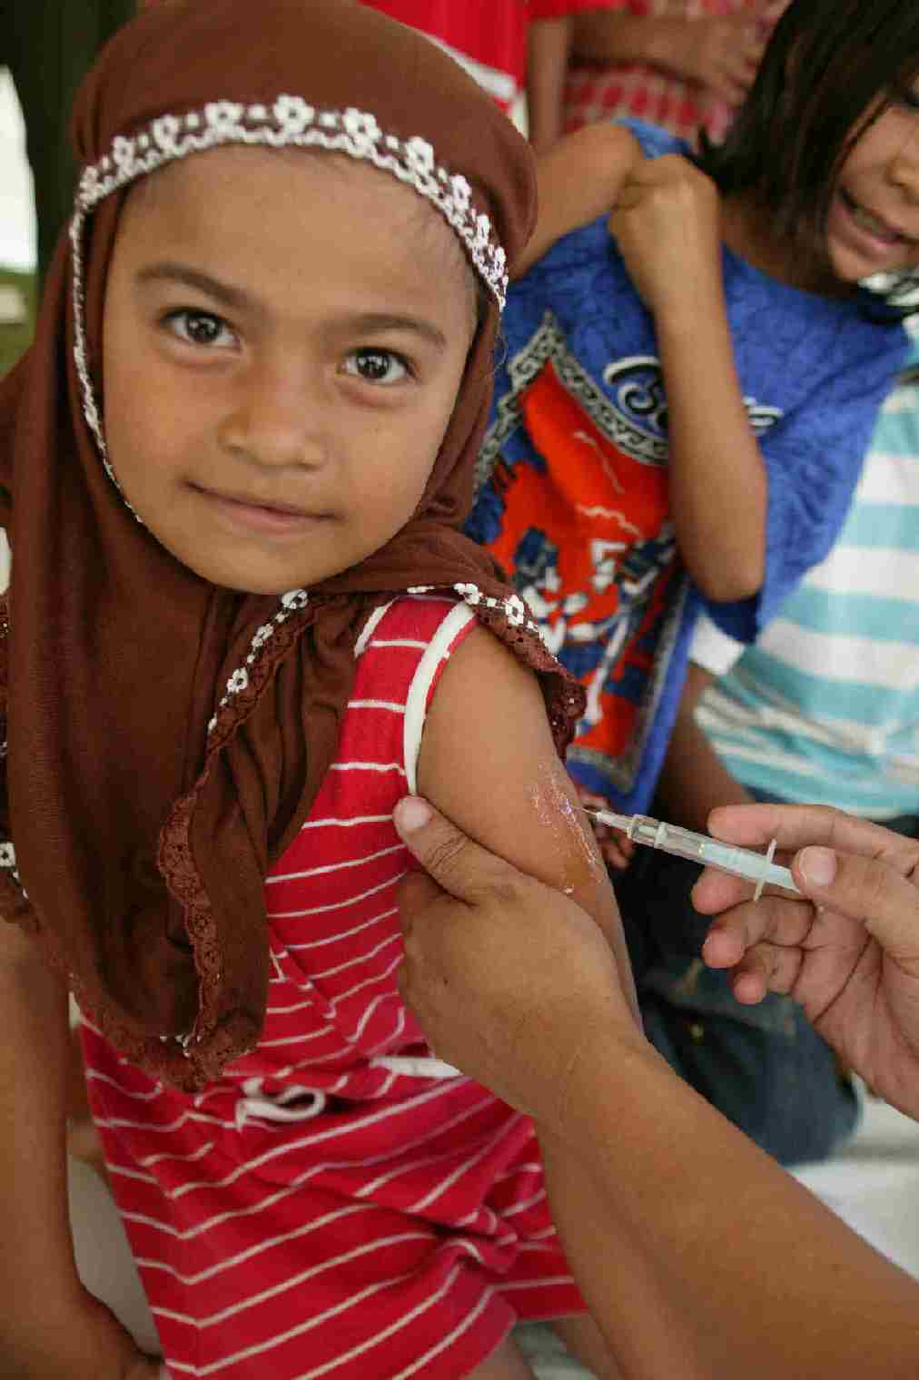
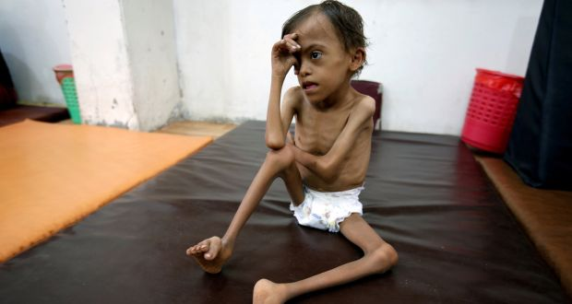
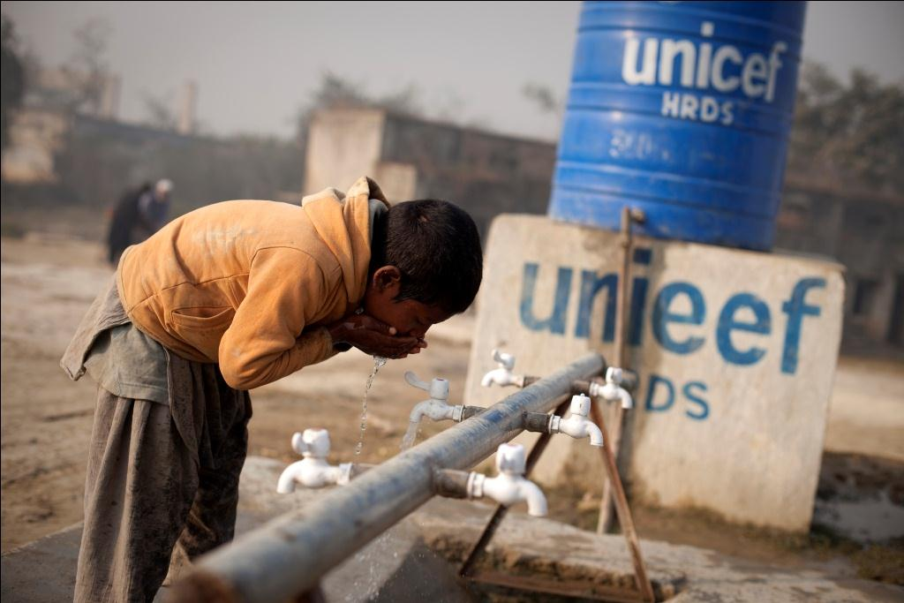

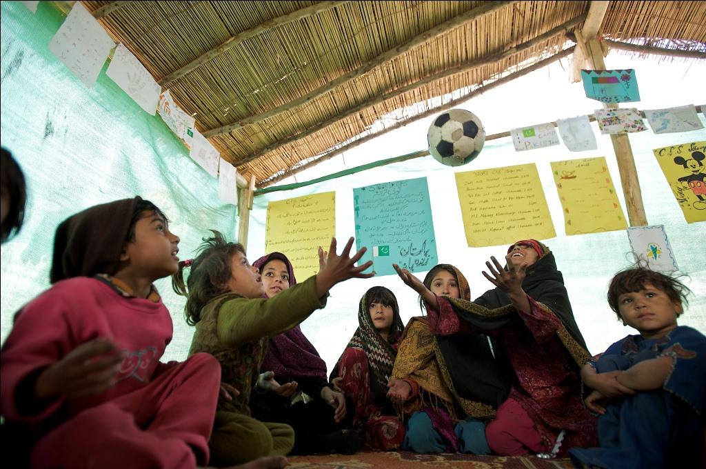
JMM teams with UNICEF’s Core Commitments for Children
Water, Sanitation
& Hygiene
Health
Nutrition
Education
Child Protection
37

Slide 38
liability concerns
2
+
2
+
2
+
Jeffery Morse Ministries

Slide 39
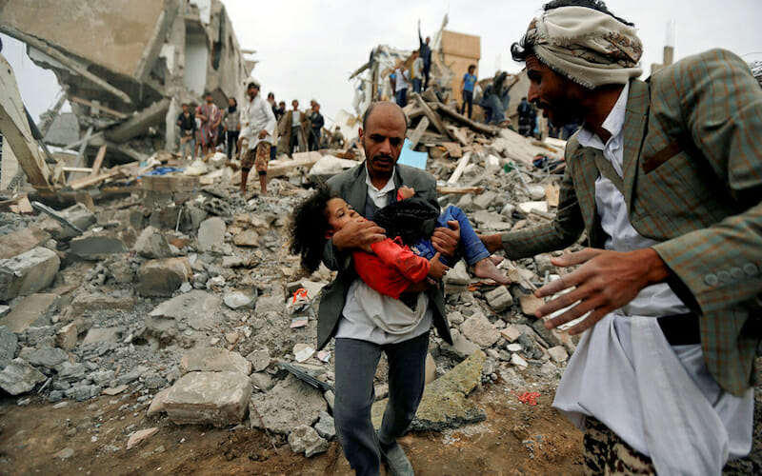
JMM
Liability
There are liability concerns in the field. Lives can be lost, people kidnapped, and property stolen. It is human nature. The same freedom given by God that allows some to seek to save a life; unfortunately, also provide opportunity for some to take a life. The same freedom that allows one person to give money also allows another to steal it. As the champions of light battle to stay the darkness, sometimes darkness still prevails temporarily. In any case, it is imperative that before JMM has anyone go out in ministry that the appropriate steps are in place. Their legal concerns as well, while in another country JMM representatives do not hold diplomatic immunity of any type. They must obey local laws – which in turn suggests that they must know the local laws. Lastly, communication is always a concern. One may unintentionally say something offensive and cause problems. Therefore, its best for a manager to know the local customs and language.
2
+
39

Slide 40
Management Plan
2
+
2
+
2
+
The buck stops here

Slide 41
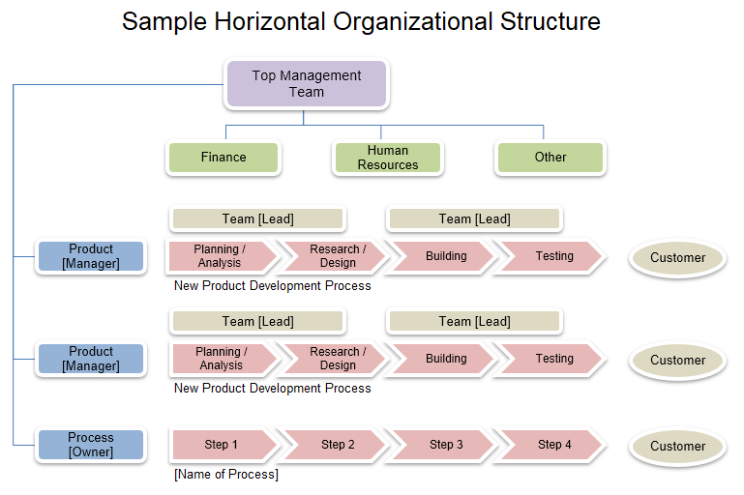
JMM
Management
Hiring Projections
Currently, JMM is classified as an LLC to keep costs low as currently the resource to support a corporate structure does not exist. An LLC while not optimal for humanitarian responders nor for those that bring the gospel it does provide a way for JMM to begin to respond to need. Hiring projections have been created using three separate models. JMM’s goal is to convert to a Corporation within five years. In this model there is only the CEO for the first year and then a secretary and CEO for the next year. After that key managers / ministers will be added one each year. The key managers also serve as a board of directors. These same will become the board of directors after incorporation. JMM has capped the amount that can be made to 100K a year for any board/management member as the vision is for most recourse received to be used for its intended purpose. Outside professionals and licenses and other compensated employees will be pursued when it is needed. For further information about the management structure please visit JefferyMorseMinistries.com and view the Constitution and ByLaws.
The biggest work force for JMM is in its volunteers. Volunteers will be the driving work force and managers are used mainly for evaluating and delivering aid response in a crisis. Volunteers will hold all other positions listed in pink or brown.
2
+
41

Slide 42
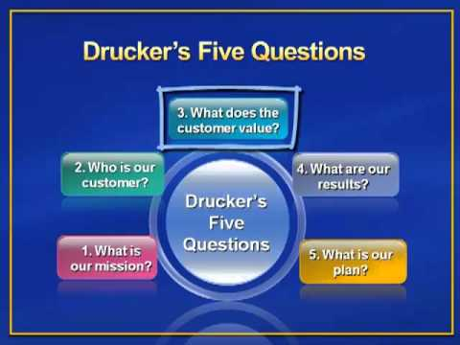
JMM
Management
Drucker’s Five Questions
What is your mission? The mission of JMM is to Preach the Gospel of Jesus Christ, provide humanitarian aid, food, clothes, housing, and medical. To establish schools and places of worship, and to license and train ministers.
Who is your customer? Our customer is anyone who has not heard the Gospel of Jesus Christ, who needs food, clothing or shelter, or requires education.
What does your customer value? The customers of JMM value the truth, empathy, and sincerity and people or organizations who are willing to provide help without judgment.
What are your results? JMM finds that there is need for altruism, need of ministry and a need for action in crisis.
What is your plan? JMM plans to connect the charitable efforts of people with the needs of others.
2
+
42

Slide 43
Marketing Plan
2
+
2
+
2
+
Jeffery Morse Ministries

Slide 44
JMM
Marketing
Get the name known. The first step in the marketing plan includes the establishment of a web page with a blog that uploads pictures of current ministries in which JMM is involved. The current page is outdated and needs upgrading. Secondly, create a social web presence by utilizing Facebook, Instagram, Snapchat, Twitter, and YouTube. Each Social place must receive updates twice a week minimum, excluding YouTube which will have two channels one for the preached word or teaching once a week and one for video on the gospel being preached, healings taking place or humanitarian need being provided. Finally, it is imperative that the other players in the humanitarian/evangelistic field begin to hear from JMM regularly first through an introduction letter/flyer/ email and then further communication designed to align JMM with other ministries and organizations.
Media. JMM will begin to use the radio, T.V., YouTube, and Facebook ads to advertise the name and the mission.
Address Crisis. JMM will seek and assist in acting in a significant crises.
Start actively seeking revenue and build up funds.
Lastly, JMM will take on humanitarian efforts as the lead organization.
Information. One of the most problematic things for humanitarian efforts is information accumulation. For this reason, JMM will partner with an organization such as ACAPs who just put out their first crisis alert app in February 2017. The app lists more than 40 key crisis countries and offers up-to-date detailed humanitarian crisis information and is available for iOS and Android. JMM will use a specialized form of the app which incorporates supply chain information, tracking, and human resource.
Distribution tiers. The distribution tiers are yet to be designed for the logistics of food and clothing. One possibility is through military transport. Most military hops are less expensive, and the US is usually ready to help transport humanitarian items. Secondly, it may be better to partner with an existing humanitarian aid NGO like the Red Cross, whose logistics has been stable for years.
2
+
44

Slide 45
JMM
Marketing –Strategic Advantage
The customer relationship management plan (CRMP). The CRMP for JMM is social media based. By utilizing social media, customer relationship management can excel. In addition, traditional methods such as email, video conferencing and mail will be used when needed. Lastly, personal one-on-one meetings many times are the only way to get something done or resolved. However, since all revenue is through charitable donations, and JMM is mandated to be a good steward of those funds expensive flights and stays will only be when necessary. If there is any possibility of accomplishing the work through video conferencing or other means this will be the first choice. The handling of unsatisfied people and complaints is of utmost importance. All efforts will be made to resolve any issue.
Other Things
Management Information System (MiS) plan
The expanded Crisis App is the cornerstone of JMMs MiS and competitive advantage. Logistic checks will occur on an online portal accessible from a cell phone. The supply chain will be tracked by scan code and entered into the MiS. At an instant, JMM should be able to locate resource coming in and its delivery time, as well as humanitarian needed items going out and its delivery time. The portal will also include employee and management check-ins that have comment areas for problems encountered that are carbon copied to the key management team. This not only keeps track of employee safety abroad but also allows a team to work out any hiccups right away. MiS will develop lists of preferred logistics that are available for scheduling for which items need shipping. Inventory of food, clothing, perishables and medical supplies will also be kept in the MiS. Lastly, employee timecards and any work-related equipment assigned to them.
Competitive Advantage
According to Darnall and Preston (2012), first-mover advantages often last for a decades or more (Darnall & Preston, 2012). Though JMM will not be the first in responding to crisis aid or preaching the gospel its approach may prove to have first-mover benefits anyway. The Crisis App linked with supply chain management, human resource, risk, and Information systems management is revolutionary. More on this later.
2
+
45

Slide 46
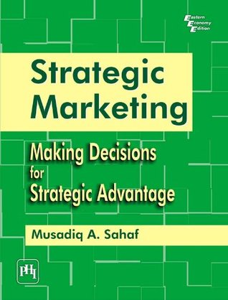

JMM
Marketing –Strategic Advantage
Some other ways JMM can achieve a competitive advantage might be the Home-Country Demand Knowing one's market locally may be an advantage. Still, other advantages include Total Quality Management (TQM), Innovation, Joint Ventures Partners (a cooperative arrangement that involves two or more organizations), Strategic Alliance (a cooperative agreement between two or more firms) and Customer Focus (Darnall & Preston, 2012; Global Industry Analysts, Inc., 2011). Further, since JMM is people-centered its ability to get and retain great employees should excel as a result of the fully paid health and benefit plan. Lastly, our people will be doing what they love because they care about people and the environment. As a result, sustainable green options will be chosen, and quality will be addressed in the Total Quality fashion.
The Four Ps
The four Ps of Marketing are Product, Price, Place, and Promotion. They are also known as the 'Product Mix.' How the four Ps apply to JMM: the Product is through humanitarian aid and the gospel. Both are free to the customer but cost a lot to provide. The place: the place of need which is the entire world. This leaves only promotion. Promoting JMM was covered in the marketing strategy. However, today is an optimal time for JMM to upstart as charitable contributions are at a high in the US.
The Overall marketing strategy. Overall strategy for JMM is not focused on the customer but the provider. In the financial forecast of JMM it was recommended that JMM pursue foundation grants as a source. This may be difficult as most foundations like to see a history in humanitarian aid, and JMM is new to the global arena. To compound the problem most foundations prefer to give to non-profit corporations, not non-profit LLC’s. However, JMM only needs one significant donation to get the wheels rolling.
The specific marketing mix. A specific marketing mix for JMM is using foundations and grants minimally. Individual donations are to be the primary source of revenue. Advertising will go out through mailers, billboards, web media, social web sites, commercials on radio, tv, Facebook and YouTube.
The Strengths and weaknesses. Inability to satisfy the target market needs lay in the targeting algorithms of Google and Facebook. Weaknesses might include such things as not knowing how many large donators potential contributors use those sites. It may be necessary to develop an alternative marketing plan for those that give large donations.
The Communication Plan
The communications plan is the final area of this section. First, internal communications will be face to face whenever possible. This will alleviate misunderstandings. Resources such as Monday.com for scheduling and task accomplishment will be leveraged. Video chat is preferred over phone calls and Facebook has a free one that is worldwide. Weekly internal mandatory meetings keeping track of logistics, goal accomplishment, and upcoming endeavors will be weekly. Finally, any change to a project plan must be approved in a weekly meeting by the key managers. Externally, JMM representative must be polite, empathetic, and professional. Language is maintained as an example of purity. No foul language is acceptable at any time. When addressing problems, it is important to find the best resolution for the customer and the provider. Finally, when dealing with people it is JMM’s instruction not to be alone. There must always be a witness to prevent false allegations of any type. There has been a computer network plan created and available upon request.
2
+
46

Slide 47
Operations Plan
2
+
2
+
2
+
Jeffery Morse Ministries

Slide 48

JMM
Operations
What products are involved in the supply chain of JMM? JMM is like several businesses rolled up into this one organization. First, presenting the gospel might include travel, housing, and food for sure. However, there are two items that may be overlooked that would be at the heart of all the ministries—at the top of the list is relationships. Cultivating relationships with governments is of utmost priority. Secondly, developing relationships with humanitarian organizations in other countries is the second most crucial part of the supply chain of JMM. Following those is cultivating relationships with individuals. Getting boots at ground zero of a crisis as fast as possible is the first call. Secondly, are humanitarian needs such as water, food, clothing, and shelter. Because of the necessity of quickness of time, it is imperative that good relationships are cultivated with governments and humanitarian organizations (HO) on foreign continents
It is simple, the closer the product is that needs to be shipped, the quicker it will arrive. While one might argue that with today’s superfast air freight world delivery system that this is no longer true the logic behind this is simple. Air freight costs more than truck, train, or marine cargo. The competitive advantage is in the time factor. If JMM can deliver its product as fast as air freight, by utilizing a resource that is nearer to the crisis, while cutting costs by using a different mode of delivery, than more dollars can be spent on actual aid than on logistics. In business this is not a new idea.
2
+
48

Slide 49
JMM
Operations
Relationships with Governments
Humanitarian Organizations and Others
Cross-docking.
Just in Time Supply Chain Strategy
Quantitative factors for a crisis might include product costs, utilities, taxes, housing, transportation, real estate costs, labor costs, construction costs, and government incentive payouts (White & Vonderembse, 2013)
Qualitative factors include the environmental climate, labor climate, political climate, quality of life, proximity to volunteers, and proximity to suppliers and resources (White & Vonderembse, 2013). Loss of hope is hard to fight. If help is close it has the added effect of producing hope in the lives of those affected by the crisis. The bible states that hope deferred makes the heart sick (Prov. 13:12, KJV)
Resource Planning (RP)
RP is needed to better coordinate the activities of operations, distribution, and purchasing. Implications in the master schedule need allowances for personnel, shipping, workforce requirements, purchases of materials and finance. Resource planning helps to tie all parts of an organization together in producing a strategic plan.
Benchmarking.
The plan-do-check-act cycle.
Scheduling & Data collection.
Cradle to End of Life or Cradle to Cradle
Green Policies
2
+
49

Slide 50
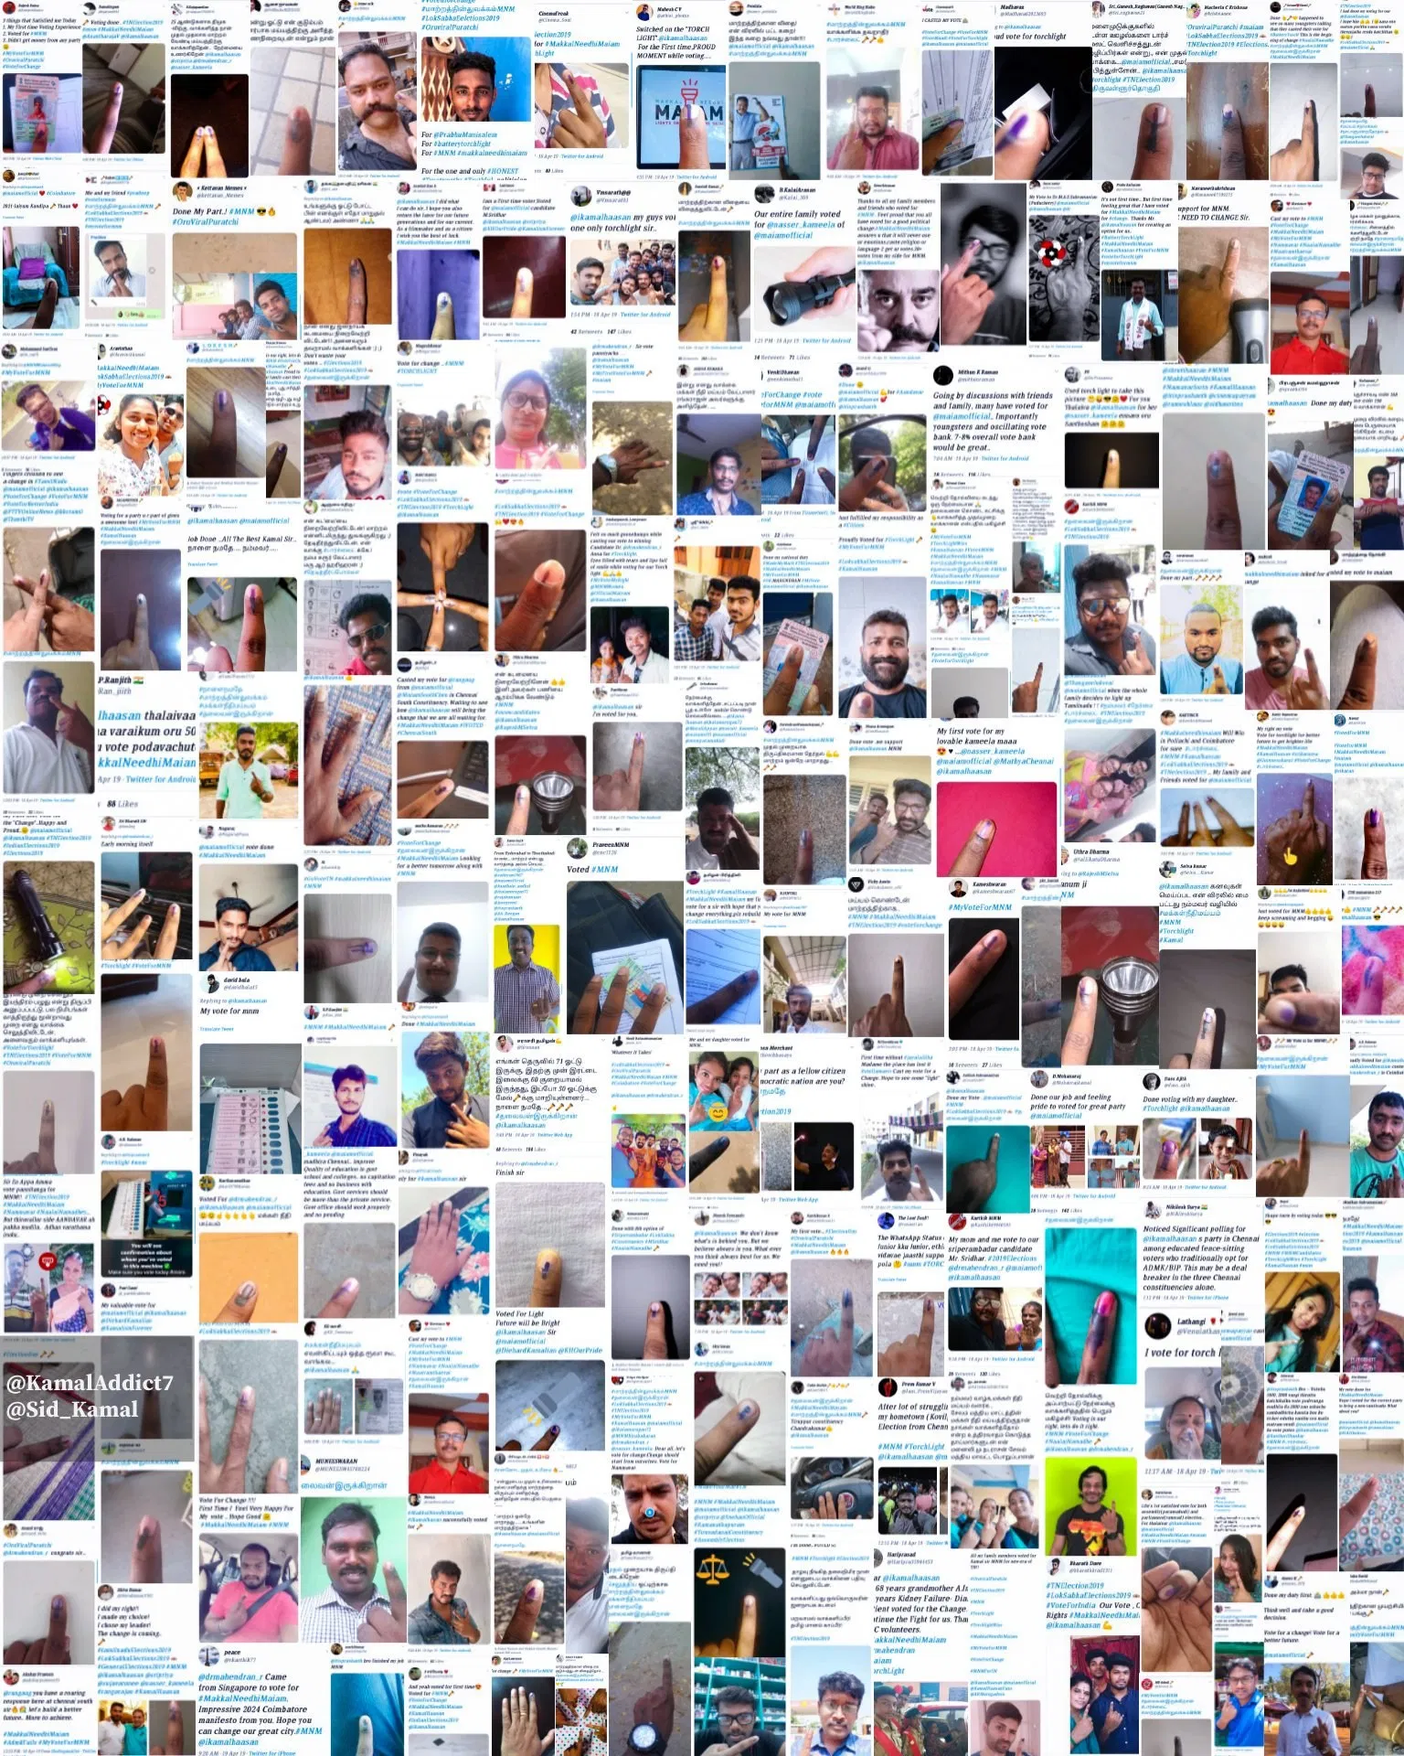
JMM
JMM
&
The
Crisis
App
Individuals
Giving
Foundations
Giving
Partners
Supply Chain
Governments
For
Profit
Giving
Giving
Partners in
Need
Giving
50

Slide 51
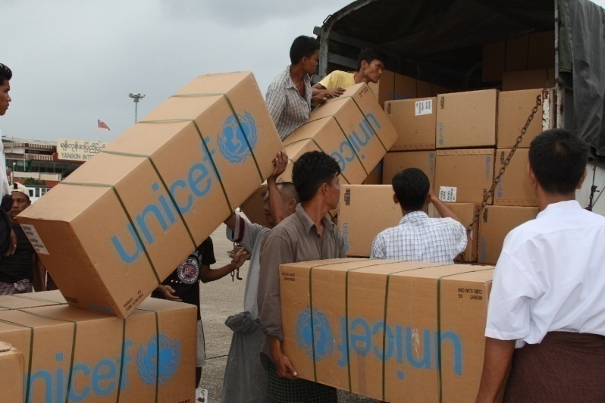
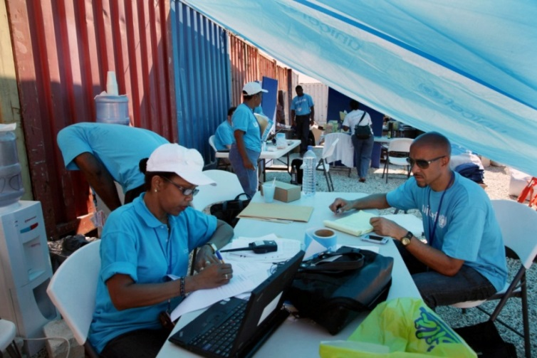
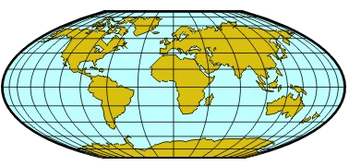
UNICEF is set up Globally
UNICEF GENEVA
Partnerships with other UN agencies
Fundraising
Global Cluster Support
UNICEF NYHQ
Office of Emergency Programs
Emergency Response Team
Global Support for Program Areas
Global Cluster Support
COPENHAGEN SUPPLY DIVISION
Regional Offices (7 locations)
- Guidance and direct support
SHANGHAI SUPPLY HUB
County Offices
Emergency Response Plan
Stockpiling supplies
Working with partners
PANAMA SUPPLY HUB
DUBAI SUPPLY HUB
UNICEF
51

Slide 52
Financial Plan
2
+
2
+
2
+
Show Me The Money!!

Slide 53
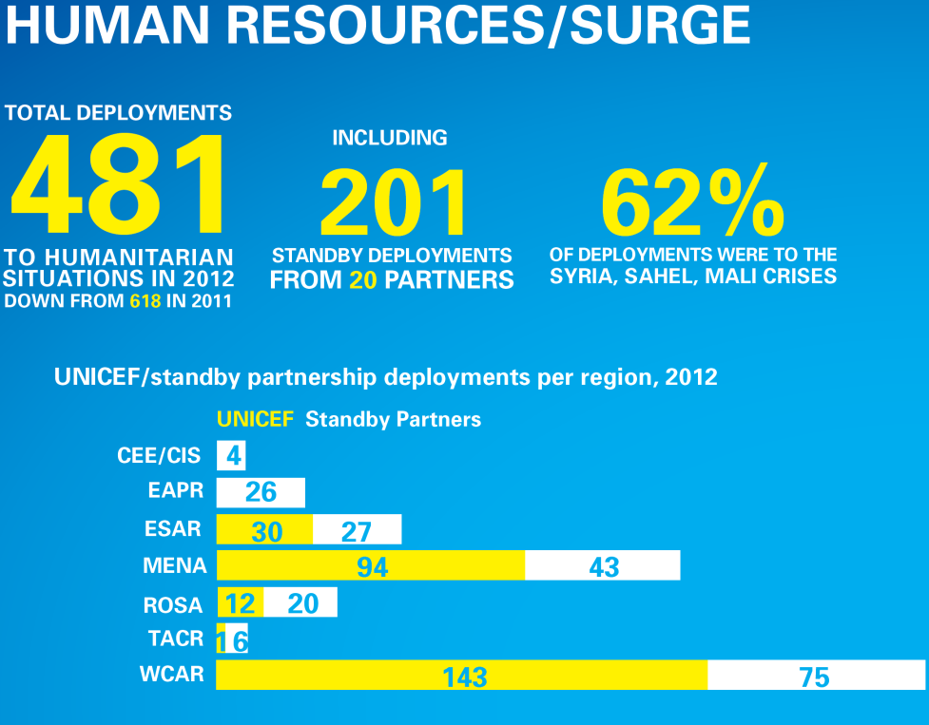

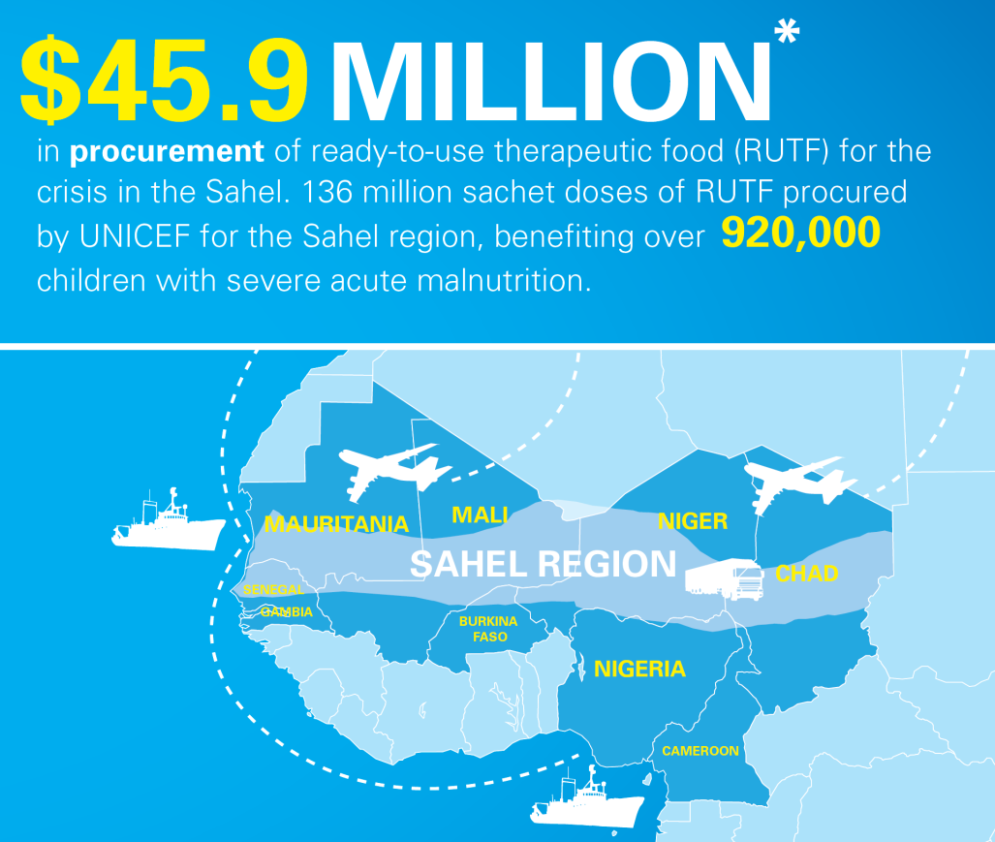
Humanitarian Income
2
+
53

Slide 54
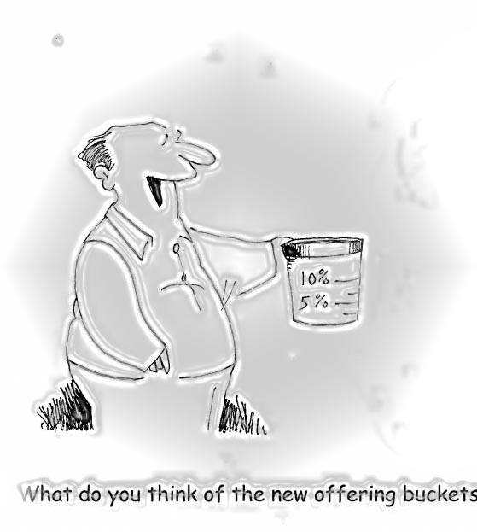
JMM
Financial Plan
As JMM is a new venture, there is no historical data. However, projected revenue is available (Morse, 2019). Charitable donations. Charitable donations are JMM's most significant source of revenue. General calls go out for monthly support through radio, tv, mail, email, social web, and billboards. Further, personal calls go out when a key manager preaches or holds a revival meeting, dinner, or personal outing. Lastly, charitable donations come in from partners and other HOs. It is not uncommon for other philanthropic organizations to support each other.
Grants. Grants from foundations and government entities must be applied for but also represent up to approximately 25% of income revenue.
Contracts. Sub-contracting with other non-profit organizations, governments, for-profit organizations, or other government entities like FEMA is also a common source of income.
Financing. Lastly, loans from financial institutions is a source of revenue for the purchase of building, land, or other properties. Loans are not to ever be used for aid or aid supplies. Please note that JMM has specific rules financial loans, please refer to the JMM constitution and bylaws.
2
+
54

Slide 55
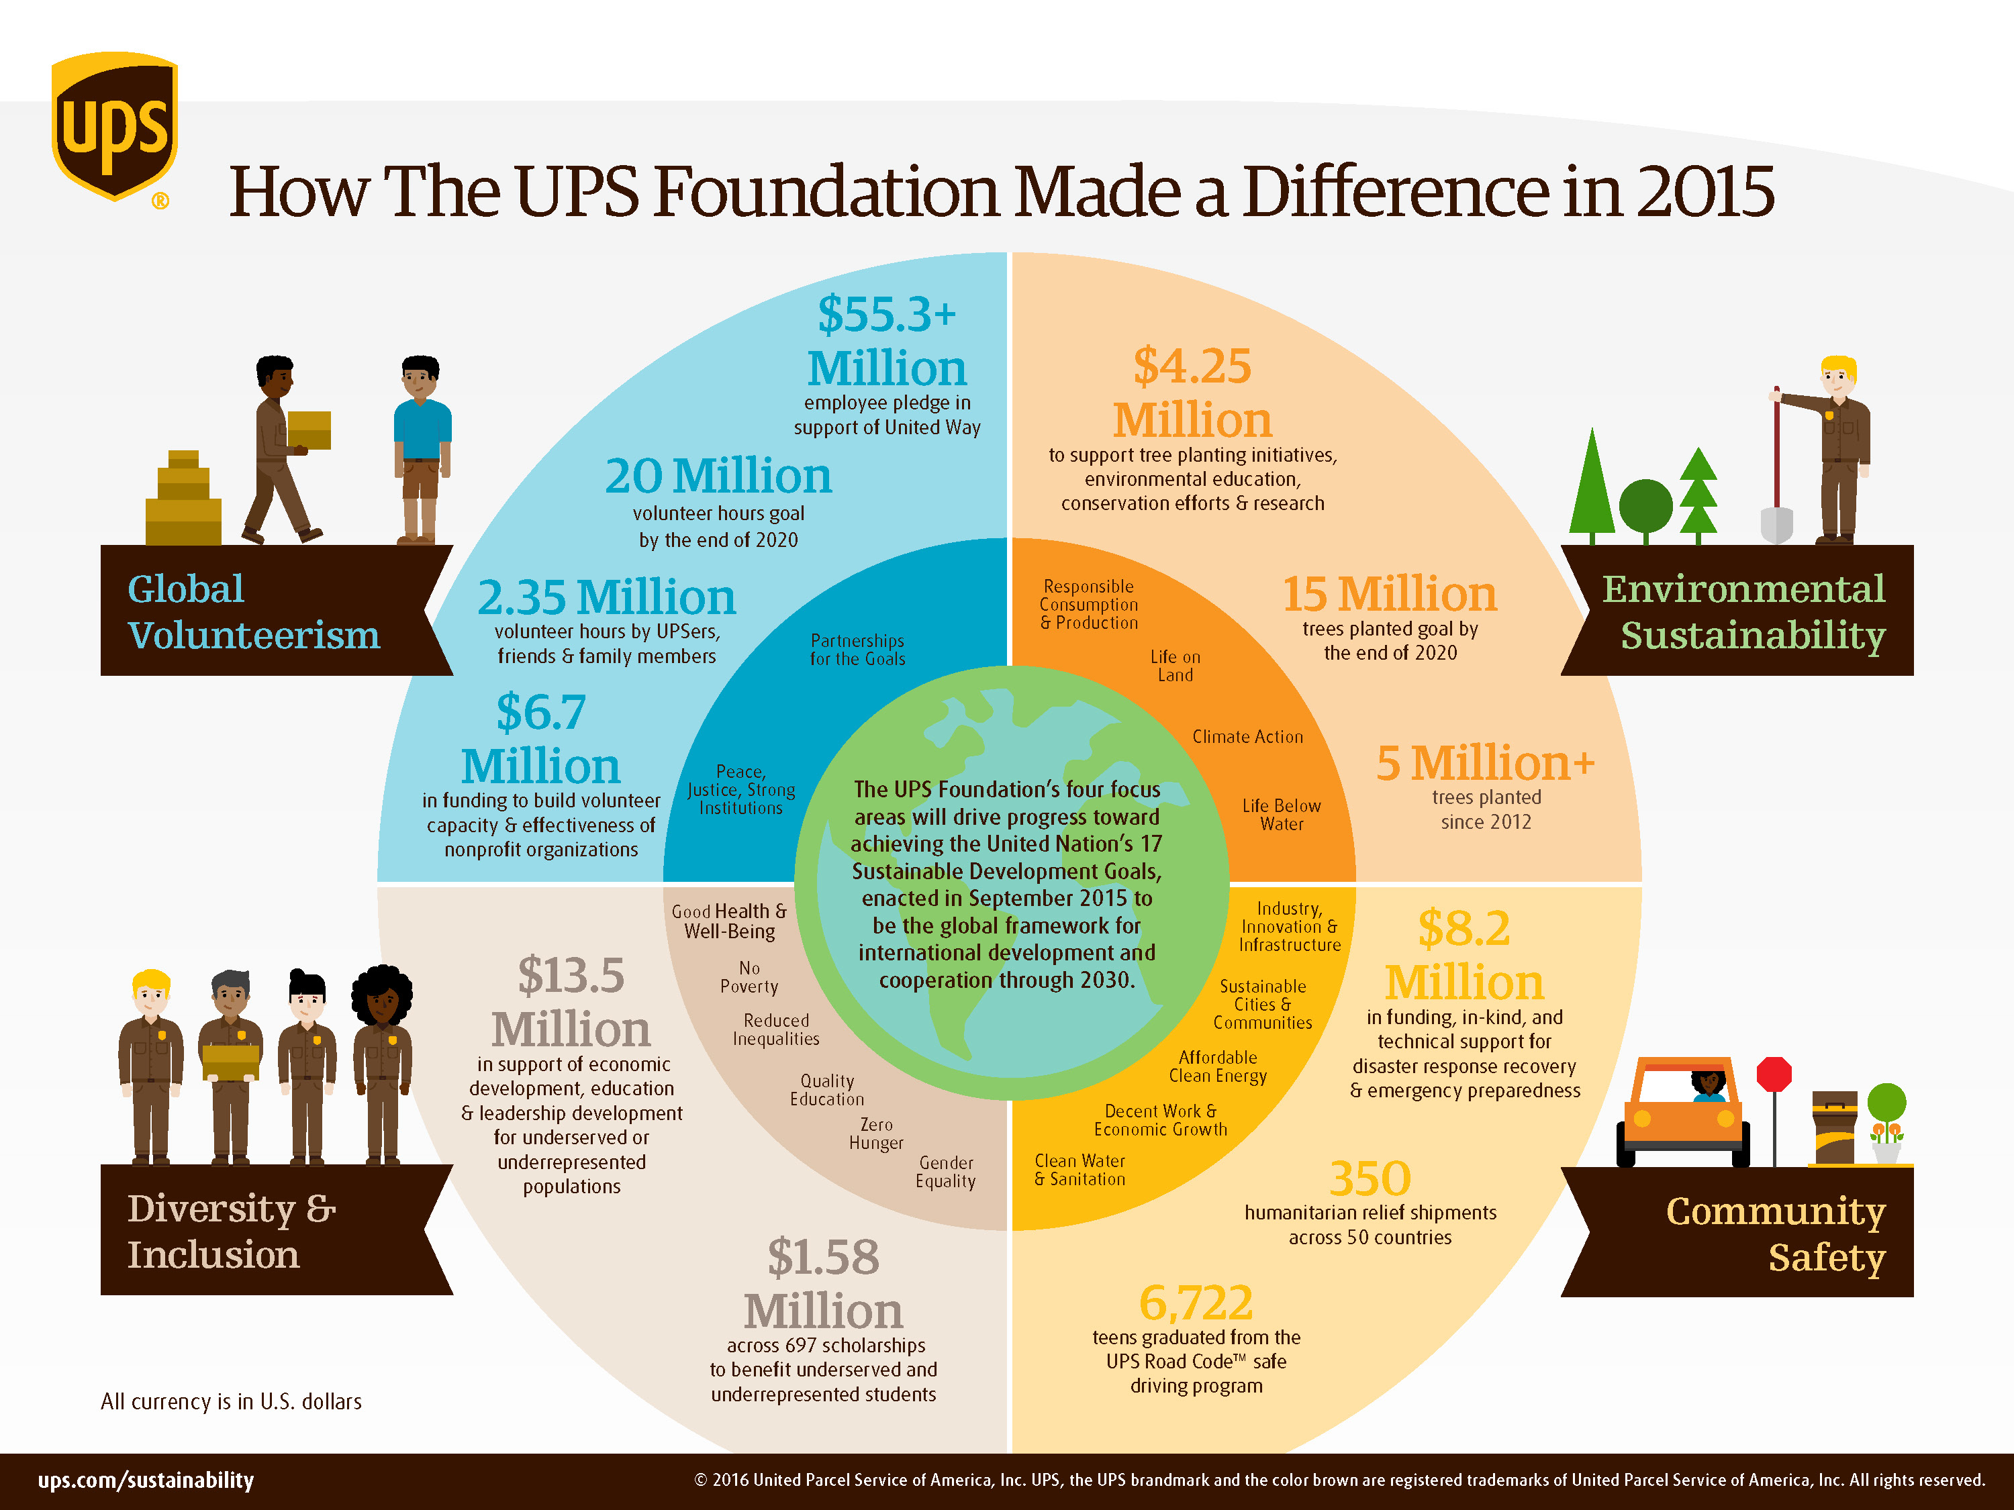
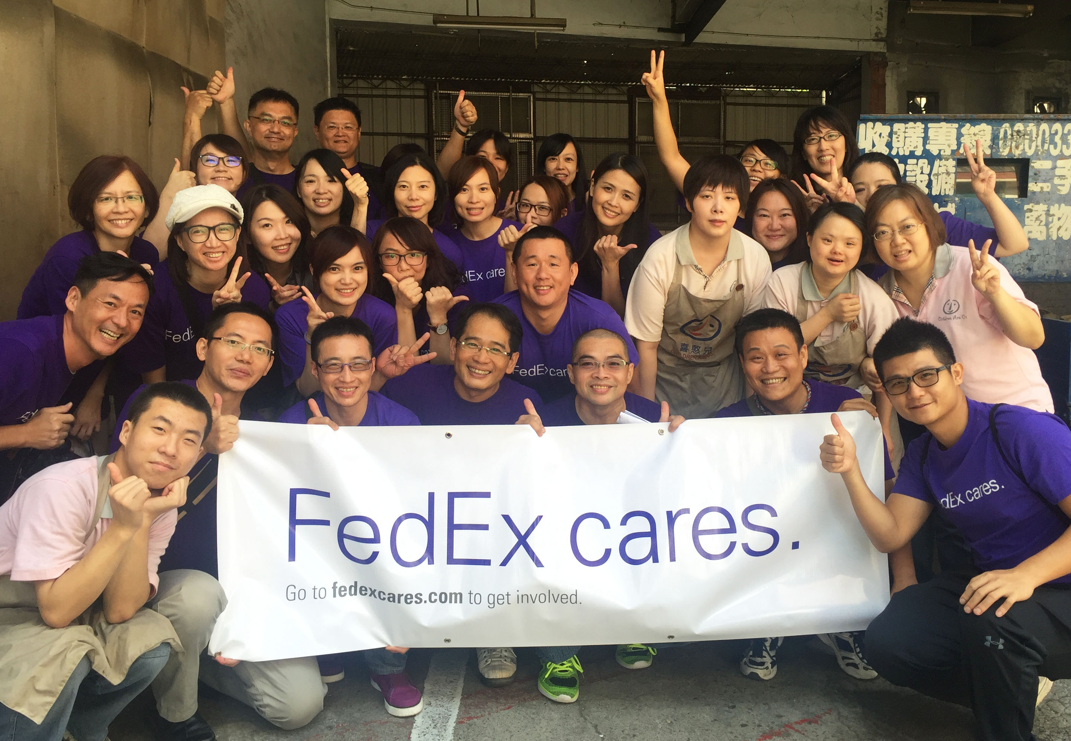

JMM
Financial Plan -- Logistics
2
+
Transportation is handled mostly through partner distribution networks. Coca Cola, Amazon, UPS, FedEx, Walmart, Cemex, and more. By employing the distribution networks that are already in place JMM can ensure a reasonable rate or can even be free. Secondly, military and or government transportation is many times a viable solution. This is usually free or at a significantly discounted rate. Thirdly, the distribution network of other HOs is also a significant resource. Lastly, the purchase of transportation from one of JMM logistics partners can be acquired. The mode of logistics whether air, sea, or land depends on the urgency of the aid needed.
55

Slide 56
Financial Analysis
2
+
2
+
2
+
Jeffery Morse Ministries

Slide 57
JMM
Financial Projection Income Statement
Taken as 0.1% of our benchmark organization

Slide 58
JMM
Financial Projection Balance Sheet & Cash Flows

Slide 59
Action Plan
2
+
2
+
2
+
Ready Set GO

Slide 60
JMM
Action Plan
Plans in Motion
JMM has created and reviewed both its constitution and bylaws for both JMM LLC and a second set for the future of the firm JMM INC. The articles of LLC are already filed with the California State Secretary for JMM LLC, and an EIN for JMM LLC is established. Web Pages for JMM are created and in the process of being updated. The subsidiaries of JMM are established as single proprietor businesses and have EIN and are sovereign companies but are considered under the JMM LLC umbrella. The business plan is now being completed. Financial projections have been compiled. Currently, the CEO has established a web presence under PcColusa were he is on staff streaming media live on the web on several platforms which include, Facebook, Periscope(Twitter) and YouTube.
Next Steps
Review all non-profit status 501c3 with the IRS.
Review of the web presence and adjusted accordingly.
Media Blitz “Get the Name Known” Then proceed in Partnership Blitz.
Crisis App up and Usable– Supply Chain, HR, Vender Chain, Logistics, and Tracking functioning properly.
Local Aid up scaled
Key Managers hired as needed
First international Response Effort
Incorporation
A lofty hope is a one-year timetable before we address our first major crisis, realistically it will be closer to two. No loans from financial institutions will be acquired in the startup of JMM.
2
+

Slide 61
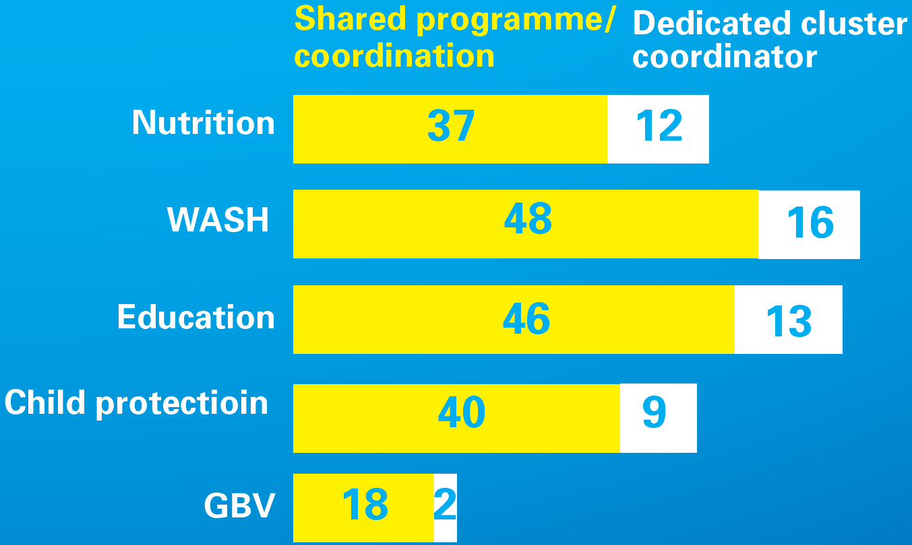

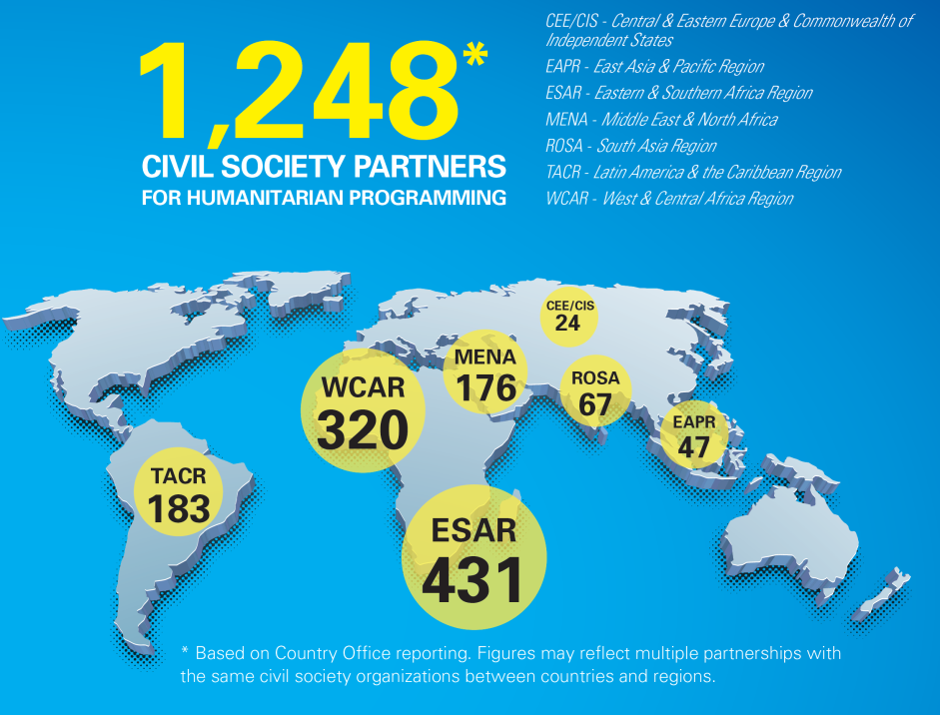
Strengthened collaboration / Coordination
61

Slide 62
BE PREPARED!
Crisis Hits

Slide 63
GET IT DONE!
Appoint a crisis manager
Evaluate the Need, and the Resource from the Crisis App
Develop and circulate crisis procedures
Create emergency communications vehicles
Determine Partnership Involvement
Establish Schedule
Distribute Aid
Leave Everything Clean and Better
Key Manager Steps on site of a Crisis
Notes:
Today is all about getting that crisis plan you may have done, or started years ago, or last year, or even last month – and getting it finished and crisis ready. So let me start by asking you, how many of you have an up to date crisis plan?
How many have one on the shelf that needs to be updated?
How many of you feel like you might be up the creek if a crisis hits tomorrow?
And finally, how many of you are on the line to create a crisis plan?

Slide 64
Appoint a crisis Manager
64
Notes:
At this point let me pass out an old fashioned paper template for us to work with while we go through some basics of a crisis team so that you can actually create a draft of your team, then you can incorporate that into your plan once you get back to the office

Slide 65
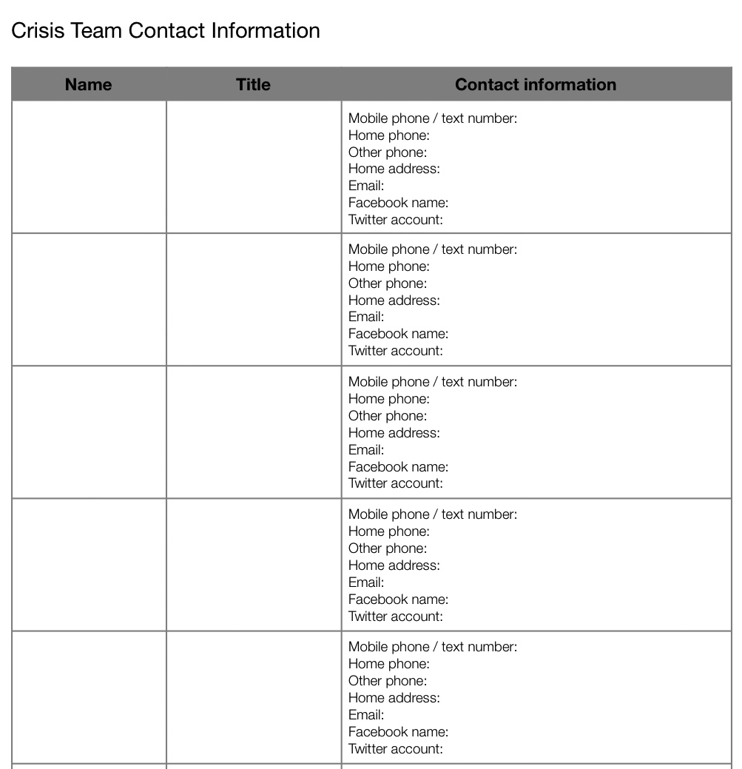
65
Notes:
From the word document, but remove any SYTA title, logo

Slide 66
Crisis Team
Who?
President or CEO
Chief operations officer
Chief communications officer
Legal counsel
Safety officer
Board president
HR Lead
66

Slide 67
Evaluate the need
67
Notes:
This is where the crisis team goes into action. Dependin on the structure of you company, there may be a central person who would be responsible for drafting these crisis procedures, or, the members of the crisis team can be given the responsibility of drafting protocols for their own area of responsibility. Once they are drafted, they should be circulated to the whole team, to ensure that they all mesh together and clearly delineate responsibilities, then the final documents should be circulated to all appropriate people, posted on your website, and posssibly on your app, which we will discuss in a minute

Slide 68
When to Activate “Crisis Mode”
Is there an immediate threat to safety or to the reputation of the company or the industry?
Are you traveling to an unsafe destination?
Is there impending weather that could affect you?
Have you been notified of a crisis by a credible source?
Have there been any fatalities?
Are the media calling?
Has real or false information been reported in the media -- especially social media?
68

Slide 69
Communications: Operations
Ensure that systems are in place for maintaining and replacing if necessary:
    Wi-Fi network
    Phone system
    Email servers and backup
    Financial records
    Website
    Crisis app
  Responsible: Chief Operations Officer/Chief Communications Officer
69
Notes:
One of the most crucial areas to focus on in pre-crisis prep is communications. Start with your operations. Do you have back up plans for all of these systems? Do you have a communications mechanism in the event you lose power, lose internet connection, lose phone contact? Do your team leaders know where to go for help –e.g., an embassy, an office location in another country, Red Cross, etc? This will all be part of a resource list we’ll get started on later.

Slide 70
Communications: Monitoring
Start now to identify resources that are in house or will have to be hired to:
  Monitor all news outlets, social media channels (including not just your own channels, such as Facebook, Twitter, Pinterest, Instagram, etc., but also foreign channels in the event the crisis occurs in another country)
  Close down social media outlets if necessary
  Implement emergency 800 number, dark site on website, multi-channel app
  Responsible: Chief Communications Officer
70

Slide 71
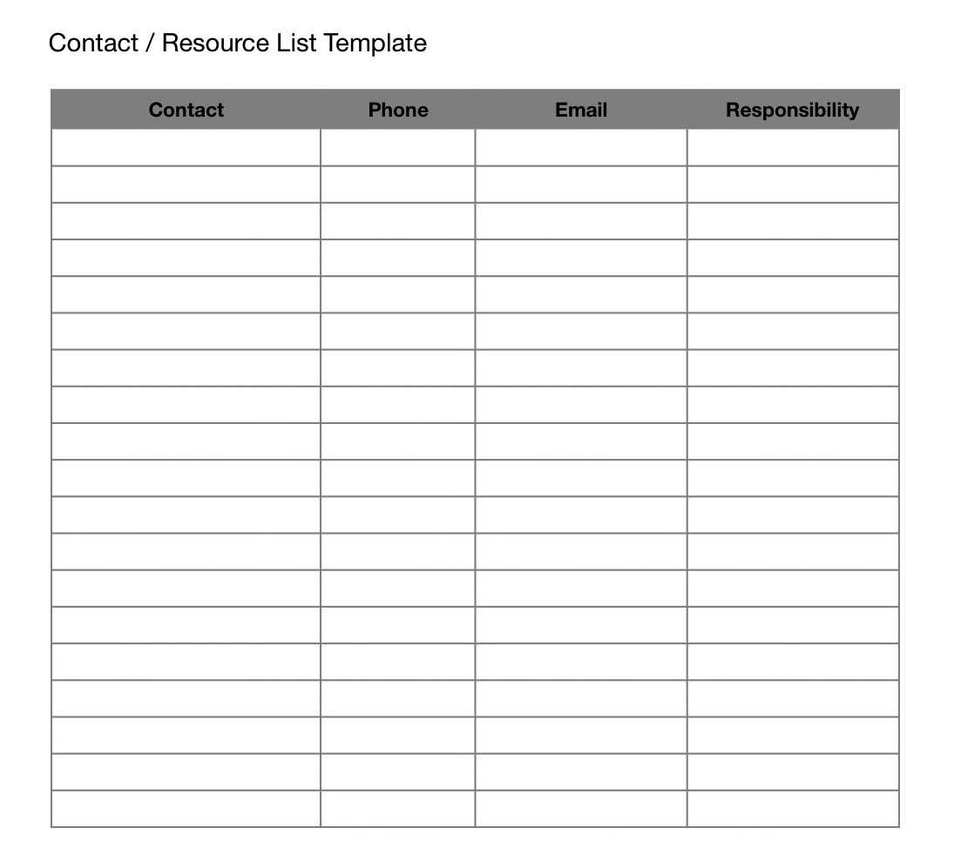
71
Notes:
Let’s just take 5 minutes now to brainstorm the types of people, organizations that should be on your contact list
Social media provider
Ad firm
PR firm
US embassies
State Department
Fire Department
Police
Transportation companies
Hospitals, doctors
Trauma Centers
School principals, teachers

Slide 72
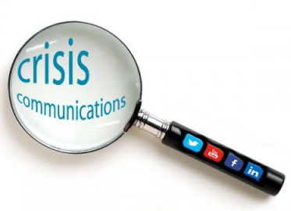

Communications Vehicles to Develop in Advance of a Crisis
An 800 number in reserve
Dark site prepared for website
Smart phone app
72

Slide 73
Smart Phone App
Enroll your user groups in an automated way
A native app that lives on the device; no web access needed
Publish lists, protocols, plans
Track and manage briefings, reports
Real time information to all audiences
Different authorization levels possible
Can access 24-7 support
73
Notes:
My firm creates this kind of app for companies– we can do everything from guiding you through the application set up to creating the content for you and managing the entire process

Slide 74
Post Crisis Debrief
Review each crisis scenario for these crucial barometers:
  Performance of crisis team members under pressure
  Efficacy of procedures and protocols in place
  Weaknesses in systems
  Tenor and fairness of media coverage
  Overall outcomes – sales, customer relations, employee morale
Publish and circulate the debrief and “Crisis Lessons Learned” to Crisis Team and other relevant staff, stakeholders
Don’t allow the debrief to languish on the back burner!
74

Slide 75

HOW YOU CAN HELP
PRAY
Join us in praying. This is our biggest need.
SHARE
Facebook: www.jefferymorseministries.com
Twitter: @JMM
Email our updates to your networks
DONATE
www.JefferyMorseMinisistries.com
Mail: 308 D Humphrey Rd. Yuba City Ca. 95993
75

Slide 76
THANK YOU
2
+
2
+

