Slide 1

Managing Change
Jeffery Morse
Brandman university

Slide 2


Slide 3

Scenario
New technology is being introduced to By Every Word Productions to increase productivity and accommodate the changing demographic of artist. Successful implementation requires productively completing current contract work within old systems while new work will begin to be completed within the new software and processes. Senior management is disquietly concerned and wishes this implementation to go smoothly while keeping costs minimal through this quick transition.
Notes:
New technology is being introduced to By Every Word Productions to increase productivity and accommodate the changing demographic of artist. Successful implementation requires productively completing current contract work within old systems while new work will begin to be completed within the new software and processes. Senior management is disquietly concerned and wishes this implementation to go smoothly while keeping costs minimal through this quick transition.

Slide 4
What is Change
Most Businesses experience a 60% failure rate in change. However, change masters have an 80% success rate (Connor, 2008). Because they..
1. Act on real insights and real reactions
2. Establish solid methods and solid benefits
3. Use better skills and better change
4. Use the right investments and impact
Notes:
(Connor, 2008)

Slide 5
What is Change
Change can be identified by the forces causing it. There are several types of change but this video focuses on three.
Developmental
Transitional
Transformational

Slide 6
Three types of change
Developmental
Developmental change involves an improvement of what already exists. For example, an organization improving a previously established process or procedure, such as an HR policy regarding employee leave time or a particular department’s procedure for filing and sharing expertise on certain projects, are examples of developmental change. The change does not necessarily have to be large in scale and scope. Often, although not always, little stress or anxiety is created with this type of small-scale change.

Slide 7
Three types of change
Transitional
Transitional change consists of an implementation to achieve a known desired state that is different from the existing one. Examples of this more intrusive, larger change include organizational mergers and acquisitions or replacing a process or procedure and introducing a new one, such as installing a new technology system. Such changes can shake up an organizational culture, disturb relationships, unsettle jobs, and require retraining and hiring.

Slide 8
Three types of change
Transformational
Transformational change involves the emergence of a new, unknown state for the organization. Examples of such changes include a shift in radically different markets that require a different strategy and skills, a move to incorporate “bleeding edge” technologies, or a new CEO and top-level team who change the structure and culture of the company.
Notes:
The change that will be coming to By Every Word Productions is a Major Transformational Change. We will in effect be transforming from a centrally based recording studio to a global one. This will be achieved through Hard Work, Vision, Technology, and Innovation. Make no mistake, what is being proposed has never been done, and will be meet with resistance from within and from without. However, the only successful coarse for BEW is straight up change, with the artist, writer, and producer at the heart of the business.

Slide 9
Reasons for change
Notes:
There are many reasons for change. Let us look at the end of some businesses that failed in recognizing or navigating change.

Slide 10

1. Blockbuster (1985 – 2010)
Unable to accommodate change to digital media and unable to compete with RedBox Blockbuster filed for bankruptcy in 2010.
In 2000, Blockbuster was approached by Netflix with an offer to of purchase for US$50 million-- Blockbuster was not interested

Slide 11

2. Polaroid (1937 – 2001)
The Polaroid Corporation was declared bankrupt in 2001 and its brand and assets were sold off. However, starting in 2008 the brand and intellectual property of the Polaroid corporation was acquired by the largest shareholder of the Impossible Project who attempted to transition to flat screen tv’s. This ended in its bankruptcy and the final closer. First, Polaroid did not anticipate the impact that digital cameras would have on film, then as a result of poor design, and even worse customer service the firm was unable to navigate change.

Slide 12
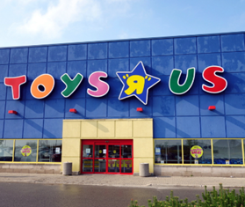
3. Toys R Us (1948 – 2017)
Toys "R" Us may have led to its own defeat when they brokered a 10-year contract to be the exclusive vendor of toys on Amazon in 2000. Unfortunately, Amazon began to allow other vendors to sell on its site not keeping their of the deal. When Toys "R" Us sued Amazon and ended the agreement in 2004. if not for that deal Toys "R" Us may have seized the opportunity to develop its own e-commerce presence early on.

Slide 13

4. Compaq (1982 – 2002)
The company was a top seller of PCs and almost invented the laptop singlehandedly. Compaq was the first company to legally reverse engineer the IBM Bios used on the IBM Desktop Personal Computer (Hinted to in the show “halt and catch on fire”). However, Dell whose strength lied in innovation in the distribution chain only built from aftermarket parts and thus was able to supply cheaper and customizable PCs while producing better quality while supplying better customer support. Compaq was acquired by Hewlett Packard who still sell under the Compaq name.

Slide 14
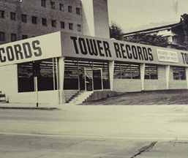
5. Tower Records (1960 – 2004)
A pioneer in its time, Tower Records was the first to create the concept of the retail music mega-store as well as the first to launch the online retail music outlet tower.com the only online music store in 1995. However, Tower Records only sold CDs, cassette tapes, DVDs, electronic gadgets, video games, accessories and toys while ignoring the media format change to the digital streaming format and digital downloads. This soon resulted in bankrupt as Spotify, Pandora, and iTunes cornered the market in the new streaming media format.

Slide 15
Reasons for change

Slide 16
According to Forbes magazine
The reason for change is pretty simple. music has shifted from a product-based business (CDs and individual downloads) to a service-based business (streaming), unfortunately, no one has been able to create a model to support that transition adequately. Both Amazon and apple music loose money, Pandora and Spotify struggle to stay alive (Gerber, 2017).

Slide 17
Major label decline
Factors that resulted in decline are many. According to Bielas (2012) these factors might include such things as artists feeling cheated by record labels which resulted in actions such as the 1997 open web release of the Radio Head’s “Rainbow” album, effectively bypassing labels.
The largest factor was the transition of music from analog (vinyl records) to digital (cd’s and mp3’s). Today the music industry is still very much in flux. Major Labels are scrambling and creating 360 contracts, which artists do not want, while technology has made the need for a label non existent.
Notes:
Bielas, I. (2012) THE RISE AND FALL OF RECORD LABELS, Claremont McKenna College, Senior Thesis Spring 2012

Slide 18
Reasons for change
Advances in technology such as the Internet, MP3s, and file-sharing software have made it possible to bypass the traditional role of record labels, thus creating a closer link between artists and consumers.
Technology has new distribution, marketing, and engineering channels that record labels cannot compete with. In October of 2007, Radiohead released their new album, In Rainbows, directly to consumers online grossing millions more than they would have while effectively taking the label out of the loop.

Slide 19
U.S. Recorded Music Revenues by Format
File created on: 4/10/2019 11:07:47 PM

Slide 20
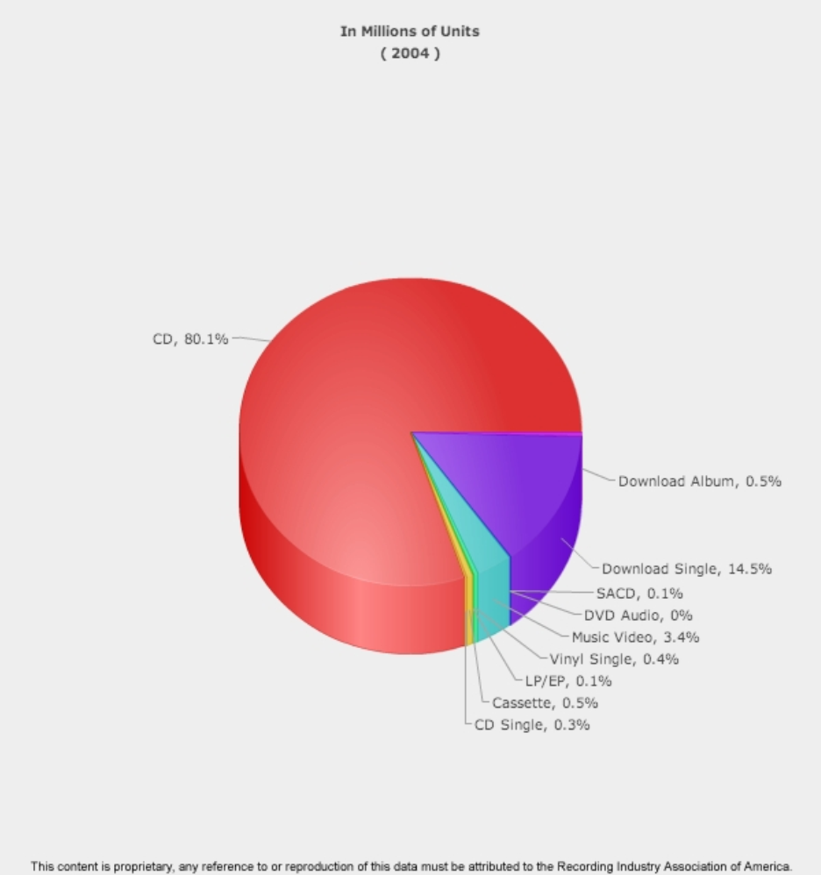
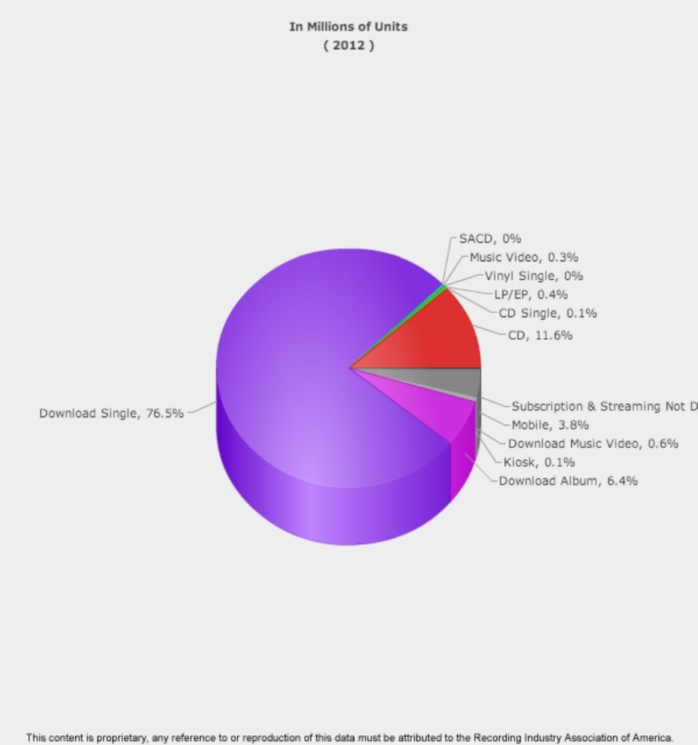
Reasons for Change
RIAA (2019)

Slide 21
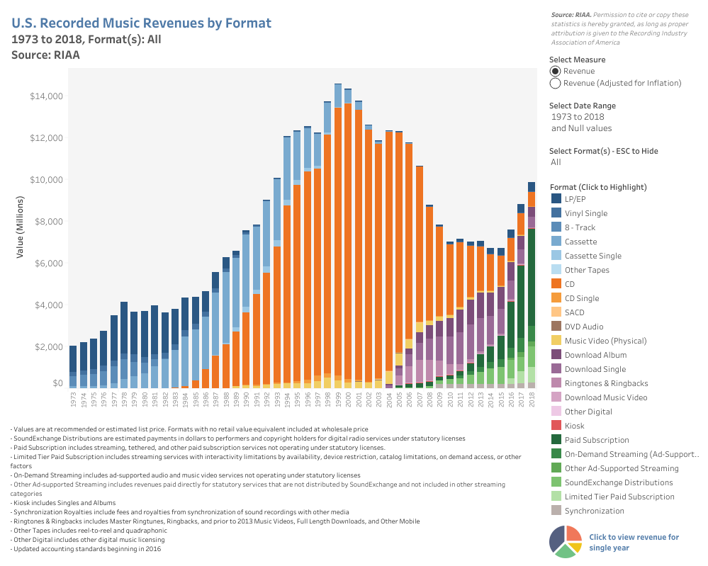

Slide 22
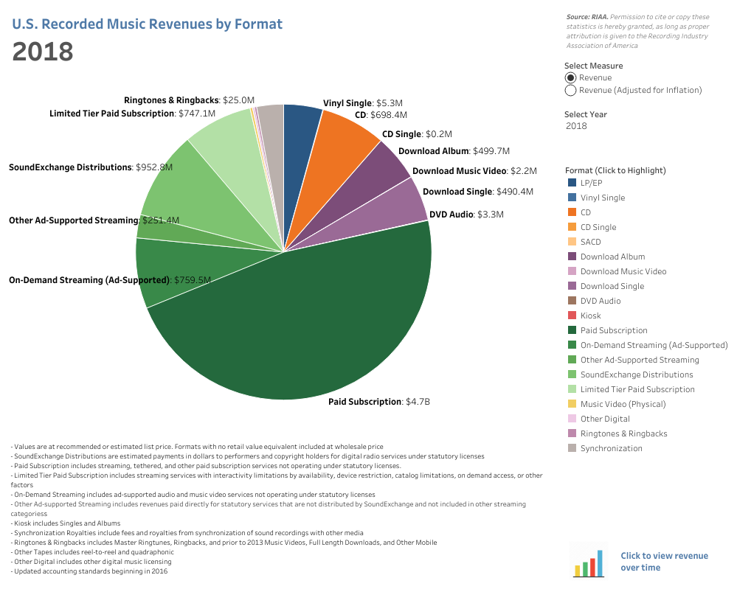


Slide 23
Reasons for change
Globalization and technology have made the world smaller and far more interconnected (Beer, 1980).
Somewhere out there is a competitor, unborn and unknown, that will render your business model obsolete” (Hamel, 1998a, p. 81).
Things that can result in disaster are unforeseen opportunities missed, industry trends, pressures generating inside or outside the company due to a lack of innovation.
Detecting signs of external change is imperative since failure to do so means missed opportunities and identification of impending threats.
Notes:
Note. Adapted from "Organizational Structure and Change," by T. Bauer & B. Erdogan, 2010, Organizational Behavior, Chapter 14, Section 3. Copyright 2010 by Flat World Knowledge, Inc.

Slide 24
Traditional
Reasons for Change
Things to keep track of are
Workforce Demographic Changes
Technology Advancement
Globalization Opportunities
Market Conditions
Areas of Poor Performance
Notes:
Put in the word change animation
Note. Adapted from "Organizational Structure and Change," by T. Bauer & B. Erdogan, 2010, Organizational Behavior, Chapter 14, Section 3. Copyright 2010 by Flat World Knowledge, Inc.

Slide 25
Reasons for Change
Things to keep track of are
Technology Advancement
Globalization Opportunities
Areas of Poor Performance
Vision and mantra; “We will be a global force for all lovers and creators of music.”
Notes:
Put in the word change animation
Note. Adapted from "Organizational Structure and Change," by T. Bauer & B. Erdogan, 2010, Organizational Behavior, Chapter 14, Section 3. Copyright 2010 by Flat World Knowledge, Inc.

Slide 26
Vision and mantra
“We will be a global force for all lovers and creators of music.”
Notes:
Vision and mantra; “We will be a global force for all lovers and creators of music.”

Slide 27
Expected Change
Technology Advancement
The Internet
Video Based Communication
Pro tools and Cloud Based Projects
Availability of the Computer Based Mobile Studio
Availability of Per Diem Engineers and Musicians
Today’s Competition is Every Producer with a Computer
Notes:
The internet has become common place, it not only brings accessibility to knowledge but also provides a distribution channel, cloud based functionality, the ability to transfer large data files easily, cloud based recording environments, per diem employees, it opens up scheduling, brings competition with almost no barriers to entry, and effectually removes the monopoly major record label have had for years. If a record label desires to stay in competition innovation is a must.
Video based communications has advanced to the point that it is no longer necessary for artist or engineers to come to a central location for recording purposes.
Pro Tools 12 now includes cloud based projects. This allows us to bring anyone anywhere in on the project. Further, Pro Tools offer a free version of the product for those who need to work on the session but do not have the software.
Computers have now advanced to the point that 90% of all studio work is performed on them. Using this technology means we can take a laptop to any place on earth and product high quality music. On the flip side so can anyone else.
Per Diem employees are available. The best engineers, the best studio musicians not longer have to be present in the studio to add their artistry. This brings down costs in travel and lodging, but produces a market for the best per diem people. The benefit is that the label no longer has to pay hourly wages to many of these people but can hire by the job.
Basically the label is faced with the following choice, innovate or close the doors. Exploiting publishers and writers as major labels have done in the past is now hindered with the new copyright laws passed in both the US. and EU. Smaller labels with a new and fair template have an opportunity to benefit through a first mover name recognition establishing a new era for artists and producers.

Slide 28
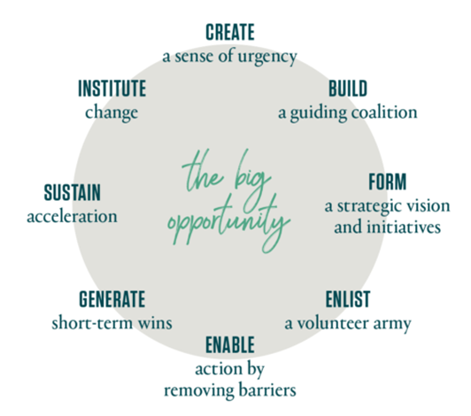
Kotter’s 8 Steps
Notes:
This plan utilizes the Kotter 8 step process.
Urgency, the first step in the eight steps was already previously addressed, however, defining resistance is also necessary.

Slide 29



Notes:
Weiss (2012) in his teaching on Organizational Change makes note that the Internet, social media, and information technology have resulted in the creation of new industries, business models, professions, products, and services. Google, Facebook, Twitter, Yahoo!, eBay, YouTube, Amazon.com, and Groupon.com to name a few. Facebook created not only networks of friends but also networks of clustered, self-promotional buyers. Organizations, regardless of size, are becoming more effective, efficient, connected, and “globalized” because of the Internet and related technologies.
Note. Adapted from “Forces Driving Change in Organizations,” by J.W. Weiss, 2012, Organizational Change, Chapter 1, Section 3. Copyright 2012 by Bridgepoint Education, Inc.

Slide 30
Why People Resist Change
Disrupted Habits
Personality
Fear of Failure
Personal Impact of Change (Fedor, Caldwell, & Herold, 2006).
Prevalence of Change (Labianca, Gray, & Brass, 2000; Rafferty & Griffin, 2006).
Perceived Loss of Power
Notes:
Disrupted Habits-- People often resist change for the simple reason that change disrupts our habits.
Personality-- Some people are more resistant to change than others. Research shows that people who have a positive self-concept are better at coping with change, probably because those who have high self-esteem may feel that whatever the change is, they are likely to adjust to it well and be successful in the new system.
Fear of Failure-- People also resist change when they feel that their performance may be affected under the new system.
Personal Impact of Change-- Research also shows that commitment to change is highest when proposed changes affect the work unit with a low impact on how individual jobs are performed (Fedor, Caldwell, & Herold, 2006).
Prevalence of Change-- If the company is considering a simple switch to a new computer program, such as introducing Microsoft Access for database management, the change may not be as extensive or stressful compared to a switch to an enterprise resource planning (ERP) system. ERP systems, such as SAP or PeopleSoft, require a significant time commitment and can fundamentally affect how business is conducted (Labianca, Gray, & Brass, 2000; Rafferty & Griffin, 2006).
Perceived Loss of Power-- Given the loss in prestige and status in the new structure, some supervisors may resist the proposed changes even if it is better for the organization to operate with teams.

Slide 31
Resistance from within
Types of Resistance (Kotter, 2011).
Organizational inertia is the tendency of an employee to maintain the status quo (Carr, Hardf & Trahant, 1996).
Change is Uncomfortable (Carr et al, 1996).
Lack of Substantiation
Notes:
Types of Resistance
There are both Active resistance, as well as Passive resistance. Kotter suggests that those produce active outcries against change should be released from employment (Kotter, 2017).
Organizational inertia is the tendency of an employee to maintain the status quo (Carr, Hardf & Trahant, 1996). This resistance is often the result of giving up bureaucratic command-and-control as the hierarchical structure brings power to the status quo. Artist are sometimes hard to work with as their art is a personal extension. Changing the way one produces art is a big task indeed. It is very important that the artist as well as the engineers see the benefits of the change. No longer will an artist have to take a long journey, or sleep in unfamiliar places.
Further, research shows that when people negatively react to organizational change, they experience negative emotions, use sick time more often, and are more likely to voluntarily leave the company (Fugate, Kinicki, & Prussia, 2008).
While all those previous reasons play a part, BEW anticipates the following to be the major factors in the resistance to change.
Other reasons for resistance include the fact that change, for many, is often uncomfortable and even threatening (Carr et al, 1996). Some people just do not do well with change, I know I am one of them.
Lack of Substantiation represents probably the biggest hurdle--Perceived Loss of Power. Engineers, and Artist seek popularity as a source of income. The future, however, had diversity in mind. Much of the music place in film, tv, and even played on the radio is becoming more and more sourced from the plethora of unknowns producing music from their home studio. The big names in music and big labels are quickly coming to an end.
Some of the other reasons for resistance from with in might be -- Lack of trust or confidence, miss understanding, resistance for personal reasons all may play a part.
BEW will be utilizing a three step plan to address this internal resistance.

Slide 32
Addressing Internal resistance
Define the Outcome.
The Path.
Meetings and Team Leaders
Suggestions and Expectations
Notes:
Define the outcome. With in a two year period a companywide cultural change will be accomplished. As each employee begins to work from home or on site using a mobile early production computer based studio freedom of work will become the natural expectation. This allows for creativity, life outside of work, and helps with deadlines making music production less stressful. Communication is key.
The Path. It is imperative that all senior representatives are well versed, trained and on board. To ensure administrators and employees know the new plan, those not versed on Pro tools 12 capabilities must be trained in the benefits of cloud based production. Starting within two months 50% of new tracks and recordings shall be done in the field. To help with logistics the new position of Production Logistics Manager will be created, who will utilize and schedule through two cloud based services, Monday.com and Band.com. Accounts will be setup for each employee by the BEW Network Administrator, each login will be tracked and passwords must be kept secure.
Those who are trained first and seen as supporters of change will be team leaders. Team leaders will be responsible for overseeing change, addressing questions and misunderstandings, holding bi weekly meetings that are mandatory for anyone currently not away on assignment. These meeting will continue after six months but will be scheduled only once a month.
Suggestions and Expectations. It is suggested that one take advantage of all reading provided, attend all meetings and discussion groups, educate oneself and those in proximity to the benefits of the planned change. One may champion the cause by becoming an Organizational/Conflict Manager in which one may empower others to act on the set vision by succeeding first. In this step BEW addresses resistance from uncomfortableness, personal resistance, and trust issues.

Slide 33
Addressing EXTERNAL resistance
Major Labels
Non Compete
Online music exclusivity
Nay Sayers
Notes:
Major Labels. Since this is a pioneering effort which may in effect be seen as a threat to those who have monopolized the music industry in the past, BEW will be retaining special counsel to guard against any attacks from those who are threatened by the shifting of power from the major label to the artists/producers and creators of music.
Non Compete. All employees will be required to sign a non compete agreement and will further will be under strict copyright and company secret contractual obligations.
On Line. Many of our customers will have fallen into a the “exclusivity trap by such companies as Reverb Nation who enforce exclusive rights to songs uploaded to their sight. While it is true that most creatives do not realize that they are bound by such contractual obligations, it is imperative that all music represented be absent from such exclusive contracting sites. Non exclusive sites are not viewed at a possible source of resistance.
Nay Sayers. In is important to keep a positive representation on social media or other media sites. Social publicist will be employed to Manage and Maintain our Online Representation.

Slide 34
Communication Plan
Company posters portraying the new slogan
Emails
Mandatory Meetings
Feed back loops
Questionnaires
The Change message
Notes:
Describe your communication plans, including the change message, effective communication channels and feedback loops,
and rationale.
Company posters portraying the new slogan, “a global force for all lovers and creators of music.” and others saying, “BEW the evolution of the music industry” will be displayed on posters at every location, posters will be supplied to employees, venders, and customers. Business cards will be printed for representatives with these slogans as well. Slogans will be posted throughout our catalogs and pricing tables. Marketing efforts on Social Media will also begin using these slogans. People and employees will become expectant and hopeful for the new change.
Emails to every employee stating the vision, the change coming, and information on who they can forward any questions or concerns will be supplied. All emails will show the support of all administrators.
Conferences by team leaders has already been addressed, however, it should be noted that these times are also used as a feedback loop.
Feed Back Loops. Feed back will be sought after from all venders, customers and employees during times of contact.
Questionnaires. In addition to contact feedback a questionnaire will be formulated and sent out every month along with a current events / vision progress success and failures news letter. This news letter will be emailed if possible, and mailed to those who request it.
The change message.
The challenges in the music production industry dictate that we do things differently - internally in the way we produce music and externally in the way we serve our customers. The modifications we are calling for will not be easy, however, they are necessary. Our technological age decrees that we must embrace change to survive. Change will not be feared, but it will be leveraged by us for its power to capitalize on the new and innovative opportunities it will provide. This will result in our success!

Slide 35
The Change message
The challenges in the music production industry dictate that we do things differently - internally in the way we produce music and externally in the way we serve our customers. The modifications we are calling for will not be easy, however, they are necessary. Our technological age decrees that we must embrace change to survive. Change will not be feared, but it will be leveraged by us for its power to capitalize on the new and innovative opportunities it will provide. This will result in our success!
Notes:
The Change Message
The challenges in the music production industry dictate that we do things differently - internally in the way we produce music and externally in the way we serve our customers. The modifications we are calling for will not be easy, however, they are necessary. Our technological age decrees that we must embrace change to survive. Change will not be feared, but it will be leveraged by us for its power to capitalize on the new and innovative opportunities it will provide. This will result in our success!

Slide 36
Champion for change
From the CEO
Systems thinking
Organizational culture
Communications
Change champion
Notes:
Systems Thinking. We stand at a precipice. This change has been coming since the advent of the computer in the 80’s. Media has outgrown all of its formats. As the format for media changed the information age irrupted. Music today is available easily for download, those who wish can download from peer to peer services never paying a dime for their favorite music. The current music system is undergoing transition. Then money supplied in the past just is not available in our technological present or future. Yet we as music industry pioneers will innovate and overcome. Just as movie scores break genre boundaries, music production innovation must shift its focus on making sure creatives are paid for their work. Today many artist bypass record labels entirely by selling their self produced music from their own webpages, iTunes, or Amazon. The music industry at large must change globally. The US and the EU have already began adjusting laws to support this change. This is a service based world and no longer can those who create be the last one to get paid. BEW is proud to be on the ground floor of a transformational change that will support the heralding voice, “change or die!” As a champion this is my cry as well.
Organizational cultures become creative and innovative when they encourage “combinatorial play” (Shames, 2009).
Employees need to use their imagination to fit ideas together in new ways. Then take those ideas and see if they work in reality. This is promoted, and feed back loops are provided to feedback, also flexibility in work scheduling goes hand in hand with this change, finally team collaboration is available on every project through the Pro Tools Cloud. In addition, our organizational culture must be one that puts people first. The songwriter/creator and producer displace the label to be on the top of the ladder. Life outside work is important, work from home, or mobile studios are now services provided to the creators of the music. Expensive tours, mass produced cd’s are not what will equate to song plays. BEW will be a company that puts people first, money is a tool to use to help others and not a means to an end. This is not a culture for those who “want it all” but now a culture for those who want to “give it all”.
John Kotter flatly states that ineffective communication of the change initiative is one of the primary causes of failed organizational transformations (1996). First, verbal communication should always be chosen over written. Preferably video conferencing should be used. There is no reason why a video conference should not be chosen with todays internet speeds. When communicating my communications will be hopeful. Living the dream or blessed and highly favored will be my worlds. All things are possible to those who believe!. The sole purpose of this label is the success of its customers. Soon people under our employ will take on this cultural communicational change.
leader is perceived to be honest and authentic, then the message is likely to be heard (Goffee & Jones, 2006). Warren Bennis and Bert Nanus state, “A leader must be a superb listener, particularly to those advocating new or different images of the emerging reality. Many leaders establish both formal and informal channels of communication to gain access to these ideas” (1997, p. 96). As a champion for change I will be among the first to use the mobile studio technology. I will pursue digital music creation when possible to keep costs down. I will provide the same quality whether the customer is well known or unknown. I will actively point out the benefits of this new way of doing things.

Slide 37
Thankyou for being a Change champion here at by every word productions
This concludes our presentation

