Slide 1
U.S. Recorded Music Revenues by Format
File created on: 4/10/2019 11:07:47 PM

Slide 2
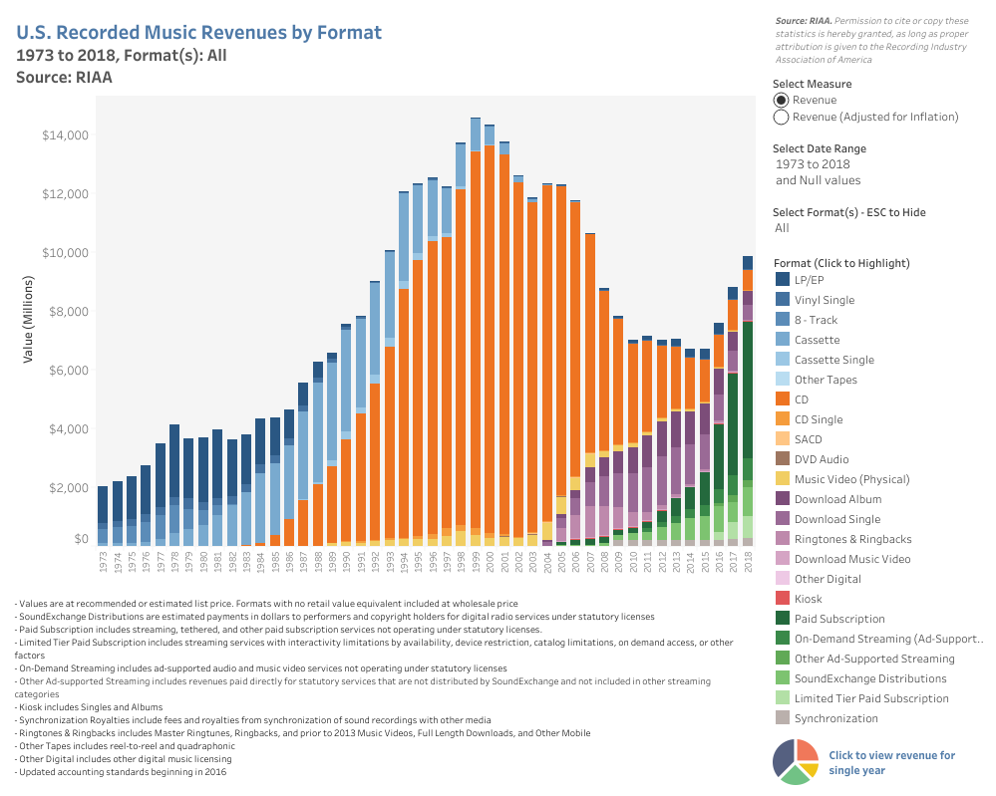

Slide 3
