Slide 1

DutchBro
plus
Notes:
Welcome to the Concept Pitch

Slide 2
Positioning Techniques
Environmental Scan
Target Customers
Analysis
Value Proposition, Culture
Goals and Mission and Vision
Competitive Advantage
Performance Measures
Notes:
Dutch Brothers Plus will be reviewing the following positioning Techniques:
Environmental Scan.
Target Customers
Analysis
Value Proposition, Culture
Goals and Mission and Vision
Competitive Advantage
Performance Measures

Slide 3
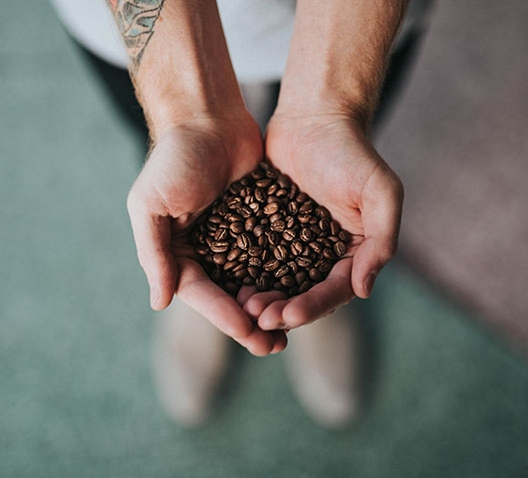

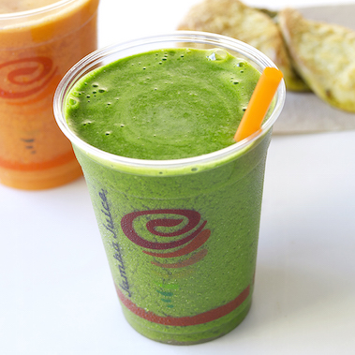
Divider slide
Co-Branding
Concept
Merging of Coffee Franchise with Juice Franchise
Reduces impacts of slump seasons
Reduces impacts due to world health trends
Positive powered business improve the socioeconomic status
Notes:
The Merging of Franchises is referred to as Co-branding (also known as piggyback franchising and dual or combination franchising) (Daley, 2012)
-- Reduces impacts of a slump in sales in seasonal changes (Invest, 2018).
The Idea is to bring two business together to help any weak areas one might have. This concept is the successful co-branding of Dutch Brothers Coffee with Jamba Juice. Jamba Juice normally has a slump in business in cold weather. Coffee shops are experiencing a slump due to the current health craze of the up coming generation.
-- Reduces impacts due to world health trends.
The current trend in the world seems to be one of Health. Not only is the U.S. new generation is looking for healthier beverage but the world’s new generation.
-- Positive powered business improve the socioeconomic status of communities by influencing positivity and success in the community it serves.

Slide 4


The Current Socioeconomic status of Linda California
People of Vision
Donating Back
Being Successful
Hiring Local
Notes:
-- The Current socioeconomic status of Linda California is bleak.
---- In fact, over 25% of the seventeen thousand people in this area are impoverished (FactFinder, 2018)
--- This is the socioeconomic condition that DBP will set as a goal to change.
-- By bringing people and students with a vision for the future into the community.
-- By donating back to the local community.
-- By establishing a successful business.
-- By hiring from the local market.

Slide 5
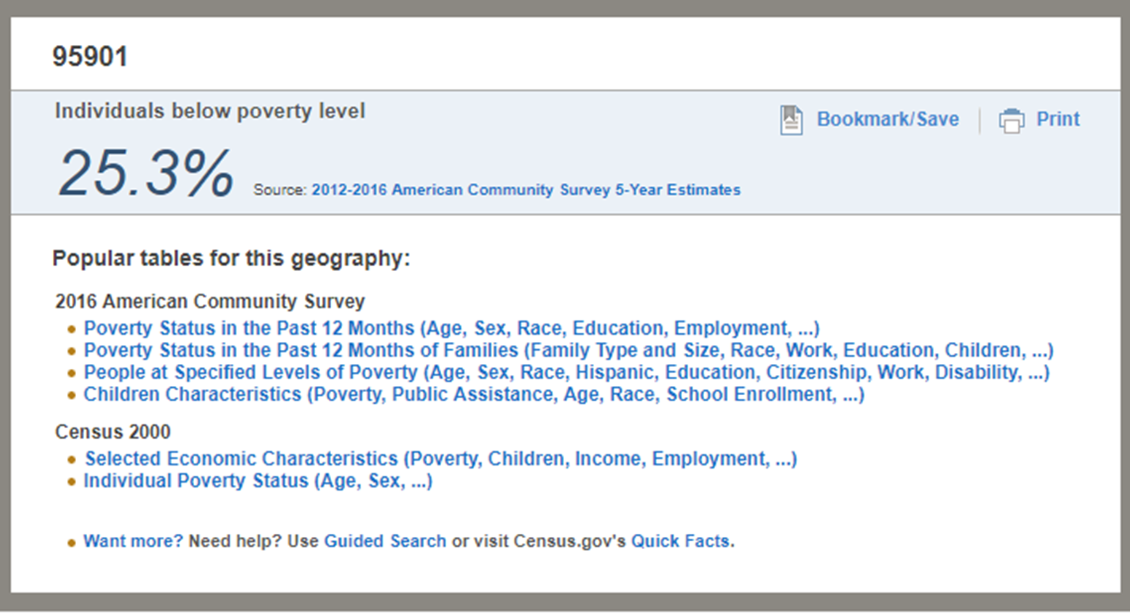
The Current Socioeconomic status of Linda California
Notes:
-- Here is the actual report from factfinder.
---- It show that at the time of the last census 25.3% of the seventeen thousand people in this area are impoverished (FactFinder, 2018)

Slide 6
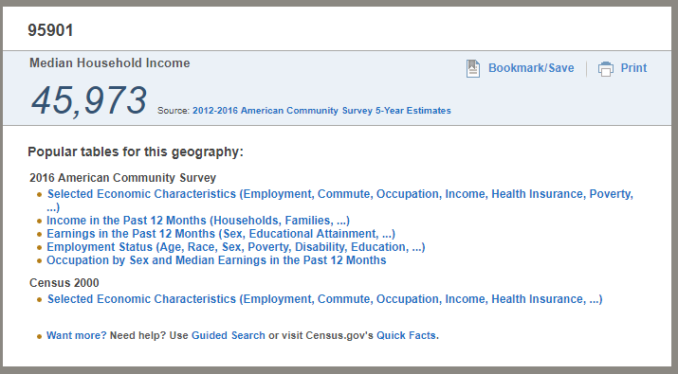
The Current Socioeconomic status of Linda California
Notes:
---- However, there is money in the area with an average income of being about 45 thousand a year.

Slide 7
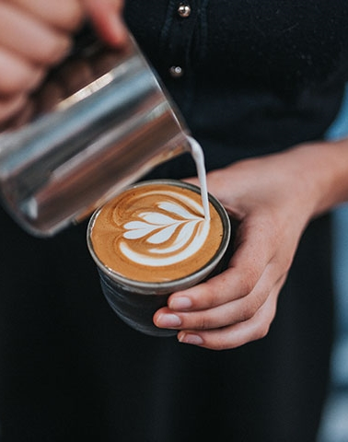
Key Opportunities
First Mover Advantage – the Healthy Coffee Choice.
First in Attaining Key Contracts.
The Advantage of Yuba College.
Six local k12 public schools are nearby.
North Beale Road is also a main entrance to Beale air force base
Notes:
--- Key Opportunities
----Dutch Brothers Plus is expecting rewards from the first mover advantage.
--- Currently there are no other combination Coffee / Healthy Juice & Smoothie stores in existence. We can be the first to advertise “The Healthy Coffee Choice”
---First in Attaining Key Contracts.
---DBP can get local contracts, and create partnerships with local produce growers and suppliers that may make entry of new businesses difficult.
---The Advantage of Yuba College.
--- The only Community College within sixty Miles is only Blocks away. By creating an environment that is favorable to study DBP can expect Student Activity during the day. An estimation of approximately 30% of DBP business is easily expected.
---Six local k12 public schools are nearby.
--- With six public schools nearby DBP can expect rushes of customers in the mornings as parents take their children to school and once again when kids get out, as parents want to provide a healthy drink alternative for their children.
---North Beale Road is also a main entrance to Beale air force base.
DBP can offer a great coffee beverage and a roll for military personnel as they go on duty.

Slide 8
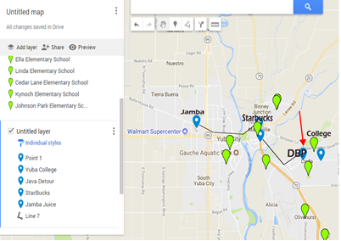
No real direct competition
8
Notes:
-- There is no real competition
--- The closest coffee house is in downtown Marysville, and the Closest Juice bar is a city away on the other end of Yuba City.
--- Note the green place marks, these are all local schools
The danger is that a firm with much more capital may be able to establish before we can. With out the first comer advantage contracts the business may suffer, however, the piggybacking of the two is not likely to be duplicated by another firm soon.

Slide 9
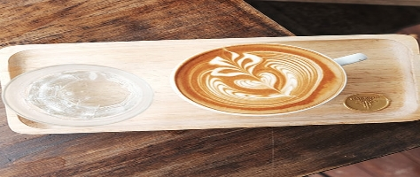
Industry Analysis
9
Jamba Juice is reporting EBIT 15 million (Jamba. 2018).
Starbucks in reporting EIT as 4.3 billion.
One source estimates Dutch Brothers at 250 Million (Owler, 2018).
Planet Smoothie is reporting a total of 290 Million in sales /yr.
Notes:
-- Jamba Juice is reporting about 75 million in revenue with 22% of that being the EBIT or about 15 million (Jamba. 2018).
--Starbucks in reporting EBIT as 4.3 billion.
--Owler estimates Dutch Brothers at 250 Million (Owler, 2018)
--Planet Smoothie is reporting a total of 290 Million in sales /yr
So both industries are doing well.

Slide 10
SWOT
Notes:
Looking at the SWOT of two comparable businesses and comparing them to each other we see the following.
Both have great customer service as one of their strengths so it is important to keep that strength in DBP
DBP may be able to capitalize on the positive branding of one or both by purchasing or acquiring a franchise or the name. Community involvement and a name for health can both be capitalized on by DBP.
DBP will be giving back in 2 ways, a share of profits going toward community improvements as well as supporting local growers. Current entry costs are low, especially if we don’t buy a franchise.

Slide 11
SWOT
Notes:
Weaknesses
The weakness for each will be addressed by the other.
Merchandise will be supplemented, and the lull in sales in colder times are both handled.
Dutch Brothers not being a franchise opens up the possibility of adapting the DBP name, and needing fresh produce is a positive. The limited unhealthy selection will have healthy choices, and the customer base is expanded, especially in this location. The no seating in traditional DB is taken care of by the store, and the fact that there is no Jamba Juice franchise available is dealt with by using Plus instead.

Slide 12
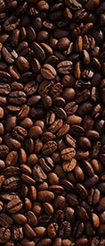
Opportunities
Cross-promoting merchandise.
The slogan, “The Healthy Coffee”.
First Mover Advantage – No competition.
Partnering with Gyms.
The goal to acquire the Jamba Juice.
Notes:
Opportunities include
Cross-promoting merchandise will fill in merchandise gaps,
The slogan, “The Healthy Coffee”. Since DBP can promote health and serve caffeinated drinks, both cold and hot beverages with a unique listing of menu items to eat DBP can find a niche’ be the healthy coffee shop.
First Mover Advantage – No competition
The cafeteria on the campus is always rumbling, busy, and loud. This startup will offer an alternative that is close enough to the college to be a desired quiet destination.
Partnering with Gyms
Finally, promoting health will mean that DBP will actively partner with Gyms. By offering promotional items such as reward cards with free drinks after a number of visits. We will continue to promote health down the line after the DBP franchise chain is established as we would like to acquire a chain of gyms to stand along our commitment to health.
The goal to acquire the Jamba Juice Brand.
Though Jamba is still making money it has been is a steady decline. It will be DBP goal to acquire Jamba if this trend continues.

Slide 13
Threats
● Easily reproduced, entry costs are low.
● A change in the economy.
● Existing branding would be difficult.
● Transportation fuel costs.
● Home juicing, and espresso.
● Major supermarkets and Campus.
.
Notes:
Threats
● While the firm is unique, it is easily reproduced, and entry costs are low.
● A change in the economy might cause people to stop spending on unnecessary drinks.
● Market entry without an existing branding may be difficult.
● Transportation cost for fresh fruit would vary with fuel costs.
● There is an upswing in home juicing, and home espresso that are cheaper alternatives.
● Major supermarkets supply bottled juices and cold coffees, and both Food Max, and Walmart are nearby.
● The Campus has a Starbucks vendor in the cafeteria.

Slide 14
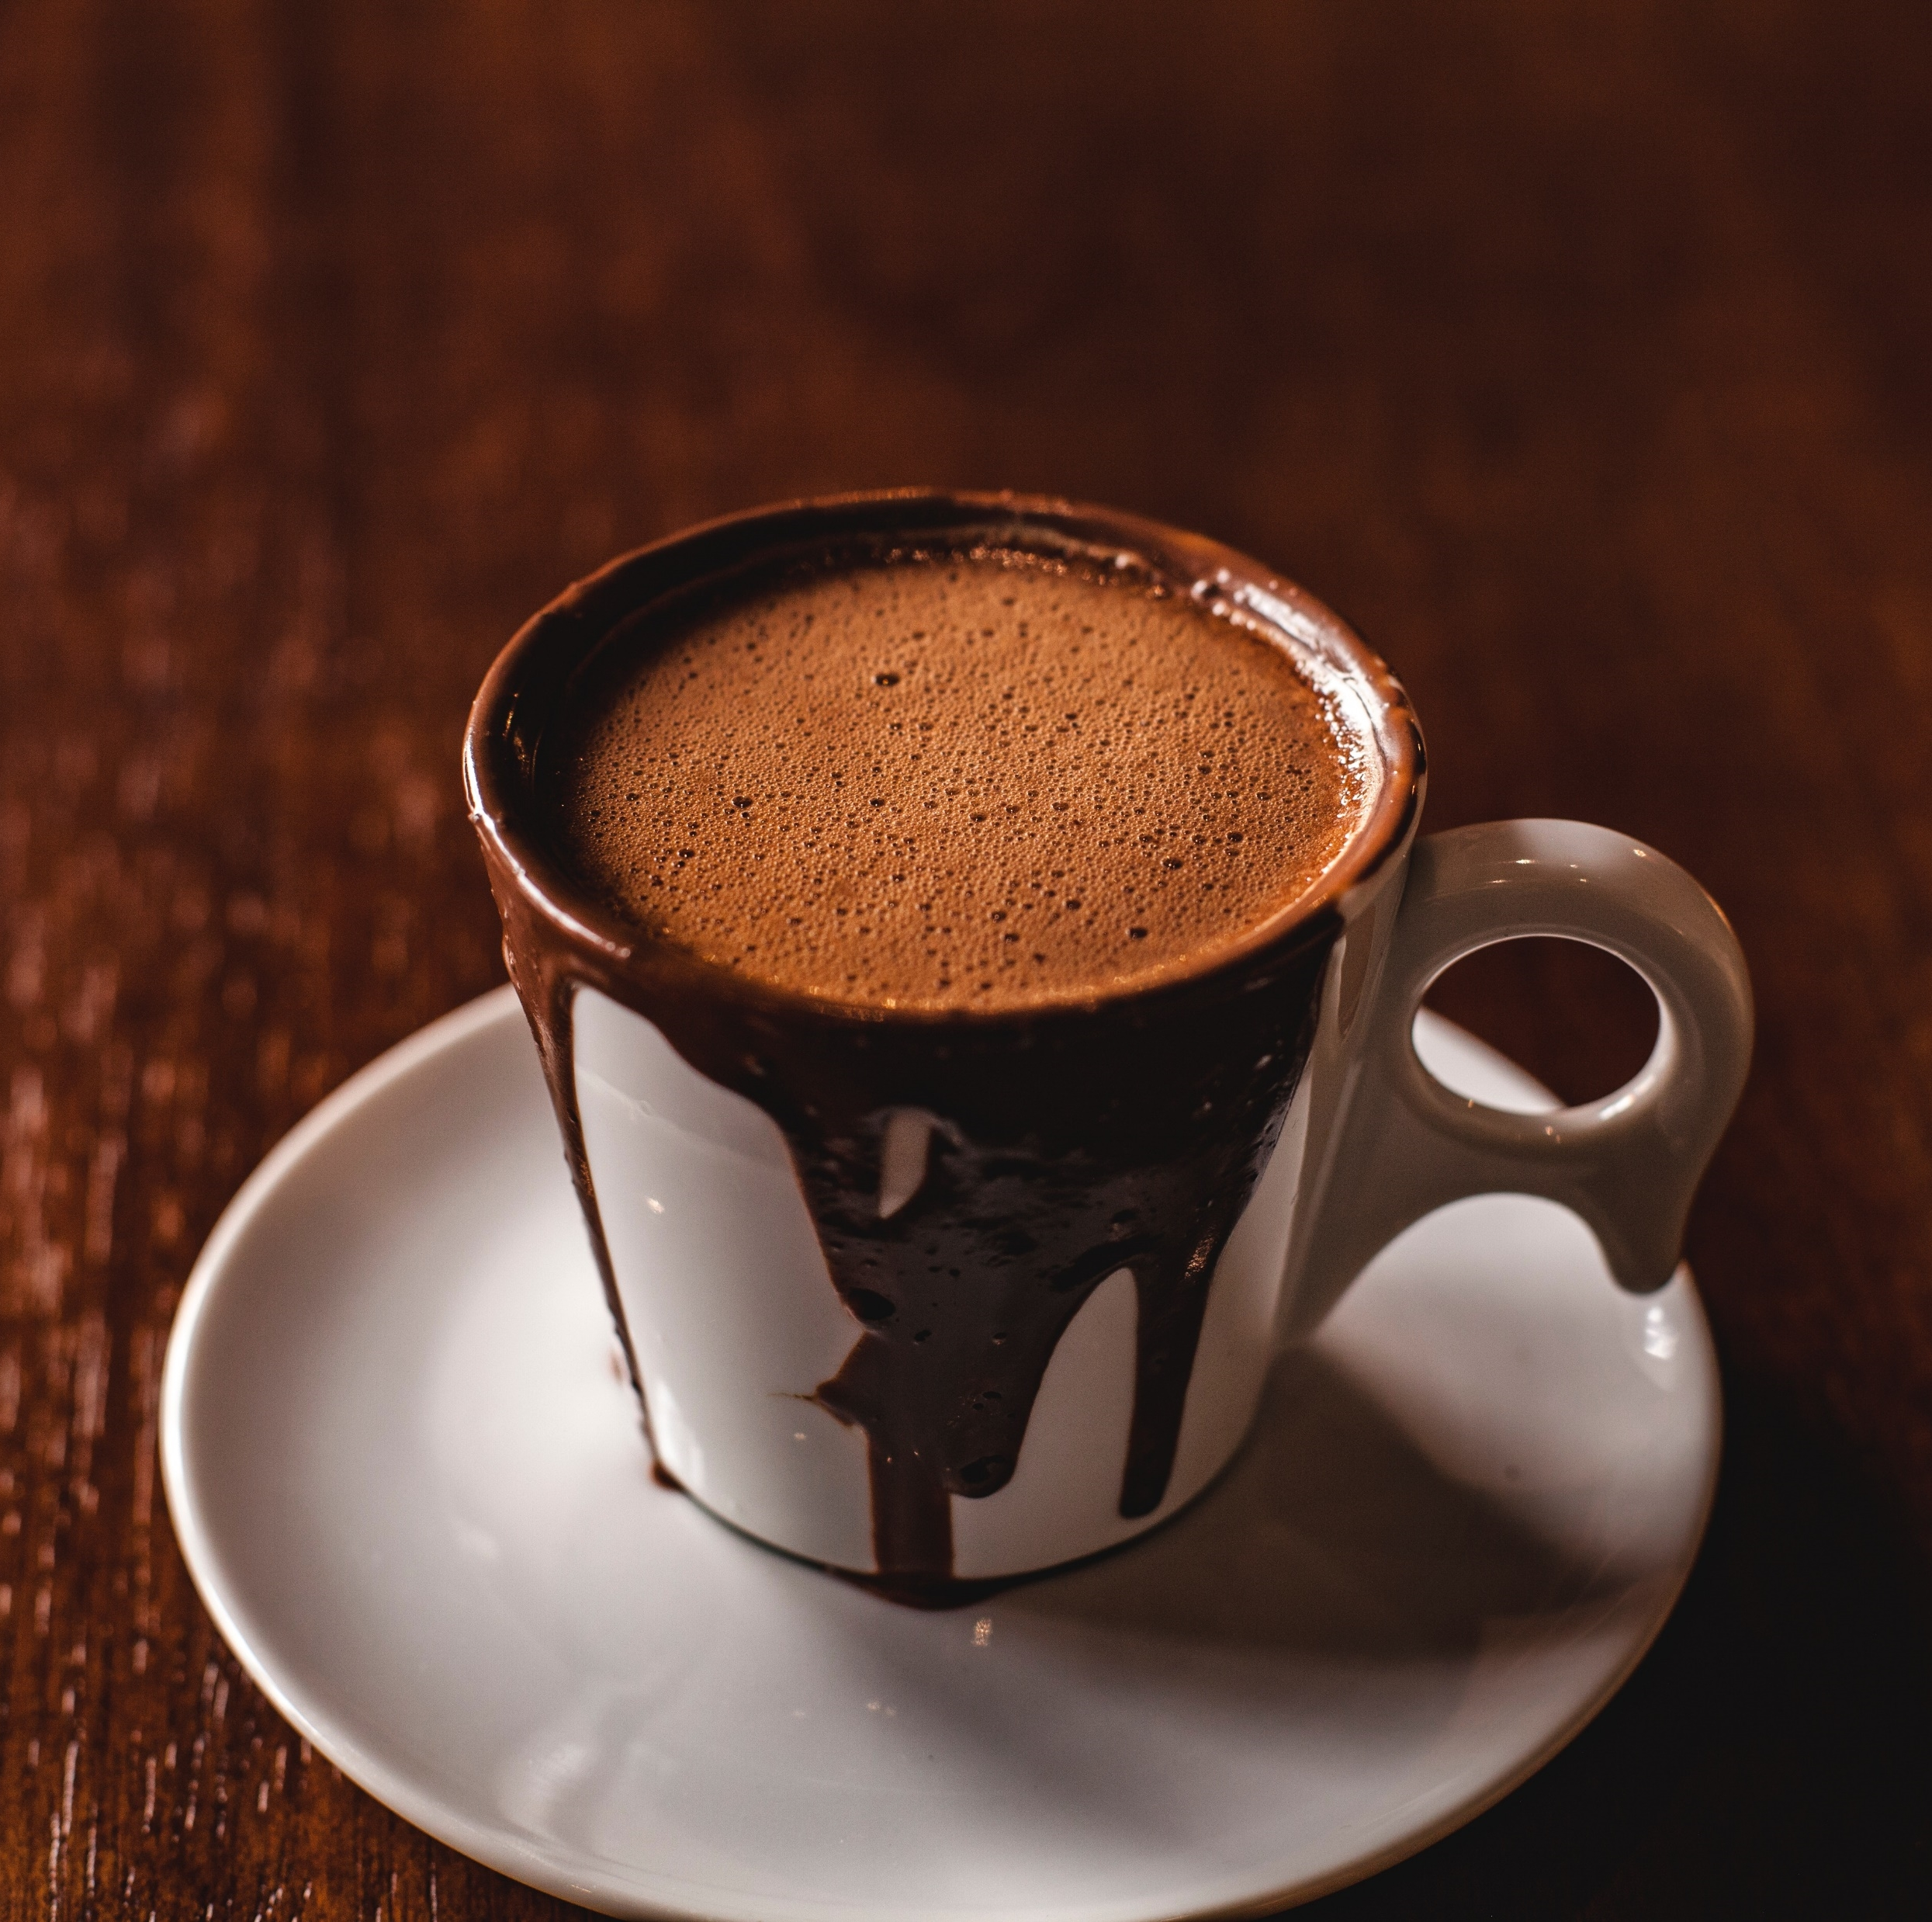
VRIO
Value
Rarity
Imitability
Organization
Notes:
Value:
First, people love their coffee, and they also love a place to relax. This behavior adds value. In addition, Dutch Brothers Coffees add value by offering beverages at a discount when compared to Starbucks, or Java Detour. Also, streaming music is a cornerstone of Dutch Brothers Coffees that DBP will continue adding even greater value. Music partnerships with companies such as iTunes have proven to create value for firms such as Starbucks. Jamba Juice creates value by cornering the market on the health front. Healthy, organic juice is a great supplement for coffee and a great alternative to soda pop. DBP plans on continuing creating value through this great service that supports both quality and friendliness.
Rarity:
DBP is very rare in that it is a hybrid coffee house and a juice bar. Also, it is rare because there are no other juice bars within the city, to add to this, the closest coffee house is in downtown Marysville.
Imitability:
This business is easily duplicated. While this may be a negative if another entrepreneur knows where to start one in competition, it is also positive for DBP in producing carbon copies in other locations as the firm grows. On the other hand, this business supply chain and Supply Management system will be costly to reproduce. There are only so many fresh organic fruits and vegetables grown locally, and since DBP is the first of its kind, it will have a strategic advantage through new product development. The first one gets all the contracts with the organic suppliers. Further, using Porter's Generic Competitive Strategies there is a competitive advantage from having a focus as well as having differentiation (Porter, 1980).
Organization:
DBP must organize its management systems, policies, organizational structure, processes, and culture to fully realize the potential of its valuable, rare and costly to imitate resources and capabilities. This will come through Total Quality Management, eventual Blue Ocean, as well as the adaptable product line.

Slide 15
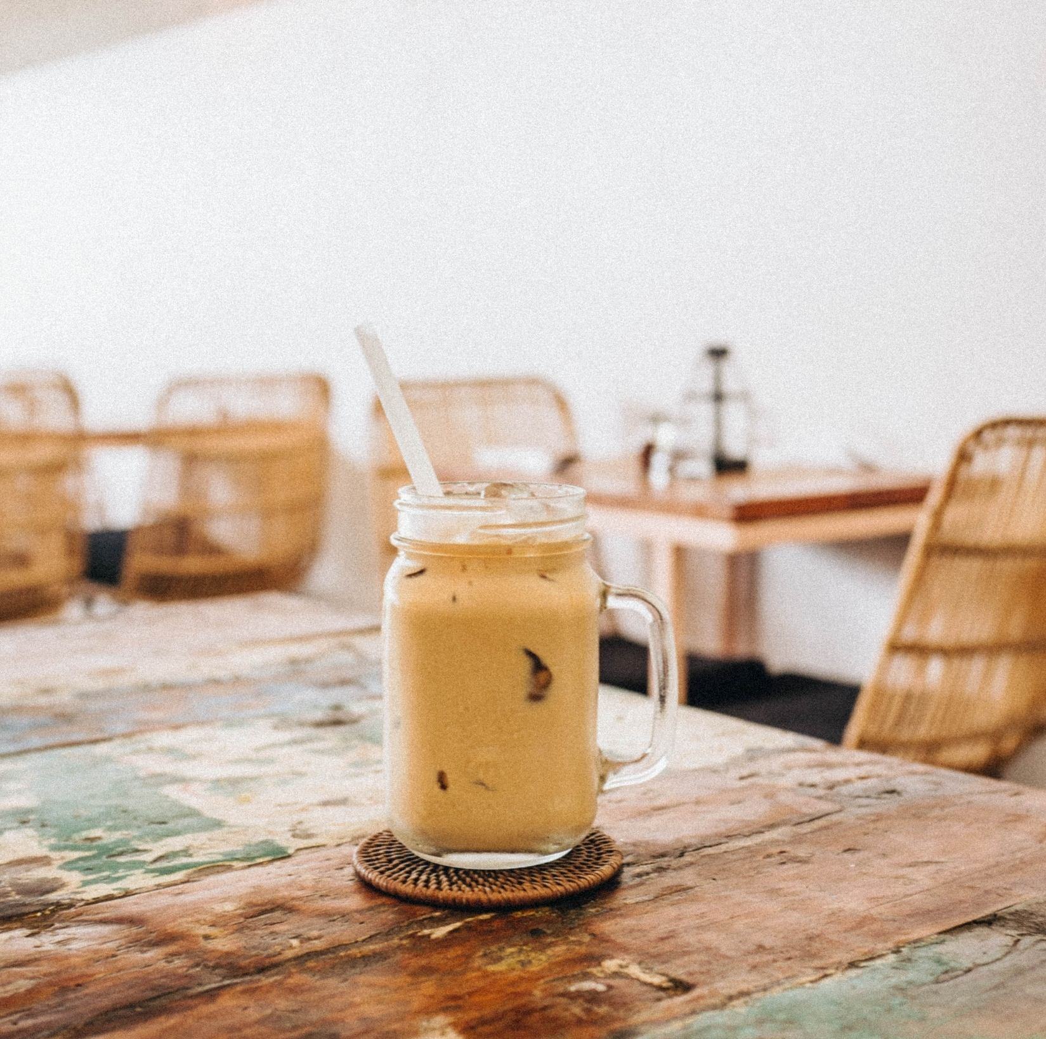
VRIO
PESTEL
Value
Rarity
Imitability
Organization
Political
Economic
Sociocultural
Technological
Environmental
Legal Environments
Notes:
Political:
Currently the city is undergoing a facelift, and much effort is being put into updating the area, for this reason, its felt that favor from the city council will be given to any business that represents an uplift in the socioeconomic status of the current inhabitants of the community. Since DBP is focused on catering to those who currently have an academic vision for the future and has community involvement plans, we forecast political support. Also, the U.S. is currently experiencing some reprieve from the last recession as business is not only up in California but the U.S. In general, we forecast this will be the case for the next couple of years at least.
Economical:
Economically though the location has been economically repressed in the past, there is economic growth projected as sidewalks and drainage are being installed from the highway to the college. This will encourage more foot traffic as well as cyclists. Correspondingly, both companies that DBP is patterned after are doing well financially in both California, The U.S., including the locations currently doing business closest to our proposed location.
Social-cultural:
This is an area of targeted change. Though the current Social-cultural feel of the area is one of oppression in the area surrounding Yuba College it is our desire to change this by bringing a new thriving business that promotes health, by attracting patrons who have a vision for the future, by having a culture that focuses on success, music, honest, quality, and fellowship into the community. While we know that DBP will be unable to accomplish this community transformation on its own, DBP will help to pioneer efforts by continuing the Dutch Brothers commitment of annually giving back a percentage of its profits to improve the community in which it does business.
Technological:
DBP will use up to date supply systems to ensure Just-In-Time deliveries of produce ensuring the freshest organic supplies for juicing and coffees possible. Further, the music traditions of Dutch Brothers combined with patterns borrowed from Starbucks will help to keep DBP on the cutting edge of music. Offering Wi-Fi and high-speed internet access as well as computers on timed rentals will also keep DBP a valued location for study or out of office work. Lastly, DBP commitment to innovation will ensure that DBP is always on top of the technologies advancement.
Environmental:
The family feel and laid-back smooth work environment will be a cornerstone at DBP locations. Also, for those on the go, a drive-thru that focuses on satisfied repeat business will be offered.
Legal Environments: There are no foreseen legal ramifications.

Slide 16
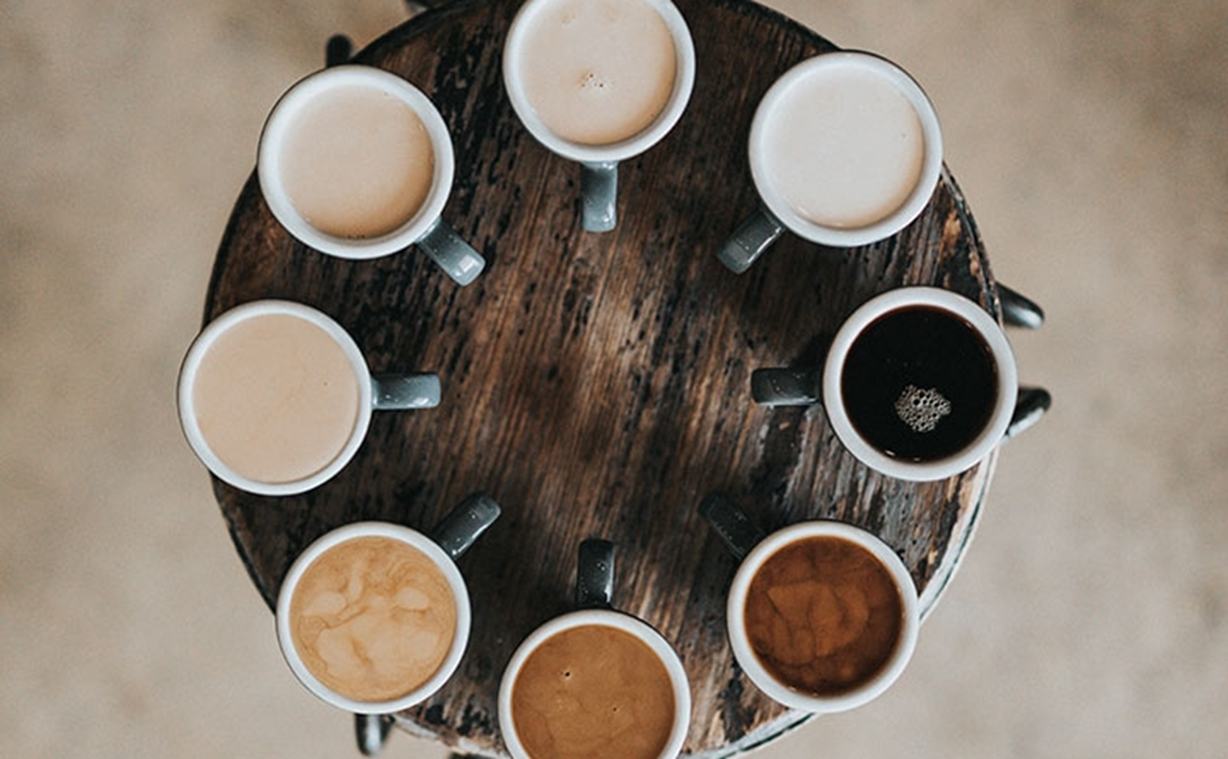
Core Values
DBP is a people first firm.
Honesty, Loyalty, Innovation, and Dedication are its chief values.
Being a light in a dark community is its calling.
Making sure its family of employees is paid fairly, have medical, dental, and a balanced home and work life are doctrines under which teach DBP will function.
Notes:
Core Values
-DBP is a people first firm.
-Honesty, Loyalty, Innovation, and Dedication are its chief values.
-Being a light in a dark community is its calling.
-Making sure its family of employees is paid fairly, have medical, dental, and a balanced home and work life are doctrines under which each DBP will function.

Slide 17
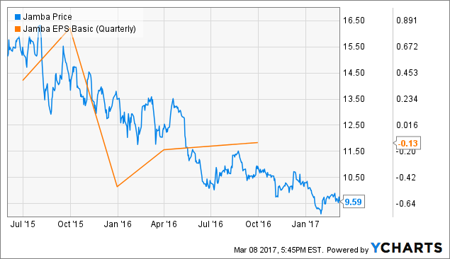
Our Goals
1. To have a positive impact on the community within in 6 months..
2. To break even in 12 months.
3. To have the second location opened or on its way to being opened within 24 months.
4 The eventual acquisition of Jamba Juice.
5. Successful partnerships with national Gyms, with the eventual addition of a chain of gyms.
Notes:
1. To have a positive impact on the community in 6 months through a marked increase in the socioeconomic status in the local community and through general community improvement efforts-at least two.
2. To break even in 12 months.
3. To have the second location opened or on its way to being opened within 24 months.
The eventual acquisition of Jamba Juice.
Jamba Juice has been an a steady decline for years. While the product is good it is just not enough to promote sustainability. DBP plans on acquiring the chain as soon as it can easily afford to do so.
5. Successful partnerships with national Gyms such as Planet Fitness, and In-Shape, with the eventual addition of it’s own chain of gyms.

Slide 18
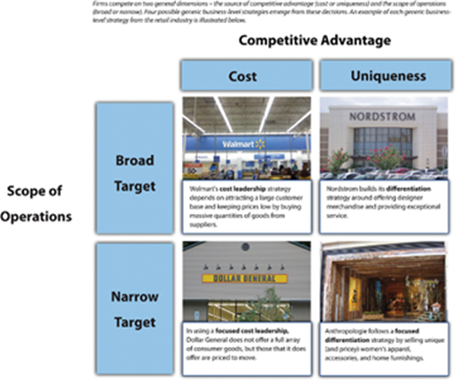
Stratagies
Porter’s Key Strategies and Ghemawat’s “AAA” Global strategies
Adaption.
Aggregation.
Arbitrage.
Focused Differentiation.
First Mover Advantage.
Tactical Plan.
Operational.
Notes:
• Adaption.
Being a franchise DBP will be employing mostly Adaption, as we seek to improve each community in which each DBP is placed.
• Aggregation.
This will have a place. Things such as the feel of the store, the greeting style, and the goal of improving communities will be carried into each store.
• Arbitrage.
Since the Juicing side will depend on mostly local veggies and fruits, we may be able to leverage some prices when we find an overabundance of lower cost quality fruits and veggies in a location, if so, it may be possible to import/export those items that are not indigenous in a market for a profit.
Using Porter's Generic Competitive Strategies this creates a competitive advantage from having a focus as well as having differentiation of being the only store of its kind around. (Porter, 1980)
First Mover Advantage has already been brought up but it is worth mentioning again. By being first mover DBP will be able to claim needed local contracts for fruit and product that may create barriers to entry for those who wish to follow.
Tactical Plan
Be the fist to create long lasting supplier partnerships in our supply chain. Make it favorable and profitable conditions for suppliers to promote having contracts with us. Leverage these partnerships to supply discounted items in locations where items are harder to come by. Use the buying power of DBP to bring in economies of scale for such things as lids, straws, cups etc, while preferring green solution over the rest. And when economies of scale are not available seek partnership with business who have the same green mindset to create economies of scale.
Operational
Our operational strategy is to make sure that all greeters make every customer feel as if they are one of the most important people to visit, make every order a priority, and make everyone one family. Local produce will be preferred typically over shipped produce, with those supply partners managing and delivering just on time fruits, produce, and green supplies.

Slide 19
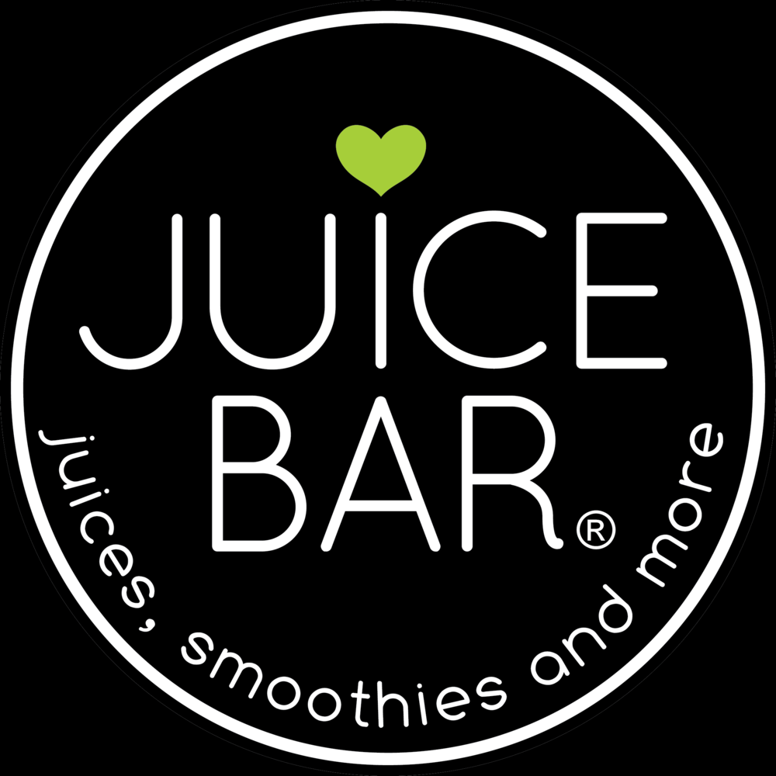
Mission and Vision
Mission Statement
DBP Vision
Performance
To become our community’s leader in promoting health by presenting a quality product. Juices and smoothies that are naturally healthy, coffees that encourage, uplift and inspire the hearts of people, person by person, cup by cup, while supporting our community through giving, health, music, and friendliness.
To inspire healthy living through providing a place where human connection and great health come together in song.
DBP will be taking Benchmarks from Starbuck, Dutch Brothers, Jamba Juice and Planet Smoothies. Further, DBP will be using Balance Score Card Technologies to insure performance.
Notes:
Mission Statement DBP
To become our community’s leader in promoting health by presenting a quality product. Juices and smoothies that are naturally healthy, coffees that encourage, uplift and inspire the hearts of people, person by person, cup by cup, while supporting our community through giving, health, music, and friendliness.
DBP Vision
To inspire healthy living through providing a place where human connection and great health come together in song.
Performance Measures
DBP will be taking Bench Marks from Starbuck, Dutch Brothers, Jamba Juice and Planet Smoothies. Further, DBP will be using Balance Score Card Technologies to insure performance.

Slide 20
Conclusion
The triple bottom line emphasizes the three Ps of people, the planet, and profits (Ketchen, 2011).
DBP represents each area uniquely.
The location, “after the light and to the right.”
The chosen mission, vision, and goals of this enterprise will make this firm a community favorite.
For these reasons and all the rest listed in this presentation we feel that DBP is the future of the Coffee House and has a profitable future.
Notes:
--The triple bottom line emphasizes the three Ps of people, the planet, and profits (Ketchen, 2011).
-- DBP represents each area uniquely and has the opportunity and potential to become a billion-dollar franchise easily. The idea of having hot coffees in cold weather and cold juices in warm weather ensures there will be no slump in seasonal sales.
--The location, “after the light and to the right,” being near several schools and the only local college and having the only competition miles away almost ensures success.
--The chosen mission, vision, and goals of this enterprise will make this firm a community favorite while providing the entrepreneur an eventual possible cash flow potential above and beyond the benchmark firms.
--For these reasons and all the rest listed in this presentation we feel that DBP is the future of the Coffee House and has a profitable future.

Slide 21

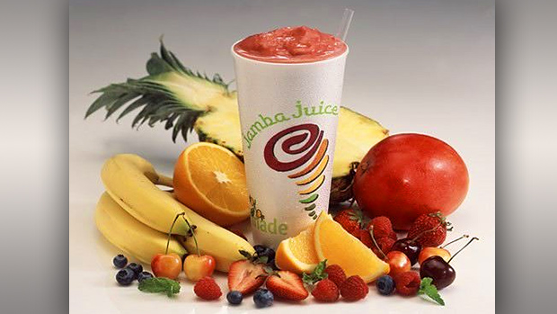
Large Photo Slide
21
Dutch Brothers
Plus

Slide 22
THANK YOU
Jeffery Morse
Strategic Fundamentals
Brandman University

Slide 23
References
Daley, J. (2012) New Franchises Team Up and Make Co-branding Work, Url https://www.nasdaq.com/article/new-franchises-team-up-and-make-cobranding-work-cm129748
FactFinder, (2018) Url https://factfinder.census.gov/faces/nav/jsf/pages/community_facts.xhtml
Invest, (2018) Url https://www.investopedia.com/markets/stocks/sbux/#Financials
Jamba Inc. (2018) Annual Report http://ir.jambajuice.com/phoenix.zhtml?c=192409&p=irol-newsArticle&id=2338420
Ketchen, D. & Short, J. (2011). Mastering Strategic Management. Washington, DC: Flat World Knowledge, Inc.
Owler (2018) Owler.com Url https://www.owler.com/company/dutchbros
Porter, M. E. (1980). Competitive strategy: Techniques for analyzing industries and competitors. New York, NY: Free Press.

