Slide 1
Chapter 5
Capital Structure
Presenter’s name
Presenter’s title
dd Month yyyy

Slide 2
1. Introduction
The capital structure decision affects financial risk and, hence, the value of the company.
The capital structure theory helps us understand the factors most important in the relationship between capital structure and the value of the company.
Notes:
Pages 199–200
Introduction
The connection between the capital structure decision and the value of the company was established in Chapter 4 with respect to financial risk.
In this chapter, complexities are examined, including taxes, financial distress, and agency issues.

Slide 3
2. The Capital Structure Decision
Development of the theory of capital structure, beginning with the capital structure theory of Miller and Modigliani:
Capital Structure Irrelevance
Benefit from Tax Deductibility of Interest
Costs of Financial Distress
Agency Costs
Costs of Asymmetric Information
Notes:
LOS: Explain the Modigliani–Miller propositions concerning capital structure, including the impact of leverage, taxes, financial distress, agency costs, and asymmetric information on a company’s cost of equity, cost of capital, and optimal capital structure.
Pages 200–205
2. The Capital Structure Decision
The basis for capital structure theory is the Modigliani and Miller theory.

Slide 4
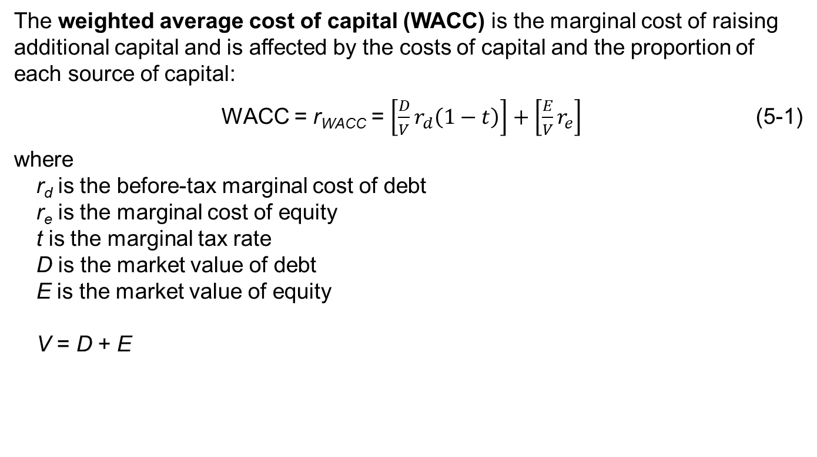
The Weighted average Cost of Capital
The weighted average cost of capital (WACC) is the marginal cost of raising additional capital and is affected by the costs of capital and the proportion of each source of capital:
WACC = r_{WACC} = $\left[\frac{D}{V}r_{d}\left(1−t\right)\right]+\left[\frac{E}{V}r_{e}\right]$ (5-1)
where
r_{d} is the before-tax marginal cost of debt
r_{e} is the marginal cost of equity
t is the marginal tax rate
D is the market value of debt
E is the market value of equity
V = D + E
Notes:
LOS: Explain the Modigliani–Miller propositions concerning capital structure, including the impact of leverage, taxes, financial distress, agency costs, and asymmetric information on a company’s cost of equity, cost of capital, and optimal capital structure.
Page 200
The Weighted Average Cost of Capital
We use the weighted average cost of capital in the capital structure decision because the capital structure decision affects the proportions of the different capital.
The weighted average cost of capital was discussed in Chapter 3. Equation 3-1 (p. 129) is the same as Equation 5.1, although the notation is slightly different.
w_{d} is D ÷ V and w_{e} is E ÷ V.
Discussion question: If a company varies its capital structure (hence, changing the weights in equation 5-1), do the costs of the different sources of capital change?

Slide 5
Proposition I without Taxes:
Capital Structure Irrelevance
Franco Modigliani and Merton Miller (MM) developed a theory that helps us understand how taxes and financial distress affect a company’s capital structure decision.
The assumptions of their model are unrealistic, but they help us work through the effects of the capital structure decision:
  Investors have homogeneous expectations regarding future cash flows.
  Bonds and stocks trade in perfect markets.
  Investors can borrow and lend at the same rate.
  There are no agency costs.
  Investment and financing decisions are independent of one another.
Notes:
LOS: Explain the Modigliani–Miller propositions concerning capital structure, including the impact of leverage, taxes, financial distress, agency costs, and asymmetric information on a company’s cost of equity, cost of capital, and optimal capital structure.
Page 201–202
Proposition I without Taxes: Capital Structure Irrelevance
Assumptions:
Investors agree on the expected cash flows from a given investment. This means that all investors have the same expectations with respect to the cash flows from an investment in bonds or stocks. In other words, expectations are homogeneous.
Therefore, investors will agree on the value of the firm.
Bonds and shares of stock are traded in perfect capital markets.
This means that there are no transaction costs, no taxes, and no bankruptcy costs and everyone has the same information. In a perfect capital market, any two investments with identical cash flow streams and risk must trade for the same price.
This helps isolate the effects of taxes and financial distress, which are introduced slowly in the MM theories.
Without transaction costs, investors can move funds among investments and firms can issue securities without a cost.
Investors can borrow and lend at the risk-free rate.
This means that it does not matter whether the firm or the investors borrow or lend; it is all done at the same rate.
There are no agency costs. This means that managers always act to maximize shareholder wealth.
The assumption is that the company will not waste funds; all funds are put to productive use.
The financing decision and the investment decision are independent of each other. This means that operating income is unaffected by changes in the capital structure.
Therefore, the value of the firm before considering how it is financed is the same regardless of the financing chosen.

Slide 6
Proposition I without Taxes:
Capital Structure Irrelevance
Based on the assumptions that there are no taxes, costs of financial distress, or agency costs, so investors would value firms with the same cash flows as the same, regardless of how the firms are financed.
Reasoning: There is no benefit to borrowing at the firm level because there is no interest deductibility. Firms would be indifferent to the source of capital and investors could use financial leverage if they wish.
MM Proposition I
The market value of a company is not affected by the capital structure of the company.
Notes:
LOS: Explain the Modigliani–Miller propositions concerning capital structure, including the impact of leverage, taxes, financial distress, agency costs, and asymmetric information on a company’s cost of equity, cost of capital, and optimal capital structure.
Page 201–202, 204
Proposition I without Taxes: Capital Structure Irrelevance
Same set of cash flows → Same valuation (See Leverkin Company example, p. 204).
You can see this proposition by capitalizing EBIT (that is, value of the firm = EBIT ÷ WACC).
Bottom line: There is no benefit to using debt versus equity.

Slide 7
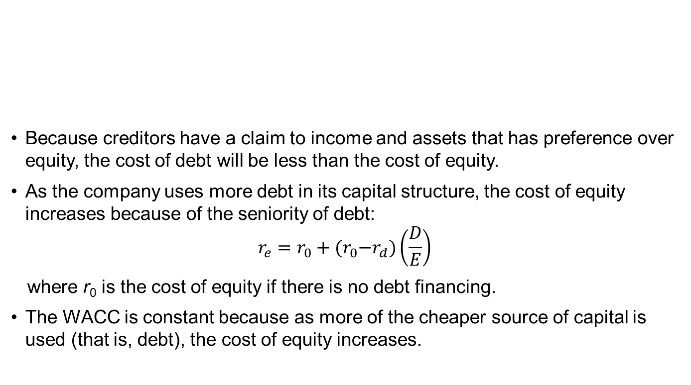
Proposition II without Taxes:
Higher Financial Leverage
Because creditors have a claim to income and assets that has preference over equity, the cost of debt will be less than the cost of equity.
As the company uses more debt in its capital structure, the cost of equity increases because of the seniority of debt:
$$r_{e}=r_{0}+{(r}_{0}−r_{d})\left(\frac{D}{E}\right)$$
  where r₀ is the cost of equity if there is no debt financing.
The WACC is constant because as more of the cheaper source of capital is used (that is, debt), the cost of equity increases.
MM Proposition II:
The cost of equity is a linear function of the company’s debt/equity ratio.
Notes:
LOS: Explain the Modigliani–Miller propositions concerning capital structure, including the impact of leverage, taxes, financial distress, agency costs, and asymmetric information on a company’s cost of equity, cost of capital, and optimal capital structure.
Pages 203–205
Proposition II without Taxes: Higher Financial Leverage
Proposition II relates to the cost of capital.
The cost of equity increases as more debt is used (see Leverkin example, p. 204).
Debt is a cheaper source of capital, so as more is used, the WACC is reduced if the cost of equity has not risen.
Key:
Cost of equity = Cost of equity for an all-equity financed firm + [(Cost of equity for an all-equity financed firm – Cost of debt)(D ÷ E)]
Net effect: Constant WACC
In other words, the increase in the cost of equity is balanced out by the increased use of the cheaper source of capital, debt.
Bottom line: There is no benefit to using debt versus equity.

Slide 8
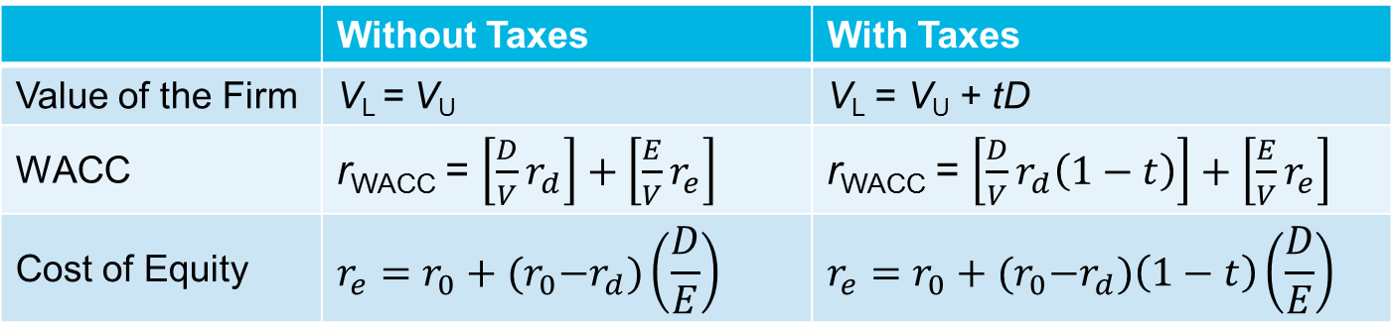
Introducing Taxes into the MM Theory
When taxes are introduced (specifically, the tax deductibility of interest by the firm), the value of the firm is enhanced by the tax shield provided by this interest deduction. The tax shield:
  Lowers the cost of debt.
  Lowers the WACC as more debt is used.
  Increases the value of the firm by tD (that is, marginal tax rate times debt)
Bottom line: The optimal capital structure is 99.99% debt.
 | Without Taxes | With Taxes
Value of the Firm | V_{L} = V_{U} | V_{L} = V_{U} + tD
WACC | r_{WACC} = $\left[\frac{D}{V}r_{d}\right]+\left[\frac{E}{V}r_{e}\right]$ | r_{WACC} = $\left[\frac{D}{V}r_{d}\left(1−t\right)\right]+\left[\frac{E}{V}r_{e}\right]$
Cost of Equity | $$r_{e}=r_{0}+{(r}_{0}−r_{d})\left(\frac{D}{E}\right)$$ | $$r_{e}=r_{0}+{(r}_{0}−r_{d})\left(1−t\right)\left(\frac{D}{E}\right)$$
Notes:
LOS: Explain the Modigliani–Miller propositions concerning capital structure, including the impact of leverage, taxes, financial distress, agency costs, and asymmetric information on a company’s cost of equity, cost of capital, and optimal capital structure.
Pages 205–209
Introducing Taxes into the MM Theory
When taxes are introduced (specifically, the tax deductibility of interest by the firm), the value of the firm is enhanced by the tax shield provided by the interest deduction. The tax shield:
Lowers the cost of debt because the cost is now multiplied by 1 minus the marginal tax rate.
Lowers the cost of equity as more debt is used (Exhibit 5-1, Panel C).
Increases the value of the firm by tD (that is, marginal tax rate times debt)—the interest tax shield.
Why isn’t the optimal capital structure not 100% debt? Because in this extreme, debt would be, essentially, the equity of the firm.
Discussion question: What happens if we relax the assumption of no costs to bankruptcy (or financial distress)?

Slide 9
Introducing costs of financial distress
Costs of financial distress are costs associated with a company that is having difficulty meeting its obligations.
Costs of financial distress include the following:
  Opportunity cost of not making optimal decisions
  Inability to negotiate long-term supply contracts.
  Loss of customers.
The expected cost of financial distress increases as the relative use of debt financing increases.
  This expected cost reduces the value of the firm, offsetting, in part, the benefit from interest deductibility.
  The expected cost of distress affects the cost of debt and equity.
  Bottom line: There is an optimal capital structure at which the value of the firm is maximized and the cost of capital is minimized.
Notes:
LOS: Explain the Modigliani–Miller propositions concerning capital structure, including the impact of leverage, taxes, financial distress, agency costs, and asymmetric information on a company’s cost of equity, cost of capital, and optimal capital structure.
Pages 210–211
Introducing Costs of Financial Distress
Costs of financial distress are costs associated with a company that is having difficulty meeting its obligations.
Costs of financial distress include the following:
Opportunity cost of not making optimal decisions (forgoing profitable projects because of rationed capital or need for quick payback).
Inability to negotiate long-term supply contracts.
Loss of customers who do not have confidence in warranties, repairs, or returns.
Sale of productive assets to generate cash.
Change in inventory stocked to generate quick sales.
The expected cost of financial distress increases as the relative use of debt financing increases.
Note that this is the expected cost: The probability of distress increases as more debt is used.

Slide 10
Agency Costs
Agency costs are the costs associated with the separation of owners and management.
Types of agency costs:
  Monitoring costs
  Bonding costs
  Residual loss
The better the corporate governance, the lower the agency costs.
Agency costs increase the cost of equity and reduce the value of the firm.
The higher the use of debt relative to equity, the greater the monitoring of the firm and, therefore, the lower the cost of equity.
Notes:
LOS: Explain the Modigliani–Miller propositions concerning capital structure, including the impact of leverage, taxes, financial distress, agency costs, and asymmetric information on a company’s cost of equity, cost of capital, and optimal capital structure.
Page 211–212
Agency Costs
Monitoring costs:
Cost of the annual report
Cost of independent auditors
Cost of having securities rated
Bonding costs (difficult to observe):
Noncompete clauses in employment contracts
Residual loss:
Consumption of excessive perquisites (e.g., corporate jet used for personal business)

Slide 11
Costs of Asymmetric Information
Asymmetric information is the situation in which different parties have different information.
  In a corporation, managers will have a better information set than investors.
  The degree of asymmetric information varies among companies and industries.
The pecking order theory argues that the capital structure decision is affected by management’s choice of a source of capital that gives higher priority to sources that reveal the least amount of information.
Notes:
LOS: Explain the Modigliani–Miller propositions concerning capital structure, including the impact of leverage, taxes, financial distress, agency costs, and asymmetric information on a company’s cost of equity, cost of capital, and optimal capital structure.
Page 212–213
Costs of Asymmetric Information
Asymmetric information is the situation in which different parties have different information.
In a corporation, managers will have a better information set than investors.
The degree of asymmetric information varies among companies and industries, depending on the following:
Complexity of the line of business.
Transparency of financial information.
Proportion of institutional ownership.
The pecking order theory argues that the capital structure decision is affected by management’s choice of a source of capital that gives higher priority to sources that reveal the least amount of information.
Discussion question: Why would institutional ownership affect the degree of asymmetric information?

Slide 12
The Optimal Capital Structure
Taxes | Costs to Financial Distress | Optimal Capital Structure?
No | No | No
Yes | No | Yes, 99.99% debt
Yes | Yes | Yes, benefits of interest deductibility are offset by the expected costs of financial distress
We cannot determine the optimal capital structure for a given company, but we know that it depends on the following:
The business risk of the company.
The tax situation of the company.
The degree to which the company’s assets are tangible.
The company’s corporate governance.
The transparency of the financial information.
Notes:
LOS: Explain the Modigliani–Miller propositions concerning capital structure, including the impact of leverage, taxes, financial distress, agency costs, and asymmetric information on a company’s cost of equity, cost of capital, and optimal capital structure.
Page 213–215
The Optimal Capital Structure
If there are no taxes or costs of financial distress, there is no optimal capital structure and the firm’s cost of capital is constant (See p. 202).
If there are taxes but no expected costs of financial distress, the optimal structure is as much debt as possible (99.99% debt) and the cost of capital declines as more debt is used (See p. 208).
We cannot determine the optimal capital structure for a given company, but we know that it depends on the following:
The business risk of the company (greater the business risk, the lower the optimal capital structure).
The tax situation of the company (if the company cannot use tax deductions, then there is no benefit from debt).
The degree to which the company’s assets are tangible (the more tangible, the greater the optimal capital structure).
The company’s corporate governance (the better the governance, the lower the cost of equity and, therefore, the greater the optimal capital structure).
The transparency of the financial information (the more transparent, the lower the cost of equity and, therefore, the greater the optimal capital structure).

Slide 13
Trade-off Theory: Value of the Firm
Notes:
LOS: Explain the Modigliani–Miller propositions concerning capital structure, including the impact of leverage, taxes, financial distress, agency costs, and asymmetric information on a company’s cost of equity, cost of capital, and optimal capital structure.
Pages 213–215
Trade-Off Theory
This is a simplified chart, similar to Exhibit 5-2, Panel A.
Items to note on this chart:
The present value of interest tax shields (distance between the value of the unlevered firm and the value of the levered firm without costs of financial distress)
The present value of the costs of financial distress (distance between the value of the levered firm with and without costs of financial distress)
The optimal capital structure
Discussion question: Based on the value of the firm diagram, what should the cost of capital diagram look like? Why?

Slide 14
Deviating from Target
A company’s capital structure may be different from its target capital structure because of the following:
  Market values of outstanding issues change constantly.
  Market conditions that are favorable to one type of security over another.
  Market conditions in which it is inadvisable or too expensive to raise capital.
  Investment banking fees that encourage larger, less frequent security issuance.
Notes:
LOS: Explain the target capital structure and why actual capital structure may fluctuate around the target.
Pages 213–214
Deviating from Target
The target capital structure is a goal, but at any point in time, a company may deviate from this target for a number of reasons.
Market values of the outstanding obligations may change.
Market conditions may favor one security or maturity over another.
Market costs of capital.
Investment banking fees.

Slide 15
3. Practical Issues in
Capital Structure Policy
Debt Ratings
Factors to Consider
Leverage in an International Setting
Notes:
LOS: Describe the role of debt ratings in capital structure policy.
LOS: Explain factors an analyst should consider in evaluating the impact of capital structure policy on valuation.
LOS: Describe international differences in financial leverage and their implications for investment analysis.
Page 216
3. Practical Issues in Capital Structure Policy
Debt ratings
Factors to consider
Leverage in an international setting

Slide 16
Debt Ratings
Companies consider debt ratings in making capital structure decisions because the cost of debt is affected by the rating.
The spread between AAA rated and BBB rated bond yields is around 100 bps.
Bond Ratings by Moody’s, Standard & Poor’s, and Fitch
 | Moody’s | Standard & Poor’s | Fitch
Highest quality | Aaa | AAA | AAA | Investment grade
High quality | Aa | AA | AA
Upper medium grade | A | A | A
Medium grade | Baa | BBB | BBB
Speculative | Ba | BB | BB | Speculative grade
Highly speculative | B | B | B
Substantial risk | Caa | CCC | CCC
Extremely speculative | Ca
Possibly in default | C
Default |  | D | DDD-D
Notes:
LOS: Describe the role of debt ratings in capital structure policy.
Pages 216–217
Debt Ratings
Slide from Exhibit 5-4.
Companies pay a Nationally Recognized Statistical Rating Organization (NRSRO), such as Moody’s, to rate the debt.
Debt ratings reflect the financial risk of a security.
The lower the debt rating, the greater the cost of debt.

Slide 17
Evaluating Capital Structure Policy
Analysts consider a company’s capital structure
  Over time.
  Compared with competitors with similar business risk.
  Considering the company’s corporate governance.
Analysts must also consider
  The industry in which the company operates.
  The regulatory environment.
  The extent to which the company has tangible assets.
  The degree of information asymmetry.
  The need for financial flexibility.
Notes:
LOS: Explain factors an analyst should consider in evaluating the impact of capital structure policy on valuation.
Pages 217–218
Evaluating Capital Structure Policy
Factors to consider:
The company’s capital structure over time
The company’s capital structure compared with competitors with similar business risk
The company’s capital structure considering the company’s corporate governance
The industry in which the company operates
The regulatory environment
The extent to which the company has tangible assets
The degree of information asymmetry
The need for financial flexibility

Slide 18
Leverage in an International Setting
Country-specific factors affect a company’s choice of capital structure and the maturity structure within the capital structure.
Types of factors to consider:
  Institutional and legal environments
  Financial markets and banking sector
  Macroeconomic factors
Notes:
LOS: Describe international differences in financial leverage and their implications for investment analysis
Pages 218–221
Leverage in an International Setting
Country-specific factors may be more important than company-specific factors in determining capital structure.
Factors:
Institutional and legal environments (legal, financial reporting, taxation, corruption)
Financial markets and banking sector (activity and size of markets)
Macroeconomic factors (economic environment, business environment, economic growth, inflation)

Slide 19
Country-Specific Factors
Country-Specific Factors and Their Assumed Impacts
on the Companies’ Capital Structure
Country-Specific Factor | If a Country | … then D/E Ratio is Potentially |  |  | … and Debt Maturity is Potentially
Institutional framework
Legal system efficiency | is more efficient |  | Lower | Longer
Legal system origin | has common law as opposed to civil law |  | Lower | Longer
Information intermediaries | has auditors and analysts |  | Lower | Longer
Taxation | has taxes that favor equity |  | Lower
p. 222
Notes:
LOS: Describe international differences in financial leverage and their implications for investment analysis
Pages 218–222
Country-Specific Factors
See Exhibit 5-6.

Slide 20
Country-Specific factors
Country-Specific Factors and Their Assumed Impacts
on the Companies’ Capital Structure
Country-Specific Factor | If a Country | … then D/E Ratio is Potentially |  | … and Debt Maturity is Potentially
Banking system, financial markets
Equity and bond markets | has active bond and stock markets |  |  |  | Longer
Bank-based or market-based country | has a bank-based financial system | Higher
Investors | has large institutional investors | Lower |  |  | Longer
Macroeconomic environment
Inflation | has high inflation |  | Lower |  | Shorter
Growth | has high GDP growth |  | Lower |  | Longer
Notes:
LOS: Describe international differences in financial leverage and their implications for investment analysis
Pages 218–221
Country-Specific Factors
See Exhibit 5-6.

Slide 21
4. Summary
The goal of the capital structure decision is to determine the financial leverage that maximizes the value of the company (or minimizes the weighted average cost of capital).
In the Modigliani and Miller theory developed without taxes, capital structure is irrelevant and has no effect on company value.
The deductibility of interest lowers the cost of debt and the cost of capital for the company as a whole. Adding the tax shield provided by debt to the Modigliani and Miller framework suggests that the optimal capital structure is all debt.
In the Modigliani and Miller propositions with and without taxes, increasing a company’s relative use of debt in the capital structure increases the risk for equity providers and, hence, the cost of equity capital.
When there are bankruptcy costs, a high debt ratio increases the risk of bankruptcy.
Using more debt in a company’s capital structure reduces the net agency costs of equity.
Notes:
4. Summary

Slide 22
Summary (continued)
The costs of asymmetric information increase as more equity is used versus debt, suggesting the pecking order theory of leverage, in which new equity issuance is the least preferred method of raising capital.
According to the static trade-off theory of capital structure, in choosing a capital structure, a company balances the value of the tax benefit from deductibility of interest with the present value of the costs of financial distress. At the optimal target capital structure, the incremental tax shield benefit is exactly offset by the incremental costs of financial distress.
A company may identify its target capital structure, but its capital structure at any point in time may not be equal to its target for many reasons.
Many companies have goals for maintaining a certain credit rating, and these goals are influenced by the relative costs of debt financing among the different rating classes.
In evaluating a company’s capital structure, the financial analyst must look at the capital structure of the company over time, the capital structure of competitors that have similar business risk, and company-specific factors that may affect agency costs.
Notes:
4. Summary

Slide 23
Summary (continued)
Good corporate governance and accounting transparency should lower the net agency costs of equity.
When comparing capital structures of companies in different countries, an analyst must consider a variety of characteristics that might differ and affect both the typical capital structure and the debt maturity structure.
Notes:
4. Summary

