Slide 1
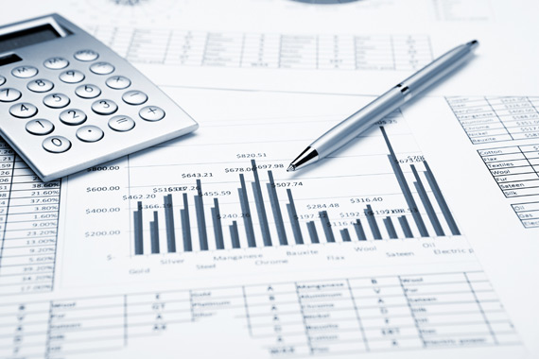
Financial Accounting and Analysis Project
Ratio analysis based on beverages industry
COCA-COLA AND PEPSI

Slide 2
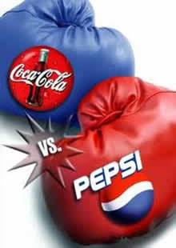
COCA-COLA VS PEPSI

Slide 3
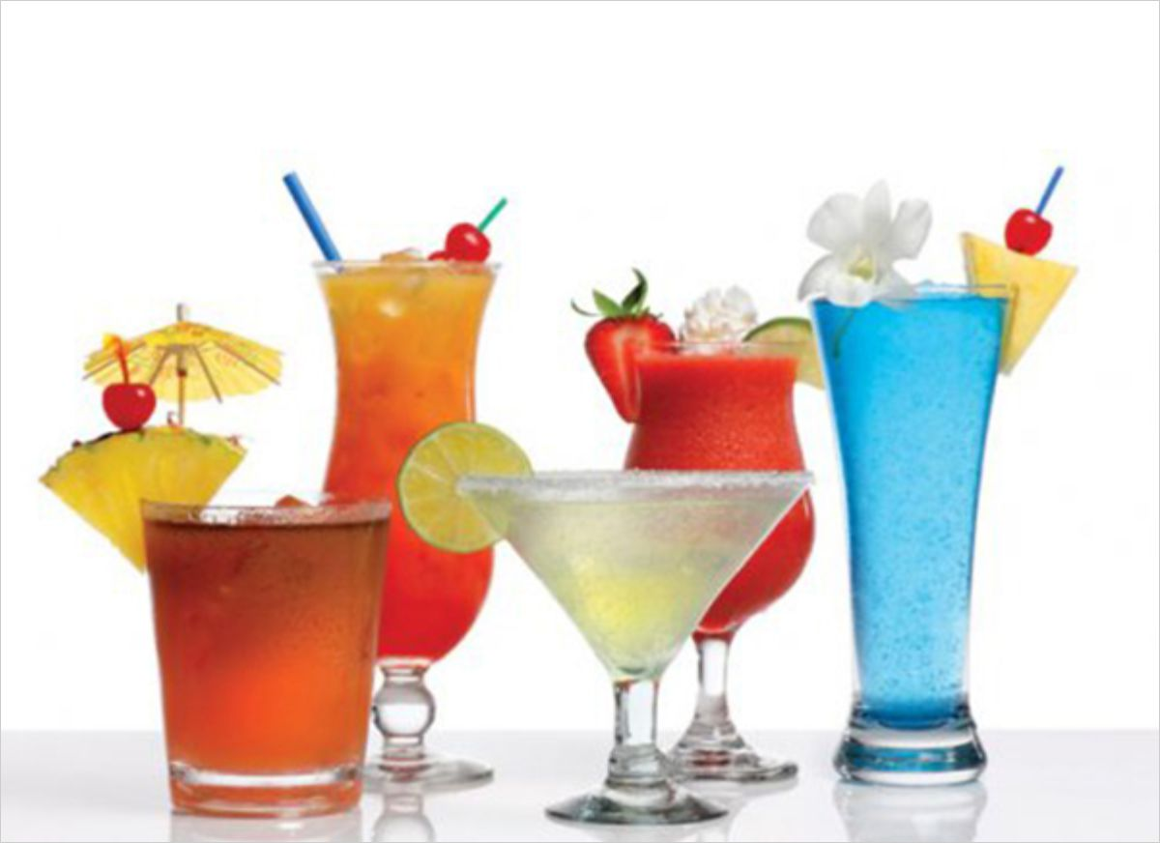
About the Beverage Industry
The Beverage Industry is a mature sector and includes companies that market non- alcoholic and alcoholic items
The global beverage market has been forecast to increase at a compound annual growth rate (CAGR) of 4.6% over the next five years, to reach a market value of $1,347 billion by 2017.

Slide 4
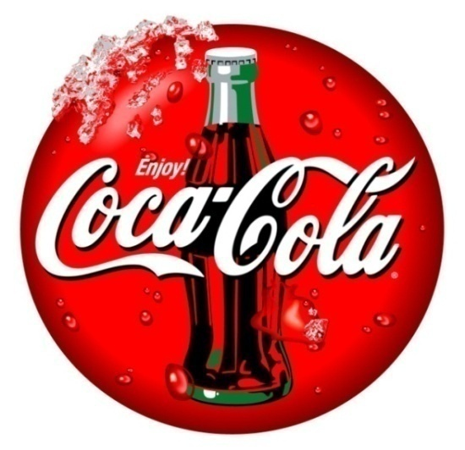
COCA-COLA
The Coca-Cola Company is the world's largest beverage company.
Coca-Cola was invented in 1886 by John Pemberton, an Atlanta, Georgia, pharmacist.
Most-valuable brand, the Company markets four of the world's top five soft drink brands.
Through the world's largest beverage distribution system, consumers in more than 200 countries enjoy the Company's beverages at a rate exceeding 1.5 billion servings each day.
Coca-Cola has been one of the strongest and most reliable trading stocks, showing a steady return in all of its years of existence but one.

Slide 5
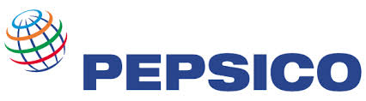
PEPSI CO.
PepsiCo is one of the most successful beverage and snack food business in the world.
Consist of Frito Lay Co., Pepsi-Cola Co., and Tropicana Products.
PepsiCo was funded in 1965 by Donald M. Kendall Pepsi-Cola president, and Herman W. Lay, president of Frito-Lay.
Today Pepsi-Cola products account for about a quarter of all soft drinks sold internationally.
The company has also established operations in the emerging markets of the Czech Republic, Hungary, Poland, Slovakia and Russia, where Pepsi-Cola was the first U.S. consumer product to be marketed.

Slide 6
Ratios
Liquidity ratio
Solvency ratio
Turnover ratio
Profitability ratio

Slide 7
LIQUIDITY RATIO
Current ratio = current assets
current liability
Quick ratio= cash + marketable securities + receivables
current liability

Slide 8
Current Ratio:
Year | PepsiCo | Coca Cola
2010-11 | 1.11 | 1.17
2011-12 | 0.96 | 1.05
2012-13 | 1.10 | 1.09
2013-14 | 1.24 | 1.13
2014-15 | 1.14 | 1.02

Slide 9
Interpretation
standard ratio 2:1
It is a financial ratio that measures whether or not a company has enough resources to pay its debt over the next business cycle (usually 12 months) by comparing firm's current assets to its current liabilities.
The higher the current ratio is, the more capable the company is to pay its obligations.
Pepsi and coke both have enough current assets to pay off their current liabilities. Only in 2011 – 12 Pepsi fell short of current assets otherwise both the companies had enough current assets to settle their dues

Slide 10
Quick Ratio:
Year | PepsiCo | Coca Cola
2010-11 | 0.80 | 0.85
2011-12 | 0.62 | 0.78
2012-13 | 0.80 | 0.77
2013-14 | 0.93 | 0.90
2014-15 | 0.85 | 0.81

Slide 11
Interpretation
Ideally, quick ratio should be 1:1.
If quick ratio is higher, company may keep too much cash on hand or have a problem collecting its accounts receivable. A quick ratio lower than 1:1 may indicate that the company relies too much on inventory or other assets to pay its short-term liabilities.
ability to use its quick assets to pay its current liabilities.
Quick ratio of both the companies is less than 1. This implies that they do not have enough quick assets to pay of their liabilities. Both the companies are relying heavily on their inventory sale to pay the liabilities ( since current ratio is positive)

Slide 12
SOLVENCY RATIO
Debt- equity ratio=
Debt
Equity
Interest coverage ratio=
EBIT
Interest

Slide 13
Debt-Equity Ratio:
Year | Pepsi | Coca Cola
2010-11 | 0.95 | 0.45
2011-12 | 1.00 | 0.43
2012-13 | 1.06 | 0.45
2013-14 | 1.00 | 0.58
2014-15 | 1.37 | 0.63

Slide 14
Interpretation
Debt –equity ratio should be 1:1.
A lower debt to equity ratio usually implies a more financially stable business. Companies with a higher debt to equity ratio are considered more risky to creditors and investors than companies with a lower ratio
Coke cola has maintained a healthy debt- equity ratio. The money generated for investors ( share capital) is more than enough to pay off their debts. Till 2013, Pepsi was just managing to pay of their debts through equity however in 2014, their debts are higher than share capital. They must have used their current assets to pay of their debts

Slide 15
Interest Coverage Ratio:
Year | Pepsi | Coca Cola
2010-11 | 10.12 | 20.43
2011-12 | 11.32 | 28.43
2012-13 | 10.24 | 30.75
2013-14 | 10.76 | 25.79
2014-15 | 10.63 | 20.31

Slide 16
Interpretation
It measures a company’s ability to make interest payments on its debt in a timely manner.
It calculates the firm’s ability to afford the interest on the debt. If the computation is less than 1, it means the company isn’t making enough money to pay its interest payments or a company can’t even pay the interest on its debt. This type of company is beyond risky and probably would never get bank financing.
Pepsi is paying less interest in comparison to coke. Coke has been trying to reduce their debts as it is reflected on the fluctuating interest ratio. Pepsi has been paying the same amount of interest on consistent basis

Slide 17
PROFITABILTY RATIO
INVESTMENT-
      Return on capital employed= EBIT capital employed
      Return on Asset = PAT Assets
      Return on Equity = PAT Equity
MARGIN-
Gross profit ratio=(Gross profit net sales)*100
Net profit ratio =(PAT net sales )*100
Operating exp ratio =(Operating exp net sales)*100

Slide 18
Return On Capital employed:
Year | Pepsi | Coca Cola
2010-11 | 19.71 | 26.69
2011-12 | 15.06 | 14.87
2012-13 | 13.85 | 14.27
2013-14 | 14.09 | 12.58
2014-15 | 14.24 | 9.86

Slide 19
Interpretation
Return on capital employed measures how efficiently a company can generate profits from its capital.
A higher ratio would be more favourable because it means that more of profits are generated by each rupee of capital employed.
The efficiency of Pepsi in using the money which is raised from share capital and loans is higher than that of coke. The efficiency of coke is gradually declining where as Pepsi is more consistent

Slide 20
Return On Asset:
Year | Pepsi | Coca Cola
2010-11 | 11.70 | 16.19
2011-12 | 9.14 | 10.72
2012-13 | 8.38 | 10.47
2013-14 | 8.86 | 9.53
2014-15 | 8.80 | 7.71

Slide 21
Interpretation
It measures the net income produced by total assets during a period by comparing net income to the average total assets.
It shows how efficiently a company can convert the money used to purchase assets into net income or profits
It only makes sense that a higher ratio is more favourable to investors because it shows that the company is more effectively managing its assets to produce greater amounts of net income.
A positive ROA ratio usually indicates an upward profit trend as well.
Both the companies are using their assets to good use. Pepsi has been more consistent with the usage of its assets since 3 years. There could be a possibility that Pepsi may not have purchased any asset and are using the same machinery and coke has seen a gradual decrease but they may have bought additional machinery whose benefits will be seen in the years to follow

Slide 22
Return On Equity:
Year | Pepsi | Coca Cola
2010-11 | 33.36 | 38.09
2011-12 | 30.92 | 27.10
2012-13 | 28.87 | 27.51
2013-14 | 28.99 | 25.88
2014-15 | 31.29 | 23.41

Slide 23
Interpretation
It measures the ability of a firm to generate profits from its shareholders investments in the company.
It shows how efficiently a firm can use the money from shareholders to generate profits and grow the company.
High return on equity ratio is acceptable by the investors.
Pepsi really knows how well to use the money which is raised by through the investors. The investor would be happy to see his usage of money in Pepsi than in coke. Pepsi has been ahead of coke in all the five years

Slide 24
Gross Profit Ratio:
Year | Pepsi | Coca Cola
2010-11 | 52.05 | 63.86
2011-12 | 52.49 | 60.86
2012-13 | 52.22 | 60.32
2013-14 | 52.96 | 60.68
2014-15 | 53.69 | 61.11

Slide 25
Interpretation
There should be sufficient gross profit to cover all expenses and provide for profit. There is no norm or standard to interpret gross profit ratio.
A higher ratio is considered better.
A consistent improvement in gross profit ratio over the past years is the indication of continuous improvement.
Gross profit of coke is higher than that of Pepsi. This implies that the COGS of coke is lesser than Pepsi. Cost of producing goods at coke is lesser than Pepsi. If Pepsi wants to expand they need to reduce their cost of production to avail high net profit

Slide 26
Net Profit Ratio:
Year | Pepsi | Coca Cola
2010-11 | 10.93 | 33.63
2011-12 | 9.69 | 18.42
2012-13 | 9.43 | 18.78
2013-14 | 10.51 | 18.32
2014-15 | 9.77 | 15.43

Slide 27
Interpretation
It measure the overall profitability of the business.
A high ratio indicates the efficient management of the affairs of business.
The net profit of coke is way higher than that of Pepsi. This is because the gross profit of coke was higher than Pepsi and expenses were similar to Pepsi. Pepsi should either increase their Gross profit or reduce their expenses to avail high profits

Slide 28
Operating Expense Ratio:
Year | Pepsi | Coca Cola
2010-11 | 14.4 | 24.06
2011-12 | 14.5 | 21.82
2012-13 | 13.9 | 22.45
2013-14 | 14.6 | 21.83
2014-15 | 14.4 | 21.11

Slide 29
Interpretation
A low operating ratio means high net profit ratio more operating profit.
If the operating profit ratio is 80% It means 80% of the sales revenue would be used to cover cost of goods sold and operating expenses.
Pepsi is doing well in this case, as their operating expenses are consistently lower than coke. Coke and Pepsi, both are into aggressive advertisements, sponsorships etc. However Pepsi has able to manage its operating cost better than coke. Both the companies can increase their net profit, either by reducing operating cost or by increasing non operating income.

Slide 30
TURNOVER RATIOS
Debtor turnover ratio=
credit sales
average debtors
Inventory turnover ratio/stock turnover ratio =
cost of goods sold
average stock

Slide 31
Debtor Turnover Ratio:
Year | Pepsi | Coca Cola
2010-11 | 10.57 | 8.58
2011-12 | 10.05 | 9.96
2012-13 | 10.10 | 9.92
2013-14 | 10.99 | 9.73
2014-15 | 16.25 | 9.85

Slide 32
Interpretation
It measures a business' ability to efficiently collect its receivables.
Higher ratios mean that companies are collecting their receivables more frequently throughout the year.
Pepsi has a better debtor turnover ratio than coke. It shows that Pepsi is more efficient in collecting money from their credit sales to debtors. However, Pepsi in the last year took a steep jump by collecting money 16 times in a year. Coke has been consistent with its efficiency of 9 times in a year

Slide 33
Inventory Turnover Ratio:
Year | Pepsi | Coca Cola
2010-11 | 8.87 | 5.07
2011-12 | 8.78 | 6.34
2012-13 | 8.45 | 6.00
2013-14 | 8.94 | 5.63
2014-15 | 9.43 | 5.61

Slide 34
Interpretation
It measures company's efficiency in turning its inventory into sales. Its purpose is to measure the liquidity of the inventory.
Low inventory turnover ratio is a signal of inefficiency, since inventory usually has a rate of return of zero. It also implies either poor sales or excess inventory
High inventory turnover ratio implies either strong sales or ineffective buying (the company buys too often in small quantities,
Coke is able to convert its inventory into sale more efficiently than Pepsi. Coke has an efficiency of 5 and Pepsi has an efficiency of 9. However, there could be a possibility that coke is maintaining low level of inventory and thus getting it liquidated much faster than Pepsi. Also, Pepsi could have maintained a high level of inventory way beyond the demand.

Slide 35
Earnings Per Share:
Year | Pepsi | Coca Cola
2010-11 | 10.20 | 19.12
2011-12 | 10.61 | 8.72
2012-13 | 7.80 | 12.35
2013-14 | 7.74 | 7.94
2014-15 | 5.76 | 4.81

Slide 36
Interpretation
It is the amount of money each share of stock would receive if all of the profits were distributed to the outstanding shares at the end of the year.
Higher earnings per share is always better than a lower ratio because this means the company is more profitable and the company has more profits to distribute to its shareholders
Pepsi's earning per share have been reducing gradually every year and cokes EPS has been fluctuating. Since the profits of both the companies have been consistent which we came to know through GP ratio and NP ratio, there could be a possibility that the both the companies are re-investing their majority profits back into the business and leaving few profits for the shareholders

Slide 37
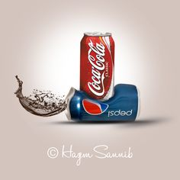
Conclusion, Overall Analysis
Coca-cola is performing much better than Pepsi co. Coca-cola’s net profit ratio and debt equity ratio is better than Pepsi co.
We cannot neglect the fact that pepsi has been consistent with its performance over the past years. How ever it will take some time to compete with the beverage giant, coke.

Slide 38
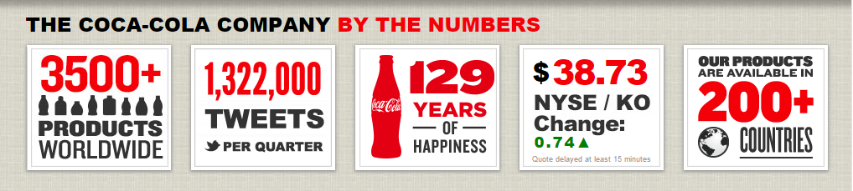
THANK YOU!!

